Slide 1

MakeMore Language Model
STATISTICAL SOFTWARE 16:954:577:01
PROJECT PRESENTATION
SHREYASH KALAL
SARTHAK SINGH
VAIBHAV KUMAR
ssk241
ss4767
vk510

Slide 2
Introduction
What is MakeMore?
Aim
Dataset
MAKEMORE IS A CHARACTER-LEVEL LANGUAGE MODEL DESIGNED TO GENERATE TEXT RESEMBLING THE TEXT DATA IT IS TRAINED ON.
TO BUILD A ROBUST MODEL TRAINED ON A CORPUS OF SHAKESPEARE'S WORKS TO PRODUCE COHERENT, STYLISTIC, AND CONTEXTUALLY RICH TEXT.
THE TINY SHAKESPEARE DATASET: A COMPACT CORPUS CONTAINING SHAKESPEARE’S WORKS, USED TO EVALUATE THE MODEL’S ABILITY TO LEARN AND MIMIC SHAKESPEAREAN TEXT PATTERNS.
Tiny Shakespeare Metadata
Total Number of Lines = 40,000
Total Number of Tokens = 1,115,394
Total Number of Unique Characters = 65 (including uppercase and lowercase letters, digits, punctuation marks, and whitespace characters)
Total Number of Words = 201,966
Vocabulary Size = 28431

Slide 3
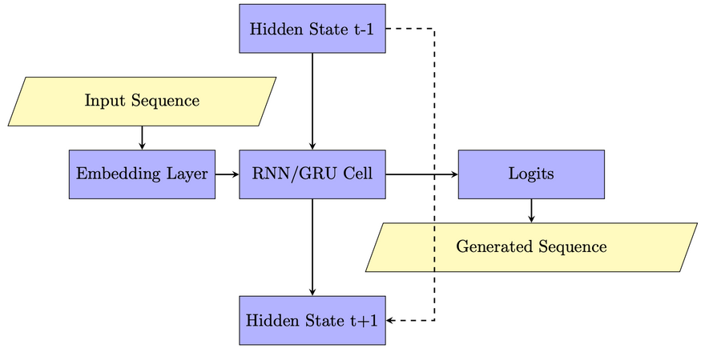
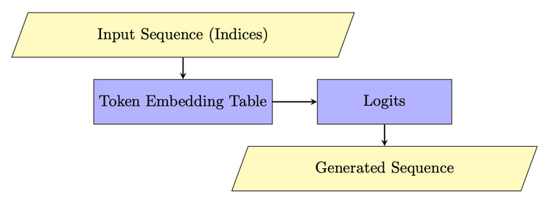
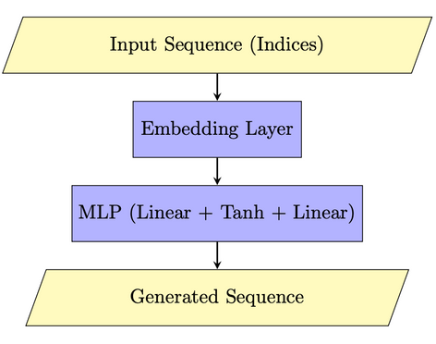
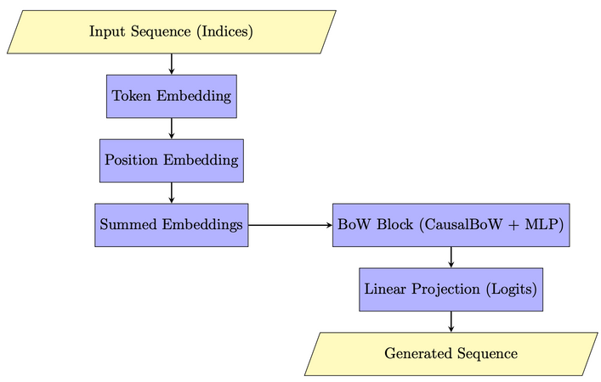
RNN
Bigram
Builds on BoW by capturing minimal sequential dependencies between character pairs.
Experimenting with Non-Transformer Architectures
Designed to capture sequential dependencies, useful for text generation due to its memory retention over time steps.
MLP
BoW
A baseline feedforward model to understand if simple, non-sequential processing can generate coherent text.
A simplistic approach to study the effect of word frequency distributions on text generation.

Slide 4
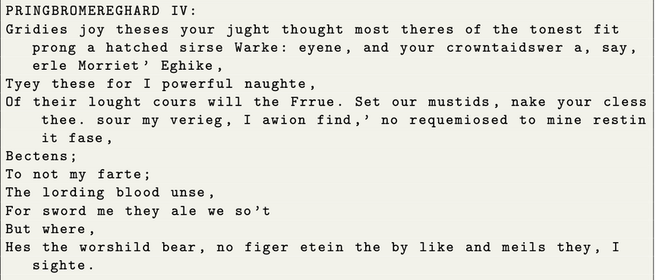
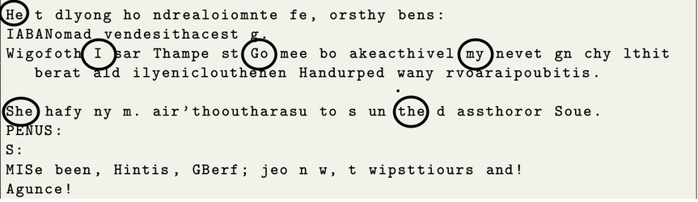
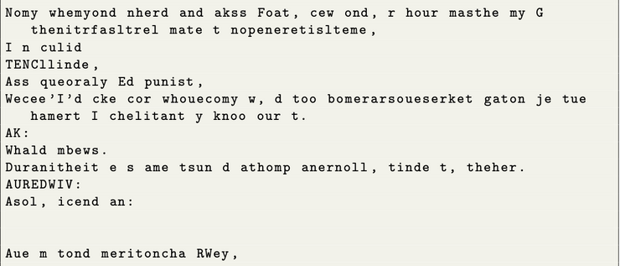
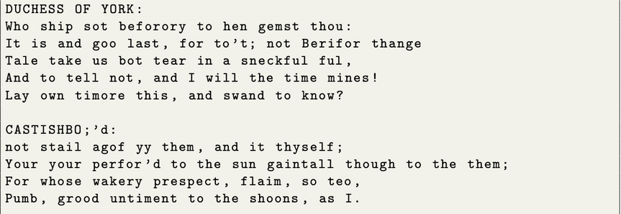
RNN
Bigram
Result: Validation loss at 2.95; captures short-range patterns.
Drawback: Limited to two-character dependencies, lacks contextual depth.
Result: Validation loss at 1.80; struggles with long-range dependencies, due to compute restrictions.
Drawback: Limited context retention due to block size.
Results of Non-Transformer Architectures
MLP
BoW
Result: Validation loss at 1.85; ignores temporal structure.
Drawback: Cannot capture sequential relationships, resulting in incoherent text generation.
Result: Validation loss at 2.45; lacks semantic coherence.
Drawback: Ignores sequential order.

Slide 5
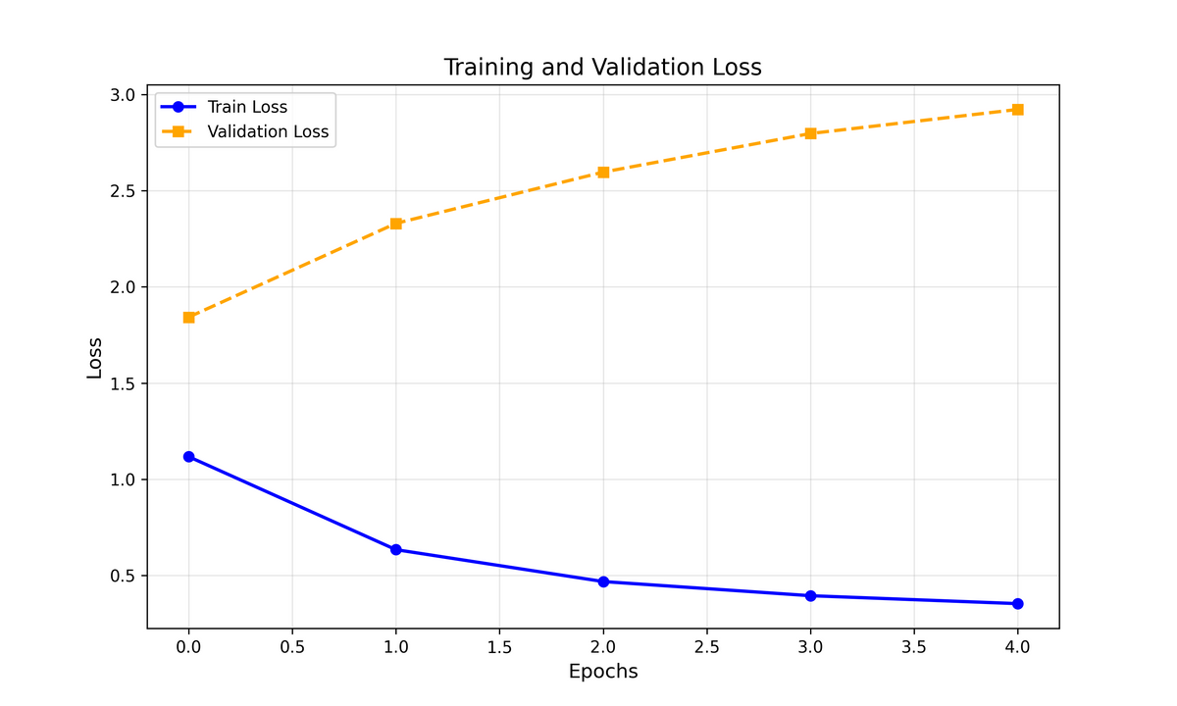
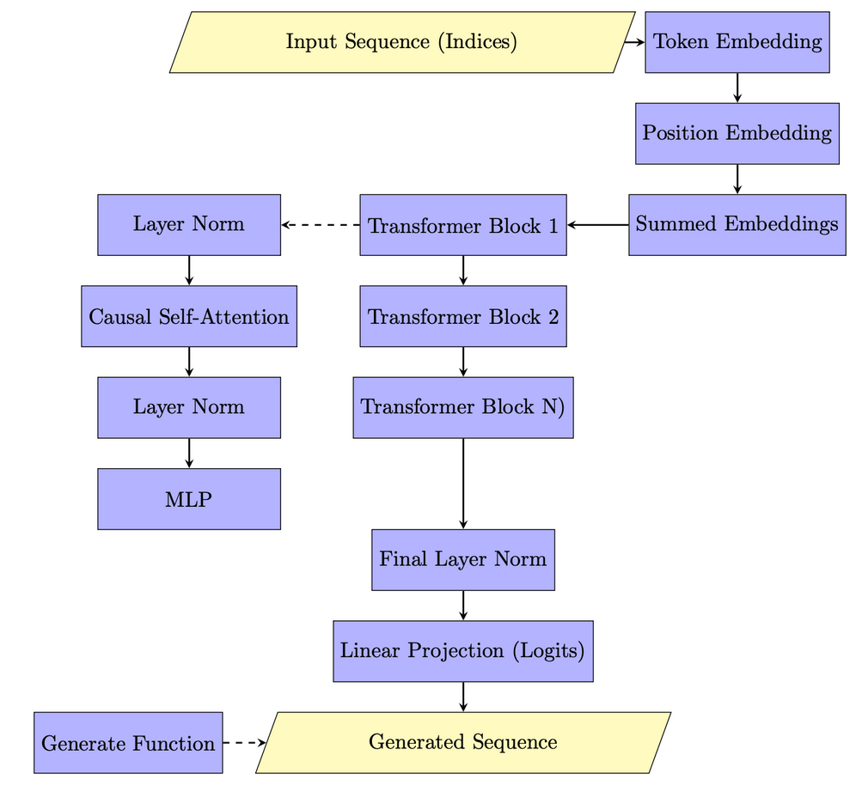
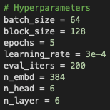
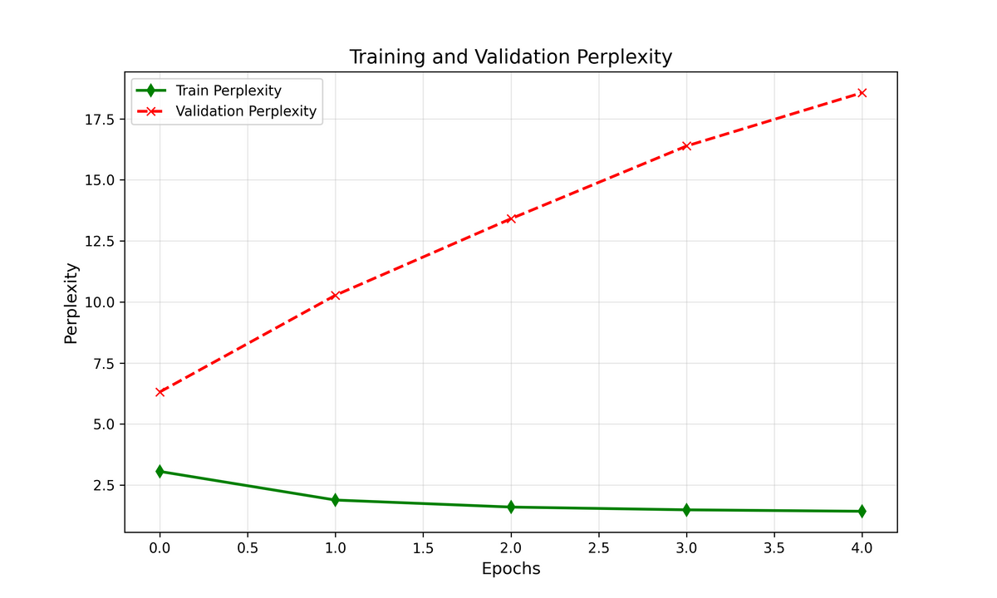
Transformer with Causal Self-Attention
Training Time =
1 hour 40 minutes
GPU Configuration:
Name = NVIDIA A100-SXM4-40GB
Total Memory = 42.48 GB
CUDA Cores = 108
Compute Capability = 8.0

Slide 6
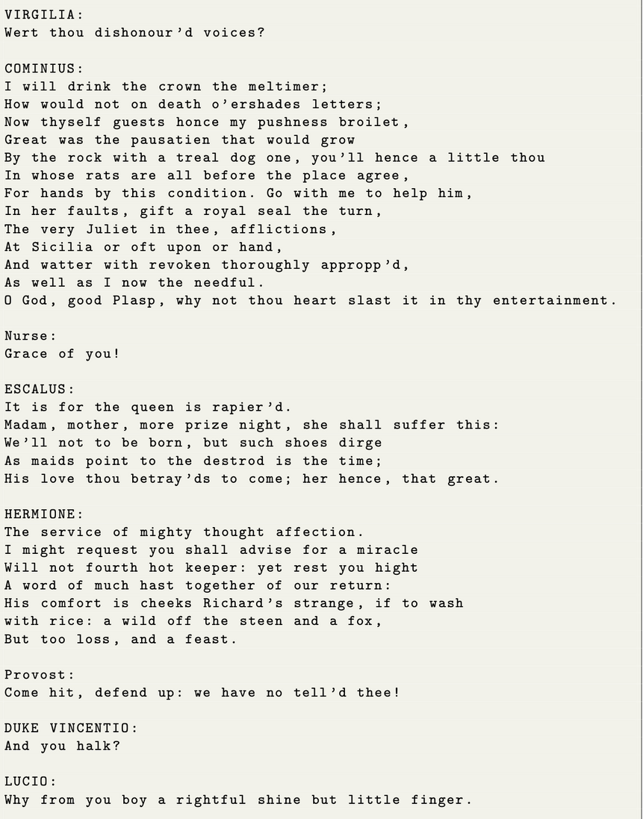
Generated Text
1. Shakespearean Style
Phrases such as "O God, good Plasp," and "Grace of you!" mimic the stylistic flair of Elizabethan English, though the specific words often lack meaning or context.
2. Character Naming and Structure
The text assigns dialogues to characters like ROMEO, VIRGILIA, ESCALUS, etc., which aligns well with the format of Shakespeare's plays.
However, some names like Plasp and Cominius feel out of place or fabricated, which could be an artifact of the character-level generation model.
3. Vocabulary
The vocabulary captures the essence of Shakespeare's lexicon, with words like "thou," "hath," and "afflictions."
Some phrases, like "cheeks Richard's strange, if to wash with rice," combine valid words but lack coherence or meaning.
4. Syntax and Grammar
The model successfully imitates the inverted sentence structure typical of Shakespearean English, such as "Why not thou heart slast it in thy entertainment."
However, grammatical inaccuracies, like mismatched verbs and subjects ("the sistern hour, 'tis brood knows our Anointed"), indicate limitations in understanding sentence-level dependencies.
5. Coherence and Context
While individual lines have a Shakespearean feel, the overall text lacks coherence:
Example: "Madam, mother, more prize night, she shall suffer this" fails to form a logical idea or context.
There is little continuity or meaningful interaction between characters, as seen in dialogues like:
DUKE VINCENTIO: "And you halk?"
LUCIO: "Why from you boy a rightful shine but little finger."
COMMENTS

Slide 7
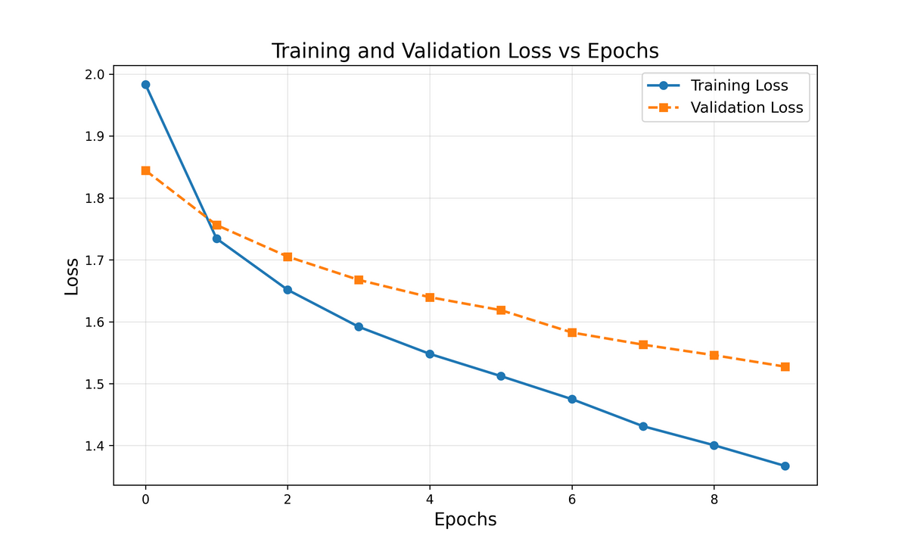
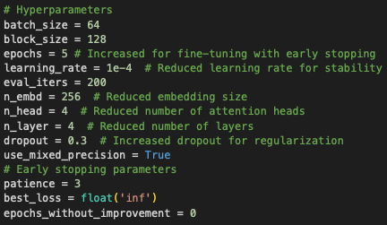
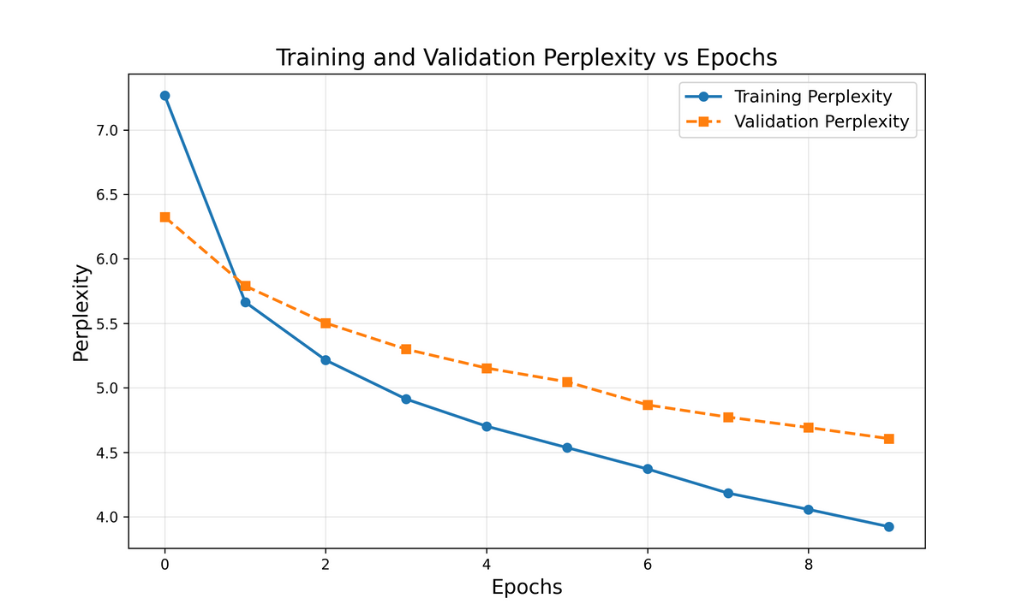
Resolving Overfitting
Training Time =
1 hour
GPU Configuration:
Name = NVIDIA A100-SXM4-40GB
Total Memory = 42.48 GB
CUDA Cores = 108
Compute Capability = 8.0
Notes:
1. To resolve overfitting, we used a dropout of 0.3, early stopping with a patience of 3, and mixed precision with FP16 in the forward pass for calculating gradients and FP32 in the backward pass or updating the gradients.
2. We can see that overfitting has been resolved, with a validation loss of little below 1.4 and validation perplexity of little below 4, and the model converged at 5 epochs with early stopping in place.
3. Training Time was 1 hour with the A100 GPU on collab.

Slide 8
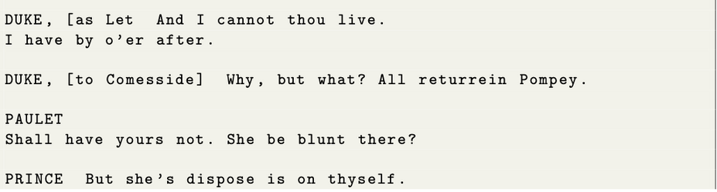
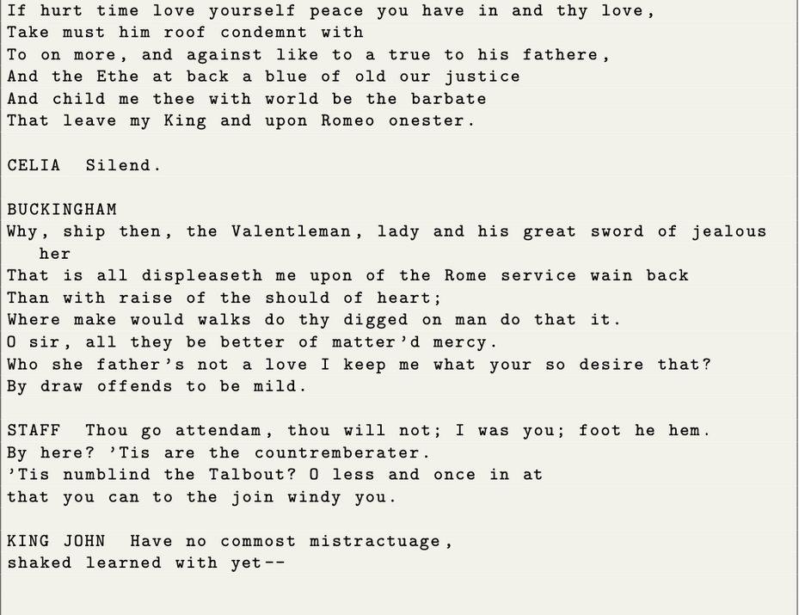
Generated Text
1. Shakespearean Style
Retains a dramatic tone with phrases like "For it were against his her from the heavy."
Some phrases, such as "abmouth hot be Crancholy," are nonsensical despite appearing stylistically similar to Elizabethan English.
2. Character Naming and Structure
Includes characters like SUFFOLK, YORK, and KING JOHN, aligning with Shakespearean play conventions.
Names like ADROLLES OF GARDIER and stage directions like "[companymede]" feel fabricated or nonsensical.
3. Vocabulary
Attempts to emulate intricate diction with words like "mind mebarrive" and "displeaseth."
Many words are invented or misused, such as "commost mistractuage" and "numblind."
4. Syntax and Grammar
Successfully imitates inverted sentence structures typical of Shakespeare’s writing, e.g., "Why, ship then, the Valentleman."
Frequent grammatical errors and sentence fragments, such as "She be blunt there?" and "All returrein Pompey."
5. Coherence and Context
Shows emotional tension in some lines, e.g., "If hurt time love yourself peace you have in and thy love."
Interactions between characters often fail to convey a logical or meaningful storyline, e.g., KING JOHN: "O’ thal" and DUKE: "Why, but what? All returrein Pompey."
COMMENTS
Notes:
We can see that the text retains a dramatic tone with a successful, emulation of intricate words like “displeaseth” and imitation of inverted sentence structures used in Shakespearean writing.
Although there is emotional tension, the interactions fail to convey logic.

Slide 9
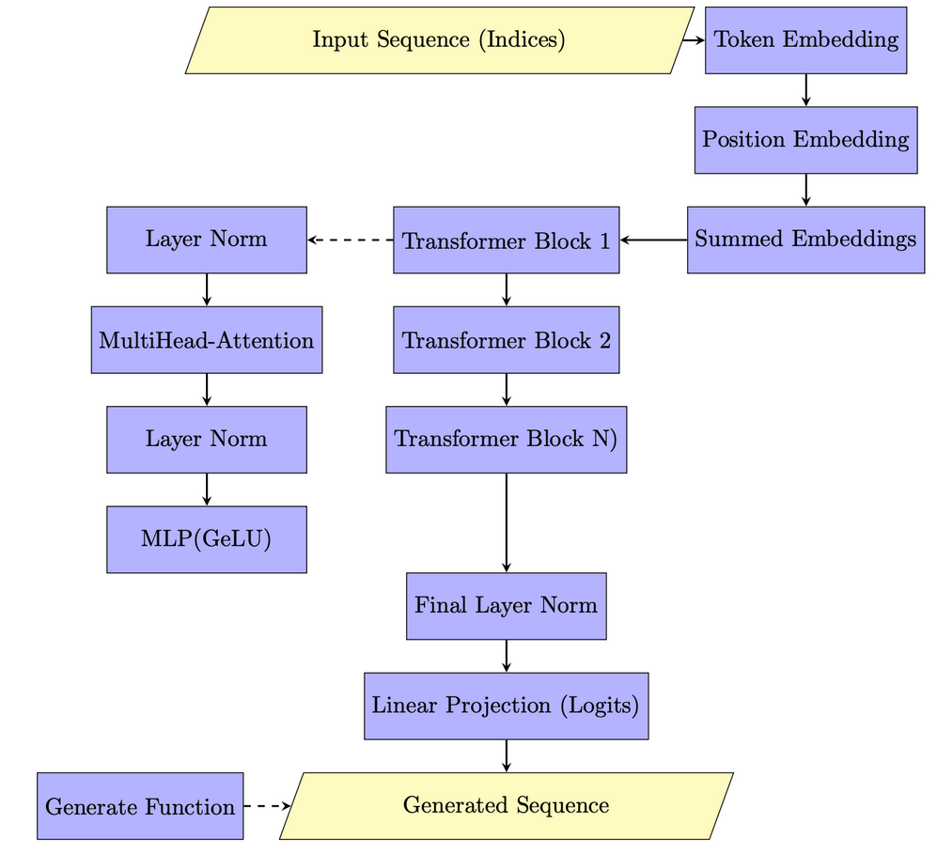

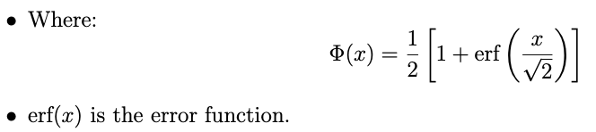
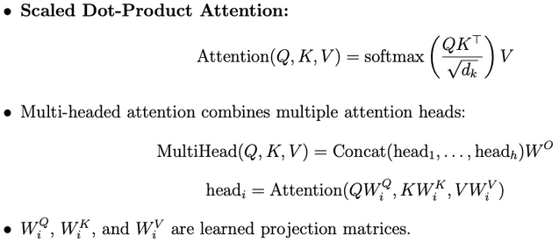
Improving Architecture and Enhancing Dataset
1. Improved Architecture
GeLU (Gaussian Error Linear Unit)
GeLU instead of traditional ReLU (Rectified Linear Unit). GeLU applies a smooth curve that better models non-linearities, allowing for more effective gradient flow and improved convergence.
Multi-Headed Attention
Multi-headed attention allows the model to focus on different parts of the input simultaneously, capturing diverse contextual dependencies.
2. Enhanced Dataset
Total Number of Lines: 214,939
Total Number of Characters: 6,248,308
Number of Unique Characters: 84
Total Number of Tokens: 1,135,671
Number of Words: 878,440
Vocabulary Size: 25,273
Notes:
Use of a Gaussian Error Linear Unit instead of ReLU. It uses the error function o apply a smooth curve that models the non-linearities in the model better giving a more effective gradient flow and improved convergence.
Mulit-Headed Attention to capture multiple contextual dependencies in parallel.
Cleaned and preprocessed a bigger dataset that is 5 times bigger that the previous one used.

Slide 10
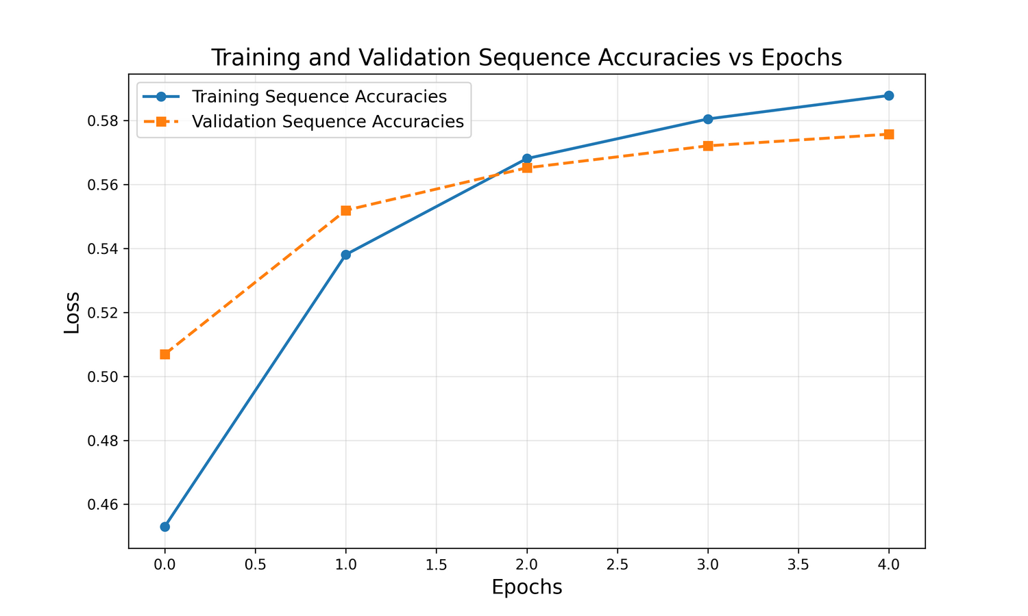
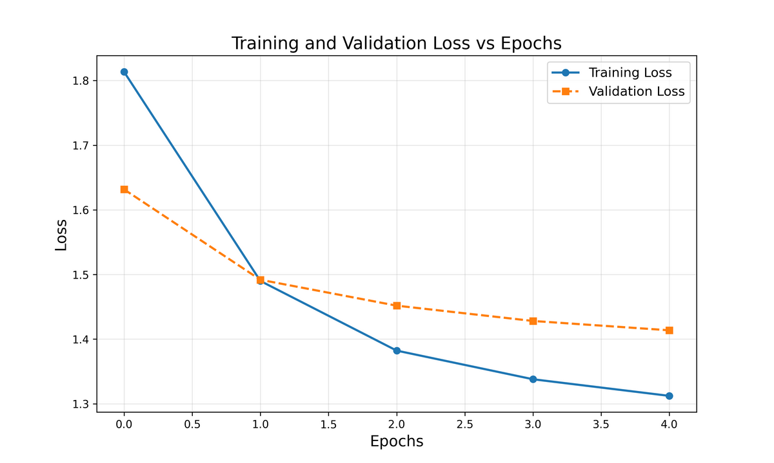
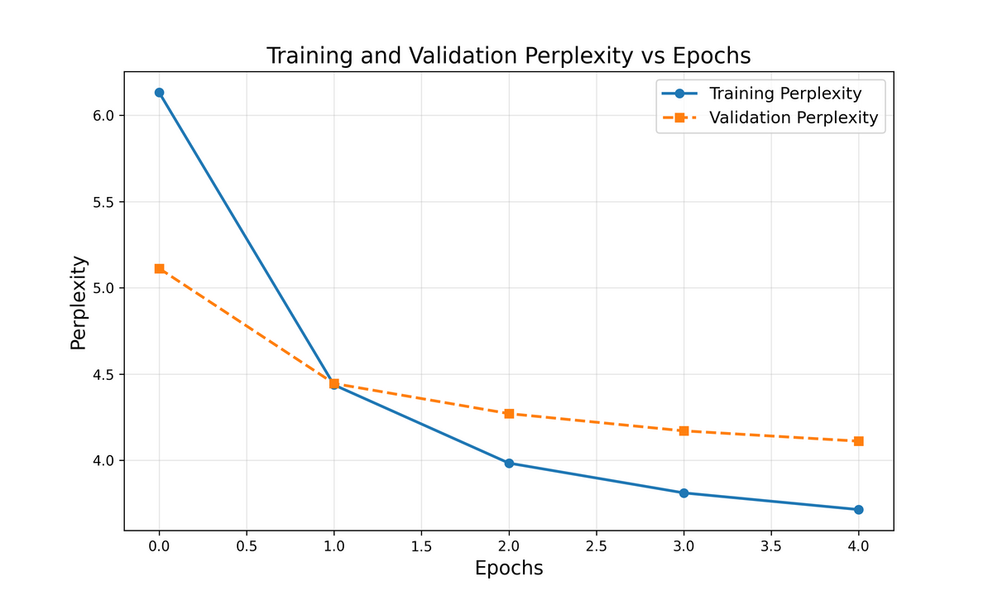
Results of Transformer Model with GeLU and Multi-Head Attention
Training Time =
5 hours
GPU Configuration:
Name = NVIDIA A100-SXM4-40GB
Total Memory = 42.48 GB
CUDA Cores = 108
Compute Capability = 8.0
Notes:
A significant improvement that we note from the previous plots is the first descent after the first epoch for both loss and perplexity. Although we don’t see a significant reduction in loss, the model did not converge at 5 epochs with early stopping, but we couldn’t go further to observe the second descent due to computational limitations as the training time also increased 5 folds on the A100 GPU due to the increase in dataset.
The model achieved a sequence accuracy of 0.58 with just 5 epochs of training.

Slide 11
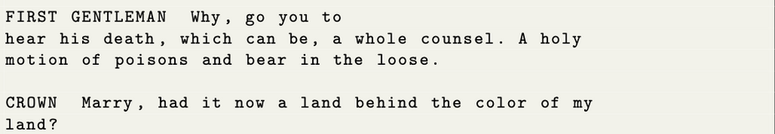
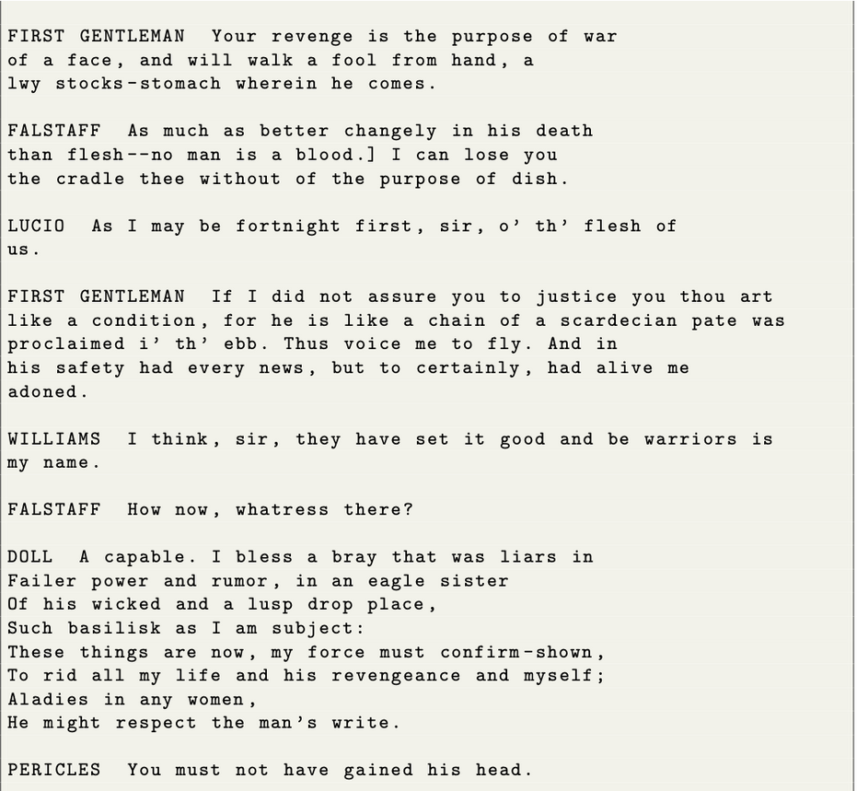
Generated Text
1. Shakespearean Style
The text effectively mimics Shakespearean language with terms like "thou," "hast," and "methinks," and a dramatic tone typical of Shakespeare’s plays.
However, many phrases lack clarity, such as "Better his life with fancy very soldiers."
2. Character Naming and Structure
Characters like CORIOLANUS, JULIET, and HORATIO align with Shakespearean plays, and stage directions (e.g., FIRST GENTLEMAN) reflect theatrical formatting.
Some fabricated names, like COLION, are inconsistent with Shakespeare’s style.
3. Vocabulary
The model uses archaic terms like "methinks" and "anon" and dramatic phrases like "Their despised cmmon enclips up. O, let them live."
However, nonsensical phrases like "blind his blaments action other doth have" detract from coherence.
4. Syntax and Grammar
Inverted sentence structures, such as "Methinks we say, now nighting will stay my man," successfully replicate Shakespearean syntax.
Grammar occasionally breaks down, as in "He was not a house, he hath anon," leading to confusion.
5. Coherence and Context
Some lines maintain dramatic tension, e.g., "Why, hast he had his tears the manifest his dam?"
Overall, the text lacks narrative coherence, with disjointed character interactions and unclear storylines.
COMMENTS
Notes:
The improvements from the previous output include, significant reduction in grammatical errors, use of archaic terms like ‘methinks’ and ‘anon’, although the interactions convey logic it was generally observed that the text loses narrative coherence after the 4th stanza.

Slide 12
Thank You.

