Slide 1
🚀 TESLA
MEDIA STRATEGY & MARKET INTELLIGENCE
🎯 Electric Vehicles | 🌍 United States | 📊 Competitive Intelligence

Slide 2
💡 EXECUTIVE SUMMARY
📈 Tesla remains the market leader in U.S. electric vehicles but its share has slipped from 60% to 50% as legacy automakers and EV specialists launch competitive models. To defend its position, Tesla must shift from a purely organic approach to a data‑driven, multi‑channel strategy that leverages its brand equity, Supercharger advantage, and the $750k media budget across Google, Meta, YouTube, LinkedIn, Twitter/X, and TikTok. The plan focuses on brand awareness, test‑drive conversion, and sustained engagement through video, blog, and social content, with clear KPIs and a three‑phase timeline.
🏢 6
📊 5
💰 $750,000
COMPETITORS
MARKET TRENDS
BUDGET

Slide 3
🏢 COMPETITIVE LANDSCAPE
🏆 Ford
🏆 BYD
🏆 Rivian
Legacy automaker transitioning to EVs with Mustang Mach-E and F-150 Lightning, leveraging establishe...
World's largest EV manufacturer from China, focusing on cost-effective vehicles and vertical integra...
Electric truck specialist targeting adventure enthusiasts with R1T pickup and R1S SUV, backed by Ama...
🏆 Lucid Motors
🏆 General Motors
🏆 Volkswagen Group
Luxury EV maker positioning as premium Tesla alternative with industry-leading range and high-end fe...
Detroit giant investing heavily in Ultium platform with plans for 30 EV models by 2025 across multip...
European leader with ID series and multi-brand EV strategy across VW, Audi, and Porsche segments...

Slide 4
🎯 SWOT ANALYSIS
💪 STRENGTHS
⚠️ WEAKNESSES
• Pioneering EV technology
• Strong brand equity
• Supercharger network
• Limited advertising presence
• High price perception
• Production constraints
🌟 OPPORTUNITIES
⚡ THREATS
• Government EV incentives
• Growing sustainability awareness
• International expansion
• Intense legacy automaker competition
• Supply chain disruptions
• Regulatory changes

Slide 5
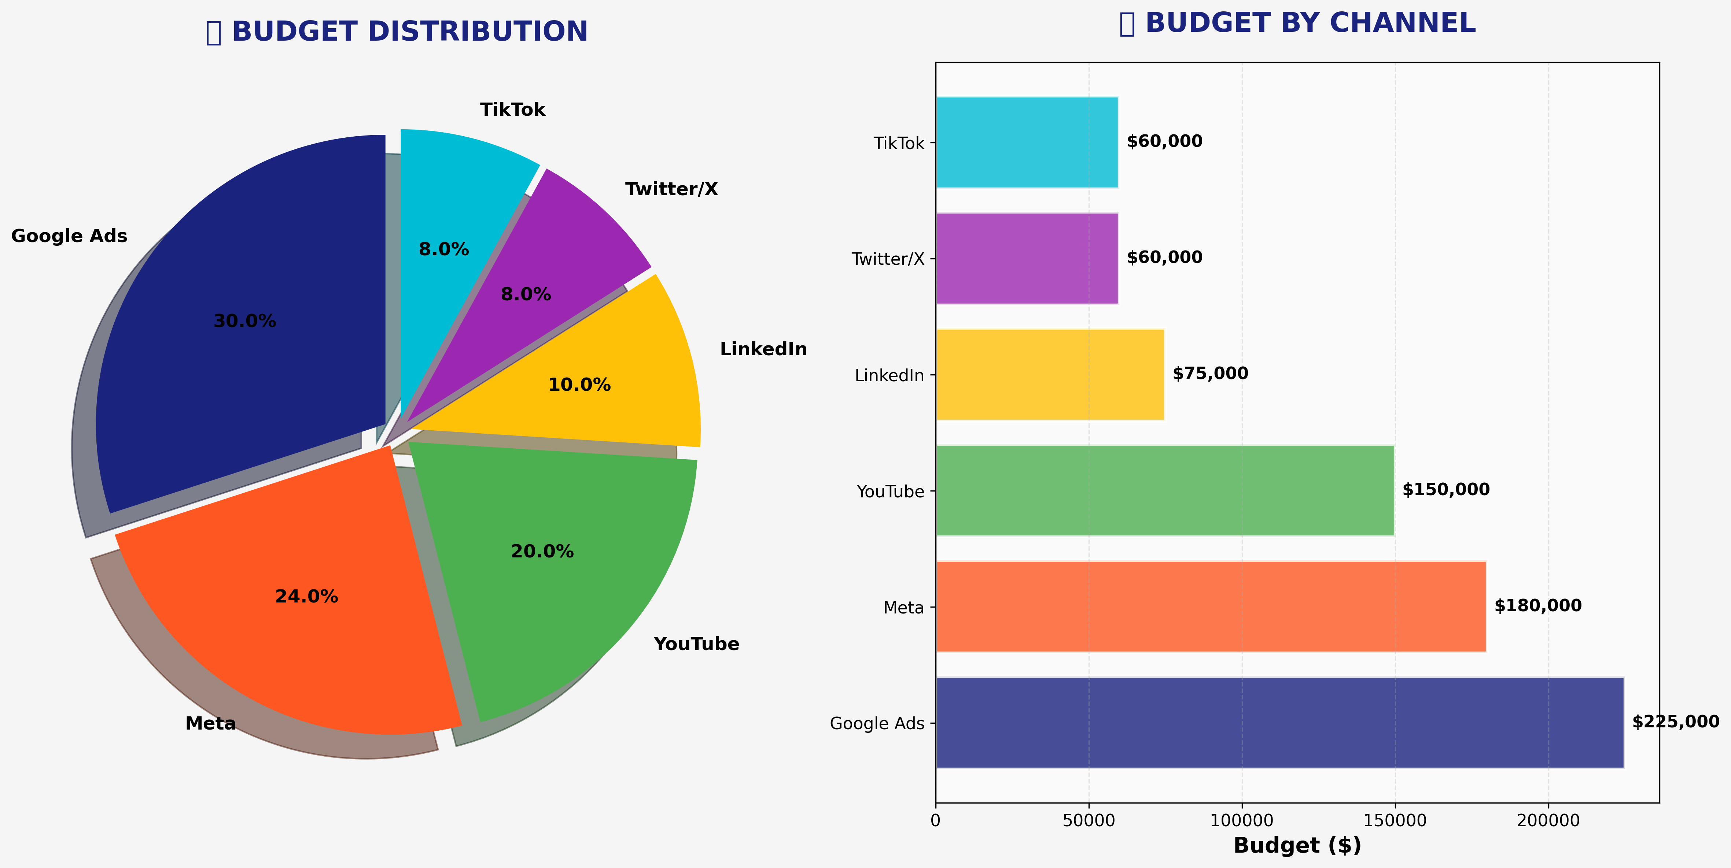
💰 BUDGET ALLOCATION
CHANNEL | BUDGET | PERCENTAGE
🎯 Google Ads | $225,000 | 30.0%
🎯 Meta | $180,000 | 24.0%
🎯 YouTube | $150,000 | 20.0%
🎯 LinkedIn | $75,000 | 10.0%
🎯 Twitter/X | $60,000 | 8.0%
🎯 TikTok | $60,000 | 8.0%

Slide 6
🗓️ STRATEGIC ROADMAP
📅 Brand Awareness Campaign: 2025-09-01 → 2025-10-31
📅 Consideration & Test Drives: 2025-11-01 → 2025-12-31
📅 Conversion Optimization: 2026-01-01 → 2026-02-28

Slide 7
🙏 THANK YOU
🚀 Ready to dominate the Electric Vehicles market!

