Slide 1

Anudip Foundation
Even Session: 2023-24
Home Rental Management System
Presented by—
Ms. Mansi Shevare
Ms. Shreyash Gajbhiye
Under the guidance of—
Prof. Priti Yadav--

Slide 2

Content :
Introduction
Abstract
Literature reviews
Problem Statement
Methodology /Technology used
Conclusion

Slide 3
Introduction :
Web development .
Platform for direct interaction between owner and student regarding the rent of room.
All the information about room easily available.
“Generation rent” is well-documental phenomenon in the literature that signifies recent changes in young people’s housing pathway , encapsulation by the growth in private renting and simultaneous decline of home ownership and social housing.

Slide 4
Abstract
This project report presents the work related to the Online Room Booking. This project helps user to register individual home to assist you in finding the perfect rental home . Also we can find your next rental from search view in your targeted area.
This website is designed to attend to all our needs from buying property, selling property or renting/leasing of property in India. Property helps us to maintain the database of various property & agents information. It not only helps us to maintain the agent information but here we also allow agents to access the portal updated information across the global environment.

Slide 5
Literature Revieew:
Sr. No. | Authors | Paper Title | Publication Details | Objectives | Limitation / Findings
1 | Gnangpinglill, Xiaynan chang | The spillover effect of rising housing rent. | May 21,2021 | Benifits of providing a room service. | Housing rent will simulate resident consumption at a central level.but excessive housing rent will great increase tenant housing consumption expenditure.
2 | Kim Mckee,Adrina Mihaela soaital Jennifer Hoolachan | Generation rent & the emotion of private renting self-worth,status & insecurity amongst low income renters. | 5 nov 2019 | He provide offers and basic facilities | Powerlessness insecurity allenation unaffordadble housing and financial stress and status anxiety stigma and the good tenant .

Slide 6
Problem Statement
Many student search for room available on rent; and for this purpose they have to visit places physically.
So many student are comes out of town to study ,they face most of problem to search room.
They can’t find out perfect room to stay. They struggling a lot .

Slide 7
Proposed Approach :
This project address the problem encountered in the allocation of room ( space) to the student in the particular area.
This project proposed and design a system that is capable of managing a database which will allocated space (hall,room ).
The propose system will automatically allocated hall,rooms and roomates by taking certain criteria into consideration and also keeps the proper records of all the vacant room and its inhabitance.

Slide 8
features
Rooms available for renting purpose.
Easy search for property near your area
Interactive mapping features: Integrating interactive maps into your platform can enable students to visualize the location of available rental properties relative to their preferred area. This feature not only facilitates easier navigation but also provides valuable insights into the surrounding neighborhood and nearby amenities..

Slide 9
METHODOLOGY / TECHNOLOGY USED
For frontend , we use HTML, CSS and Angular Framework
My SQL as a database and hibrnate
Backend as a SpringBoot
Software : Eclipse , MySQL Workbench
Operating System : Windows 7/ 8/9 /10/11

Slide 10
Expected Outcome:
This will help people in need to find the affordable rooms according to their requirements.
Student can get all the information about rooms without actually visiting the place. And this information will help them to compare different rooms and make the right decision suitable to them.

Slide 11
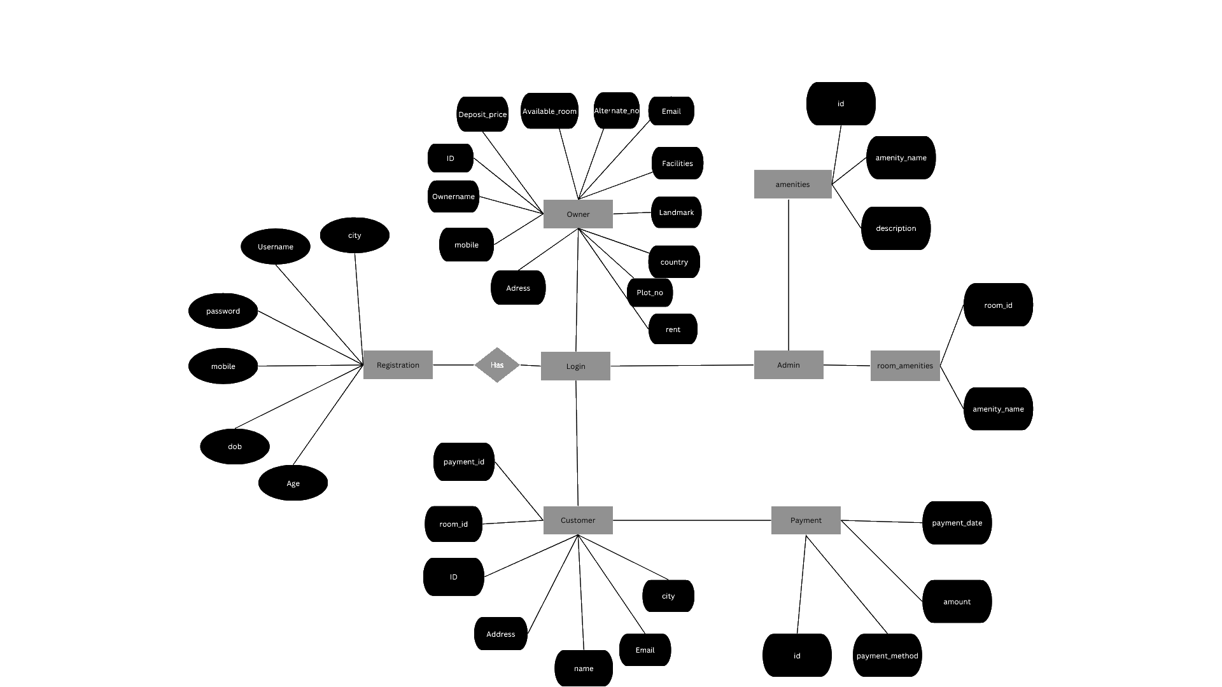
ER Diagram:

Slide 12
References :
Ambrose, P. and Barlow, J. (1987), Housing Provision and House Building in Western Europe: Increasing Expenditure, Declining Output, Housing Markets and Policies under Fiscal Austerity, London, Greenwood Press.
Erguden, S. (2001), Low cost housing policies and constraints in developing countries, International conference on spatial development for sustainable development, Nairobi.
Golland, A. (1996), Housing supply, profit and housing production: The case of the United Kingdom, Netherlands and Germany, Journal of Housing and the Built Environment, vol.11, no1.
Hancock, T. (1998), Caveat partner: Reflection of Partnership with the private sector, Health promotion international, vol. 13, no 3
Levin, K. (1999), Database Management Systems: How to use Relational Databases, vol. 2, no 4.

Slide 13
Thank You!

