Slide 1
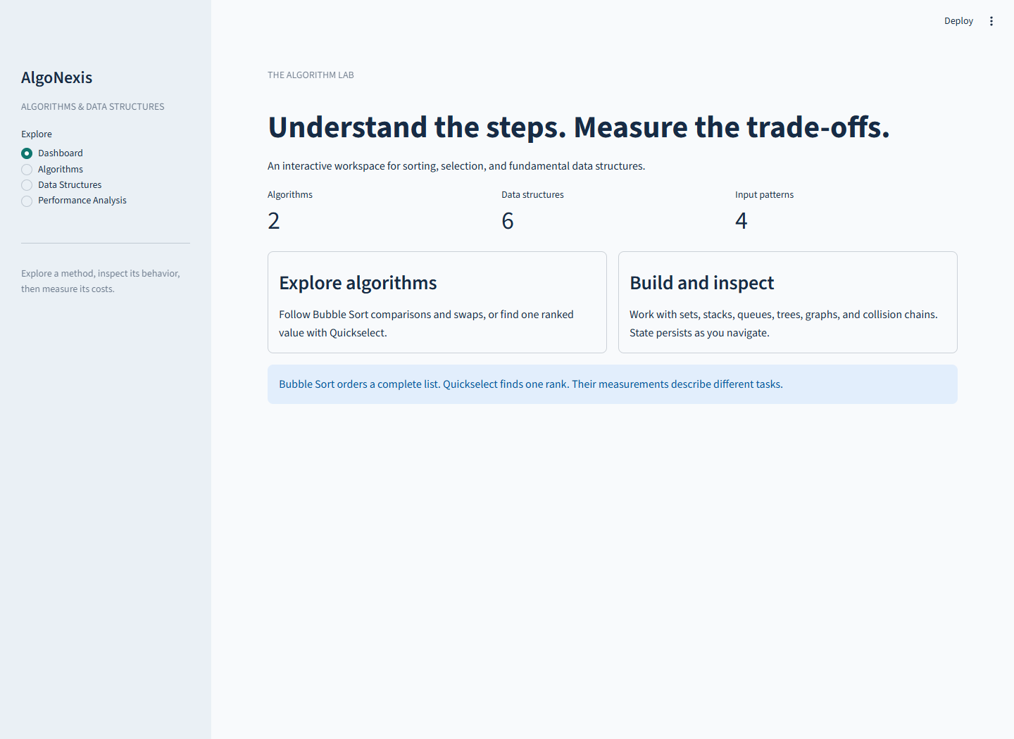
IMPLEMENTATION → EVIDENCE → LEARNING
AlgoNexis
An interactive algorithms & data structures portfolio
Shreyash · CSU Global · CSC506
November 7, 2026 · Portfolio v1.0.0
Source: AlgoNexis implementation and recorded measurements
01
Notes:
Introduce the portfolio as one application connecting implementation, explanation, and measured evidence. State the scope: two algorithms, sorting visualization, a custom set, five other structures, an interactive interface, and reproducible performance analysis. Explain that the presentation uses the actual working application and its saved data. The report provides eight substantive body pages plus a cover and references. The walkthrough follows the same requirements as the implementation plan and closes with the limits of the conclusions.

Slide 2
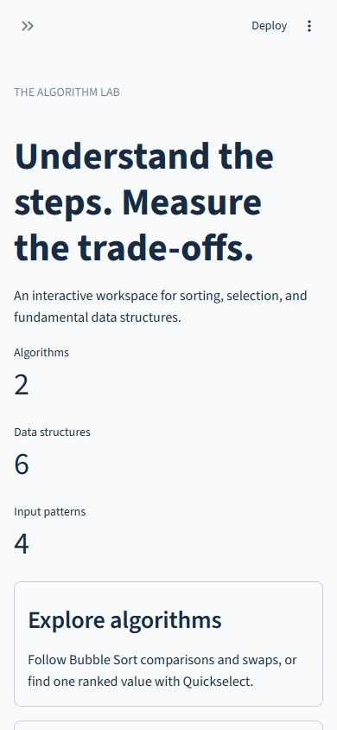
IMPLEMENTATION → EVIDENCE → LEARNING
One portfolio, four ways to explore
Dashboard: scope and guide
Algorithms: sort, select, inspect steps
Data Structures: six persistent models
Performance: measurements and CSV
Source: AlgoNexis implementation and recorded measurements
02
Notes:
Open the local app with python -m streamlit run app.py. Begin on Dashboard, then use the sidebar to visit Algorithms, Data Structures, and Performance Analysis. Describe the learner journey: enter a dataset, inspect a computed result, change a structure, and examine evidence. State survives navigation because model data is separate from widget state. The browser walkthrough exercised these navigation and reset paths; the screenshots are captures of that real session.

Slide 3
IMPLEMENTATION → EVIDENCE → LEARNING
Architecture keeps the core independently testable
Streamlit views + session state
Bounded input · explicit errors · independent model state
Algorithms → immutable frames
Manager → six structures
Bubble Sort · Quickselect · step retrieval
Explicit registry · persistent instances
Performance → CSV → figures → report / slides
Fresh fixtures · correctness checks · separate time and allocation trials
Source: AlgoNexis implementation and recorded measurements
03
Notes:
Trace the arrows from the Streamlit views to plain Python APIs. Algorithms produce immutable results and sorting frames. The manager dispatches only explicitly registered structure methods. The benchmark calls the core directly, outside rendering. Fixtures, expectations, and validation are prepared outside each measurement. This separation allows tests and command line experiments to reuse exactly the same implementations. No core import starts the user interface. The source digests identify the measured core even after later documentation commits.

Slide 4
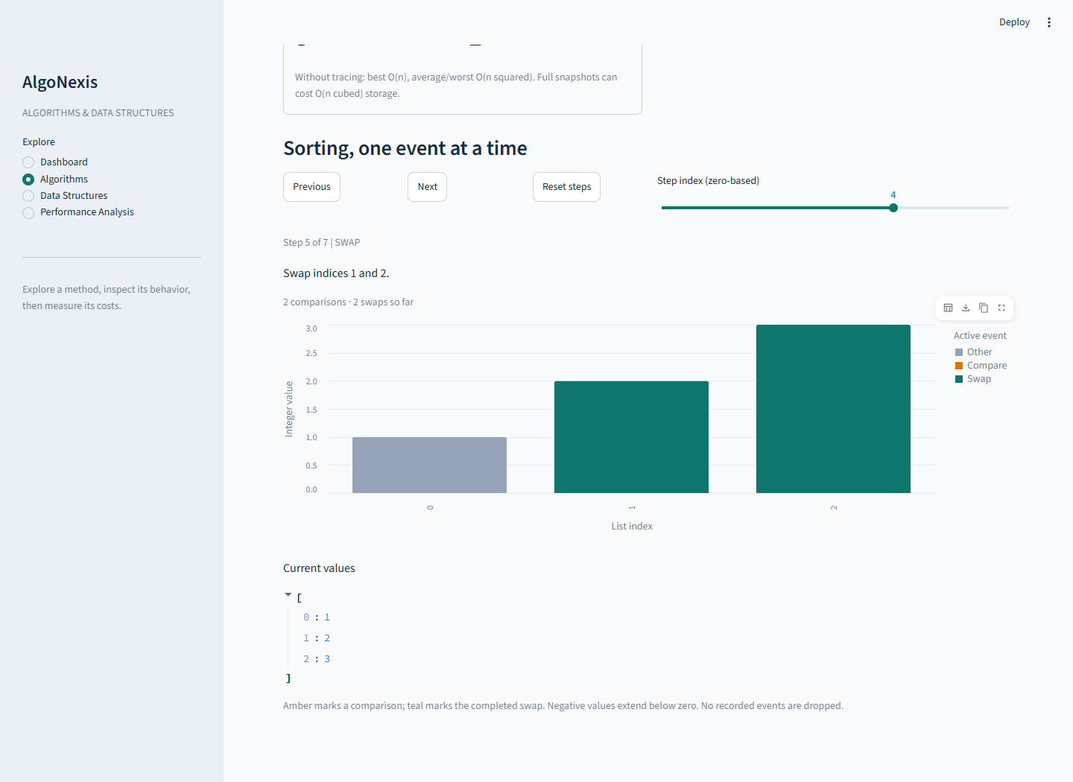
IMPLEMENTATION → EVIDENCE → LEARNING
Bubble Sort: make every comparison inspectable
Adjacent compare and swap
Early exit: O(n) best case
O(n²) average / worst, untraced
Immutable snapshots; trace limit 50
Algorithm background: OpenDSA, Bubble sort; project early-exit and trace contracts
04
Notes:
In Algorithms, enter 3, 1, 2 and run Bubble Sort. Show the output 1, 2, 3. Step through initial, comparison, swap, and final events; use Previous and Reset to demonstrate replay without recomputation. There are three comparisons and two swaps for this example. The caller list is preserved. Explain that complete snapshots can cost O(n³) time and storage, so the interface bounds traced input and benchmarks disable tracing. Cite the report for the conventional adjacent-pass algorithm and the project-specific early-exit analysis.

Slide 5
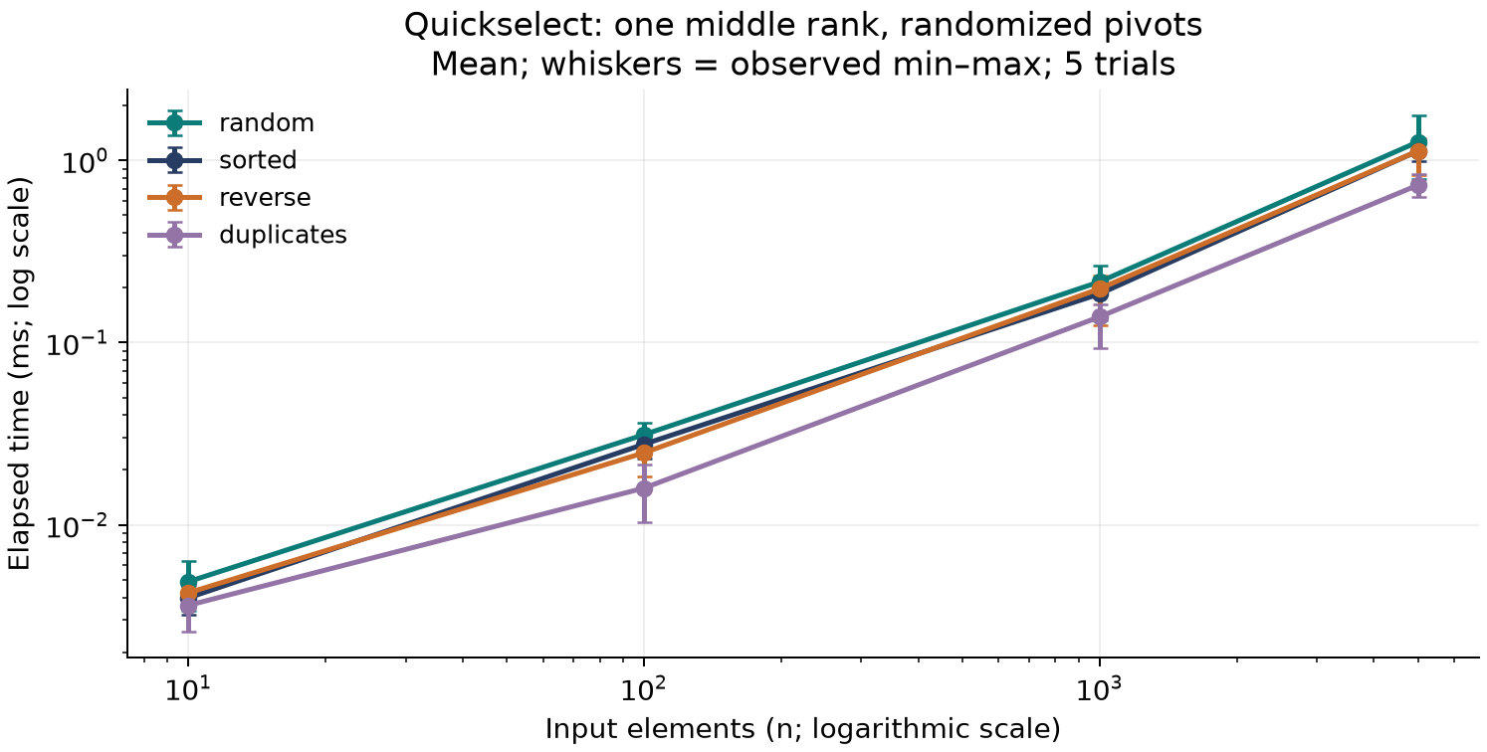
IMPLEMENTATION → EVIDENCE → LEARNING
Quickselect: ask for one rank
One-based k; duplicates retain ranks
Randomized three-way partition
Expected O(n); worst O(n²)
Copy preserves the caller’s input
Selection background: Sedgewick & Wayne, Quick.java; means/min–max from final CSV
05
Notes:
Use the list 7, 2, 7, -1, 4 and choose k=3. The selected result is 4, matching the third entry of the sorted reference. Show the invalid rank message for k beyond the list length, then restore a valid value. Explain the smaller, equal, and larger pivot regions. Only the region containing the requested rank remains active. The plotted workload selects one middle rank, while Bubble Sort returns every item ordered; their times do not represent interchangeable tasks. An injected Random instance fixes pivot seeds without changing global random state.

Slide 6
IMPLEMENTATION → EVIDENCE → LEARNING
Custom Set: membership defines equality
Dictionary-backed membership
Explicit union / intersection loops
Difference and symmetric difference
Derived results preserve both operands
Source: AlgoNexis implementation and recorded measurements
06
Notes:
Select Custom Set and add 1 and 2. Use a second operand containing 2 and 3. Demonstrate union [1,2,3], intersection [2], difference [1], and symmetric difference [1,3]. Explain that the displayed order follows insertion for predictability while set equality remains unordered membership. Derived operations return new sets and do not mutate the inputs. The implementation writes the algebra explicitly rather than delegating to built-in set operators. Keys must be hashable, and expected membership costs depend on the dictionary hashing behavior.

Slide 7
IMPLEMENTATION → EVIDENCE → LEARNING
Stack and Queue: order determines representation
Stack: list end → LIFO, amortized O(1) push
Queue: deque ends → FIFO, O(1) removal
Empty removal raises a clear IndexError
Draining n elements is an O(n) batch
Python Software Foundation, collections — deque end operations and list front-removal costs
07
Notes:
Push 10 then 20 on the Stack; peek and pop return 20. Enqueue 10 then 20 on the Queue; front and dequeue return 10. Drain both and demonstrate a graceful empty-state error. Explain the concrete representation choice: Python lists support efficient end operations, whereas repeatedly removing index zero shifts later elements. Deque avoids that front-shifting cost. The performance workload drains a preloaded fixture and constructs a returned list, so its operation allocation includes output storage and excludes the original structure.

Slide 8
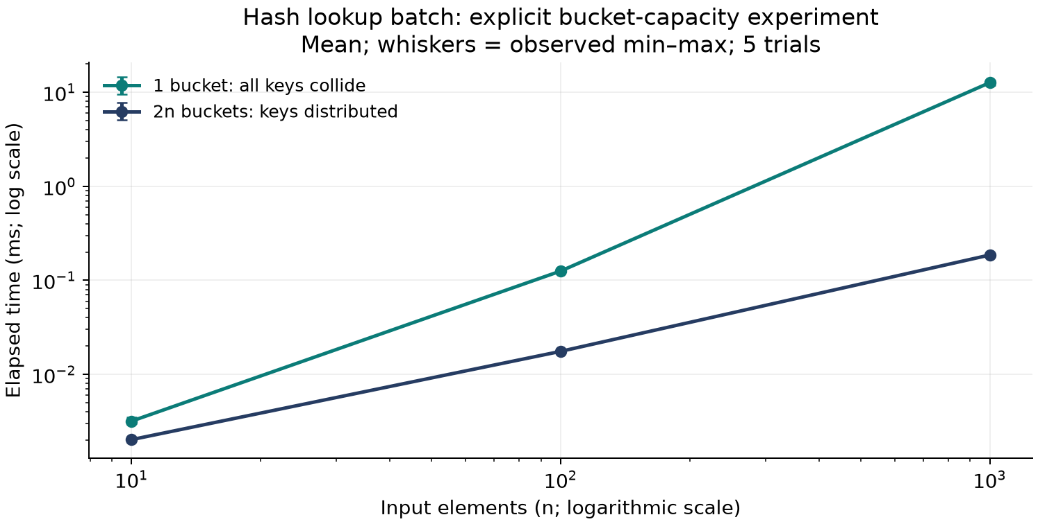
IMPLEMENTATION → EVIDENCE → LEARNING
Tree, Graph, Hash Table: expose the trade-offs
BST: ordered keys; shape controls search
Graph: undirected adjacency; BFS / DFS
Hash Table: fixed separate chains
One bucket / 2n lookup means: 68.20×
Sedgewick & Wayne: BST.java, BreadthFirstPaths.java, SeparateChainingHashST.java; controlled CSV
08
Notes:
Insert tree values 2,1,3 and show inorder [1,2,3]; describe how monotone insertion can instead form a chain. Create graph edges 0–1 and 1–2, then traverse from 0 using both BFS and DFS. Query an absent starting vertex to show the validation behavior. Insert, update, find, and delete an integer hash key with a text value. Explain that the importable core API also supports None payloads, distinct from missing keys; the UI deliberately uses text values. The chart holds queries constant while changing bucket capacity. One bucket forces a chain, while these keys occupy separate buckets at 2n capacity. It measures successful lookup batches, excluding construction.

Slide 9
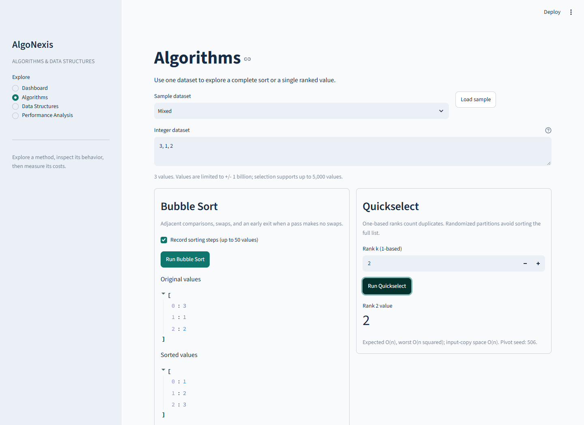
IMPLEMENTATION → EVIDENCE → LEARNING
The interface is part of correctness
Strict integer parsing; no eval
Separate model and widget state
Explicit growth and trace limits
Navigation, failures, resets checked in Edge
Source: AlgoNexis implementation and recorded measurements
09
Notes:
Show the Algorithms screenshot, then switch sections and return to demonstrate persistence. Enter 1.5 to trigger the integer-input error and disabled action. In Data Structures, operate on a model, navigate away, and return. Reset all structures and confirm their empty state. Explain the limits: 50 traced sort items, 1,000 untraced sort items, general input at most 5,000 integers, and 200-item structure growth guards. Updates that do not grow a structure remain possible. These boundaries preserve a responsive local teaching application.

Slide 10
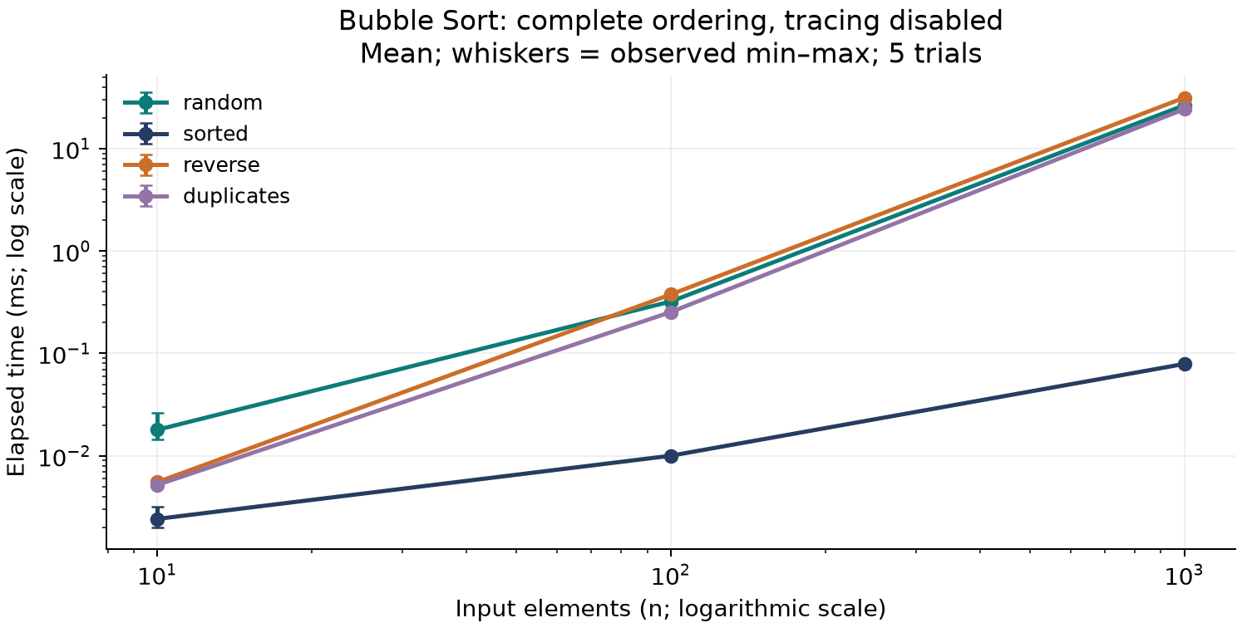
IMPLEMENTATION → EVIDENCE → LEARNING
Measure the work that the label describes
1,080 observed rows + 8 guarded skips
Five timing + five allocation repeats per case
Setup / checking excluded; output included
Separate 60-row controlled collision profile
Final run c6f11506577d47dc87eddb2fc4391644 · mean with observed min–max
10
Notes:
Open Performance Analysis and explain its pattern filter, timing and allocation charts, summary table, and full CSV download. Use the saved run instead of replacing the evidence during this presentation. Inputs are seeded with 506, and Quickselect pivots use seed plus trial. Point out that skips are blank observations rather than zeros. The CSV has environment and core source provenance; the analysis manifest hashes data and figures. The graph chart workload is a path, while the default hash profile has max(8,2n) capacity. Confidence intervals were not estimated.

Slide 11
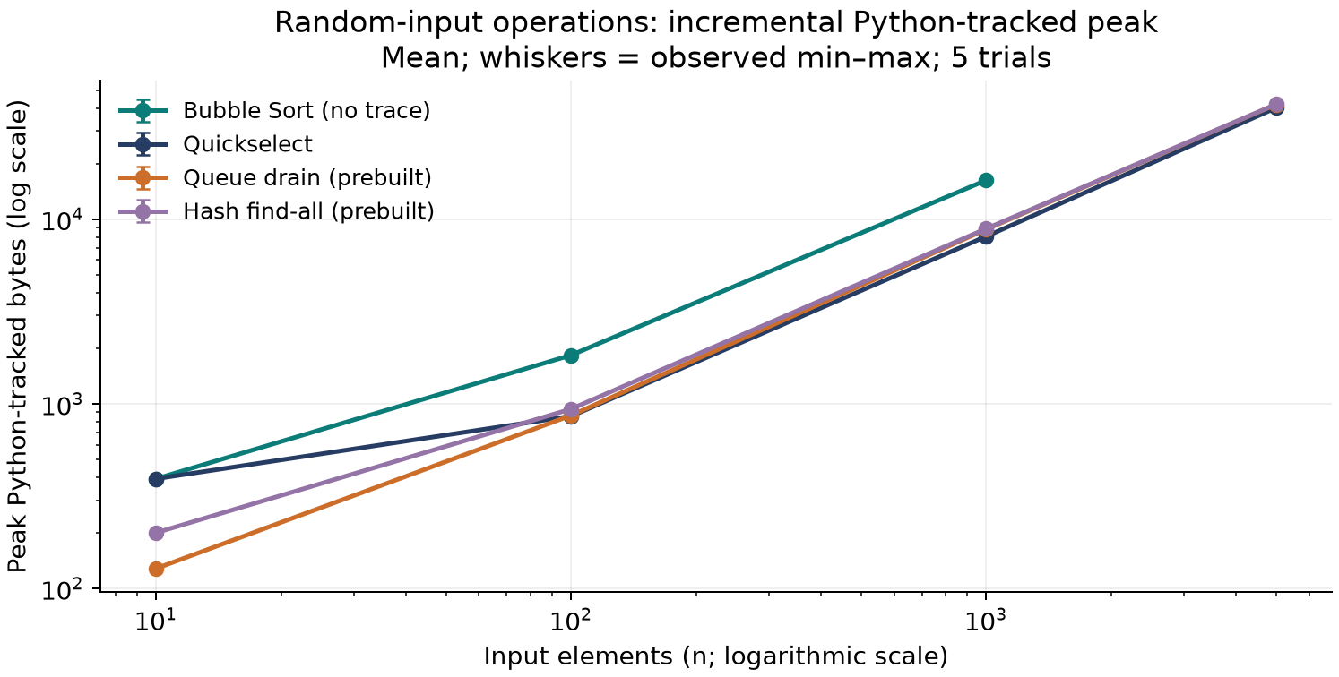
IMPLEMENTATION → EVIDENCE → LEARNING
Findings need boundaries
BST sorted / random means: 26.47×
Repeated keys reduce effective fixture size
Tracked operation allocation ≠ total RAM
One machine, five repeats, selected workloads
Python Software Foundation, tracemalloc; final measured summaries; prebuilt fixtures excluded
11
Notes:
Explain the measured BST order effect using the actual prebuilt-tree search workload. Duplicates reduce stored node count and therefore change the fixture, not merely its query order. On this chart, output lists and protective copies explain much of the incremental allocation. Prebuilt structures are excluded, so these values cannot rank total representation memory. tracemalloc observes Python-tracked allocations, not resident memory. The shapes are consistent with implementation analysis but do not prove complexity or statistical significance. Distinguish all observed ratios from portable performance guarantees.

Slide 12
IMPLEMENTATION → EVIDENCE → LEARNING
Learning outcomes and release
Contracts connect algorithms, UI, tests, and evidence
195 automated tests + real browser walkthrough
Report: 8 substantive pages; slides: 12
Next: balanced tree, resizing hash, broader datasets
Source: AlgoNexis implementation and recorded measurements
12
Notes:
Close by mapping the eight deliverables: Bubble Sort and visualization, Quickselect, Custom Set, integrated portfolio, working interface, substantive performance report, presentation, and technical documentation. Describe learning about nonmutation, event immutability, insertion-order sensitivity, collision cost, and honest measurement boundaries. The clean install exposed a pandas wheel compatibility issue; the tested maintenance version resolved it without changing system policy. The retrospective records that challenge. The release checklist and verification record provide commands and evidence. Future work should follow the observed limitations: balancing, resizing, and independent datasets rather than unmeasured feature claims.

