Slide 1
Health Insurance Analytics with Big Data
Capstone Project
Presented by: Shreyash Patel

Slide 2
Problem Statement
Healthcare insurance want to enhance revenue and customer understanding issues.
Big Data solution required to track customer behavior and policy profitability.

Slide 3
UseCases
Which disease has a maximum number of claims.
Find those Subscribers having age less than 30 and they subscribe any subgroup
Find out which group has maximum subgroups.
Find out hospital which serve most number of patients
Find out which subgroups subscribe most number of times
Find out total number of claims which were rejected
From where most claims are coming (city)
Which groups of policies subscriber subscribe mostly Government or private
Average monthly premium subscriber pay to insurance company.
Find out Which group is most profitable
List all the patients below age of 18 who admit for cancer
List patients who have cashless insurance and have total charges greater than or equal for Rs. 50,000.
List female patients over the age of 40 that have undergone knee surgery in the past year

Slide 4
Tools & Technologies
Cloud: AWS S3, Redshift
Processing: Databricks, PySpark
Visualization: Tableau
Versioning/Collaboration: : GitHub, Jira

Slide 5






Architecture Diagram
AWS S3
PowerBi
AWS RedShift

Slide 6
Database Design
Implemented star schema with optimized joins.
Defined PK/FK relationships for claims, grpsubgrp, patient_records, groups, disease, hospital, subgroup, subscriber

Slide 7
Data Ingestion & Cleaning, Output Generation
Uploaded datasets to S3.
With the help of Databricks and pyspark creating ETL pipline and we are using Medallion Architecture
Analytical queries executed in Redshift.
Results visualized with BI tools.
Bronze Layer
Ingest data from S3
Silver Layer
Clean and transformn data
Gold Layer
Upload data into Redshift

Slide 8
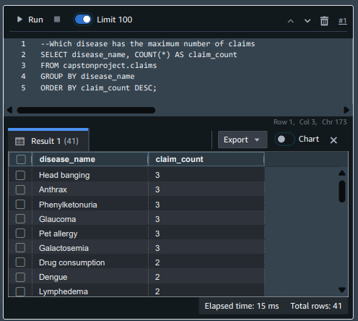
Use Case-1 Which disease has the maximum number of claims

Slide 9
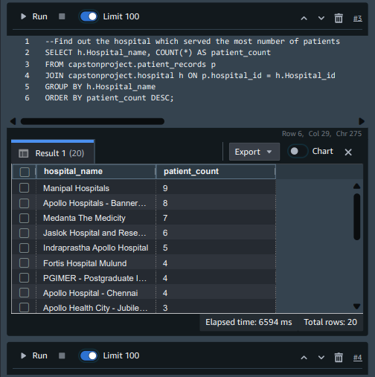
Use Case 2 Find out the hospital which served the most number of patients

Slide 10
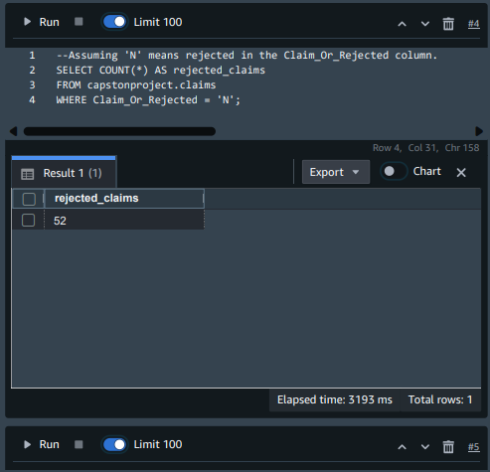
Use Case 3 Total number of claims which were rejected

Slide 11
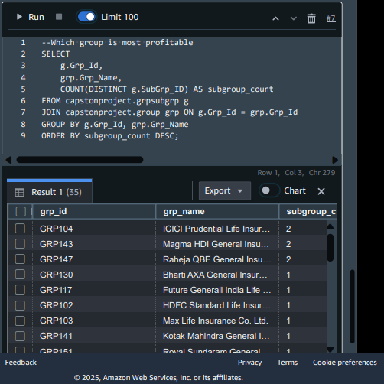
Use Case – 4 Which group is most profitable

Slide 12
Sprint & Task Management
1-Week Sprint: day 1,2 - Documentation, day 3,4 - Implementation.
Jira used to manage user stories and testing tasks.

Slide 13
Conclusion
Built an end-to-end data platform for healthcare insurance analytics.
Delivered actionable insights to support revenue growth.

