Slide 1
ASSIGNMENT 1
NAME :- SHREYASH R. GAJBHIYE
REGISTRATION No. :- 2023BIT042
SUBJECT :- SOFTWARW ENGINEERING
DATE :- 24-07-2025

Slide 2

Selected Software Company - Mphasis
Name: Mphasis Limited
Founded: Year 1998
Headquarters: Bengaluru (Bangalore), Karnataka, India
Parent Company: Blackstone Group (major stakeholder)
CEO & MD: Nitin Rakesh
Employees: Over 31,000 globally (as of 2024)

Slide 3
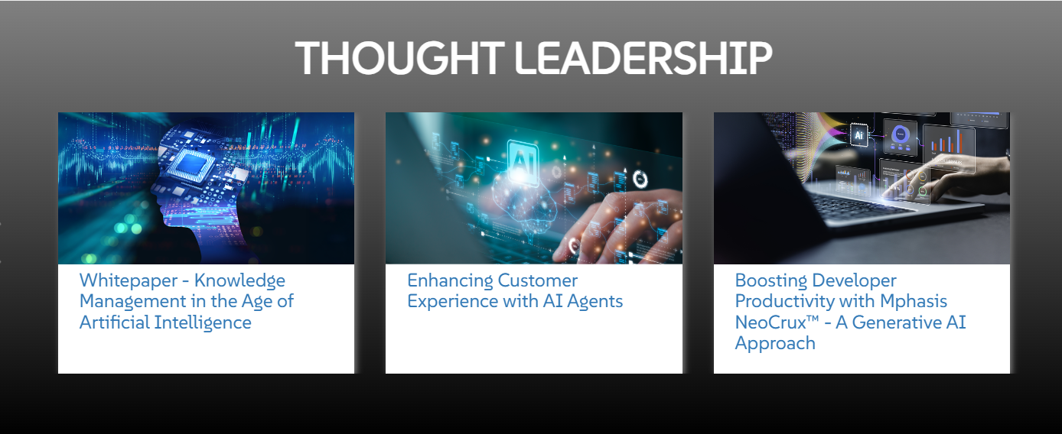

Core Services
Application Development & Maintenance
Cloud Services
DevOps & Agile Transformation
Data & AI Services
Cybersecurity & Infrastructure Services
Business Process Services (BPS)

Slide 4


Industries Served
Banking & Financial Services
Insurance
Healthcare
Telecom
Logistics & Transportation
Energy, Oil & Gas
Public Sector

Slide 5

Case Study – Modernizing Old Software for Telecom
Client: U.S. telecom company with very old system.
Problem: Old, large software; no documentation.
Solution: Analyzed code, identified useful parts, created proper documents.
Result: Easier future upgrade, saved money and time.

Slide 6
References & Sources
www.mphasis.com – Official Website
click to visit Mphasis company website
https://en.wikipedia.org/wiki/Mphasis – Company Overview (Wikipedia)
Case Study - www.mphasis.com/case-study/telecom-modernization

Slide 7


