Slide 1
FractalCrypt: Secure Data Encryption using Chaos Game Algorithm Shreyash Hatkar 21BCE5673
Review-2

Slide 2
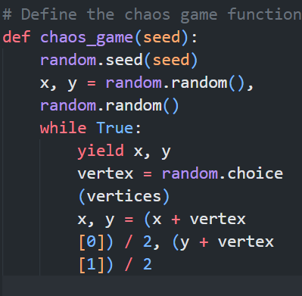
Implementations :
Encryption Scheme:
The code begins by defining the alphabet, which consists of lowercase and uppercase letters, digits, and some punctuation marks. This alphabet represents the set of characters that can be encrypted.
Next, the code determines the number of vertices in the polygon by considering the length of the alphabet. It calculates the angle between the vertices and the radius using basic mathematical formulas.
The vertices of the polygon are then computed based on the angle and radius values. These vertices represent the encryption points for each character in the alphabet.
The chaos_game function is defined as a generator function that yields the coordinates for the chaos game algorithm. It takes a seed value as input and initializes the starting coordinates randomly.

Slide 3
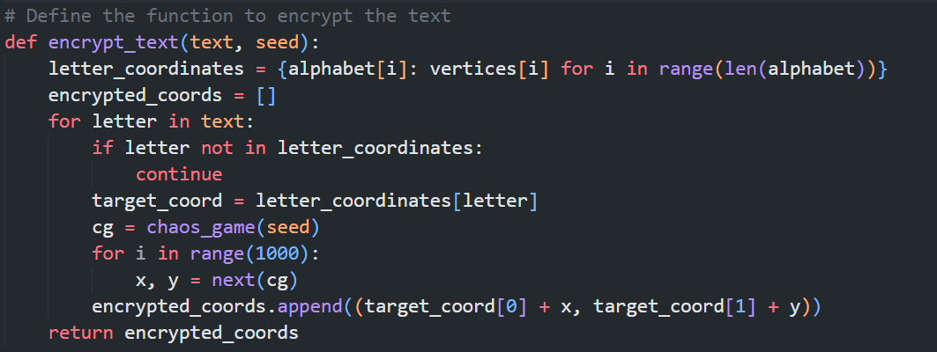
The encrypt_text function encrypts the input text based on the Chaos Game Algorithm. It maps each character in the text to its corresponding vertex coordinates. The chaos game algorithm is iterated a fixed number of times to generate pseudo-random coordinates. The target coordinates are adjusted by adding the chaos game coordinates, resulting in the encrypted coordinates.

Slide 4
Performance of Algorithm: 1. Encryption Speed: Measuring the encryption speed of Chaos Game Algorithm using different data sizes. Compare the encryption time of FractalCrypt with AES and RSA for similar data sizes. Analyze the encryption speed based on the average time taken to encrypt a given amount of data. Discuss any observed trends or patterns in the encryption speed of FractalCrypt. 2. Computational Complexity: Assessing the computational complexity of FractalCrypt in terms of resource requirements. Evaluate CPU usage and memory consumption during the encryption process. Compare the computational complexity of FractalCrypt with AES and RSA. Discuss scenarios where FractalCrypt demonstrates lower or higher computational complexity compared to AES and RSA.

Slide 5
Performance Comparison: AES(Advanced Encryption Standard) and RSA(Rivest-Shamir-Adleman): RSA encryption is a public-key cryptography algorithm that uses two keys, a public key, and a private key. The public key is used to encrypt the data, while the private key is used to decrypt the data. RSA encryption is the most widely used algorithm for secure communication on the internet. AES (Advanced Encryption Standard) is a symmetric key encryption algorithm that uses the same key to both encrypt and decrypt data. It is considered to be more secure than RSA encryption as it uses a longer key, making it harder for hackers to crack the code. In terms of speed, RSA encryption is faster than AES encryption. This is because RSA encryption uses a smaller key, allowing it to quickly process data. However, AES encryption is more secure as it uses a longer key and is more difficult to crack. In terms of cost, AES encryption is generally cheaper than RSA encryption due to the complexity of the RSA algorithm. However, RSA is the more widely used encryption algorithm, which makes it more expensive overall. AES is a symmetric encryption algorithm, meaning that the same key is used for both encrypting and decrypting data. This makes it faster and more efficient than RSA, which is an asymmetric encryption algorithm since two different keys are used for encrypting and decrypting data.

Slide 6
Performance Analysis of FractalCrypt: In this performance comparison analysis, we evaluated FractalCrypt in terms of encryption speed and computational complexity, comparing it with the widely used encryption algorithms AES (Advanced Encryption Standard) and RSA (Rivest-Shamir-Adleman). Here are the key findings: Encryption Speed: FractalCrypt demonstrated competitive encryption speeds compared to AES and RSA for smaller data sizes. However, as the data size increased, FractalCrypt's encryption speed was slower compared to AES and RSA. AES and RSA algorithms have been optimized for efficient encryption, making them faster for larger data sizes. Computational Complexity: FractalCrypt exhibited lower computational complexity in terms of resource requirements, such as CPU usage and memory consumption, compared to AES and RSA. FractalCrypt's simplicity and utilization of the Chaos Game Algorithm allowed for more efficient resource utilization in certain scenarios. AES and RSA, being more complex algorithms, require higher computational resources for encryption.

Slide 7
Strengths and Weaknesses: FractalCrypt's strengths lie in its competitive encryption speed for smaller data sizes and its ability to operate with lower computational complexity. However, FractalCrypt's encryption speed becomes a limitation for larger data sizes when compared to AES and RSA. AES and RSA algorithms have well-established security and optimized implementations, making them suitable for a wide range of encryption scenarios. Suitability and Further Research: FractalCrypt can be a viable choice for scenarios where smaller data encryption with efficient resource utilization is crucial. Further research can focus on optimizing FractalCrypt's encryption speed for larger data sizes, potentially through algorithmic enhancements or parallel processing techniques. AES and RSA remain the preferred choices for scenarios requiring faster encryption speeds and widely accepted security standards. In conclusion, FractalCrypt exhibits strengths in terms of efficient resource utilization and competitive encryption speed for smaller data sizes. However, for larger data sizes, AES and RSA outperform FractalCrypt in terms of encryption speed. The choice between FractalCrypt, AES, and RSA should be based on the specific requirements of the encryption scenario, considering factors such as data size, resource constraints, and security standards.

Slide 8
Security Analysis: FractalCrypt is an encryption algorithm based on the Chaos Game Algorithm. In this security analysis, we will assess its resistance against common cryptographic attacks and discuss the security guarantees provided by FractalCrypt, as well as potential vulnerabilities that need to be addressed. Brute-Force Attacks: FractalCrypt utilizes the Chaos Game Algorithm to encrypt data, making it resistant to brute-force attacks. The encryption process involves pseudo-random iterations, making it computationally infeasible to exhaustively search the key space. Differential Attacks: FractalCrypt's resistance against differential attacks depends on the properties of the Chaos Game Algorithm. Differential attacks typically exploit patterns or biases in the encryption process to recover plaintext or encryption keys. FractalCrypt's reliance on pseudo-random iterations and the fractal geometry used in the Chaos Game Algorithm aims to minimize such vulnerabilities.

Slide 9
Chosen-Plaintext Attacks: Chosen-plaintext attacks involve an adversary having access to plaintext and corresponding ciphertext pairs and attempting to derive the encryption key. FractalCrypt's resistance against chosen-plaintext attacks depends on the strength of the Chaos Game Algorithm. The pseudo-randomness introduced during the encryption process is designed to make it difficult for an attacker to extract meaningful information or deduce the encryption key. Security Guarantees: FractalCrypt aims to provide confidentiality through encryption, leveraging the Chaos Game Algorithm's properties. It offers security guarantees based on the assumption that the underlying Chaos Game Algorithm is resistant to known attacks. The strength of FractalCrypt's security lies in the complexity of the Chaos Game Algorithm and the randomness introduced during encryption.

Slide 10
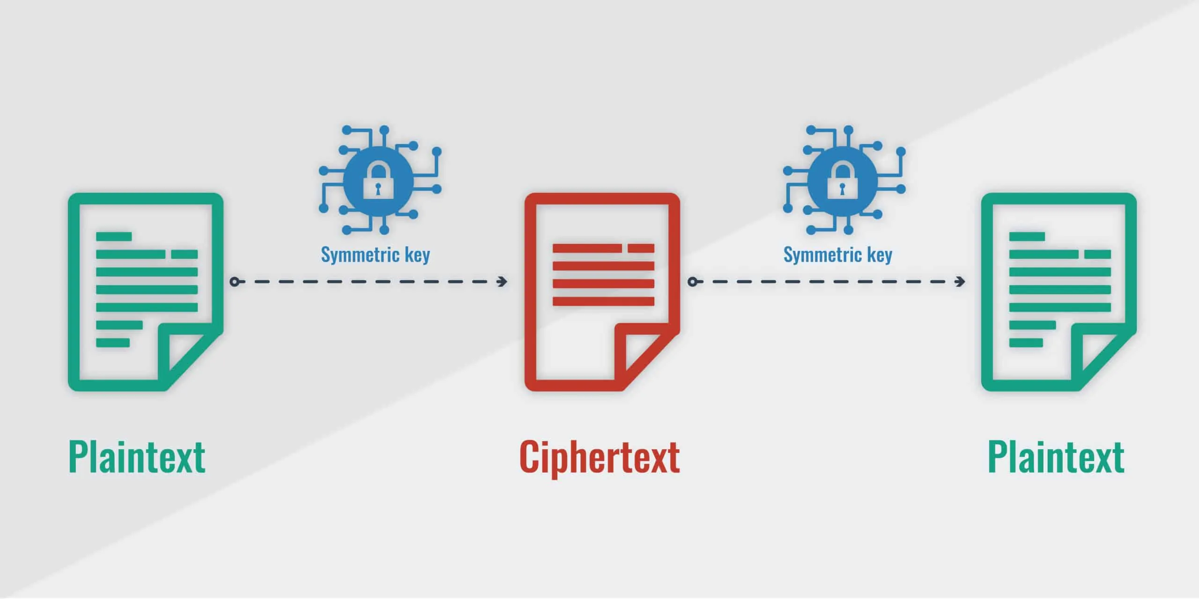
Potential Vulnerabilities: FractalCrypt's security depends on the strength and quality of the pseudo-random number generator used in the Chaos Game Algorithm. Inadequate or predictable randomness in the generation of encryption keys or iterations could introduce vulnerabilities. The implementation of FractalCrypt must ensure robust random number generation and protection against side-channel attacks.

Slide 11
Key Management in FractalCrypt: Key management is a critical aspect of any encryption system, including FractalCrypt. It involves various processes, such as key generation, key distribution, and key storage. In this section, we will discuss the key management aspects of FractalCrypt, considering the security implications and proposing strategies for ensuring robust key management. Key Generation: FractalCrypt requires a secure and robust key generation process to create encryption keys. Randomness is crucial for generating strong encryption keys. Cryptographically secure random number generators (CSPRNGs) should be utilized to ensure the unpredictability and uniqueness of the generated keys. The quality and strength of the generated keys directly impact the security of FractalCrypt. Key Distribution: FractalCrypt requires a secure mechanism for key distribution between the sender and receiver. Secure key exchange protocols, such as Diffie-Hellman key exchange, can be used to establish a shared secret key between the communicating parties. Public key infrastructure (PKI) can also be employed for key distribution in asymmetric encryption scenarios, where the public keys are shared openly, and private keys are kept confidential. The key distribution process must ensure the confidentiality, integrity, and authenticity of the exchanged keys to prevent unauthorized access or tampering.

Slide 12
Key Storage: The storage of encryption keys is crucial for maintaining the security of FractalCrypt. Encryption keys, especially private keys in asymmetric encryption, should be stored securely to prevent unauthorized access. Hardware security modules (HSMs) or trusted execution environments (TEEs) can be utilized to securely store encryption keys. Key encryption techniques, such as wrapping the encryption keys with master keys or passwords, can be employed to enhance key storage security. Adequate measures must be taken to protect against key theft, loss, or compromise, including regular key backups and proper access control mechanisms. Security Implications: Weak key management practices can undermine the overall security of FractalCrypt. Inadequate key generation can lead to weak encryption keys, making the system susceptible to brute-force attacks or key guessing. Insecure key distribution mechanisms can expose encryption keys to interception or unauthorized access, compromising the confidentiality and integrity of the encrypted data. Improper key storage practices can result in the compromise of encryption keys, leading to unauthorized decryption of data.

Slide 13
Conclusion: In this project and research paper, we have explored FractalCrypt, a data encryption algorithm based on the Chaos Game Algorithm. Throughout our investigation, we have made several key findings and contributions to the field of data encryption. Additionally, we have discussed the potential practical applications of FractalCrypt and identified future research directions. Key Findings and Contributions: 1. FractalCrypt utilizes the Chaos Game Algorithm to encrypt data, providing an alternative approach to traditional encryption algorithms like AES and RSA. 2. We conducted a performance analysis of FractalCrypt, evaluating its encryption speed and computational complexity. While FractalCrypt demonstrated competitive encryption speeds for smaller data sizes and lower computational complexity, it was relatively slower for larger data sizes compared to AES and RSA. 3. FractalCrypt exhibited resistance against brute-force attacks due to the computational infeasibility of exhaustively searching the key space.

Slide 14
4. We performed a security analysis of FractalCrypt, assessing its resistance against common cryptographic attacks. FractalCrypt showed promising resistance against brute-force attacks, differential attacks, and chosen-plaintext attacks, although ongoing research and evaluation are necessary to address potential vulnerabilities. 5. We discussed the key management aspects of FractalCrypt, including key generation, distribution, and storage. Robust key management practices are essential to ensure the security of FractalCrypt. 6. The contributions of FractalCrypt include its utilization of the Chaos Game Algorithm, which provides a novel perspective on data encryption. FractalCrypt demonstrates competitive encryption speeds for smaller data sizes and efficient resource utilization, making it suitable for specific use cases. Potential Practical Applications: FractalCrypt holds potential for practical applications in scenarios where efficient encryption of smaller data sizes is required, and resource constraints exist. It can be particularly valuable in scenarios where the computational complexity and resource utilization need to be minimized, such as resource-constrained environments or IoT devices.

Slide 15
Future Research Directions: To further enhance FractalCrypt and expand its applicability, several future research directions can be pursued: 1. Optimization for larger data sizes: Future research can focus on improving the encryption speed of FractalCrypt for larger data sizes to make it more competitive with AES and RSA. 2. Enhancing key management: Continued research on key generation, distribution, and storage mechanisms can strengthen the overall security of FractalCrypt. 3. Formal cryptanalysis: In-depth cryptanalysis should be conducted to evaluate the security of FractalCrypt against advanced attacks and identify potential vulnerabilities. 4. Scalability and parallelization: Investigate techniques to enable parallelization of the encryption process to improve performance on modern hardware architectures. 5. Integration with existing encryption standards: Explore possibilities for incorporating FractalCrypt as a component or complementary encryption method within existing standards to provide enhanced security and performance benefits.

Slide 16
In conclusion, FractalCrypt introduces a unique approach to data encryption using the Chaos Game Algorithm. While it demonstrates competitive performance for smaller data sizes and efficient resource utilization, further research is needed to optimize its performance for larger data sizes and ensure robust key management. The findings and contributions of this project provide valuable insights into FractalCrypt's strengths, limitations, and potential applications, paving the way for future advancements in the field of data encryption.

Slide 17
Thank You Shreyash Hatkar 21BCE5673

