Slide 1
FractalCrypt: Secure Data Encryption using Chaos Game Algorithm
A comprehensive overview of the project's objectives, implementation details, and significance
Shreyash Hatkar 21BCE5673

Slide 2
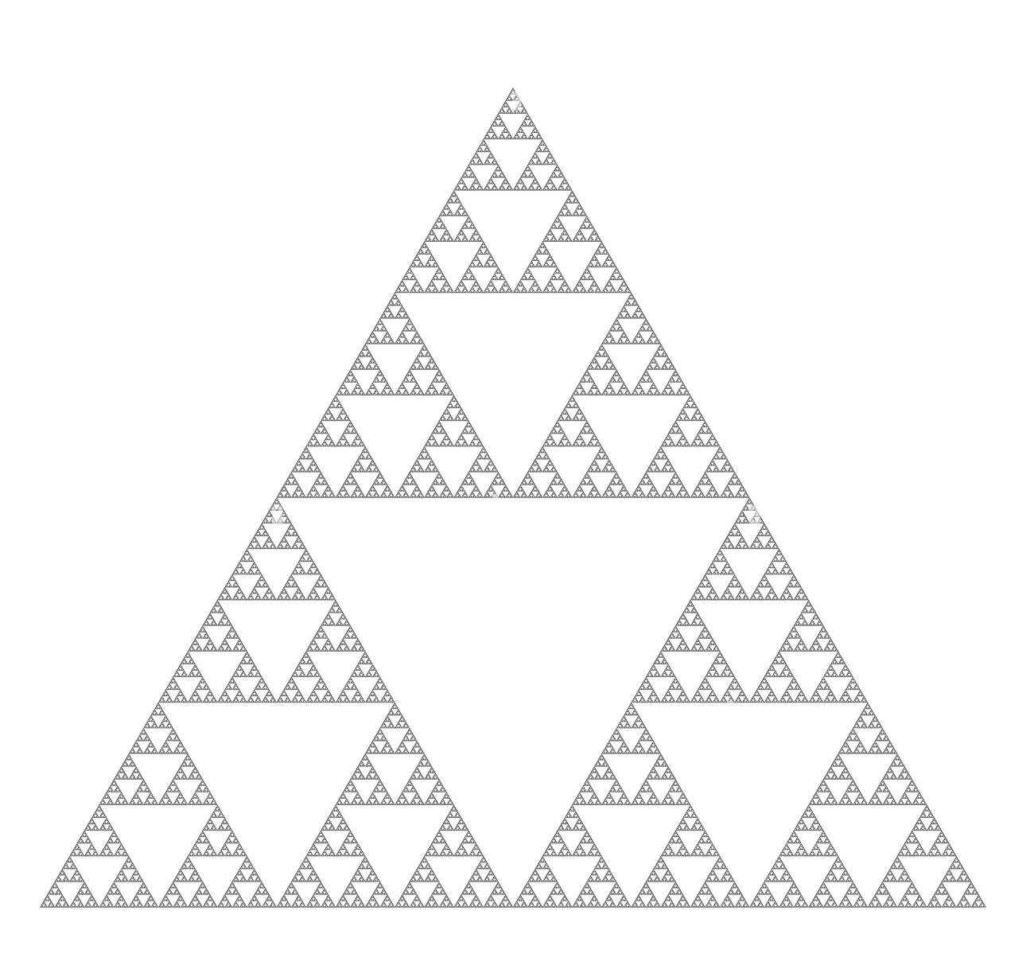
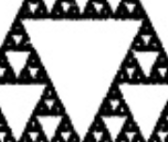
Introduction
Data protection is crucial in the digital era
Existing encryption techniques have limitations
FractalCrypt employs Chaos Game Algorithm for robust security and resistance to decryption attacks
The following work include implementation of Data encyption technique using self repeating structures called as fractals

Slide 3
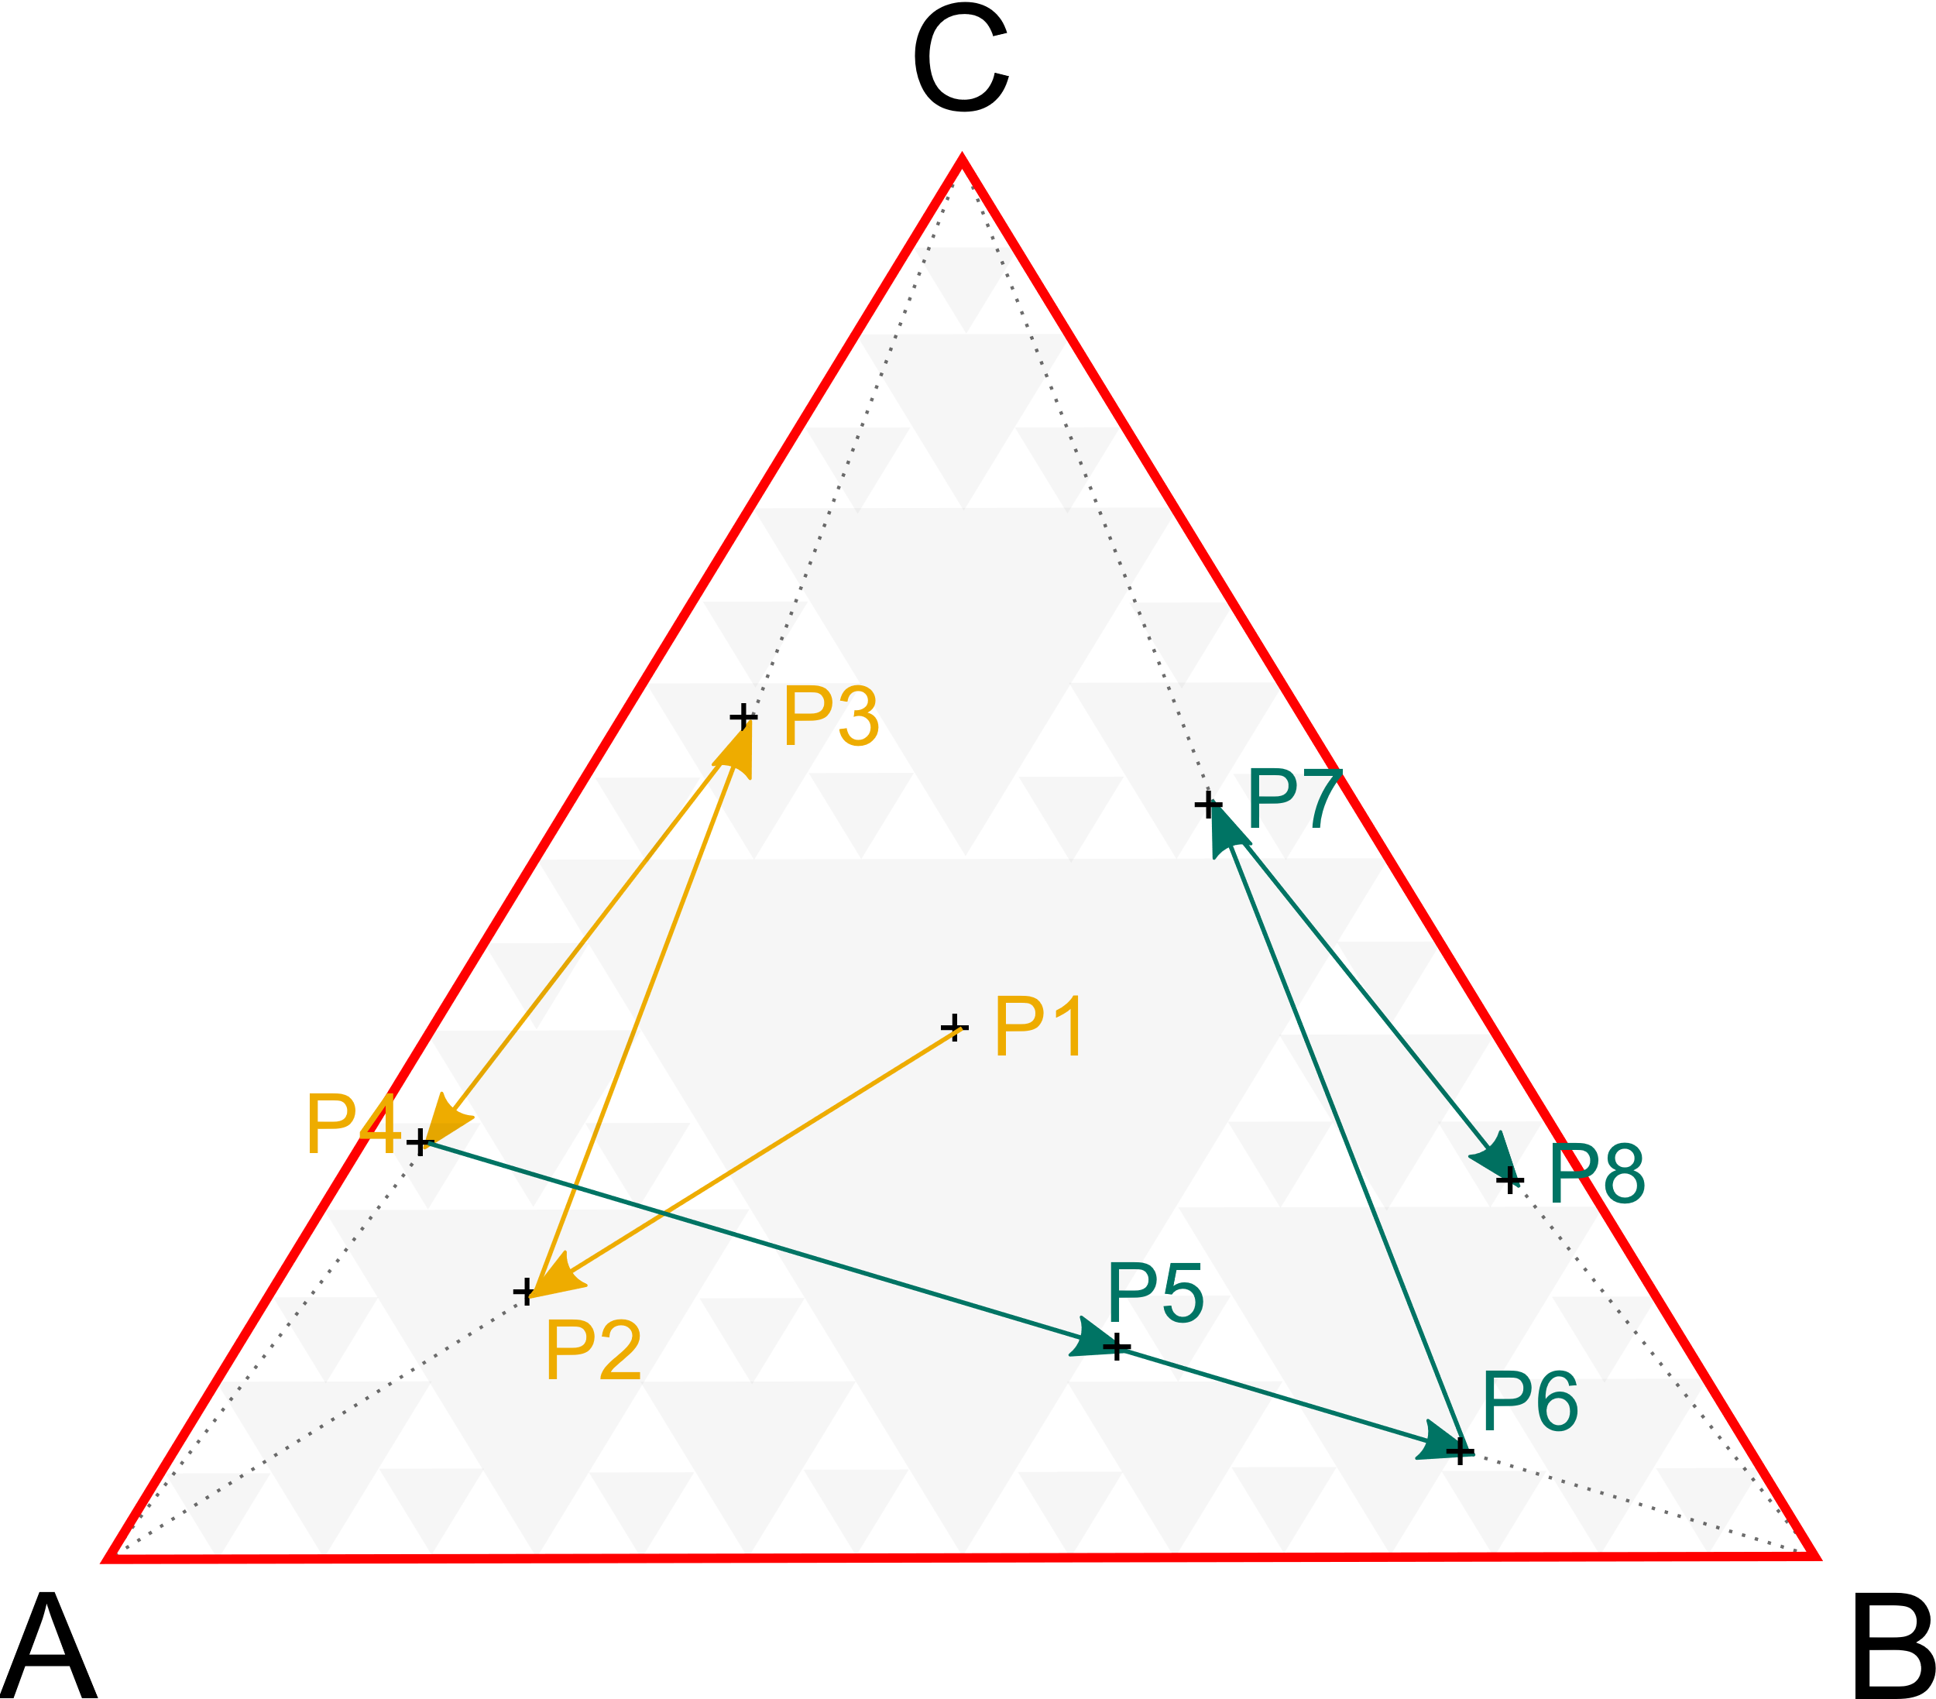
Abstract
Fractals are self-similar patterns. The so-called chaos game (also called a random iteration algorithm) is a method to generate iterative fractals with the help of polygons.
The rules are simple and will be explained using the example of a triangle. It has the corner points A, B and C. You start the chaos game at a random point P1 within the triangle. To calculate the next position P2, you choose one of the three corner points of the triangle at random and place P2 in the middle of the route between point P1 and the randomly selected corner point. Repeat this process.
This concept can be applied to various shapes and polygons and defining new rules of traversals affecting complexity and efficiency of algorithm.
Sierpinski triangle

Slide 4
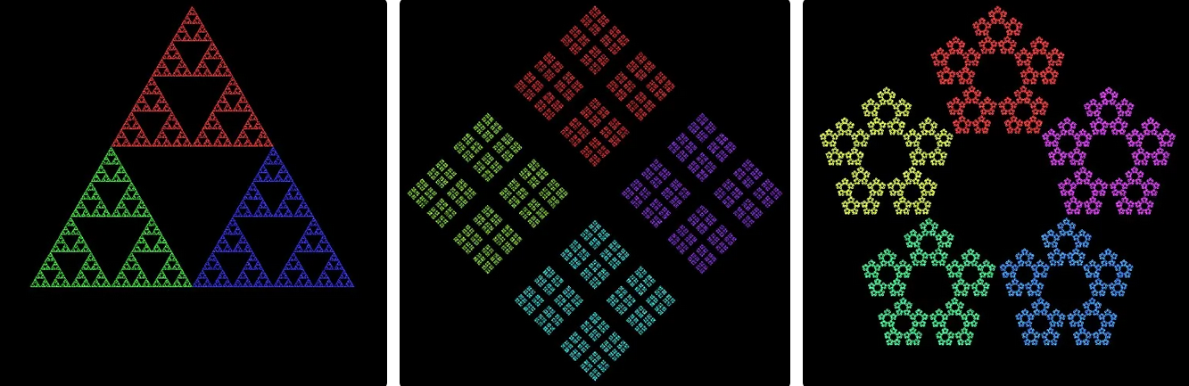
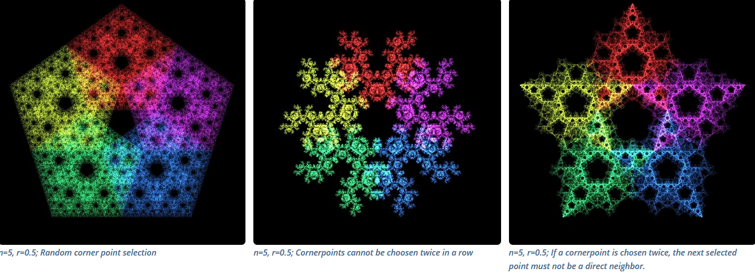
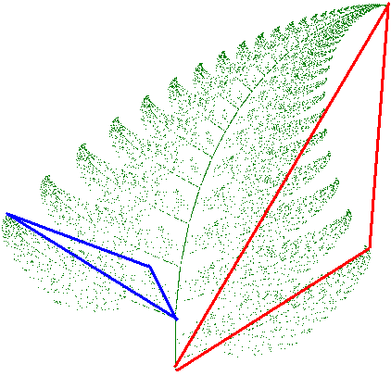
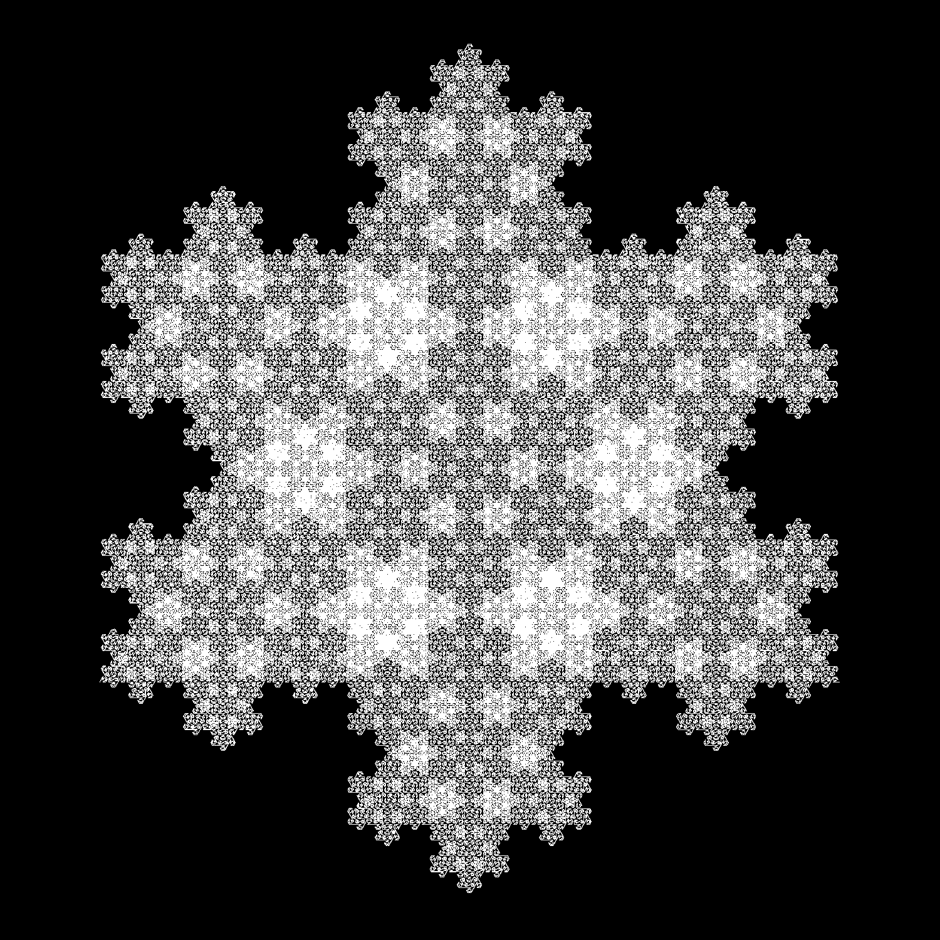
Literature Study
Review of existing encryption techniques and their limitations
To understand the context and significance of FractalCrypt, we conducted an extensive literature study on data encryption and chaos theory.
Chaos algorithm concept is used in such a way that data treated as a string follows the above mentioned rules and each traversed point is recorded as coordinates of encrypted data which is then sent over network.
The random number generator generates a sequence of pseudo-random numbers based on the seed value. The same seed is required for decryption to produce correct results.

Slide 5
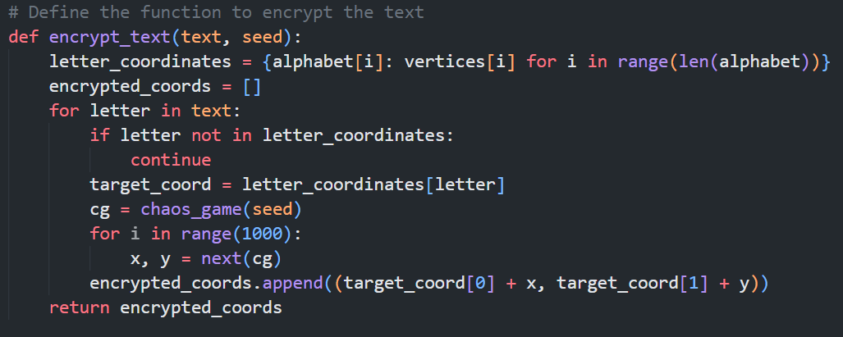
The following algorithm is used to obtain coordinates of entered string which can be sent over a network. Also shown the use of taken seed value. The encrypt_text function in the provided code is responsible for encrypting the input text using the Chaos Game Algorithm. Mapping Characters to Coordinates: The encrypt_text function initializes a dictionary called letter_coordinates.

Slide 6
Methodology
FractalCrypt uses the Chaos Game Algorithm based on iterated function systems and fractal geometry
Polygon with vertices representing an alphabet is created
Randomly selecting vertices and calculating the midpoint generates encrypted coordinates
This alphabets converted to vertices using a seed value can be used for secure data transfer.
Text
Chaos algorithm
Coordinates

Slide 7
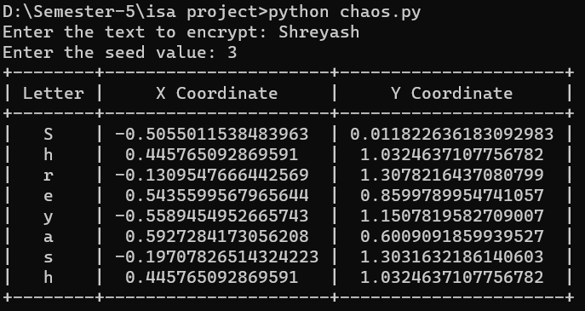

Implementation
Python code defines alphabet and calculates polygon vertices
Chaos Game Algorithm implemented using seed value
Text input encrypted by mapping each character to its corresponding vertex
S | H | R | E | Y | A | S | H

Slide 8

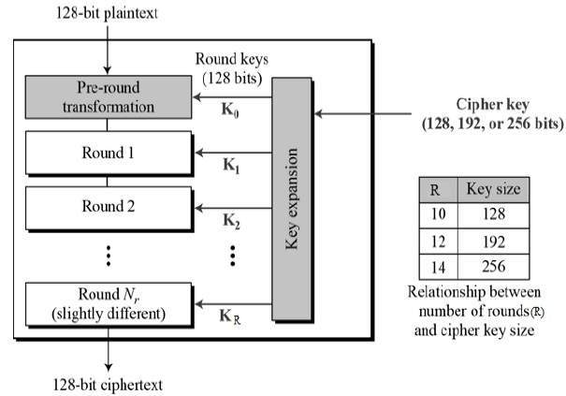
Results and Analysis
Encrypting sample inputs using FractalCrypt
Analyzing encrypted coordinates to establish relationship with original text
Highlighting security and robustness of FractalCrypt
A general comparision between chaos algorithm and Advance encryption standard:
CGA: FractalCrypt leverages chaos theory principles to generate encrypted coordinates, providing a unique and non-reversible encryption process. The randomness and unpredictability of CGA enhance the security of the encrypted data.
AES: AES is a widely adopted and standardized encryption algorithm known for its robust security. It utilizes symmetric key cryptography to ensure confidentiality and integrity of the data.

Slide 9
Advantages
Enhanced security with additional layer provided by Chaos Game Algorithm
Scalability without compromising performance
High degree of randomness with chaos theory principles

Slide 10
Limitations and Future Scope
Robust key management techniques needed
Efforts can focus on optimizing encryption process
Further analysis to assess vulnerability to cryptanalytic attacks

Slide 11
Conclusion
FractalCrypt offers novel solution to data encryption
Significance lies in seamless and robust encryption
Python code demonstrates implementation and encryption process

Slide 12
References
Diffie, W., & Hellman, M. E. (1976). New directions in cryptography. IEEE Transactions on Information Theory, 22(6), 644-654.
2. Barnsley, M. F. (1988). Fractals Everywhere. Academic Press.
3. Jeffrey, H. J. (1992). Chaos game visualization of sequences. Computers & Graphics, 16(1), 25-33.
4. https://beltoforion.de/en/recreational_mathematics/chaos_game.php

Slide 13
Thank You

