Slide 1
MUSIC RECOMMENDATION APP
HOME
TABLE OF CONTENTS
PLAYLIST
01
Model.py
02
Views.py
03
URLs.py
04
Tempelates
J036-Rahul Jiandani
J046-Shreyash Nadgouda
J047-Vanshika Nijhawan
J071-Aryan Zingade
THANKS!

Slide 2
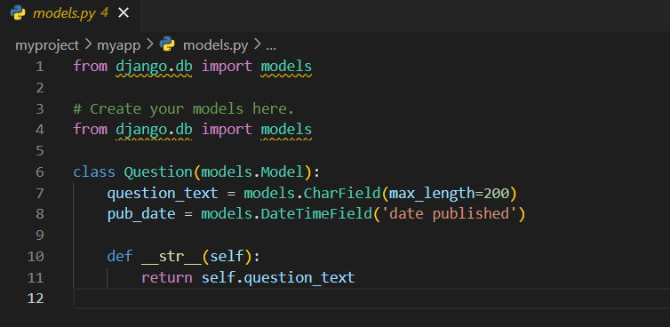
Model.py
PLAYLIST
01
The models.py file is a Python module that defines the structure and schema of a database table.
question_text = models.CharField(max_length=200): This line defines a field named question_text as a CharField with a maximum length of 200 characters.
pub_date = models.DateTimeField('date published'): This line defines a field named pub_date as a DateTimeField with a label 'date published'. This field will store date and time information for when the question was published.

Slide 3
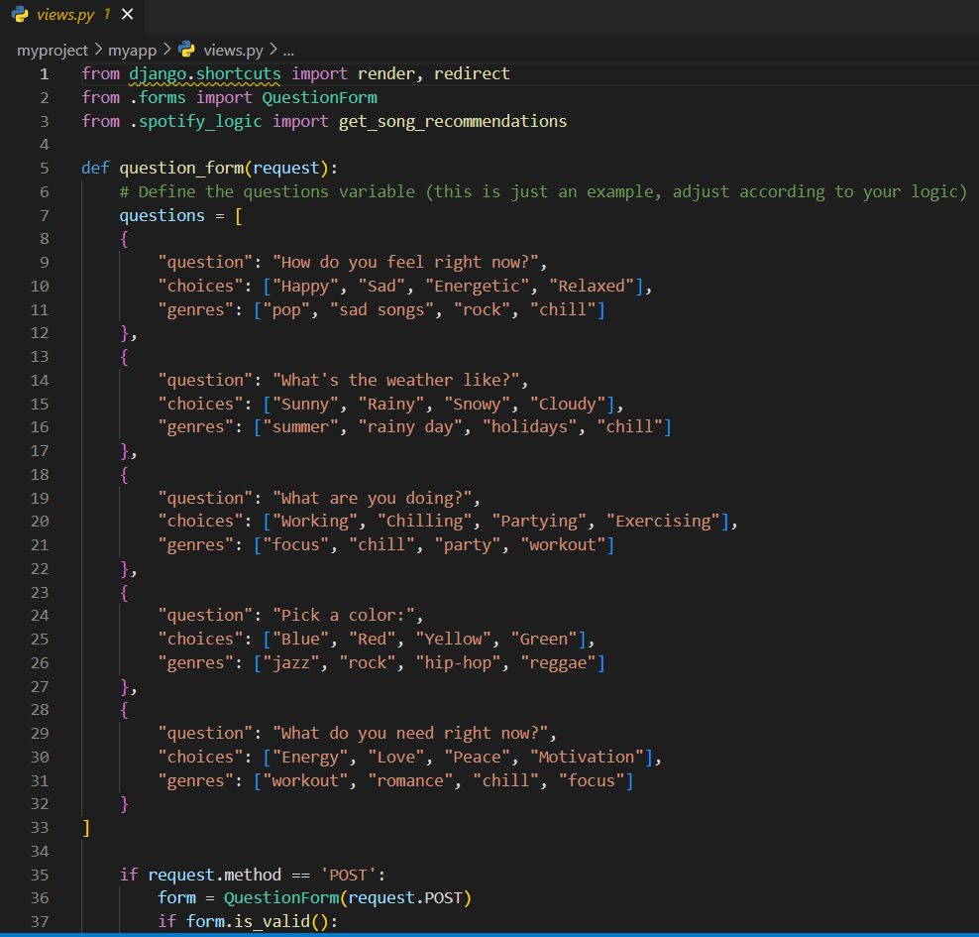
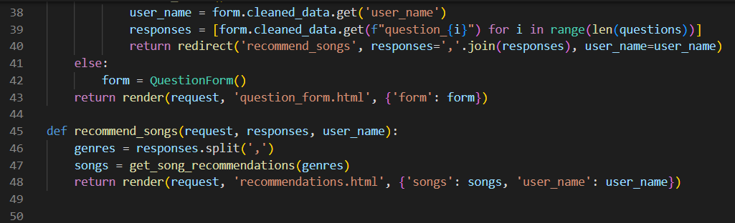
Views.py
PLAYLIST
02
views.py is a Python module that contains the functions (views) responsible for processing incoming HTTP requests, handling business logic, and returning HTTP responses. Views determine what data should be displayed to the user and how it should be presented.
Here we define a function which stores all the genres based on the respective answers.
The genres are imported from the spotify api

Slide 4
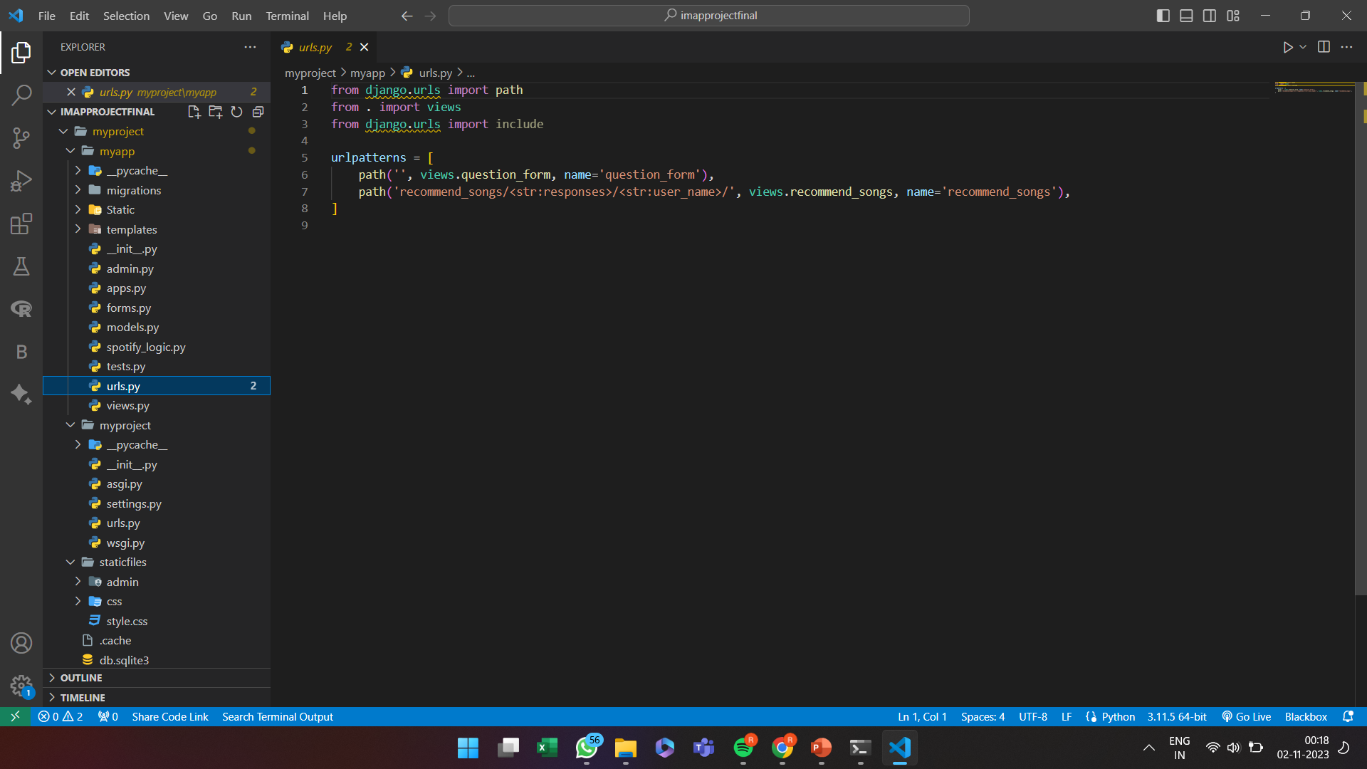
URL.py
PLAYLIST
03
urls.py file is used to define URL patterns and route incoming HTTP requests to the appropriate view functions. This file plays a crucial role in URL routing and is part of the URL configuration of your Django project

Slide 5
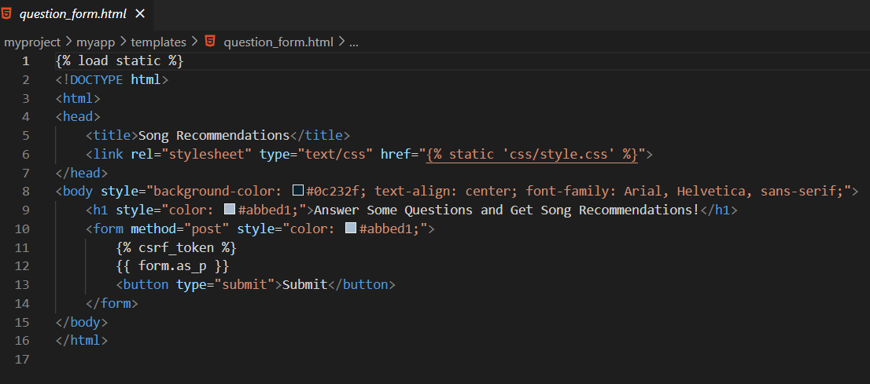
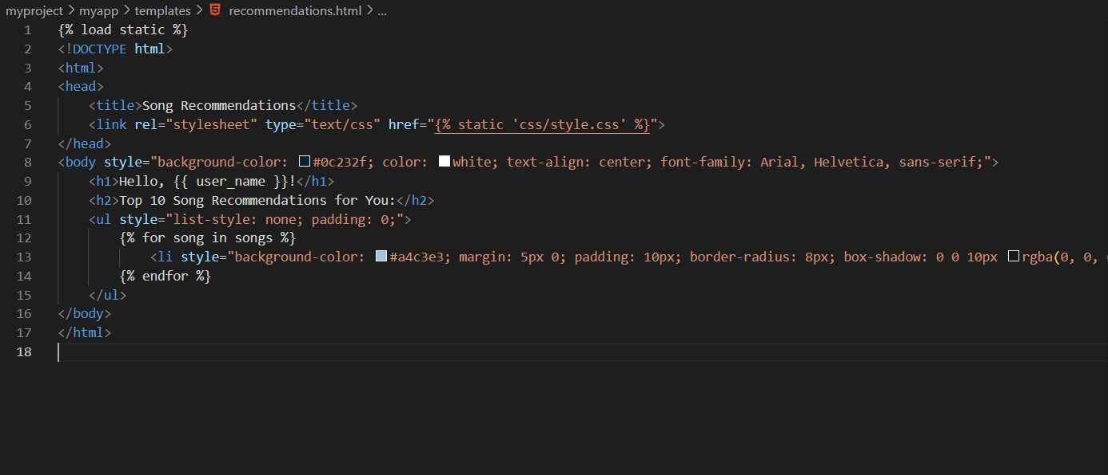
Tempelate.py
PLAYLIST
04
This is the front end of the project(html and css) and tells us how the application would be seen by the user

Slide 6
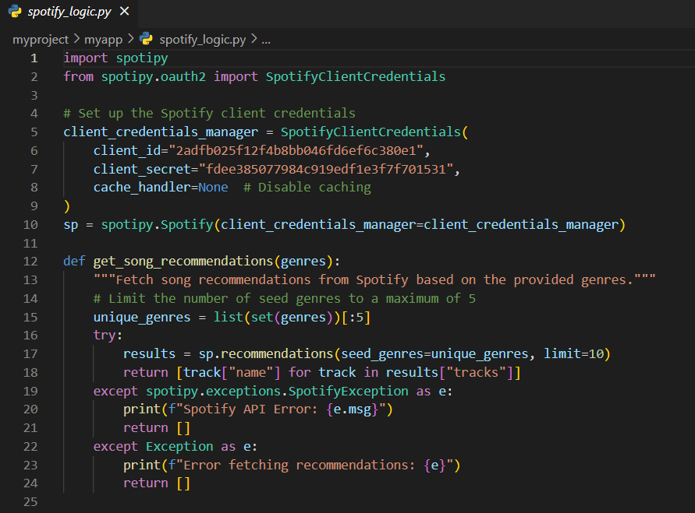
API KEY
PLAYLIST
05
We used the Spotipy library, which is a Python library for interacting with the Spotify Web API. This code sets up a connection to the Spotify API using client credentials, and it defines a function to fetch song recommendations from Spotify based on provided music genres.

