Slide 1
CAPSTONE PROJECT
Power Fault Detection Using ML
Presented By:
1. Shreyash Sunil Badve
-MIT Acadamy Of Engineering-ETX

Slide 2
OUTLINE
Problem Statement Solution
System Development Approach Algorithm & Deployment
Result (Output Image) Conclusion
Future Scope References

Slide 3
Problem Statement
The reliability of power distribution systems is critically affected by faults such as line breakages, transformer failures, and equipment overheating. Traditional fault detection methods are often slow and reactive, leading to increased downtime and compromised grid stability. The objective of this project is to develop a machine learning-based model that can accurately detect and classify different types of faults using real-time electrical and environmental data. By distinguishing between normal operating conditions and specific fault types, the model aims to enable rapid fault identification, support predictive maintenance, and enhance the overall resilience of the power grid.

Slide 4
Proposed Solution
Build a machine learning-based solution to detect faults . Use Kaggle dataset for training and testing.
Steps:
Data Collection & Preprocessing Feature Engineering
Model Selection & Training
Deployment on IBM Cloud Lite
Real-time detection with API endpoint for alerts.

Slide 5
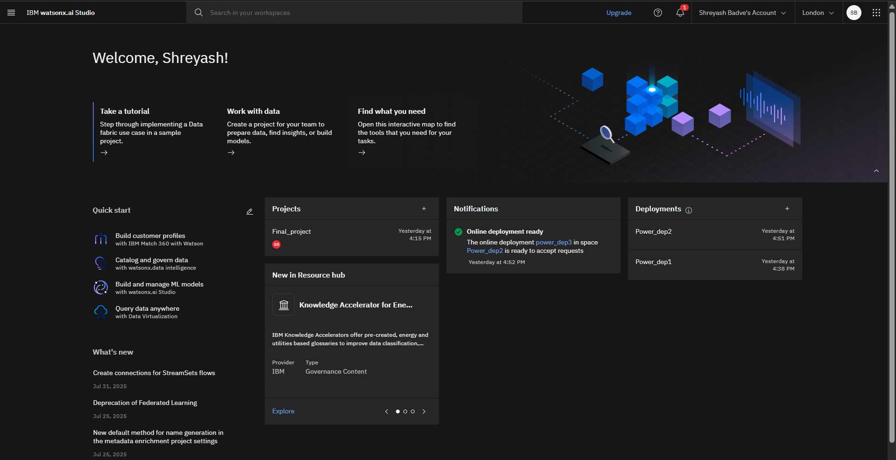
Give a name and define configuration as watsonx.ai.Runtime-jm

Slide 6
System Approach
Programming Language: Python
Libraries: Pandas, NumPy, Scikit-learn, Matplotlib, Seaborn
Machine Learning Models: Random Forest, Decision Tree, Gradient Boosting Deployment: IBM Cloud Lite (Watson Machine Learning service)
Dataset: Kaggle Network Intrusion Detection dataset

Slide 7

Algorithm & Deployment
Algorithm Selection:
Chosen models: Random Forest for classification
Reason: Handles high-dimensional data well and provides good accuracy.
Training Process:
Split dataset (70% train, 30% test)
Preprocessing: Normalize features, handle missing values Train multiple models and compare accuracy
Deployment:
Export trained model as .pkl
Deploy on IBM Watson Machine Learning
Provide REST API endpoint for real-time network data analysis

Slide 8
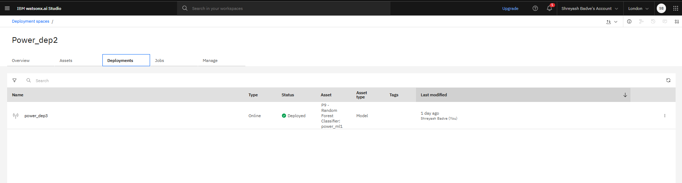
Deployment Screenshot :

Slide 9
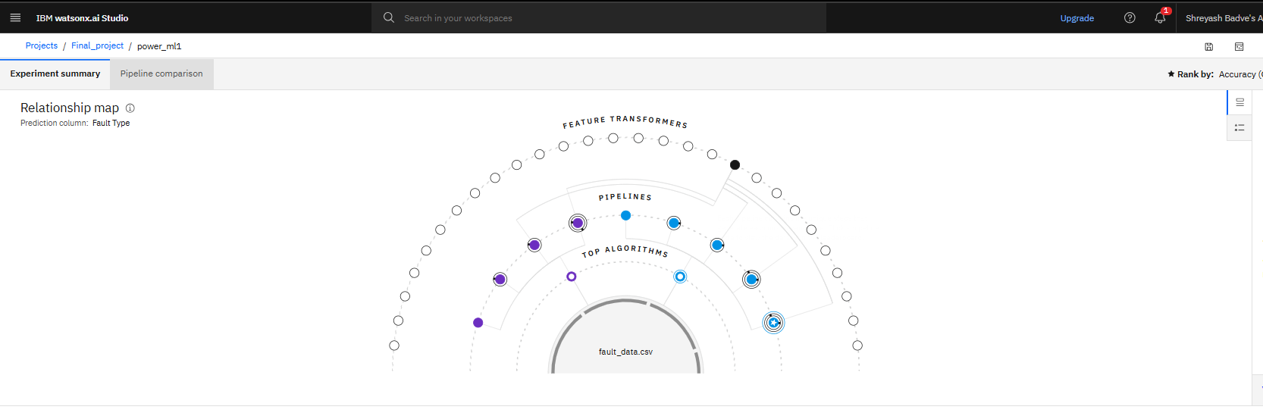
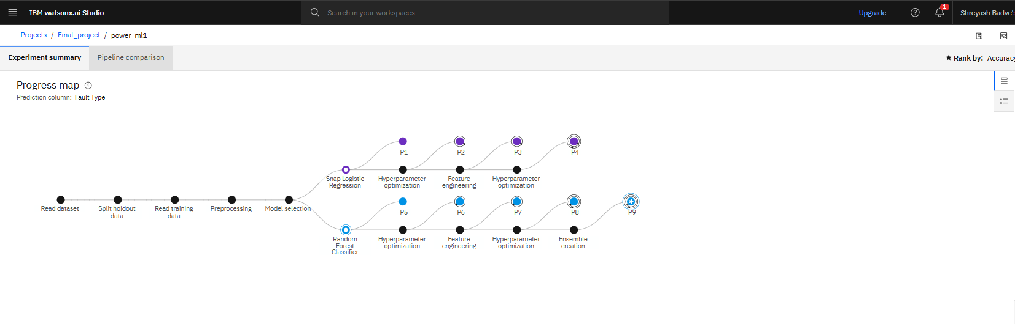

Slide 10
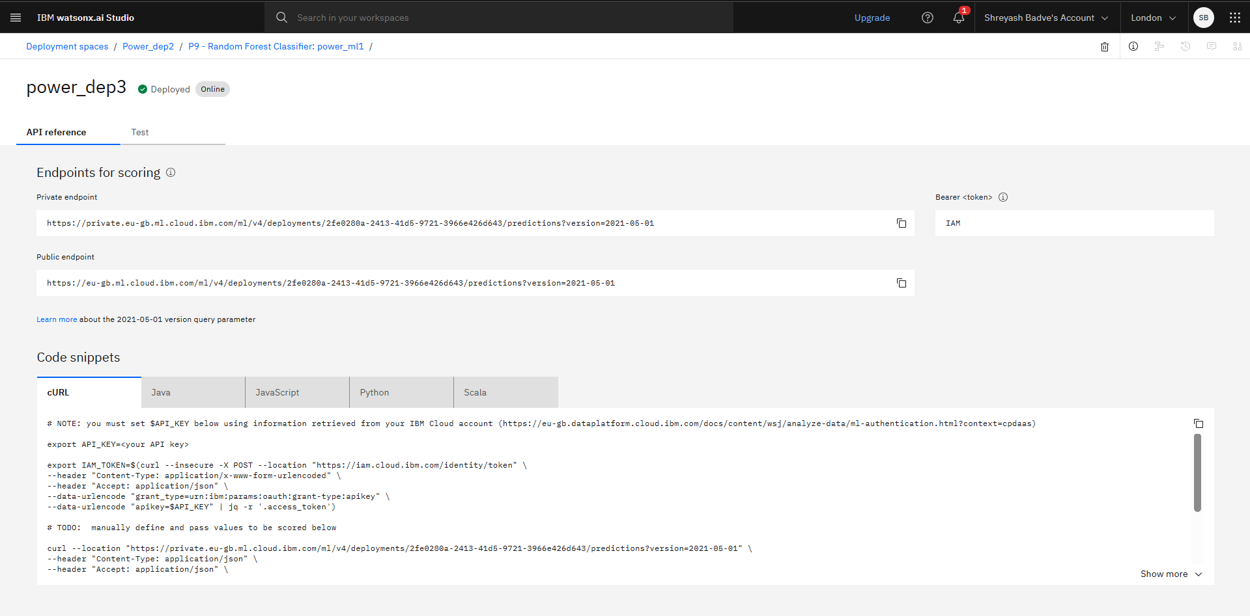

Slide 11
Result
Accuracy achieved: ~95% (Random Forest) Confusion Matrix visualization Classification report: Precision, Recall
Screenshot of IBM Cloud Deployment dashboard

Slide 12
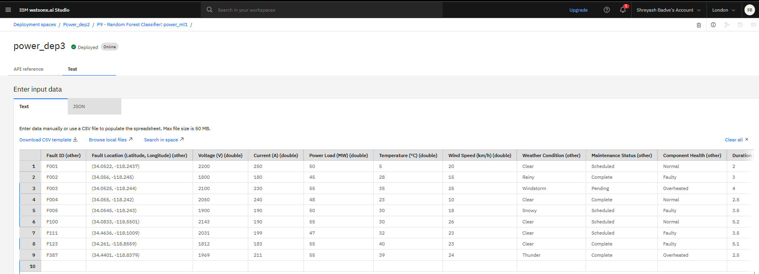
Test of model:

Slide 13
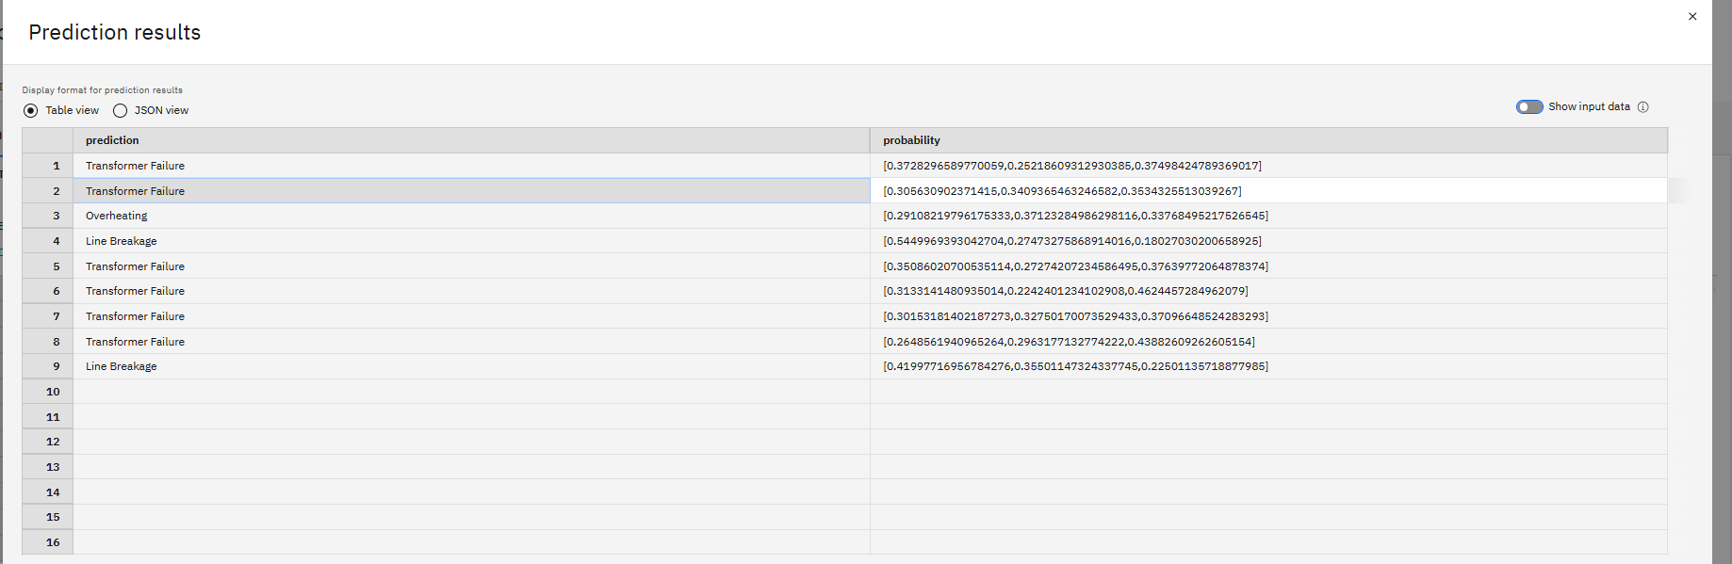
Prediction Result :

Slide 14
Conclusion
The ML model accurately classified power distribution faults using electrical and environmental data.
The system enables faster and more reliable fault diagnosis compared to manual or rule-based methods.
Deployed on IBM Cloud Lite for real-time detection capability.

Slide 15
Future scope
Integrate Deep Learning models (LSTM, CNN) for better detection Enable real-time packet sniffing and live attack alerts
Expand for IoT network security Add auto-updating threat database

Slide 16
References
Kaggle dataset:
Research papers on NIDS using ML.
IBM Cloud Lite documentation
Github: https://github.com/Shreyashbadve/power-system

Slide 17
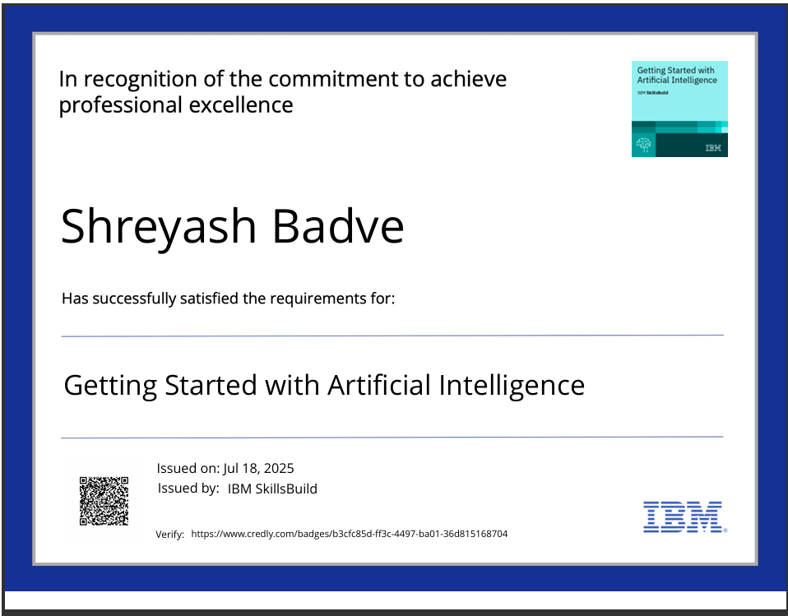
IBM Certifications
Getting Started with Artificial Intelligence :

Slide 18
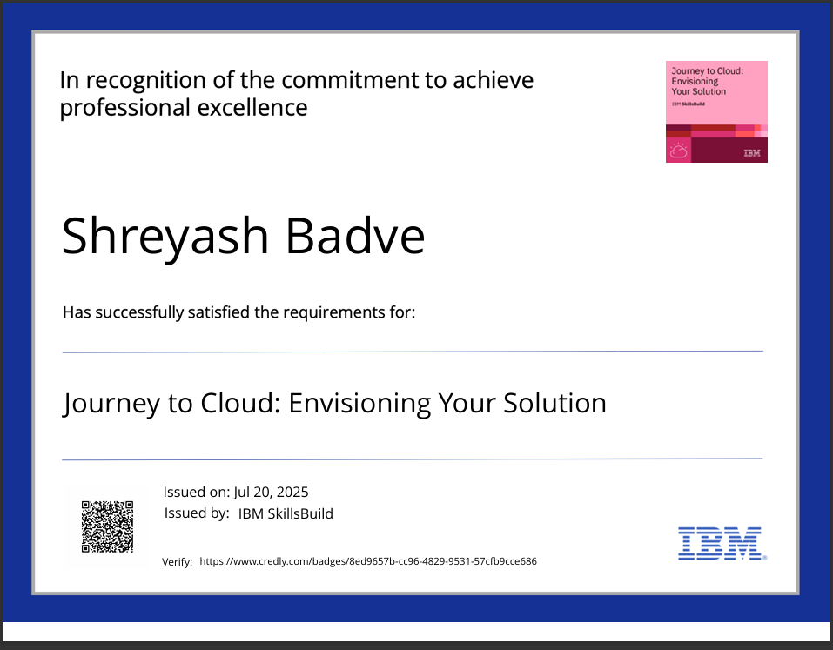
IBM Certifications
Journey to cloud :

Slide 19
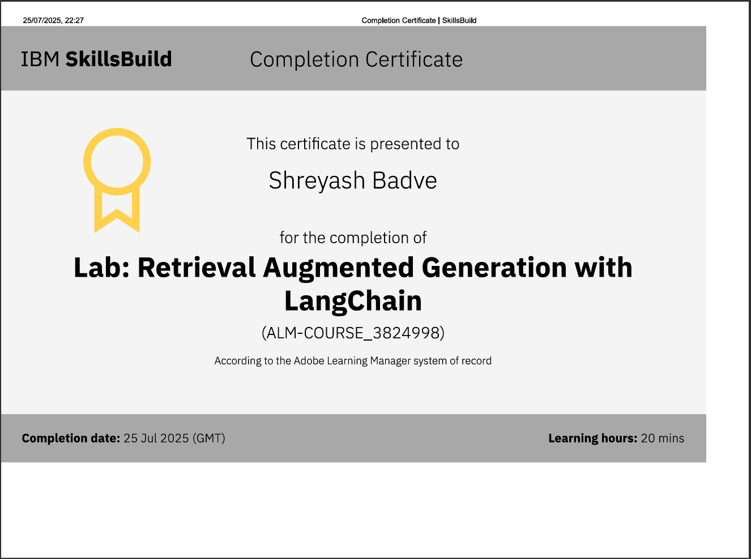
LAB : RAG COMPLETION

Slide 20
THANK YOU

