Slide 1
Analyzing Non-Point Source Pollution in Delhi
Using Export Coefficient Model with Linear and Multi-objective Programming
Shreyash Bharati
220102094
b.Shreyash@iitg.ac.in
Amaan Zaidi
220102007
z.amaan@iitg.ac.in

Slide 2
Introduction
Non-point source (NPS) pollution refers to the diffuse contamination of water bodies resulting from multiple, scattered sources rather than a single, identifiable origin. Unlike point source pollution, which can be traced to a specific location such as a factory or sewage pipe, NPS pollution originates from widespread activities like agricultural runoff, urban stormwater, and sediment erosion.
Rainfall or snowmelt often carries pollutants such as fertilizers, pesticides, oil, sediment, and nutrients like nitrogen and phosphorus into rivers, lakes, and coastal waters, leading to environmental degradation. This type of pollution is challenging to monitor and manage because it does not originate from a singular source and is influenced by weather, land use practices, and geographical conditions.
Controlling NPS pollution requires integrated approaches like sustainable land management, improved agricultural practices, and public awareness to mitigate its far-reaching impacts on ecosystems and human health.

Slide 3
Research Objectives
Develop a land-use optimization model to reduce NPS pollution. Employ empirical models to estimate TN and TP loads. Offer decision-makers alternatives for land-use adjustments.
Methods Used
Export Coefficient Model (ECM) applied to estimate TN and TP loads. Linear programming model used for effective land-use planning. Multi-objective optimization for balancing economic return and pollution reduction.

Slide 4


Export Coefficient Model
ECM can be used to estimate the total TN and TP loads produced due to NPS Pollution. Here we use export coefficients to estimate the loads generated by each land-use type.
Here, L denotes the total pollution load while Ei and Ai denote the export coefficient and area for i-th land use type respectively.
We have used a linear programming model to estimate the areas of various land-use types .The linear programming model is as specified below : -
Objective function

Slide 5


Here, BTi and Xi denote the unit economic benefit and the area of the i-th land use type.
Constraints
Ecni and Ecpi are the export coefficients for TN and TP loads for the i-th land-use type while SDn and SDp are allowable discharge amounts of TN and TP loads. By controlling the amount of SDn and SDp we can control the total pollution loads of TN and TP and thus the NPS pollution.
TA is the total area of the region available. The constraint specifies that the total area of all the regions must be less than the physically available area of the region.

Slide 6


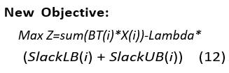
During Optimization we faced a lot of issues in implementation the bounds. We were getting infeasible solutions each time and hence we introduced slack variables SlackLBi and SlackUBi to lower the constraints on the boundedness of the area. This led to a feasible solution for the problem. Here the LBi and UBi are the specified upper and lower bounds on area Xi for the problem.
There should also be a penalty added with the introduction of the slack variables. Thus the new objective function will be :-

Slide 7


Multi-objective Model
Objective 1
Objective 2
Hence, for the multi-objective model we maximize the economic benefit and minimize the combined TN and TP loads.
The constraints for the multi-objective model include Area constraint, Lower Bound and Upper Bound constraints respectively. This constraints have been defined in the single objective model as defined above.

Slide 8
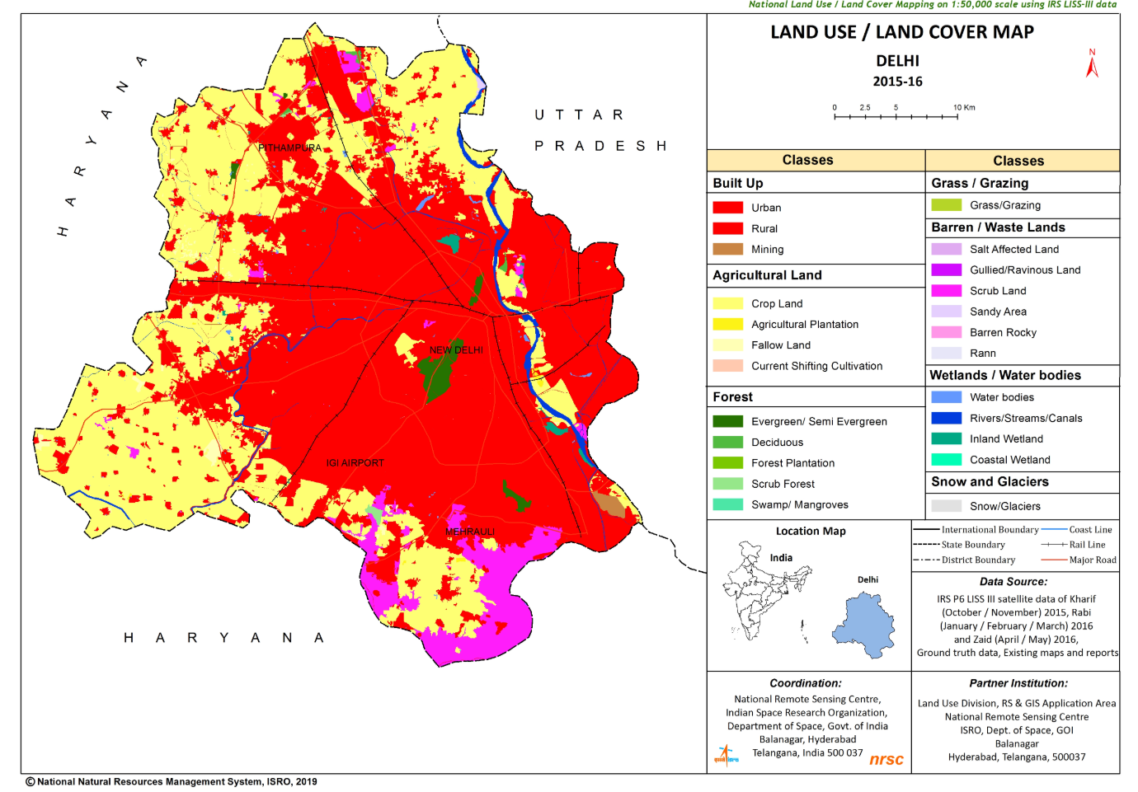
Study Area: Delhi
Delhi is a critical region located in northern India.
The average temperature is around 29 degree Celsius and the average annual precipitation is around 774.4mm. Key land-use types include agricultural land, forest land, water land, grass land, and construction land. The area covered by forests constitutes over 76% of Delhi.
Since 1960s the city’s land distribution has been majorly affected by urbanization due to Delhi being the capital of India as well as a major economic hub.
Thus, the early urbanization of Delhi has led to considerable increase in construction land area.
Agricultural land(AL) and forest land(FL) have a contribution of over more than 80% in the land use structure.
As AL is the most profitable when it comes to economic benefits, most of the GL area was converted to AL for optimizing the economic benefit.
The map of regional land distribution of Delhi was obtained through Bhuvan ISRO portal.
The areas of AL,FL,GL,WR and CL were found to be between [400, 505.28], [1353,5093.44],[0, 10],[96.16,120] and [800,1000]km², respectively.

Slide 9
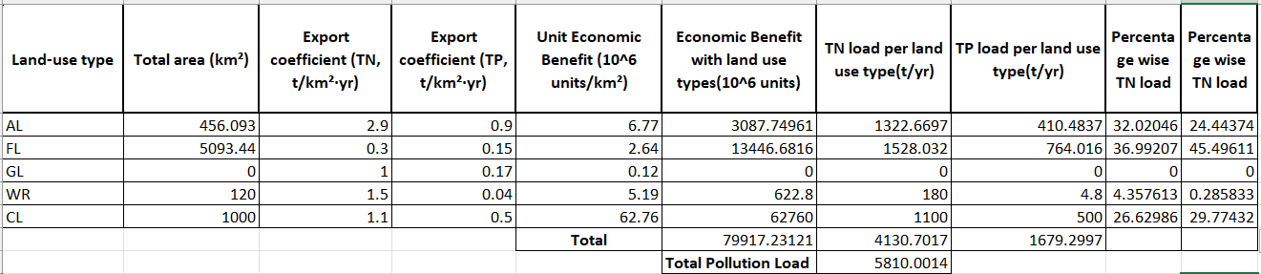
Results and Analysis
Land-Use structure in Base year
In the above table as we can see, in the base year (2015-16) the TN and TP loads were 4130.7 and 1679.3 t/yr. FL and AL are mostly responsible towards the generation of the TN and TP loads. Almost 70% of the total TN and TP pollution loads are generated due to FL and AL. The use of GL was negligible in the base year. The above analysis indicates that the planning of FL and AL areas is crucial in reducing the NPS pollution loads as well as increasing the economic benefit.
Thus, the above analysis indicated that reducing the area of FL may help in reducing the pollution loads. Also the area of AL needs to be reduced. But due to large economic benefit due to AL, considerable decrease in AL land area may lead to loss in the economic benefit.
In the next analysis, we have considered 4 optimization scenarios where we have increased the pollution reduction constraints i.e. we have reduced the SDn and SDp values by 5%, 10%, 15%, 20%.

Slide 10
Land-Use structure after Optimization
Thus, as we can see from the graph alongside that the increase in optimization of pollution loads causes a considerable decrease in the area of FL.
While the area of AL decreases across various optimization scenarios, there is not a considerable change in it. If we observe the area of AL decreases only by 12.3% while the area of FL decreases by 40.5% while going from the base year towards 20% pollution reduction.
Thus, we can observe that our previous hypothesis for the land-use area structure has proven to be true as there is a considerable decrease in FL area as it contributes most towards total area and the corresponding decrease in the area of AL is negligible as it contributes the most towards economic benefit.
Also we can observe that the contribution of GL towards both pollution reduction and economic benefit maximization is negligible.
The area of WR reduces by 19.8% which is more than the decrease in the area of AL as it has a lower value of unit economic benefit.
The area of CL remains the same and maximum due to the highest and most significant contribution of CL towards economic benefit.

Slide 11
Analysis of Pollution loads and total economic benefits
From the given TN, TP vs optimization scenarios graph we can see that the pollution loads decrease with increase in pollution reduction constraints.
Thus, we have successfully obtained the required optimization results i.e. we have decreased the pollution loads with increase in optimization conditions and parameters.
Thus, from the graph of economic benefit for various optimization scenarios we can see that the economic benefit falls as we increase the constraints on pollution reduction.
This is bound to happen as the increase in pollution reduction causes decrease in land areas which ultimately reduces the economic benefit.

Slide 12
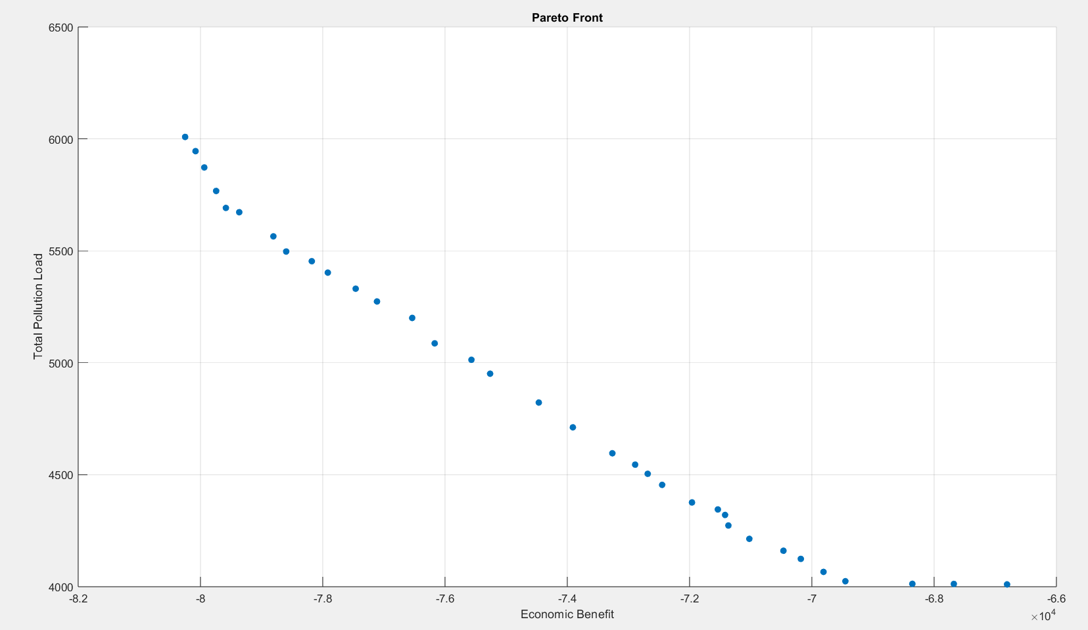
Analysis of NPS Pollution with Multi-objective Optimization
From the analysis of the pareto front obtained we can conclude that Economic benefit and total pollution load are inversely related.
Increase in the pollution reduction constraints causes a decrease in the economic benefit and vice versa.
Also, if we want to provide analysis of Pollution load with Economic Benefit plotting the pareto front is much better than manually reducing the SDn and SDp values for each linear programming scenario and then performing the calculations.
Also using pareto front we can observe the points and analyse the solutions where we can obtain maximum economic benefit and minimum pollution loads.
From our analysis both the parameters will not reach their respective optima simultaneously but selecting some point in the middle of the pareto front may provide a feasible and considerably optimal solution.

Slide 13
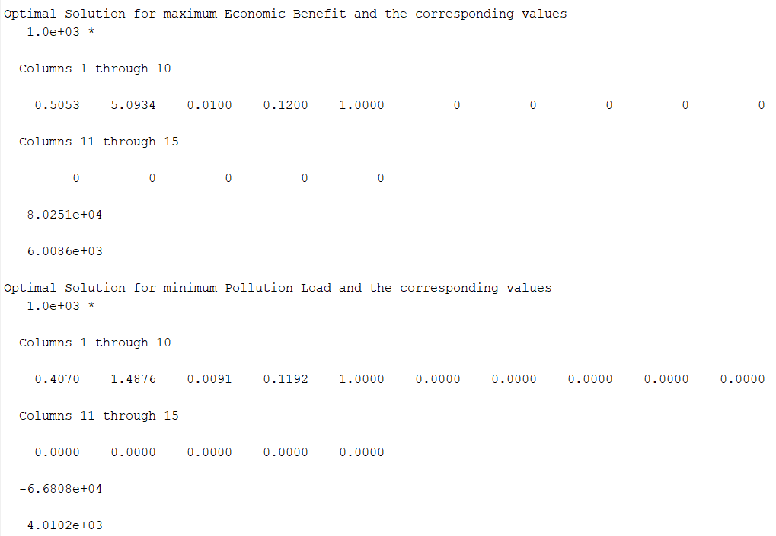
For maximum economic benefit, we obtain a solution we value of AL area slightly higher than base year AL area. The maximum economic benefit is 80251 units which is higher than the maximum of all economic benefits obtained through single objective linear programming techniques.
While economic benefit is higher for this solution the pollution load value is also quite high i.e. 6008.6 t/yr. This value is slightly higher than the maximum value of pollution load obtained through previous analysis i.e. 5810 t/yr.
The solution with minimum pollution load has a very low economic benefit of 66808 units but the pollution load is 4010.2 t/yr.
The pollution load is less than the minimum of all the pollution loads obtained through previous analysis i.e. 4632.5 t/yr.
Also, a significant decrease has been made in the FL area to reduce the pollution loads.

Slide 14
Conclusions
References
For reducing pollution reduction significant reduction in FL area is necessary and CL area should be maximized for increasing the economic benefit.
Simultaneous optimization of economic benefit and pollution load is unattainable. A multi-objective approach helps decision-makers prioritize strategies and hence reach to an optimum solution according to the parameters, conditions and physical constraints of the problem at hand. Policy makers of Delhi can use the benefits of such case studies in order to design optimum mathematical models to optimize the economic benefit as well as reduce pollution load due to NPS pollution. Pollution is already a major issue and an area of core interest for Delhi
Research articles and data were referenced from the Export Coefficient Model documentation.
Data about land use was sourced from Bhuvan ISRO portal.
Referential cases studied include previous analyses conducted in Xinfeng County.
Research paper by Shuwa Zhu and Jingni Zeng on Export Coefficient Based Linear Programming Model for Regional Land-Use Optimization Considering Control of Non-Point Source Pollution

Slide 15
Thank you!
Questions

