Slide 1
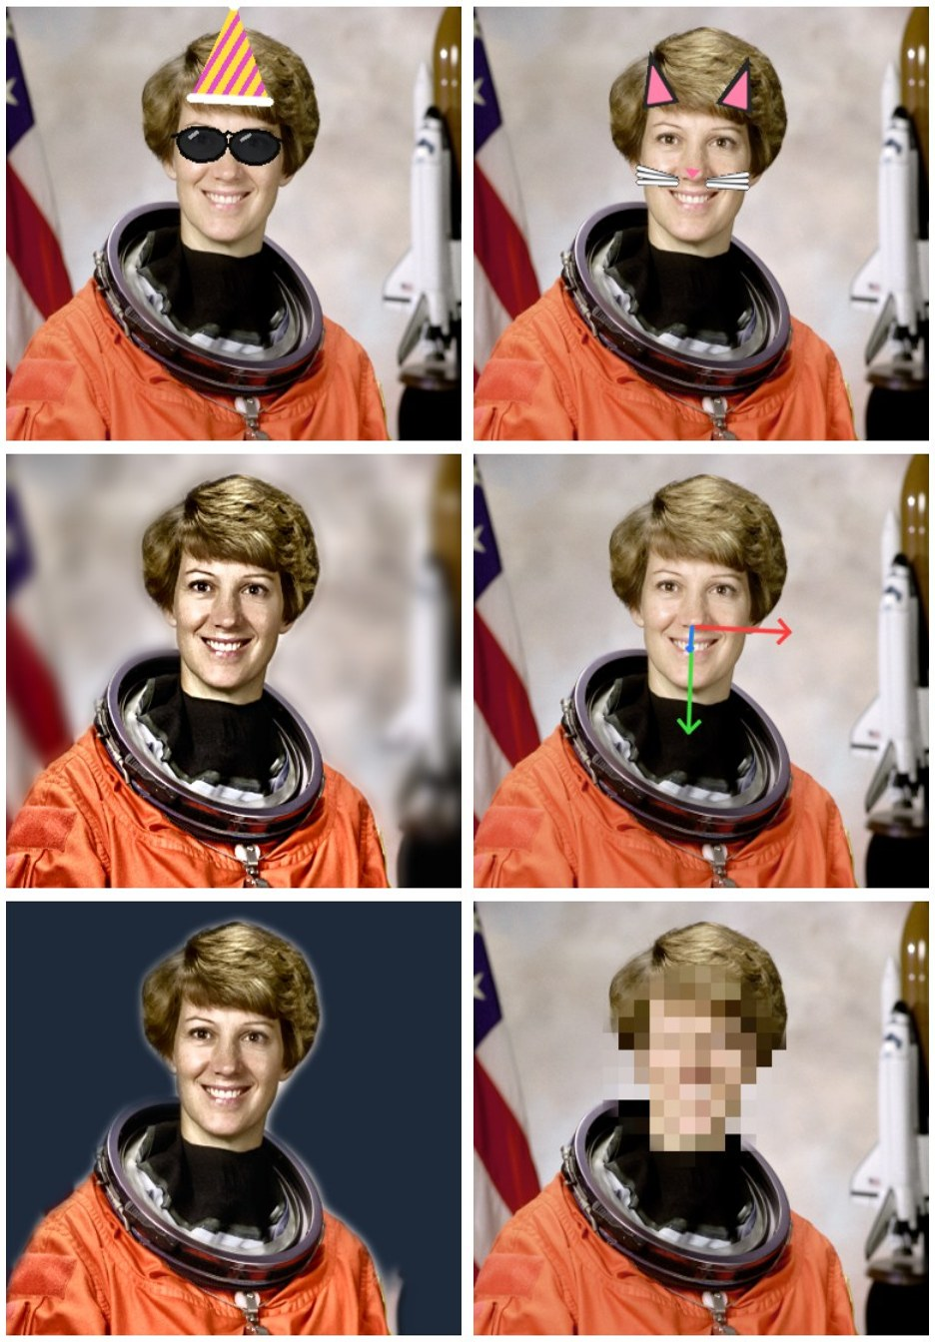
IPCV PROJECT · SECTION D · TEAM NO. ___
Face Studio Camera
A real-time photo and live-camera studio built from classical image processing and deep-learning face analysis
Anmol
20231129
Vansh Gupta
20233303
Shreyash Kumar Dube
20233567
Sparsh Singh
20233277
Notes:
Sparsh opens. Introduce the team and the topic: Face Studio Camera, a studio app combining OpenCV image processing with MediaPipe face analysis. Say that the demo runs fully offline on this laptop.

Slide 2



Every camera effect is an IPCV pipeline in disguise
MOTIVATION
Portrait mode
Beauty filters
AR lenses
Person segmentation, a feathered mask and alpha compositing over a blurred copy
An edge-preserving bilateral filter, applied only inside a landmark-built skin mask
478 facial landmarks define a face frame, so overlays follow position, size and tilt
Notes:
Sparsh: our goal was to rebuild familiar camera features from the techniques in this course, so each one can be explained and measured. Objectives: a stackable pipeline, face-aware effects, objective metrics, live video, and an interactive lab.

Slide 3
Three models run once; seven stages reuse their output
ARCHITECTURE
BlazeFace, multi-scale
FaceLandmarker
Selfie segmenter
Face boxes + 6 keypoints
478 3-D landmarks per face
Per-pixel person mask
Computed once per image and cached, so moving a slider re-runs only the cheap stages
1
2
3
4
5
6
7
Enhance
Beauty
Background
Style
Finishing
AR overlay
Privacy
Output: PNG / JPEG, batch ZIP or live video, with PSNR, SSIM, histograms and per-stage timing
Notes:
Sparsh: one pipeline object powers the Studio tab, batch mode, live video and the benchmark script. No stage moves pixels geometrically, so landmarks, mask and boxes stay valid through every stage. Stages always run in this order, so effects stack predictably.

Slide 4
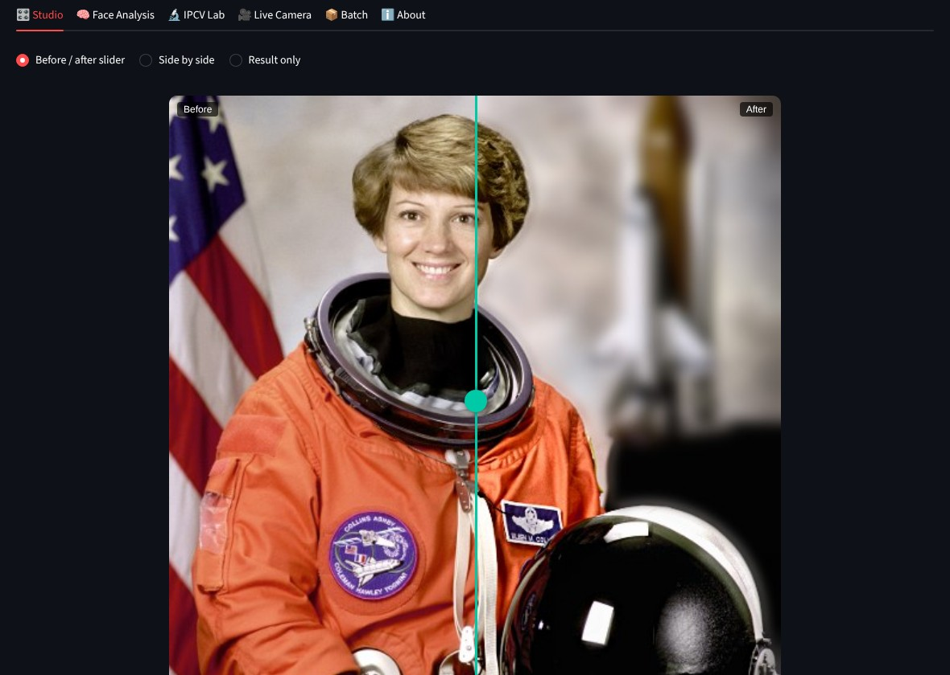
Stackable edits with a before/after slider
STUDIO · ANMOL
Brightness (HSV V), contrast, gamma LUT, unsharp mask, warmth
One-click CLAHE auto-enhance on the L channel of LAB
7 presets and Reset drive every slider
Metrics panel: PSNR, SSIM, histograms, timing
Notes:
Anmol: demo here. Pick Sample image, click Portrait Pro, drag the slider. Then Reset and move Brightness, Contrast and Gamma. Open Results and metrics to show PSNR, SSIM and the histograms.

Slide 5
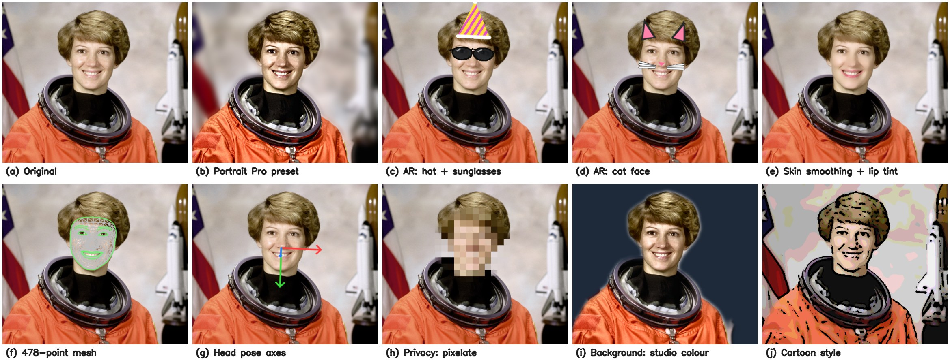
Segmentation and landmarks drive every face-aware effect
FACE EFFECTS · SHREYASH
Background: O = αI + (1 − α)B with a feathered person mask
Beauty: bilateral filter inside the skin mask; lips and eyes recoloured in HSV
Privacy: blur, pixelate or eye-bar every detected face
Notes:
Shreyash: demo Background blur, then Custom image with your own backdrop photo. Then AR Sunglasses plus Party Hat, Beauty skin smoothing with lip tint, and Privacy Pixelate. Explain that the skin mask is the face oval minus the eyes, brows and lips, so those stay sharp.

Slide 6
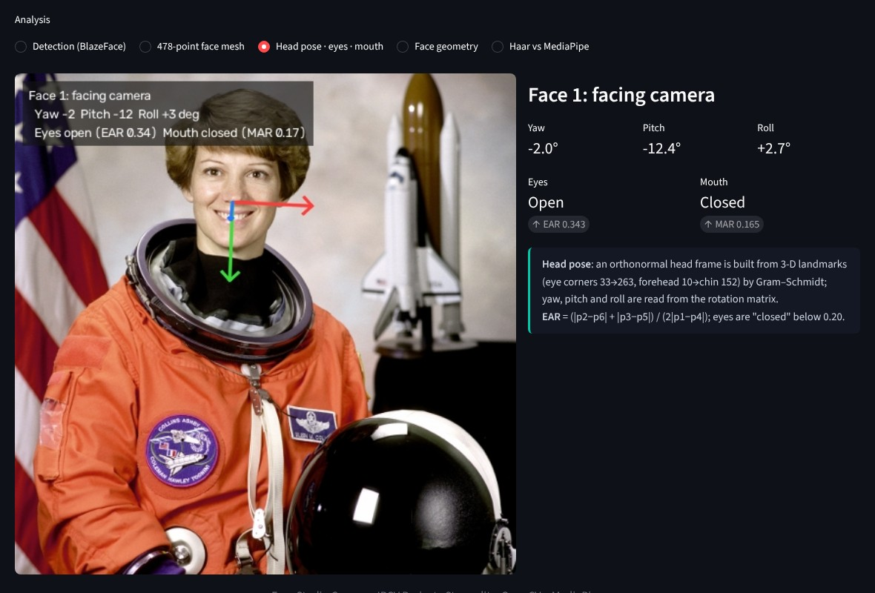
Landmarks give a face frame, head pose and blink test
FACE GEOMETRY · VANSH AND SHREYASH
AR face frame
Origin at the eye midpoint, unit = inter-ocular distance d: p = origin + d(u·e1 + v·e2)
Head pose
Gram–Schmidt on eye-corner and forehead-to-chin vectors gives a rotation matrix: yaw, pitch, roll
Eye aspect ratio
EAR = (|p2−p6| + |p3−p5|) / (2|p1−p4|); below 0.20 = closed
Notes:
Vansh: open Face Analysis, Head pose · eyes · mouth. Explain the head frame and EAR. In the live demo, the blink counter uses EAR: two or more closed frames followed by an open frame count as one blink.

Slide 7
Tiling lifted BlazeFace from 2 to 16 of 20 faces
RESULT 1 · FACE DETECTION · VANSH
2/20
16/20
20/20
BlazeFace, single pass
BlazeFace, multi-scale
Haar cascade
Whole frame at 128×128: a 40 px face shrinks to about 6 px
2×2, 3×3, 4×4 tiles, confidence ≥ 0.6, non-maximum suppression
Strong on these upright, frontal test faces
8 images (7 CMU/MIT test images from OpenCV test data + NASA portrait), 20 faces; no false boxes; every box checked by eye · benchmark.py
Notes:
Vansh: our first finding surprised us. The short-range BlazeFace model is designed for selfies, so it missed small faces in group photos. We added multi-scale tiling with non-maximum suppression. Demo: Face Analysis, Detection on a group photo, then untick Multi-scale in the sidebar to show the difference.

Slide 8
Haar loses rotated faces; BlazeFace loses heavy noise
RESULT 2 · ROBUSTNESS · VANSH
5 of 12 tested conditions shown; all 12 are in the report (Figure 2) and in docs/results/robustness.csv
Notes:
Vansh: we degraded each test image 12 ways. Haar’s rectangle features are trained on upright faces, so at 30° it found every face in only 1 of 7 images; BlazeFace found them in 6. Haar did better under heavy noise and darkness. Demo: Haar vs MediaPipe, Run robustness test.

Slide 9
One BlazeFace pass is about 30× faster than Haar
RESULT 3 · SPEED AND QUALITY · ANMOL
5 ms
13.5 ms
46 dB
BlazeFace, one pass, against 150 ms for Haar
Person segmentation per 512×512 frame
PSNR after skin smoothing (SSIM 0.998): a subtle, local edit
Background replacement scores 9.8 dB because it rewrites half the frame. Greyscale scores SSIM 1.000 because SSIM uses luminance only: these metrics measure change, not quality.
4-core CPU, no GPU · 512×512 sample image · mean of 10 runs · benchmark.py
Notes:
Anmol: timings are from a 4-core CPU without a GPU; on our laptop the live window shows its own FPS. Explain PSNR and SSIM, and why greyscale gets SSIM 1.000.

Slide 10
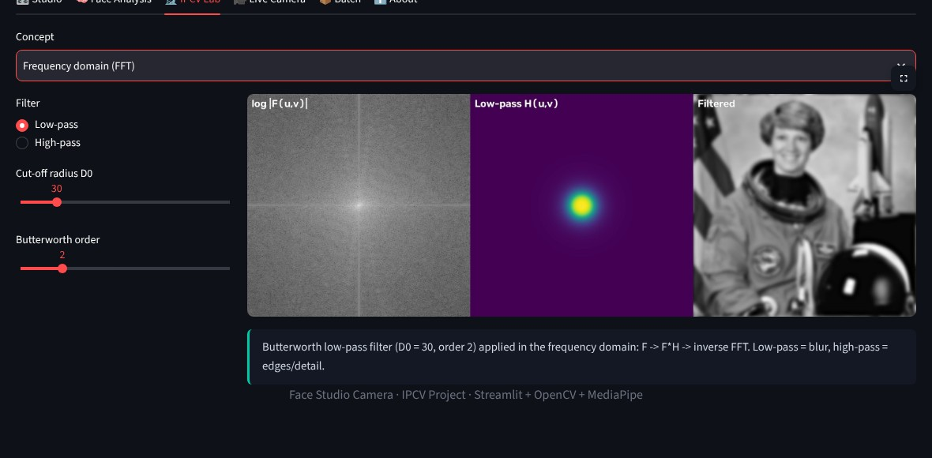
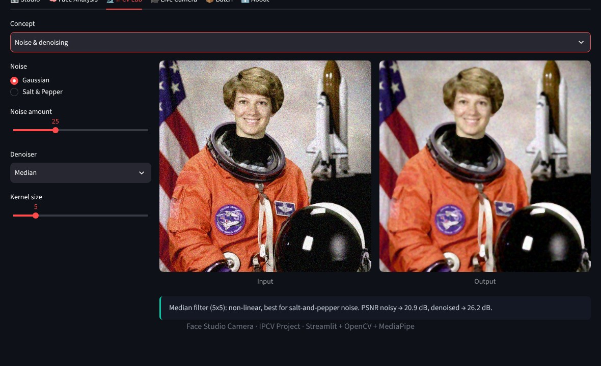
The syllabus, live, on the same photo
IPCV CONCEPTS LAB · SPARSH
Colour spaces
Equalisation and CLAHE
Noise and 5 denoisers
Sobel · Prewitt · Canny
Otsu and adaptive threshold
6 morphology operations
FFT low/high-pass
Affine transforms
Notes:
Sparsh: demo the FFT high-pass, then Noise and denoising: salt and pepper with a median filter versus a Gaussian filter, and point at the PSNR it prints. Then Morphology opening.

Slide 11
LIVE DEMO · SPARSH
15 effects on the live webcam
AR overlays, head pose with a blink counter, privacy blur, portrait mode and more, all on the laptop CPU with an on-screen FPS counter
1 · Sunglasses
5 · Head pose + blinks
8 · Privacy blur
0 · Portrait mode
s · Snapshot
Notes:
Sparsh: switch to terminal 2 and run python live_camera.py. Press 1 for sunglasses, 5 for head pose (blink a few times to show the counter), 8 for privacy blur, 0 for portrait mode. Then go back to the browser and show the Batch tab: upload three photos, process, download the ZIP. If the camera fails, switch to the Studio tab with a sample image.

Slide 12
Four members, four modules
TEAM CONTRIBUTIONS
Anmol 20231129
Vansh Gupta 20233303
Enhancement filters, the 7-stage pipeline, presets, quality metrics (PSNR, SSIM, histograms)
Multi-scale face detection, 478-point mesh, head pose and blinks, Haar vs MediaPipe benchmark
Shreyash Kumar Dube 20233567
Sparsh Singh 20233277
Segmentation and backgrounds, AR overlays, skin smoothing, lip and eye tint, privacy filters
IPCV Concepts Lab, live camera, batch mode, user interface, testing and documentation
Notes:
Each member states their own part in one sentence. Instruction 1 of the notice requires every member’s contribution to be explained.

Slide 13
Classical IPCV and three small models, in real time
CONCLUSION
Compute once, reuse in 7 stages: fast and explainable
BlazeFace beats Haar on rotation and speed
Tiling fixes small faces: 2 to 16 of 20
Limitations
Tiny dark faces still missed; extra boxes under heavy noise; soft hair edges; 8 test images only
Future work
Full-range detector, temporal smoothing of live landmarks, hair matting, a large labelled test set
Thank you · Questions?
Notes:
All: wrap up in 30 seconds, then take questions. Likely questions and short answers are in docs/DEMO_SCRIPT.md: why not Haar, how portrait mode works, how the glasses are placed, head pose, EAR, SSIM, limitations.

