Slide 1
Sign Language Translator App
Gesture recognition, backend processing and database management for barrier-free communication

Slide 2
Abstract
A system that reduces the communication gap between sign language users and people who do not understand sign language
A camera captures hand gestures, and computer vision with machine learning identifies the sign
The recognized sign is converted into understandable text or speech
A backend validates requests, performs translation and talks to the database; SQL, normalization, ACID transactions and indexing keep data reliable and fast

Slide 3
Problem Statement
1.5 billion
70 million
300+
people live with some degree of hearing loss (WHO)
deaf people use sign language as a first language (WFD)
sign languages exist, each with its own grammar
Few hearing people know sign language, creating a daily communication gap
Human interpreters are costly and rarely available in hospitals, banks and offices
Most digital services are text-first and exclude many deaf users

Slide 4
Objectives
Recognize hand gestures accurately from a live camera feed
Convert recognized signs into readable text and speech
Provide a reliable backend for validation and translation requests
Store users, signs, translations and history in a well-designed database
Build a system that is scalable to more signs, users and languages

Slide 5
Proposed Solution
A web-based application that translates sign language into text and speech in real time.
Gesture Recognition
Backend Processing
Database Management
Computer vision and machine learning detect and classify hand gestures
Validates input, runs translation and manages user requests
SQL database stores users, signs, results and history

Slide 6
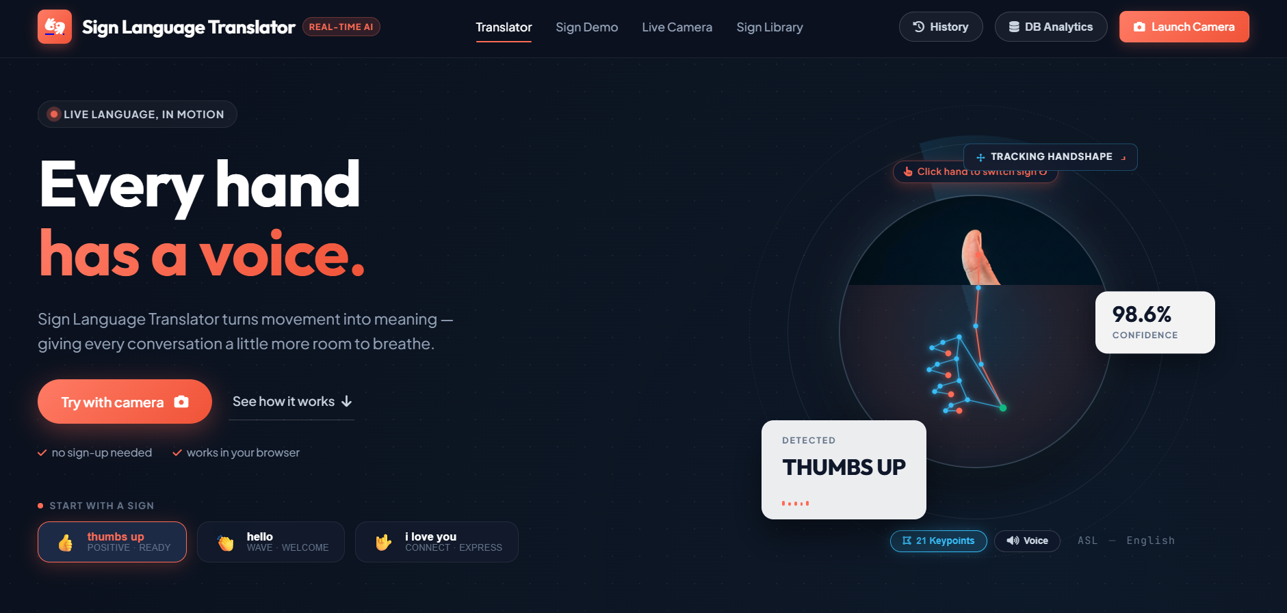
Application Overview
Real-time AI translator, ASL to English
Tracks 21 hand keypoints live
Shows detected sign with 98.6% confidence
Voice output for every sign
No sign-up needed, works in the browser
Live web app: sign-ai-web.onrender.com

Slide 7
System Architecture
Live Camera
Hand Tracking
Classifier
Backend API
SQL Database
Output
Browser video feed
21 keypoints per hand
Sign, match %, stability
Validation and logic
Logs, sync, analytics
Text and speech
Data flows left to right: every request is validated by the backend, processed by the model and recorded in the database.

Slide 8
Methodology
1
2
3
4
5
Capture
Detect
Classify
Translate
Store
Camera records hand movements as frames
21 hand keypoints are extracted from each frame
Classifier returns the sign with confidence
Backend converts the sign to text or speech
Result and history saved in the database

Slide 9
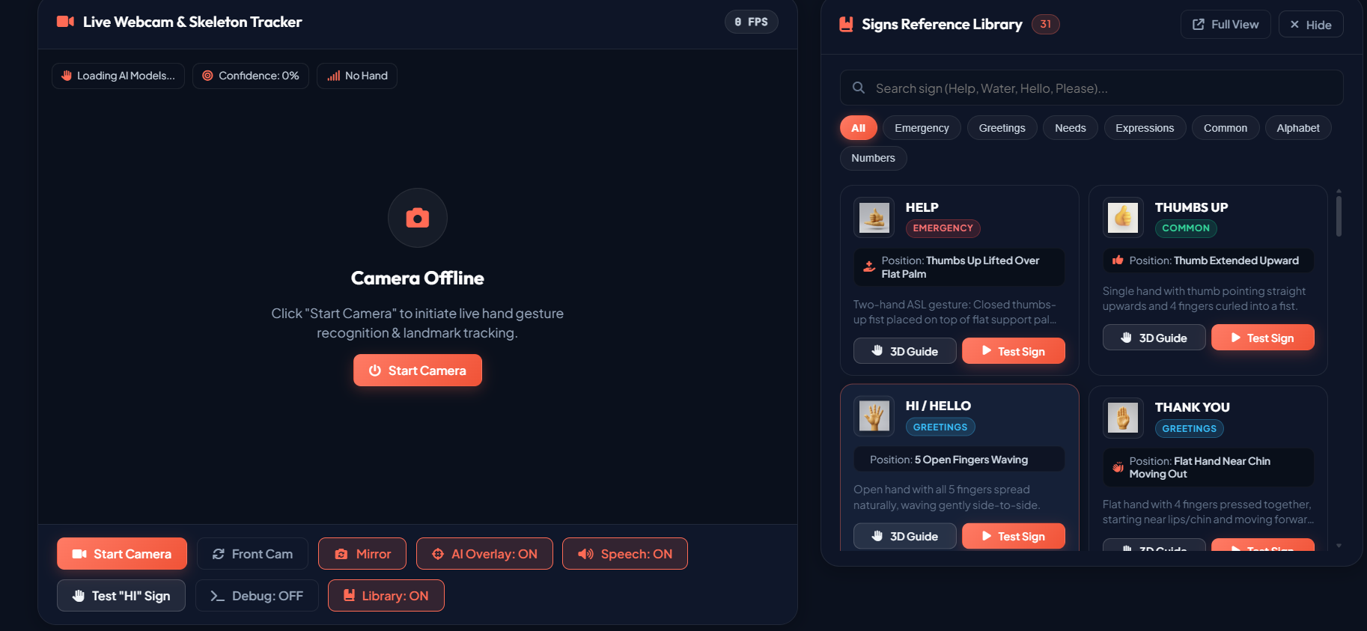
Live Translation Demo
AI Overlay draws hand keypoints on the camera feed
Detected Translation shows sign, category, match % and stability %
Recognition Confidence bar updates live (98% for Thumbs Up)
Controls: Mirror, Front Cam, Speech, Debug, Library
Sign Library cards: 3D Guide and Test Sign
Library covers Common, Daily Needs and Expressions signs

Slide 10
Key Features
Real-Time Recognition
Hand Tracking Overlay
Sign Library
Sign, match % and stability % shown live
21 keypoints drawn on the camera feed
Categories with 3D Guide and Test Sign
Sentence Builder
Translation History
DB Analytics
Joins signs into a sentence with speech
Time, confidence and DB sync status
Dedicated page for logged data

Slide 11
Technology Stack
Frontend
HTML, CSS, JavaScript, camera access
AI / ML
Computer vision and deep learning
Backend
Python API for requests and translation
Database
SQL relational database
Deployment
Hosted on Render (sign-ai-web.onrender.com)

Slide 12
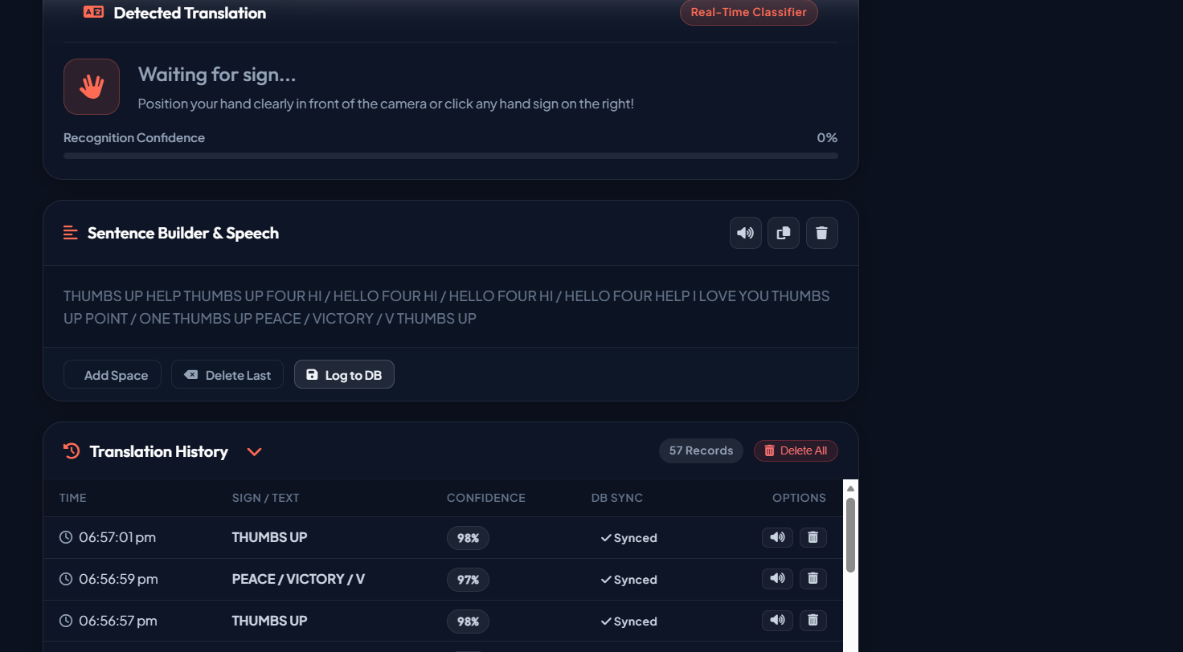
Sentence Builder and History
Sentence Builder joins recognized signs into a sentence
Speak, copy or clear the sentence; Add Space, Delete Last
Log to DB saves results to the database
History table: time, sign, confidence and DB sync status
57 records logged in our test run, each with play and delete options

Slide 13
Database Design
Users
Signs
Translations
History
user_id (PK)
name
email
created_at
sign_id (PK)
label
category
translation_id (PK)
user_id (FK)
sign_id (FK)
output_text
confidence
created_at
history_id (PK)
user_id (FK)
translation_id (FK)
viewed_at
Proposed relational schema

Slide 14
DBMS Concepts Applied
SQL
Normalization
Create, update, retrieve and manage records for users, signs and results
Reduces data redundancy and prevents update anomalies
ACID Transactions
Indexing
Keep data consistent when several operations run together
Speeds up frequently executed queries such as history lookup

Slide 15
Industry Applications
Education
Healthcare
Deaf students and teachers communicate in classrooms
Patients explain symptoms without an interpreter
Customer Service
Public Services
Banks, retail and help desks serve deaf customers
Government counters, transport and emergency help

Slide 16
Challenges and Future Scope
Challenges
Future Scope
Lighting and camera quality
Variation between signers and regions
Facial expressions carry meaning
Need for large training data
Larger vocabulary and sentences
Regional sign languages such as ISL
More languages and scalable services
Native Android and iOS apps

Slide 17
Conclusion
Combines gesture recognition, backend processing and database management in one solution
Gives deaf and hearing users a reliable, user-friendly way to communicate
Tested live with 97-98% recognition confidence and 57 logged records
Ready to grow with more signs, users, languages and services

Slide 18
Thank You

