Slide 1


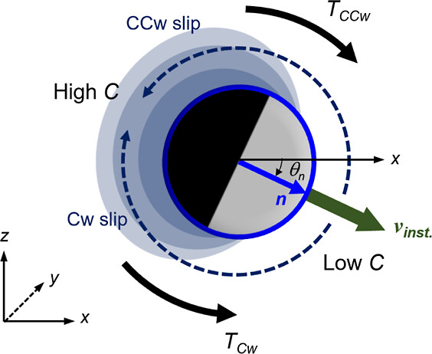
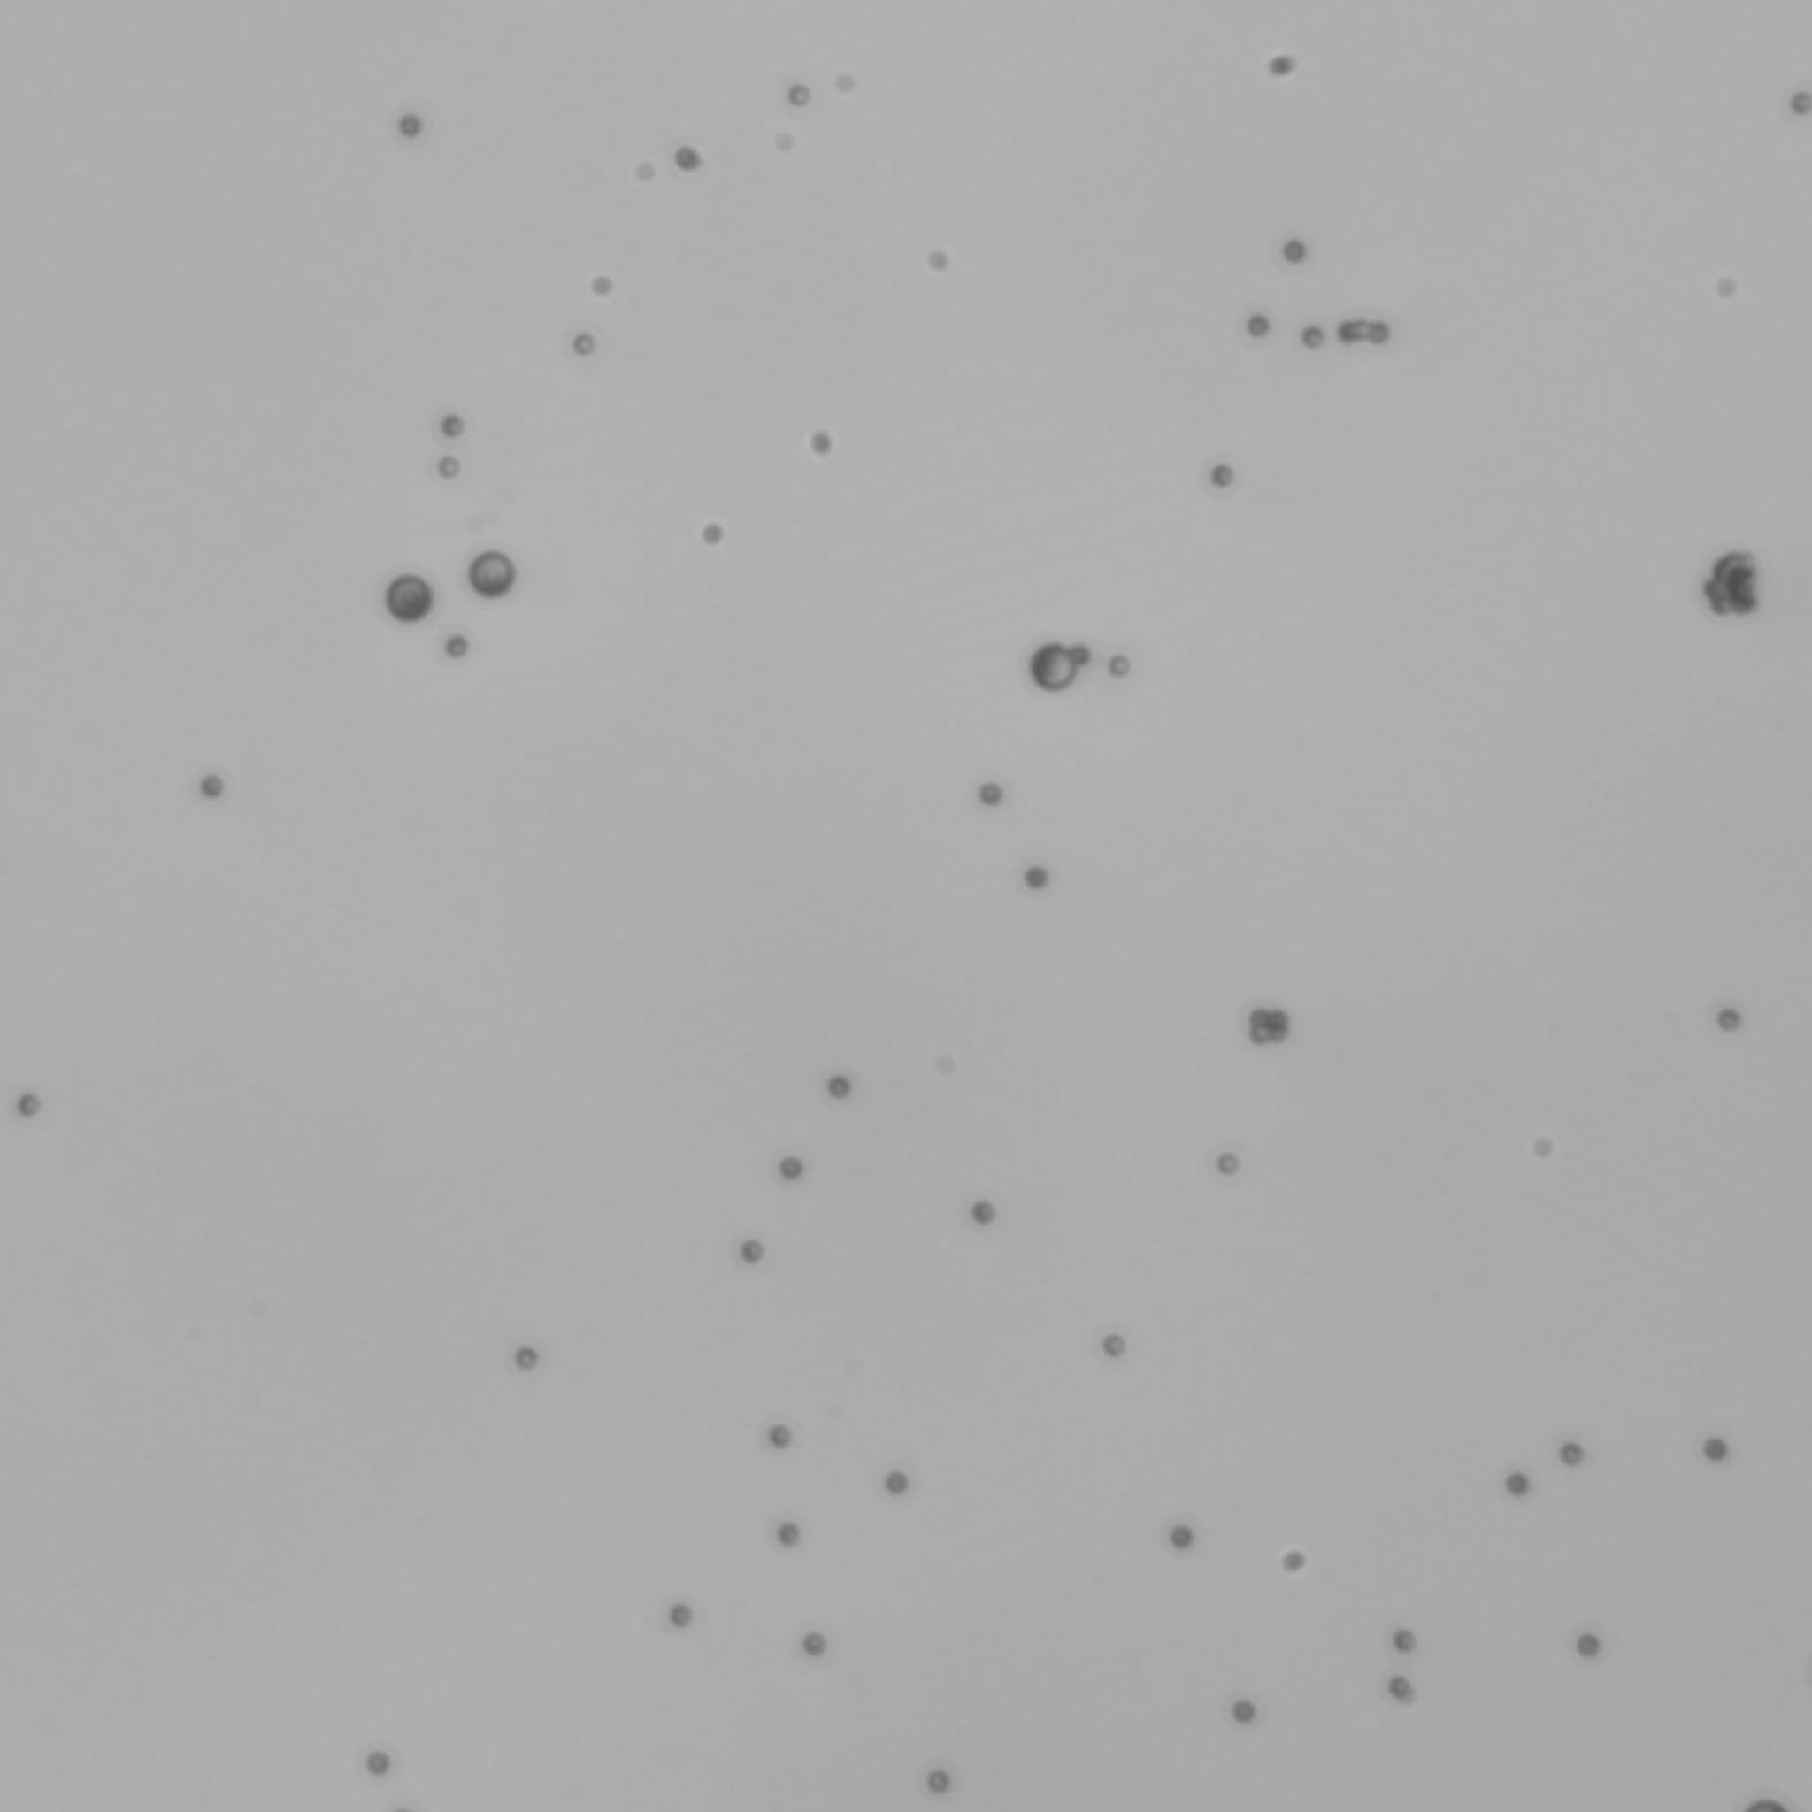

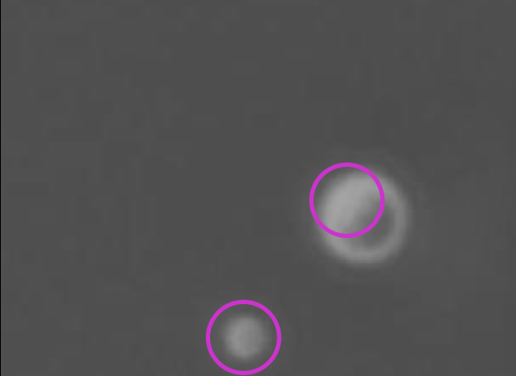
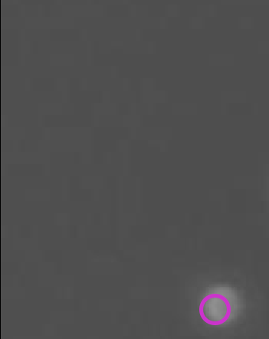
PAIR INTERACTION OF ACTIVE JANUS COLLOIDS
SHREYA SINGH DIXIT, RAHUL MANGAL
DEPARTMENT OF CHEMICAL ENGINEERING, NIT RAIPUR
2. DEPARTMENT OF CHEMICAL ENGINEERING, IIT RAIPUR
Introduction:
Result and Discussions:
Janus Particle Characteristics: Janus particles possess a dual-faced structure comprising silica (SiO₂) and platinum (Pt) hemispheres, each imparting distinct physicochemical properties.
Mechanism: Their motion is driven by the catalytic decomposition of hydrogen peroxide (H₂O₂) on the Pt surface, inducing diffusiophoresis and creating asymmetric chemical gradients.
Number of Collision in each case
Increasing H₂O₂ concentration raises the total number of collisions, with platinum side collisions increasing and silica side collisions decreasing.
Silica Side
One
Trajectories of particles
Platinum Side
Janus particles in 0.5% H2O2 solution show the longest displacement due to active propulsion. In contrast, passive colloids exhibit shorter displacement due to Brownian motion.
Singh et al., Langmuir (2024)
Average contact time during collision
Objective:
To investigate the interaction and movement dynamics of Janus particle pairs of different sizes in hydrogen peroxide solutions. This study aims to understand their behavior under varying environmental conditions and the displacement and collision types.
Methodology:
The average contact time is lower for the Equitorial side in both 0.5% H₂O₂ and 1% H₂O₂ cases. In contrast, the average contact time for the 0.5% passive colloid is significantly higher, primarily due to the domination of Brownian motion and lower reactivity.
Video Cropping to Focus on Collisions
(Around 100 collisions for each dataset)
Speed of particles
Video Recording of Particle Movement
(180 seconds at 20 frames per second)
0.5% - H₂O₂ active colloid
0.5% - H₂O₂ passive colloid
1% - H₂O₂active colloid
Particle Tracking
(Using TrackMate plugin in ImageJ)
Particle centre detection
The speed of the 2-micron particle is consistently higher in all three cases studied.
Speed ratio in each case
In the 1% H₂O₂ case, the Platinum side particle exhibits the highest speed ratio among the particles. Conversely, in the 0.5% H2O2 case, the Platinum side particle shows a higher speed ratio than others.
Pt-hemisphere centre detection
Email -dixit9639@gmail.com

