Slide 1
Large-scale Data Analytics in Recommender Systems or Graphs
More detailed project description will be uploaded to Canvas

Slide 2
Build up your team (Due by Mar 11)
At most 3 persons per team
Email TA the members and the representative of your team by Mar 11 (in two weeks)
zh252@cs.rutgers.edu
Each team works on a project and give a presentation together
Project due date is 4/18, Presentations on 4/21, 26 and part of 28)
Submission
Code, a project report, and presentation slides

Slide 3
Project Option 1
Dataset-1
Amazon (24 product categories: 24 sub-datasets)
Only need to choose one sub-dataset
Basic data format (Actually it is a sparse matrix)
user-id: which is denoted as “reviewerID” in the dataset
product-id: which is denoted as “asin” in the dataset
rating: a 1-5 integer star rating, which is the rating that the user rated on the product, it is denoted as “overall” in the dataset
review: a piece of review text, which is the review content that the user commented about the product, it is denoted as “reviewText” in the dataset
title: the title of the review, which is denoted as “summary” in the dataset
timestamp: time that the user made the rating and review
image: image of the product
description: a piece of text description of the product
….....

Slide 4
Project Option 1 - Tasks
Basic Requirements
Step 1: Data prepressing and split, create a training dataset and a testing dataset for experiment
Step 2: Rating prediction, develop an algorithm to predict the ratings in the testing set based on the information (ratings and others) in the training dataset, and evaluate the predictions based on MAE and RMSE.
Step 3: Item Recommendation, construct a recommendation list for each user, and then evaluate the recommendation quality based on precision, recall, F-measure, and NDCG.

Slide 5
Project Option 2
Dataset-2
A social network graph
Basic data format
node-id: represents a node
edge-id: represents an edge
Node feature: a set of features for the node
Tasks:
Basic Requirements
Step 1: Data prepressing and split, create a training dataset and a testing dataset for experiment
Step 2: Link Prediction, develop an algorithm to predict the links in the testing set based on the information (nodes, features, edges) in the training dataset, and evaluate the predictions based on precision, recall, F-measure.
Step 3: Node classification, predict the node labels in the testing dataset and evaluate the performance based on precision, recall, F-measure

Slide 6
An example project implementation Joint Representation Learning for Recommendation with Heterogeneous Information Sources

Slide 7
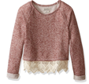

Deep Representation Learning
Deep
Representation
Learning
Deep
Representation
Learning
Deep
Representation
Learning
…
…
…

Slide 8








Joint Representation Learning
A Multi-View Machine Learning Framework with Heterogeneous Information Sources
Entity₁
Entity₂
Entity₃
Entity₄
…
Entity_{N-1}
Entity_{N}
(Deep) Representation Learning
…
…
…
…
…
…
…
V₁
…
…
…
+Item $v_{j1}$
User $u_{i}$
-Item $v_{j2}$
V₂
…
…
…
+Item $v_{j1}$
User $u_{i}$
-Item $v_{j2}$
V₃
…
…
…
+Item $v_{j1}$
User $u_{i}$
-Item $v_{j2}$
…
…
…
+Item $v_{j1}$
User $u_{i}$
-Item $v_{j2}$
S₁
>
S₂

Slide 9
Joint Representation Learning
A Multi-View Machine Learning Framework with Heterogeneous Information Sources
Review₁
Review₂
Review₃
Review₄
…
Review_{N-1}
Review_{N}
(Deep) Representation Learning
…
…
…
…
…
…
…
V₁
…
…
…
+Item $v_{j1}$
User $u_{i}$
-Item $v_{j2}$
V₂
…
…
…
+Item $v_{j1}$
User $u_{i}$
-Item $v_{j2}$
V₃
…
…
…
+Item $v_{j1}$
User $u_{i}$
-Item $v_{j2}$
…
…
…
+Item $v_{j1}$
User $u_{i}$
-Item $v_{j2}$
S₁
>
S₂

Slide 10
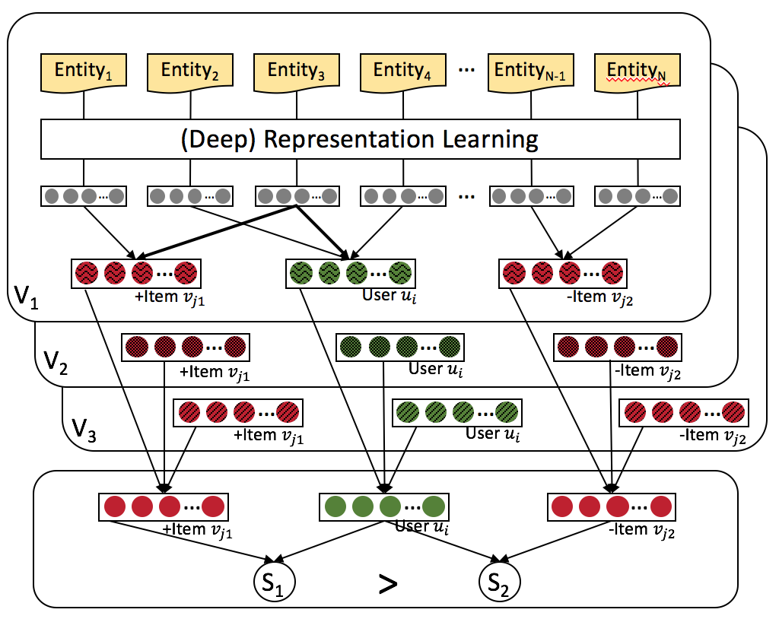


Joint Representation Learning
A Multi-View Machine Learning Framework with Heterogeneous Information Sources
L₁
L₂
L₃

Slide 11
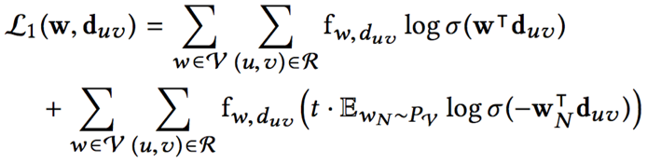








Modeling of Textual Reviews (View V₁)
Review $d_{uv}$
$$w_{uv}^{1}$$
$$w_{uv}^{2}$$
$$w_{uv}^{3}$$
…
$$w_{uv}^{n_{uv}−1}$$
$$w_{uv}^{n_{uv}}$$
Projection
…
V₁
…
…
User $u$
Item $v$
Word Embedding by Paragraph Vector Learning

Slide 12
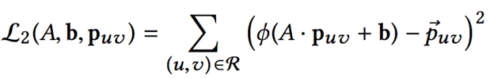



Modeling of Visual Images (View V₂)
Image $p_{uv}$
Multi-Layer Convolutional Neural Network
Multiple Fully Connected Layers
…
Fully Connected Layer
…
V₂
…
…
User $u$
Item $v$
Image Embedding by Convolutional Neural Network

Slide 13




Modeling of Numerical Ratings (View V₃)
Rating $r_{uv}$
Fully Connected Layer 2
Fully Connected Layer 1
…
…
V₃
…
…
User $u$
Item $v$
Rating Embedding by Fully Connected Layers

Slide 14
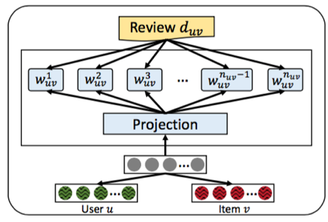
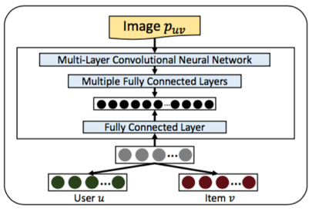
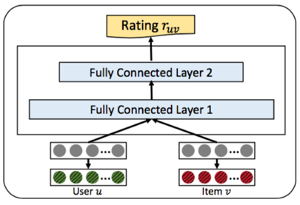
Joint Representation Learning
V₁
V₂
V₃

Slide 15
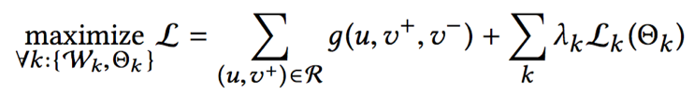
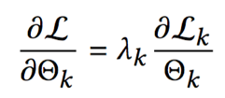
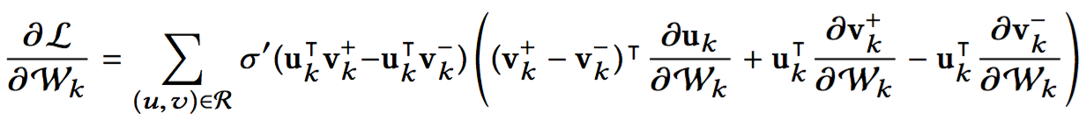
Extendable to New Information Sources
Voice
➕
Video
Text
Image
Ratings
Gradient on parameters from view k
Only contains parameters of view k itself
Independent from other views

Slide 16
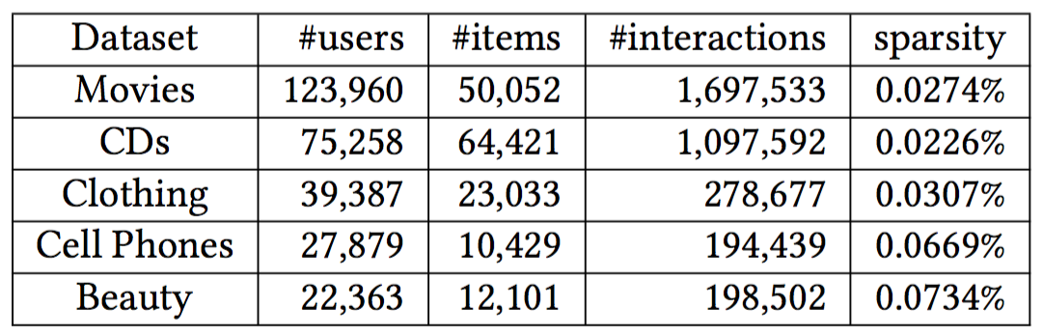
Experimental Setup
We take the Amazon dataset for experiments

Slide 17
Baseline methods
Baseline Methods
BPR: Bayesian Personalized Ranking with implicit feedback.
HFT: Hidden factor and topics model integrated into BPR, because the original model is designed for rating prediction. It relies on reviews.
VBPR: Visual Bayesian Personalized Ranking method based on images.

Slide 18
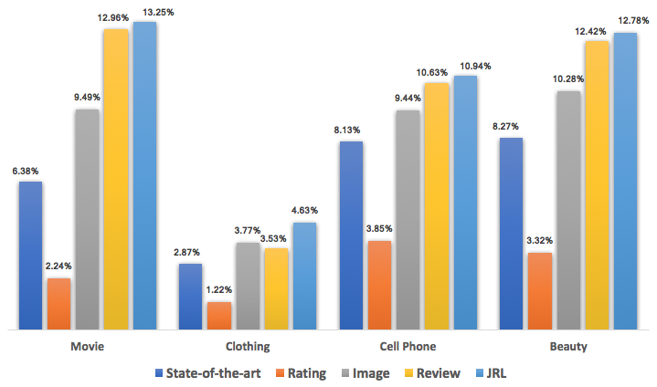
Compare with Shallow Models on NDCG
Times of
Improvement
2.08 1.61 1.34 1.54
State-of-the-art = Best of {BPR (by rating), HFT (by review), VBPR (by image)}

Slide 19
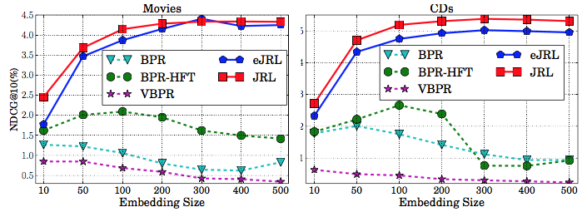
Impact of Embedding Size
Tune embedding size from 10 to 500
Observations
Our model: performance keeps increasing until about 300 dimension, and does not decrease when using more dimensions.
Shallow baselines: best performance when dimension less than 100, performance decreases when using more dimensions.
What we learn
Deep models can capture more complex interaction from data
Learning ability of shallow models is limited and may over-fit if model complexity is too high.

Slide 20

Summary and Future Works
Use various heterogeneous data to provide
Significant personalization performance.
Develop a Joint Representation Learning framework for recommendation based on heterogeneous information sources.
Not only ratings, review, and images, but also extendable to new information sources.
Achieved significant improve for top-N recommendation.
Future work
Consider other representation learning architectures for recommendation
Consider other information sources for recommendation

Slide 21


