Slide 1


ADVANCED MICROSOFT EXCEL
Hospital Billing & Management System
Real-time hospital data, billing, and performance insights for healthcare teams developed by Shreyasree Mete, Srijita Das & Mridul Manjhi

Slide 2



PROBLEM STATEMENT
Problems in Hospital Data Management
Hospitals generate massive volumes of operational and financial data daily. Managing patient information, admissions, prescriptions, insurance records, and billing manually leads to inefficiencies, delayed reporting, and poor decision-making.
Fragmented Records
Slow Reporting
Poor Visibility
Patient, billing, insurance, and admission data are stored across multiple records, making information retrieval slow and increasing the risk of inconsistencies.
Manual report preparation is time-consuming and prone to errors, delaying operational insights and management decisions.
Without a centralized dashboard, tracking revenue, admissions, payments, and department performance becomes difficult.

Slide 3






Key Challenges Addressed
Unified Data Management
Admission & Billing Tracking
Consolidating multiple hospital datasets into a single, structured system
Monitoring patient admissions and billing records in real time
Department Performance
Insurance & Payments
Tracking doctor activity and department-level operational metrics
Handling insurance claims and payment status efficiently
Rapid Report Generation
Data-to-Insight Conversion
Producing management-ready reports quickly and accurately
Transforming raw Excel data into meaningful, actionable insights

Slide 4
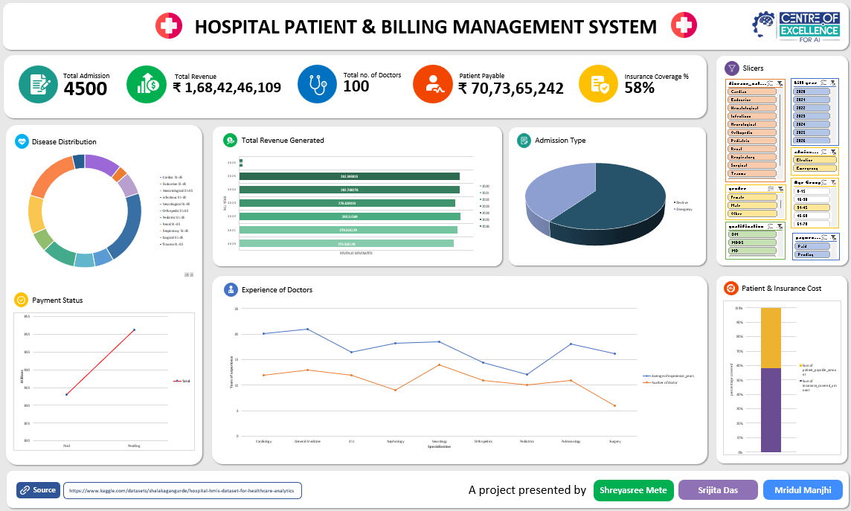
DASHBOARD DESIGN
Hospital Dashboard
Interactive view with KPI cards, charts, and slicers.
KPI Metrics
Occupancy, revenue, and patient counts.
Revenue Analysis
Department and monthly breakdowns.
Payment Status
Pending, completed, and claims.
Disease Distribution
Diagnosis mix at a glance.
Doctor Experience
No. of doctors and their experience
Admission Trends
Patient flow over time with insurance covered
Interactive Charts
Filterable, drill-down reports.

Slide 5

PROJECT OUTCOME
From Raw Data to Better Decisions
The dashboard turns hospital records into clear, actionable intelligence through a five-stage pipeline.
Raw Data
Dashboard
Decisions
Excel Prep
Insights
Manual bottlenecks are replaced with automation, live KPIs, and visual reports for faster decisions.

Slide 6


Benefits & Impact
Reduces Manual Effort
Automated calculations and structured records minimize data entry errors
Accelerates Decision-Making
Real-time dashboards give administrators the insights they need, when they need them
Simplifies Financial Analysis
Billing, revenue, and payment data visualized in one place
Scalable & Maintainable
Easy to update and expand as hospital data grows over time
Key Takeaway: This Excel-based dashboard proves that powerful healthcare analytics can be achieved without expensive software — using tools already available in every office.

