Slide 1



Gen-A-Thon FINAL ROUND
TEAM NAME : InnoVators
MEMEBERS:
Shreya Agrawal
Sai Shreya Vemana
Charvitha Yerukonda

Slide 2
TABLE OF CONTENTS
01
04
02
05
Problem Statement
Technology &
Prototype Images
Solution
Marketability
03
06
Conclusion
Criterion

Slide 3
01
Problem Statement

Slide 4
PROBLEM STATEMENT
"Campus Food Delivery Ecosystem: Bridging the Culinary Gap for IIIT Nagpur Students“
- IIIT Nagpur aims to diversify its campus food options and improve the dining experience for students. A technological solution is needed to facilitate convenient food delivery from external vendors. This initiative will offer students a wider choice of dining, enhance convenience, and promote collaboration between the college and local restaurants, benefiting both the campus and the city's culinary industry.

Slide 5
02
OUR SOLUTION

Slide 6
OUR SOLUTION
INTRODUCTION OF VIRTUAL FOOD COURTS – KIOSK
Our proposition introduces "Virtual Food Courts" at IIIT Nagpur, employing digital kiosks to elevate the dining experience. With user-friendly touch-screen interfaces, these kiosks streamline order placement, minimizing wait times. Strategically positioned in notable food hubs, they revolutionize traditional dining, offering a more accessible approach. Grounded in student understanding, we suggest the incorporation of food trucks, expanding culinary choices. Seamlessly linked to kiosks, orders are directed to the selected food truck. The kiosk interface provides a straightforward option for choosing between vegetarian and non-vegetarian preferences, ensuring an all-encompassing dining experience. Harnessing Web Development, Deep Learning, and Machine Learning, our strategy tackles logistical challenges, enriching the overall campus dining milieu.

Slide 7
MAIN IDEAS OF OUR SOLUTIONS
CULINARY DIVERSITY AND PERSONALIZATION
FOOD HOTSPOTS
Our solution encompasses setting up kiosks near campus food hotspots, allowing students to order from various restaurants. As users gain experience, they receive personalized recommendations. This not only reduces queues but also gathers valuable data on student food preferences compared to hostel meals.
This encompasses the integration of a user-friendly option in the kiosk interface for students to choose between vegetarian and non-vegetarian food preferences. This not only highlights the consideration for diverse dietary preferences but also emphasizes a personalized dining experience, catering to the individual tastes of the student population.

Slide 8
Upon students' initial registration on our kiosk database servers, we intend to enhance convenience by embedding chips in their ID cards. These chips enable seamless scanning for access to the kiosk, facilitating easy meal ordering and a streamlined user experience..

Slide 9
03
CRITERION

Slide 10
CRITERION
User Experience
Impact
Market Viability
User-friendly interface, Personalized recommendations, Customization and dietary preferences
Simplifies food ordering, saves time, Supports contactless transactions, Boosts restaurant sales
Demand data supports growth in the food delivery market, Competitive analysis highlights our unique value proposition in the market
Scalability
Sustainability
Feasibility
Adaptable for additional restaurants, locations, and menu items; Scalable cloud infrastructure handles increased traffic and data
Reduces food waste through optimized inventory management, Promotes sustainability with eco-friendly packaging
Stable technology stack ensures project feasibility and reliability and Cost breakdown covers development, maintenance, and operational expenses

Slide 11
04
Technology & Prototype images

Slide 12
TECHNOLOGY USED
Key Technological Components:
Web Development:
Leveraging modern web development technologies to ensure a user-friendly and responsive digital platform.
Deep Learning:
Incorporating deep learning algorithms to provide personalized food and restaurant recommendations based on individual preferences.
Machine Learning:
Utilizing machine learning models for intelligent decision-making, enhancing the efficiency of our Virtual Food Courts.
Touch-screen Interface:
Capacitive touch-screen technology enhances the user experience, allowing seamless interaction with the kiosk system.

Slide 13
TECHNOLOGY USED
Key Technological Components:
Cloud Computing:
Implementation of cloud computing for efficient storage, processing, and retrieval of data, ensuring real-time updates and responsiveness.
QR Code Integration:
QR code technology facilitates secure and quick order processing, enabling students to scan and place orders conveniently.
Payment Gateways:
Integration with secure payment gateways ensures smooth and secure transactions for a hassle-free dining experience.
Internet of Things (IoT):
Utilization of IoT devices for real-time monitoring of food inventory and kiosk status, ensuring optimal operation.

Slide 14

PRODUCT INFOGRAPHICS
Features
Visuals
Personalized recommendations, Real-time order tracking, Dietary customization, Efficient order processing
Attractive, user-friendly interface, High-quality food image, Interactive kiosk design
Users
Students, faculty, and staff, Convenient dining solution, Contactless ordering
Availability
Updates
Campus kiosk & mobile app, Accessible 24/7, Multiple food vendors
Regular feature enhancements, Bug fixes & security updates, User feedback-driven improvements.

Slide 15
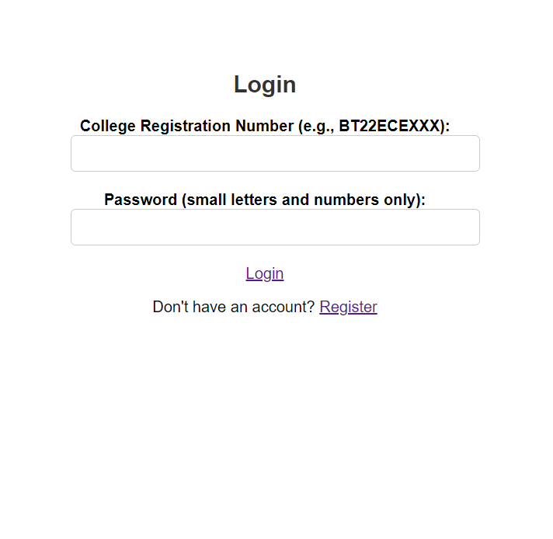
PROTOTYPE IMAGES
1. Login Page

Slide 16
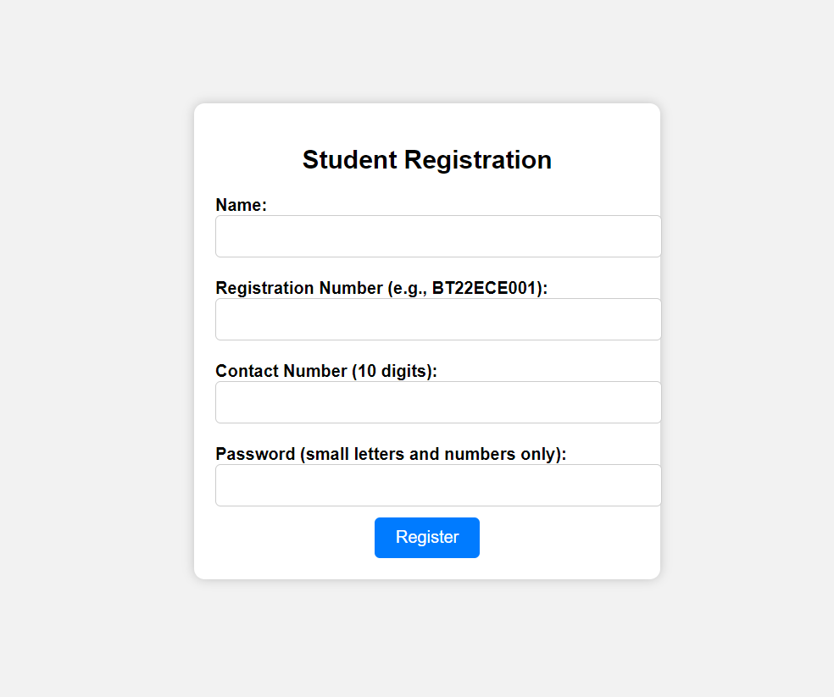
2. SIGN – IN PAGE

Slide 17
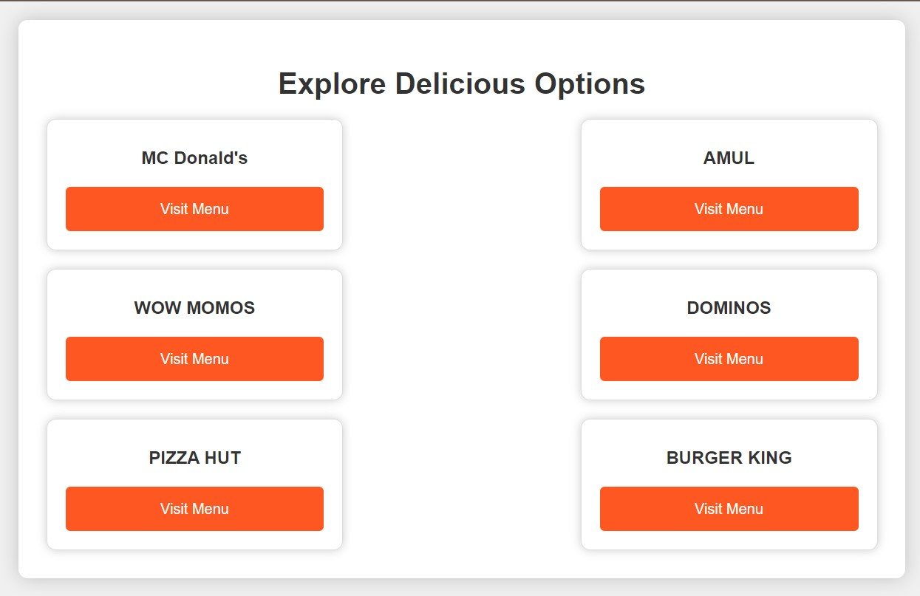
3. RESTAURANT OPTIONS PAGE

Slide 18
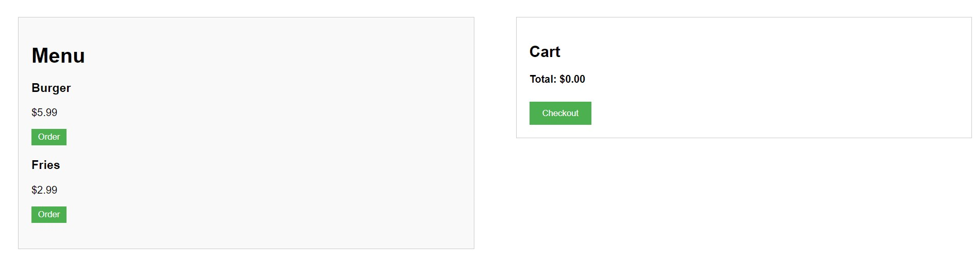
4. MENU PAGE

Slide 19
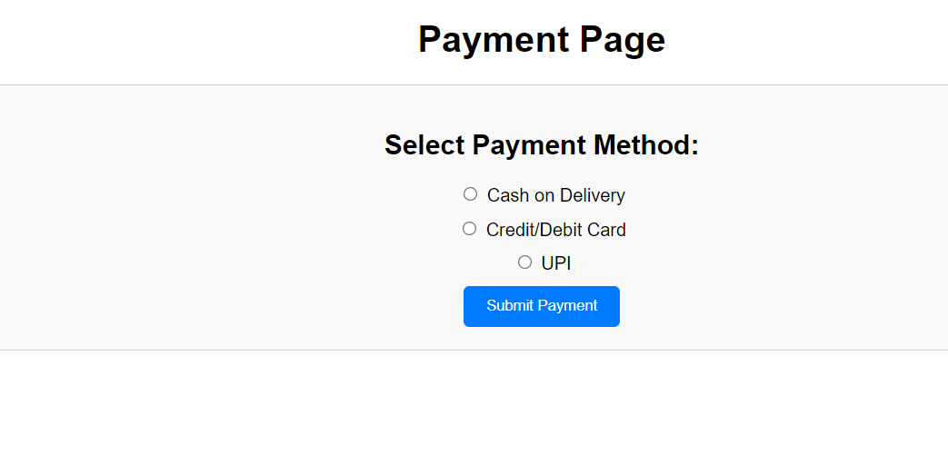
5. PAYMENT PAGE

Slide 20
05
Marketability

Slide 21
Marketability and Student Adoption
Key Marketability Factors:
User Convenience and Savings:
Streamlined ordering and reduced wait times translate to time savings for students, contributing to a more efficient daily schedule.
Vendor Visibility and Revenue Boost:
Inclusion of local food vendors and food trucks enhances visibility and attracts a broader customer base.
Increased revenue opportunities for vendors through a centralized and accessible platform for order placement.
Personalization:
Personalized food recommendations cater to individual preferences, enhancing the overall dining experience.
Accessible Technology:
User-friendly touch-screen interfaces make the system accessible to all students, regardless of technological proficiency.

Slide 22
Marketability and Student Adoption
Student Adoption Strategies:
Awareness Campaigns:
Engaging marketing campaigns to raise awareness about the convenience and benefits of the Virtual Food Courts.
Student Feedback Integration:
Continuous feedback loops to incorporate student preferences and improve the system based on user experiences.
Collaborations and Partnerships:
Collaborations with local food vendors and food truck operators to ensure a diverse and appealing range of food options.

Slide 23
06
CONCLUSION

Slide 24
CONCLUSION
In conclusion, our Virtual Food Court project at IIIT Nagpur combines user-friendly interfaces, personalized recommendations, and efficient order processing to enhance the dining experience. With its strong market viability, scalability, sustainability, and feasibility, this innovative solution fosters a mutually beneficial collaboration between the campus community and local restaurants, ultimately transforming the way we dine on campus. The strategic placement of kiosks addresses the challenges of conventional dining, providing a streamlined and accessible solution for students. The empathetic approach, evidenced by the integration of food trucks and a user-friendly interface catering to diverse dietary preferences, ensures inclusivity and culinary variety. Leveraging advanced technologies such as Web Development, Deep Learning, and Machine Learning, our solution not only tackles logistical hurdles but also embraces innovation.

Slide 25
THANK YOU
I extend my sincere gratitude to IIIT Nagpur for granting us the invaluable opportunity to participate in this esteemed Hackathon. Additionally, heartfelt thanks to the distinguished panel of judges for their consideration of our innovative solution. This experience has been truly exceptional and rewarding.

