Slide 1


SMART INDIA HACKATHON 2025
TITLE PAGE
Problem Statement ID – SIH25001
Problem Statement Title- Smart Community Health Monitoring and Early Warning System for Water-Borne Diseases in Rural Northeast India
Theme- MedTech / BioTech / HealthTech
PS Category- Software
Team ID- 78883
Team Name: Innovastra-G

Slide 2
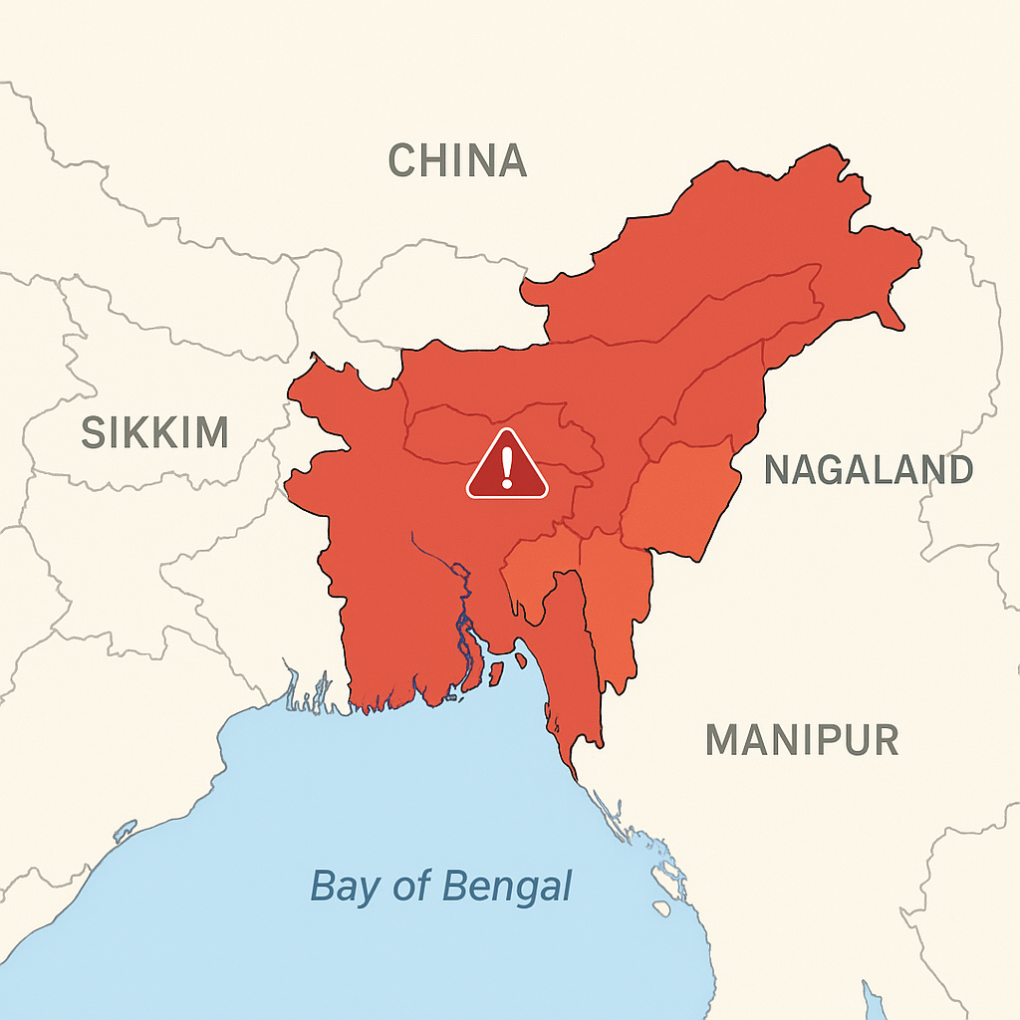
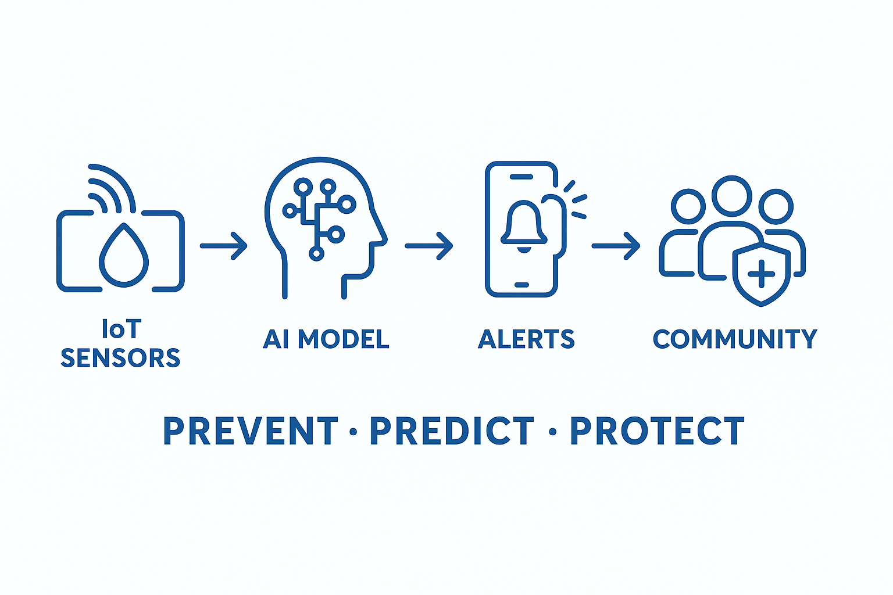
Smart Community Health Monitoring & Early Warning System for Water-Borne Diseases
Innovastra-G
Problem Statement:
Frequent water-borne outbreaks in rural NE India.
Current systems: slow, reactive, fragmented.
Facts:
40% villages lack water testing.
Monsoon ↑ outbreak risk by 60%.
Delayed response = avoidable deaths & wasted resources.
Proposed Solution:
Real-time, community-driven digital health platform combining:
Multilingual offline-first mobile app + SMS reporting
IoT sensors & manual test kits
AI/ML-powered outbreak prediction and hotspot dashboards
What makes it different:
  Community-as-sensor network
  Predictive epidemic forecasts like “health weather reports”
  Policy-ready automated alerts for officials
Target Audiences
Citizens & local communities
ASHA & health workers
District/state health officials
Government & policy makers

Slide 3
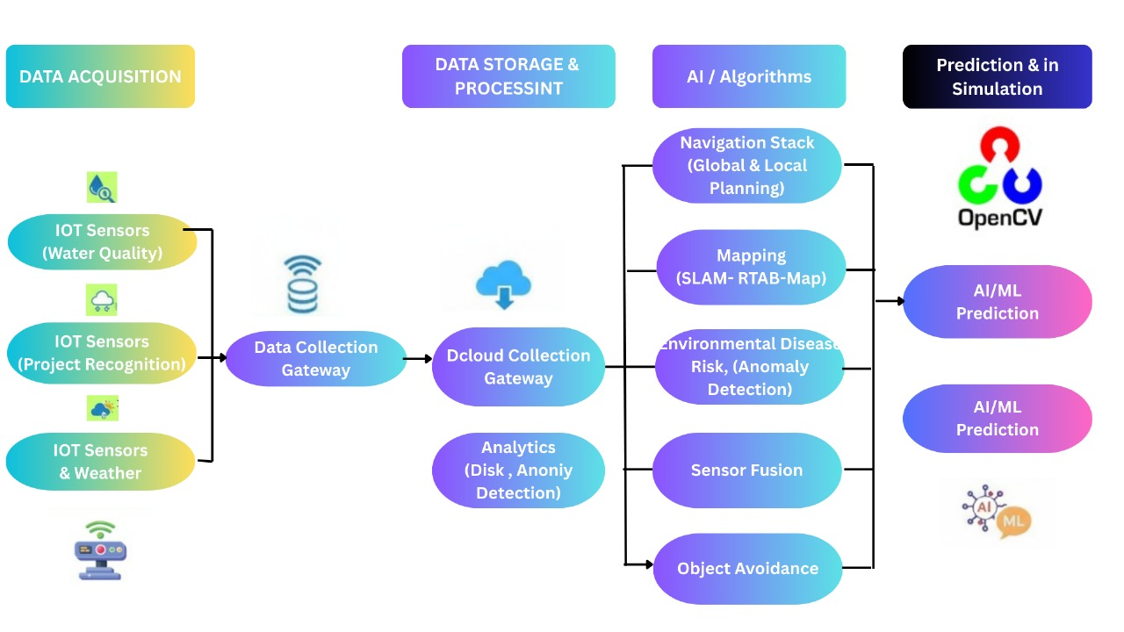
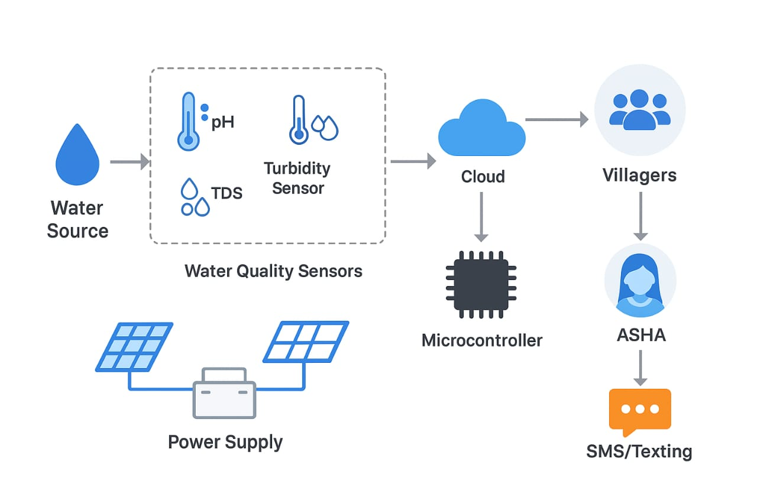
TECHNICAL APPROACH
Innovastra-G
Technical Stack:
AI/ML → TensorFlow / PyTorch (LSTM for time-series prediction, DBSCAN for clustering outbreaks).
Data Sources → Govt health data, water quality datasets (CPCB, WHO), synthetic data generation.
Frontend → Flutter (mobile app), Streamlit (dashboard).
Backend → Django / FastAPI with PostgreSQL + PostGIS (geo-spatial support).Alerts → Twilio / Msg91 (SMS & IVR alerts).
Explanation Video Link: https://youtu.be/ofJfB-CiySA

Slide 4
FEASIBILITY AND VIABILITY
Innovastra-G
Technical: IoT sensors (pH, turbidity, temperature), ESP32/Arduino, React dashboards, Leaflet maps, AI/DL (LSTM) → prototype-ready.
Economic: Low-cost setup; prevents expensive disease outbreaks.
Operational: Health workers report via mobile; villagers get SMS/IVR alerts; minimal training.
Estimated Expenditure:
Water sensors (pH, turbidity, temp) ×5 villages: ₹6,000
Microcontrollers (ESP32/Arduino) ×5: ₹4,000
Connectivity (SIM/LoRa modules): ₹2,000
Dashboard & software (open-source): ₹0
Misc. (cables, mounting, small lab tools): ₹4,000
Total Prototype Cost: ≈ ₹16,000 – ₹17,000
Challenge | Impact | Strategy
Connectivity | Delayed data | LoRa/GSM; offline sync
Sensor Reliability | Inaccurate alerts | Calibration & multiple sensors
Data Entry Errors | Wrong predictions | Simple forms + validation + AI anomaly detection
Community Trust | Low adoption | Awareness campaigns; clear alerts
AI Accuracy | Misleading alerts | Start simple; retrain with local data
Scalability & Funding | Limited deployment | Pilot → govt/NGO support

Slide 5
IMPACT AND BENEFITS
Innovastra-G
Potential Impact on Rural Communities
Early detection of water-borne diseases → fewer illnesses & deaths
Real-time alerts → villagers take preventive action
Health workers get actionable insights → faster interventions
Builds trust in local health initiatives & technology
Benefits / Key Advantages:
Efficiency: Real-time monitoring & AI prediction → faster action
Cost-Effectiveness: Prevents expensive treatments & hospitalizations
Scalability: Expandable across all rural regions of India
Long-Term Value: Continuous improvement, healthier communities, billions saved in healthcare
Metric | Traditional Approach | Smart Health Monitoring | Improvement
Disease Detection Time | 7–14 days | 1–2 days | 7× faster
Community Reach | Limited alerts | Real-time village-wide alerts | 5–10× broader coverage
Healthcare Cost per Outbreak | ₹5–10 lakh | ₹50–75k | 10× cost savings
Water Contamination Awareness | Manual inspection | IoT + AI alerts | Continuous monitoring

Slide 6
RESEARCH AND REFERENCES
Innovastra-G
IoT & AI for Waterborne Disease Prediction
Nature: https://www.nature.com/articles/s41598-024-79989-6
IoT & AI Management Model
ScienceDirect: https://www.sciencedirect.com/science/article/abs/pii/S0010482524011193
Digital Health Solutions in Rural Areas
PubMed Central: https://pmc.ncbi.nlm.nih.gov/articles/PMC11404635/
Telehealth Enhancing Rural Healthcare
SpringerLink: https://link.springer.com/article/10.1186/s12982-024-00271-1
AI & Telemedicine in Rural Healthcare
PubMed Central: https://pmc.ncbi.nlm.nih.gov/articles/PMC11816903/
Community-Driven Health Monitoring
Prezi: https://prezi.com/p/zxhpvdhloalx/smart-community-health-monitoring-and-early-warning-system-for-water-borne-diseases-in-rural-northeast-india/
Key Insight: Credible research supports IoT + AI + community approaches for proactive, scalable rural health solutions.

