Slide 1
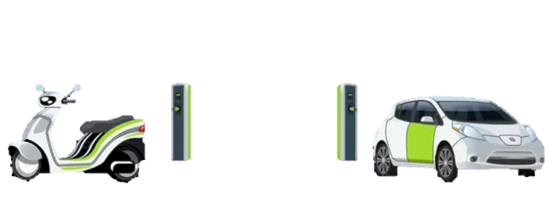
Electronic vehicle analysis
-by Shreyash Subhash Hiwale

Slide 2
About AtliQ Motors
AtliQ Motors is an automotive giant from the USA specializing in electric vehicles (EV).
In the last 5 years, their market share rose to 25% in electric and hybrid vehicles segment in North America
Mr. Bruce Haryali is the chief of AtliQ Motors India.

Slide 3
Objective
As a part of their expansion plans, AtliQ Motors wanted to launch their bestselling models in India where their market share is less than 2%.
A detailed market study of existing EV/Hybrid market in India.
A detailed presentation report of covering all the major insights about the Indian Market.

Slide 4
What are Ev’s?
A vehicle that uses one or more electric motors for propulsion
Origin
First appeared in the late 19th century during the Second Industrial Revolution
Advantages
Provides quietness, comfort, and ease of operation compared to gasoline engine cars
Vehicle Types
Includes road vehicles, rail vehicles, electric boats, electric aircraft, and more

Slide 5
Some technical terms
Penetration Rate: This indicates the percentage of total vehicle sales that are electric vehicles. For example, a 6% penetration rate means 6 out of every 100 vehicles sold are EVs.
CAGR (Compounded Annual Growth Rate): This is the rate of growth of EV sales over a specific period. If 100 vehicles are sold this year with a CAGR of 10%, we expect 110 vehicles next year and 121 the following year.
Fiscal Year: A 12-month period used for financial reporting, typically from April to March in India.

Slide 6
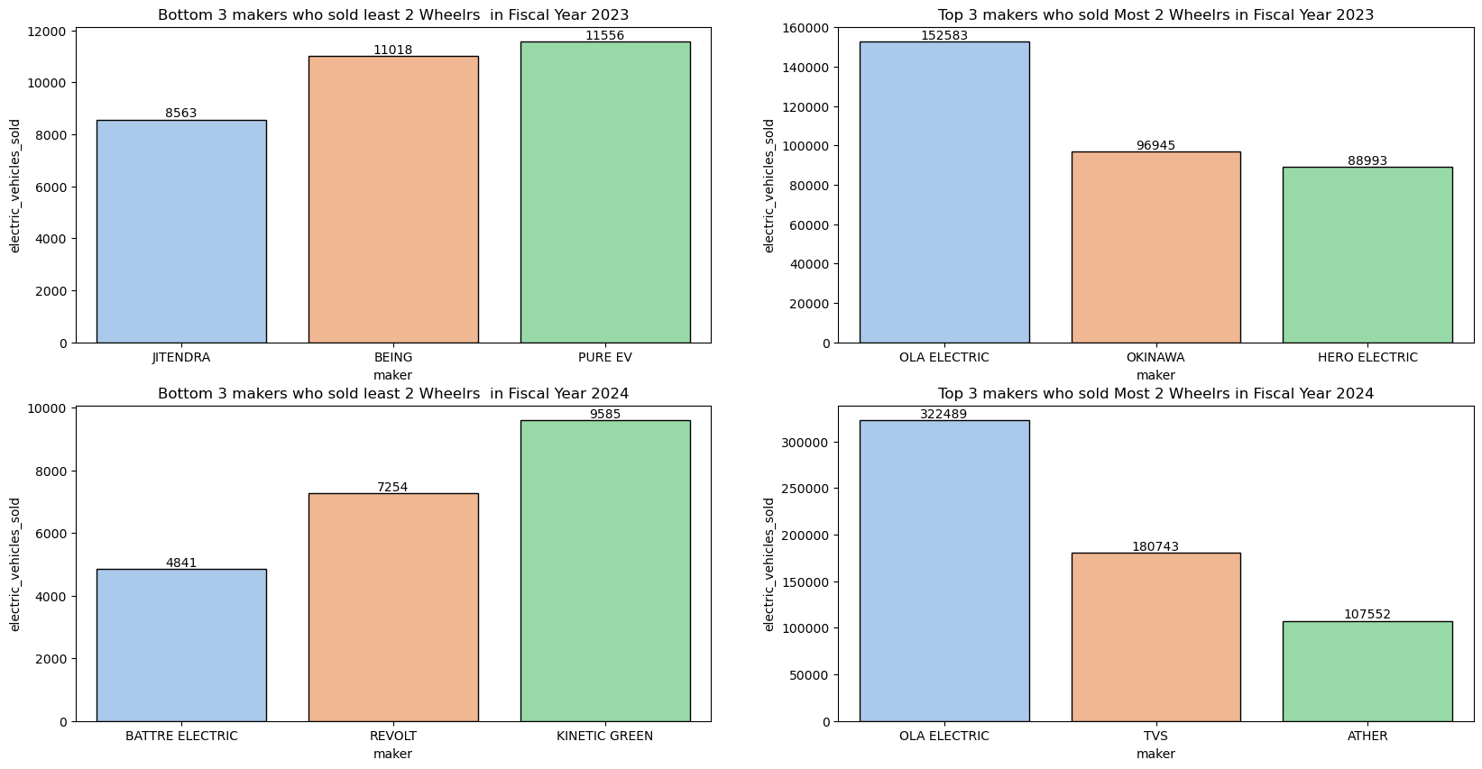
Primary Questions
Q1. List the top 3 and bottom 3 makers for the fiscal years 2023 and 2024 in terms of the number of 2-wheelers sold.
Ola Electric dominates the market across both fiscal years, showing a significant increase from 152,583 units in FY 2023 to 322,489 units in FY 2024.
TVS emerged as a strong contender in FY 2024, ranking among the top 3 with 180,743 units sold, replacing Okinawa and Hero Electric from FY 2023.
The inclusion of OLA and ATHER in the top 3 emphasizes that new players can successfully challenge and even surpass established brands like Hero and TVS in the EV market.

Slide 7
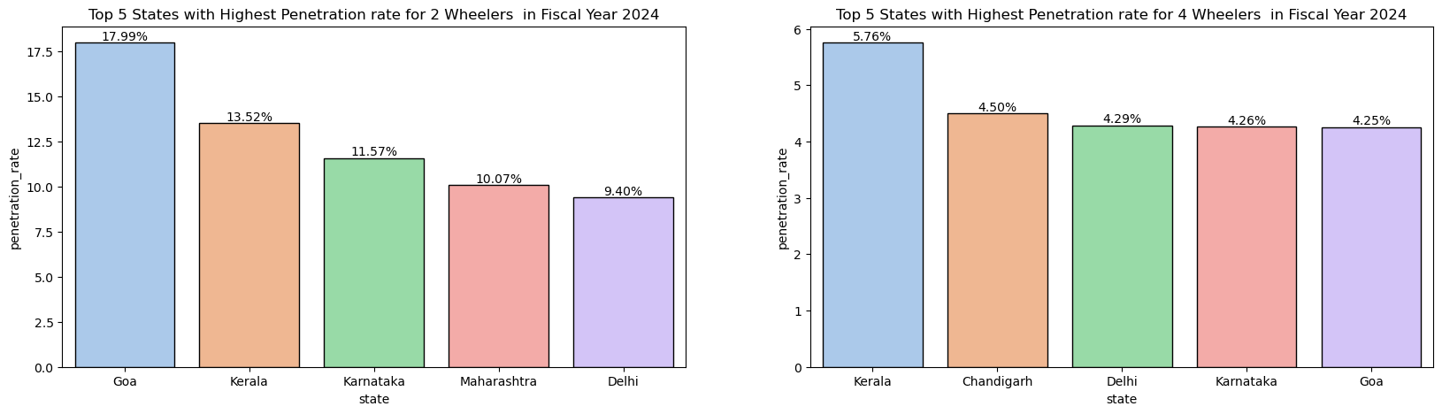
Primary Questions
Q2. Identify the top 5 states with the highest penetration rate in 2-wheeler and 4-wheeler EV sales in FY 2024.
States such as Goa, Karnataka, Kerala and Delhi have good penetration rate in year 2024 for both 2 and 4 wheelers Electric vehicles
Maharashtra has good penetration rate for 2- Wheelers
Chandigarh have penetration rate for 4- Wheelers

Slide 8
Primary Questions
Q3. List the states with negative penetration (decline) in EV sales from 2022 to 2024?
States | 2022 | 2024
Andaman & Nicobar | 0.43% | 0.49%
Andhra Pradesh | 1.80% | 4.24%
Arunachal Pradesh | 0.00% | 0.11%
Assam | 0.19% | 0.64%
Bihar | 0.54% | 1.33%
Chandigarh | 1.11% | 6.37%
Chhattisgarh | 1.16% | 5.67%
DNH and DD | 0.28% | 1.21%
Delhi | 4.12% | 7.71%
Goa | 3.68% | 13.75%
Gujarat | 1.65% | 5.30%
Haryana | 1.12% | 1.61%
Himachal Pradesh | 0.45% | 0.90%
Jammu and Kashmir | 1.07% | 1.64%
States | 2022 | 2024
Jharkhand | 0.66% | 1.58%
Karnataka | 4.28% | 10.18%
Kerala | 1.98% | 11.59%
Ladakh | 0.41% | 0.97%
Madhya Pradesh | 0.82% | 3.36%
Maharashtra | 2.90% | 8.60%
Manipur | 0.07% | 0.68%
Meghalaya | 0.02% | 0.36%
Mizoram | 0.00% | 1.00%
Nagaland | 0.01% | 0.05%
Odisha | 1.98% | 6.33%
Puducherry | 1.71% | 5.37%
Punjab | 1.02% | 1.95%
Rajasthan | 2.28% | 5.11%
Sikkim | 0.00% | 0.00%
Tamil Nadu | 2.74% | 5.49%
Tripura | 0.07% | 0.65%
Uttar Pradesh | 0.41% | 1.97%
Uttarakhand | 1.20% | 2.72%
West Bengal | 0.31% | 1.75%
Except for Sikkim every state in India has experienced increase in the penetration rate from 2022 to 2024
This indicates that people in India are gradually shifting towards the more adoption of EVS over traditional vehicles.
In 2024 goa has PR of 13.72% which means of every vehicle sold approx. 13 of them were Evs whereas in 2022 the number was just 3

Slide 9
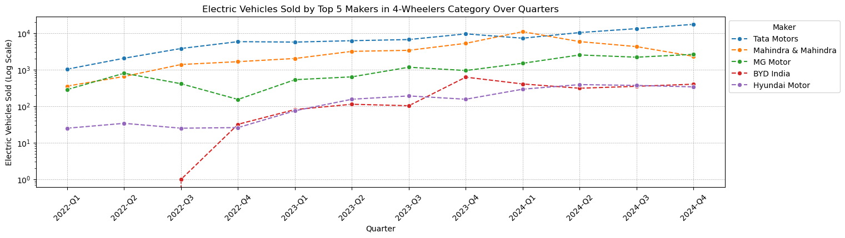
Primary Questions
Q4. What are the quarterly trends based on sales volume for the top 5 EV makers (4-wheelers) from 2022 to 2024?
Tata Motors continues to dominate the EV market among 4-wheelers.
Mahindra & Mahindra and MG Motor are competitive, but both face some volatility.
BYD India has shown impressive growth and could become a stronger competitor if the trend continues.
Hyundai Motor remains a stable player but has not achieved the sales volumes of the other top makers.

Slide 10
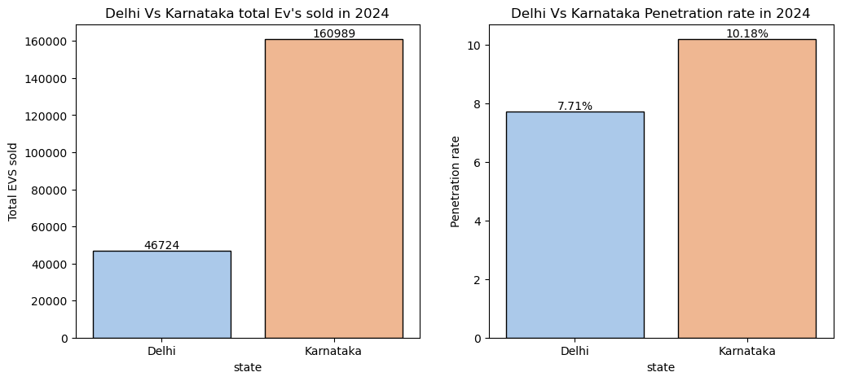
Primary Questions
Q5. How do the EV sales and penetration rates in Delhi compare to Karnataka for 2024?
Karnataka has nearly 4 times the sales of Evs compared to Delhi
Even though the difference in the sales of Evs Delhi is not far behind Karnataka in terms of penetration rate
This suggests that people of Delhi are adopting Evs more than people of Karnataka

Slide 11
Primary Questions
Q6. List down the compounded annual growth rate (CAGR) in 4-wheeler units for the top 5 makers from 2022 to 2024.
Maker | 2022 | 2023 | 2024 | CAGR
BYD India | 33 | 920 | 1466 | 566.5%
Hyundai Motor | 110 | 576 | 1390 | 255.47%
MG Motor | 1647 | 3277 | 8829 | 131.53%
Mahindra & Mahindra | 4042 | 13805 | 23346 | 140.33%
Tata Motors | 12708 | 28046 | 48181 | 94.71%
Although Tata Motors is the market leader in terms of absolute sales, newer players like BYD India and established brands like Hyundai Motor are growing quickly.
In 2024 the 1466 Evs were sold by BYD India at 566% CAGR, which means 5 times more vehicles could be sold next year by BYD India.
The high CAGRs for all makers suggest that the Indian EV market is in a rapid growth phase.
BYD India’s rapid growth could challenge existing leaders if sustained

Slide 12
Primary Questions
Q7. List down the top 10 states that had the highest compounded annual growth rate (CAGR) from 2022 to 2024 in total vehicles sold.
State | CAGR
Meghalaya | 18.17%
Goa | 17.52%
Karnataka | 16.21%
Delhi | 14.72%
Rajasthan | 13.86%
Gujarat | 13.26%
Assam | 13.00%
Mizoram | 12.15%
Arunachal Pradesh | 11.85%
Andaman & Nicobar | 11.84%
Meghalaya, Goa, and Karnataka have shown the most significant growth in vehicle sales, with CAGR rates exceeding 16%. This could indicate a strong demand for vehicles in these states.
Some of the smaller states or regions like Mizoram, Arunachal Pradesh, and Andaman & Nicobar have also exhibited notable growth rates. This suggests emerging markets with potential for further expansion.

Slide 13
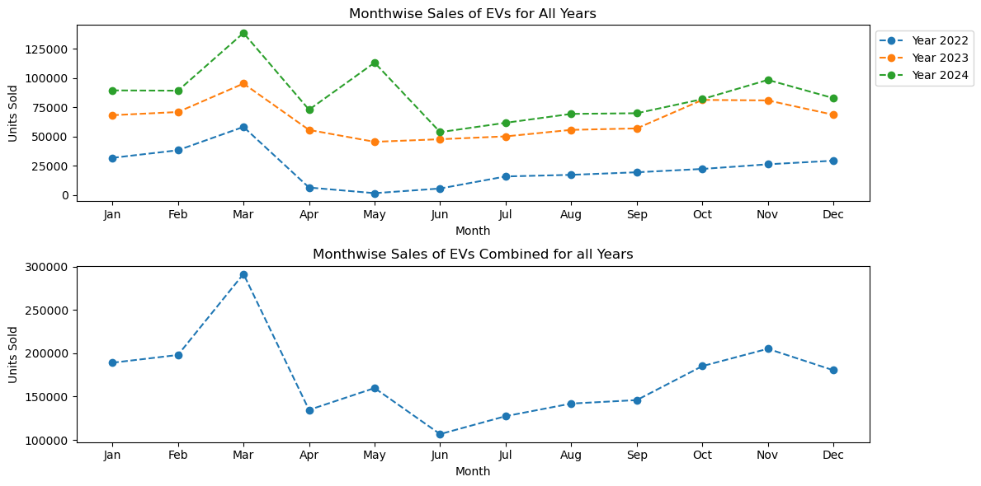
Primary Questions
Q8. What are the peak and low season months for EV sales based on the data from 2022 to 2024?
March is the month with most vehicle sold which also the ending of the Fiscal year.
April to July or Q1 is a period where sales is comparatively low than other months.
The Sales have been increased Over the Years.

Slide 14
Primary Questions
Q9. What is the projected number of EV sales (including 2-wheelers and 4-wheelers) for the top 10 states by penetration rate in 2030, based on the compounded annual growth rate (CAGR) from previous years?
State | 2022 | 2023 | 2024 | CAGR | Projected Sales 2030
Maharashtra | 48374 | 150502 | 197169 | 59.73% | 3275607
Kerala | 13639 | 49483 | 73938 | 75.66% | 2172891
Karnataka | 43111 | 108895 | 160989 | 55.14% | 2244979
Gujarat | 18026 | 79004 | 84359 | 67.26% | 1847547
Rajasthan | 20087 | 63835 | 66444 | 48.99% | 727004
Odisha | 9498 | 29651 | 39118 | 60.29% | 663537
Tamil Nadu | 36863 | 68885 | 94314 | 36.77% | 617372
Goa | 1778 | 7107 | 10799 | 82.45% | 398370
Delhi | 16535 | 44053 | 46724 | 41.37% | 373088
Chandigarh | 411 | 1991 | 2877 | 91.29% | 140972
Maharashtra, Kerala, and Karnataka are expected to have the highest EV sales by 2030, driven by strong growth rates and large populations.
Goa and Chandigarh might have smaller total sales, but their growth rates indicate strong adoption within their smaller markets.

Slide 15
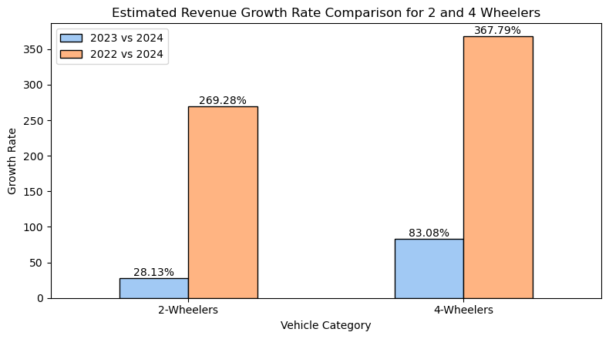
Primary Questions
Q10. Estimate the revenue growth rate of 4-wheeler and 2-wheelers EVs in India for 2022 vs 2024 and 2023 vs 2024, assuming an average unit price. H
4-Wheelers are experiencing faster revenue growth compared to 2-wheelers.
Given not much units of 4-Wheelers are sold the growth rate is still better than 2-Wheelers reason for this is the significant price per unit difference between the 2 categories.
This suggest even some amount of loss can be recovered if decent amount of 4-Wheelers are sold

Slide 16
Secondary Questions
Q1. What are the primary reasons for customers choosing 4-wheeler EVs in 2023 and 2024 (cost savings, environmental concerns, government incentives)?
In India, the primary reasons customers are choosing 4-wheeler electric vehicles (EVs) in 2023 and 2024 can be summarized as follows:
Cost Savings
Avoiding Fuel Costs: In an April 2024 survey conducted in India regarding reasons for purchasing electric vehicles. Approximately, 31% of respondents stated the desire to avoid fuel costs and fluctuations in fuel prices as a main factor in their decision to choose electric vehicles.
Lower Maintenance Costs: EVs generally have fewer moving parts, leading to reduced maintenance expenses over time. This aspect further enhances the appeal of electric vehicles for cost-conscious consumers
Environmental Concerns
Cleaner Environment: A substantial 44% of survey participants cited the contribution to a cleaner environment as a key motivation for purchasing electric vehicles. This highlights a strong consumer preference for sustainable transportation options that help reduce air pollution and greenhouse gas emissions.
Sustainability Awareness: The increasing emphasis on sustainability among Indian consumers is influencing their vehicle purchasing decisions, with many prioritizing eco-friendly options. This trend is supported by government initiatives aimed at promoting electric mobility
Government Incentives
FAME-II Scheme: The Faster Adoption and Manufacturing of Electric Vehicles (FAME-II) scheme provides significant financial incentives for EV buyers, making electric vehicles more affordable. The scheme has been allowing consumers to benefit from subsidies that can reduce the initial purchase price of EVs by up to ₹2.5 lakh.
Additional Incentives: Beyond the FAME-II scheme, various other government initiatives, such as lower GST rates and tax deductions for EV loans, further enhance the attractiveness of electric vehicles in India. These incentives are crucial in overcoming the high upfront costs associated with EVs

Slide 17
Secondary Questions
Q2. How do government incentives and subsidies impact the adoption rates of 2-wheelers and 4-wheelers? Which states in India provided most subsidies?
Reduced Upfront Costs: Financial incentives, such as direct subsidies and tax reductions, help bridge the price gap between electric and traditional vehicles. For instance, the reduction of the Goods and Services Tax (GST) on EVs from 12% to 5% has made electric vehicles substantially more affordable, thereby encouraging more consumers to consider EVs over conventional vehicles.
Encouragement for Infrastructure Development: Government incentives also extend to the development of charging infrastructure. By subsidizing the establishment of charging stations, the government addresses one of the significant barriers to EV adoption range anxiety. Increased availability of charging stations encourages more consumers to switch to electric vehicles.
Maharashtra: Known for its user-friendly policies, Maharashtra offers incentives of ₹5,000 per kWh for all EV categories, with maximum subsidies of ₹1.5 lakh for 4-wheelers and ₹10,000 for 2-wheelers. The state also provides scrapping incentives for trading in old petrol vehicles.
Delhi: Delhi's EV policy includes subsidies of ₹5,000 per kWh (up to ₹30,000 for 2-wheelers and ₹1.5 lakh for 4-wheelers), along with registration waivers and scrapping incentives.
Gujarat: Gujarat has one of the highest subsidy rates, providing ₹10,000 per kWh for electric vehicles. This significant financial support encourages consumers to adopt EVs.
Tamil Nadu: The state offers various incentives for electric vehicles, including subsidies based on battery capacity and exemptions from road taxes for electric vehicles.

Slide 18
Secondary Questions
Q3. How does the availability of charging stations infrastructure correlate with the EV sales and penetration rates in the top 5 states?
States that invest in charging infrastructure tend to have experience a more balanced growth in EV adoption. For example, while Uttar Pradesh is one of the dominant state in sales, it primarily features electric three-wheelers, which do not necessitate the same level of charging infrastructure as electric cars. In contrast, states like Karnataka, Maharashtra, Gujrat, which have developed their charging networks, also see significant sales of electric cars, reflecting a more adoption In these states.

Slide 19
Secondary Questions
Q4. Who should be the brand ambassador if AtliQ Motors launches their EV/Hybrid vehicles in India and why?
Athletes: Virat Kohli, Rohit Sharma, Rahul Dravid, Neeraj Chopra.
Reasons: These athletes are admired across the country and already serve as ambassadors for vehicle-related products like tires and engine oils. Their association with AtliQ Motors can highlight the brand's emphasis on performance, reliability, and trustworthiness, aligning with the values these athletes represent.
Politician: Nitin Gadkari or States Transport Ministers
Reasons: Nitin Gadkari, as the Minister of Road Transport and Highways of India, has been actively promoting the adoption of electric vehicles (EVs) in the country. His endorsement would not only add credibility to AtliQ Motors' EV/Hybrid vehicle campaign but also align with government initiatives for sustainable transportation. Similarly, involving state transport ministers can foster regional engagement and promote EV adoption at the local level.
ISRO Chief: S. Somanath or past Chiefs
Reasons: Renowned for their contributions to Indian space research, ISRO Chiefs symbolize technological innovation and excellence. Partnering with them as brand ambassadors would position AtliQ Motors as a forward-thinking, technology-driven company, leveraging the ISRO brand's reputation for precision, advancement, and reliability.
Celebrities: Ayushman Khurrana, Ranveer Singh or Other Bollywood celebs
Reasons: These celebrities have a strong presence in the public eye and have successfully represented various brands in different sectors. Their appeal to a broad audience, including the youth, can help AtliQ Motors reach a diverse consumer base. Their energetic and dynamic personalities could also align well with the innovative and stylish image of EV/Hybrid vehicles.
International Celebrity: Robert Downey Jr. (The Iron Man)
Reasons: Known globally for his portrayal of Tony Stark (Iron Man), Iron Man. is seen as a symbol of genius and technological innovation, especially among younger audiences. His association with AtliQ Motors would emphasize the brand’s commitment to futuristic and cutting-edge technology. Additionally, as an American celebrity, his endorsement could enhance AtliQ Motors' international appeal and highlight its origins in technological innovation.

Slide 20
Secondary Questions
Q5. Which state of India is ideal to start the manufacturing unit? (Based on subsidies provided, ease of doing business, stability in governance etc.)
Maharashtra emerges as a strong candidate. Here’s a detailed analysis:
Generous EV Subsidies
Maharashtra offers one of the most attractive subsidy schemes for electric vehicles in India. The state provides incentives of ₹5,000 per kWh for all EV categories, with maximum subsidies reaching ₹1.5 lakh for 4-wheelers and ₹10,000 for 2-wheelers. Additionally, there are benefits for manufacturers, such as incentives for providing extended battery warranties
Infrastructure Development
The state boasts a robust infrastructure network, including transportation, logistics, and industrial facilities, which are critical for manufacturing operations. This infrastructure supports efficient supply chain management and distribution.
Growing EV Market
With a significant urban population and increasing awareness of environmental issues, Maharashtra presents a large potential market for electric vehicles. The state is also home to many automotive manufacturers and suppliers, providing a ready market for components and finished vehicles.
Support for Manufacturing
The state has implemented policies that support the establishment of manufacturing units, including capital investment subsidies and exemptions from certain taxes, which can significantly reduce operational costs for new businesses
Support for Innovation
The state encourages research and development in the EV sector, fostering partnerships between government, academia, and industry. This collaborative environment can be advantageous for startups and established companies looking to innovate.
While other states like Gujarat and Delhi also offer substantial incentives and have favorable business environments, Maharashtra stands out due to its comprehensive support for EV manufacturing, strong infrastructure, and a stable governance framework.

Slide 21




SWOT Analysis
Strengths
Government Support: The Indian government offers substantial incentives through schemes like FAME II, which can significantly reduce the initial costs for both manufacturers and consumers. This support can help the new entrant gain a competitive edge in pricing.
Growing Market Demand: The Indian EV market is experiencing rapid growth. This growth is driven by increasing environmental awareness and rising fuel prices, creating a favorable environment for new entrants.
Cost-Effective Manufacturing: India has a strong manufacturing base with access to low-cost labor and resources. This can allow a new EV maker to produce vehicles at competitive prices, enhancing profitability.
Innovative Technology: The opportunity to leverage advanced technologies in battery management, electric drivetrains, and connected vehicle features can differentiate the new EV maker from traditional competitors.
Weaknesses
High Initial Investment: Establishing a manufacturing unit requires significant capital investment in technology, infrastructure, and workforce training. This can be a barrier for new entrants without substantial financial backing.
Limited Brand Recognition: Competing against well-established brands like Tata Motors and Mahindra can be challenging. A new EV maker may struggle to gain consumer trust and recognition in a market dominated by established players.
Supply Chain Challenges: The EV supply chain in India is still developing, which can lead to delays in sourcing components, especially batteries. This can affect production timelines and operational efficiency.
Opportunities
Expansion of Charging Infrastructure: The Indian government is committed to expanding the EV charging network, which can alleviate range anxiety and encourage more consumers to adopt electric vehicles. A new manufacturer can capitalize on this growing infrastructure.
Diverse Product Offerings: There is a significant opportunity to cater to various segments, including two-wheelers, three-wheelers, and commercial vehicles. Developing a diverse product lineup can help capture a broader market share.
Sustainability Trends: With increasing consumer preference for eco-friendly products, a new EV maker can position itself as a leader in sustainable mobility, appealing to environmentally conscious consumers.
Threats
Intense Competition: The presence of established competitors like Tata Motors and Ola Electric poses a significant threat. These companies have established supply chains, brand loyalty, and extensive market experience.
Regulatory Challenges: The EV industry is subject to changing regulations and policies. Any unfavorable policy changes could impact profitability and operational viability.
Technological Advancements: Rapid advancements in battery technology and electric drivetrains mean that a new entrant must continuously innovate to keep up with competitors. Failing to do so could result in obsolescence.
Market Volatility: Economic fluctuations, changes in fuel prices, and shifts in consumer preferences can affect the overall demand for electric vehicles, posing a risk to new market entrants.

Slide 22
Secondary Questions
Q6. Your top 3 recommendations for AtliQ Motors.
Research Based Recommendations
Effective Marketing Campaigns
Since AtliQ Motors is a Giant in North America leverage its Reputation to Build Brand Awareness and trust.
Launch comprehensive marketing campaigns that educate consumers about the benefits of EVs, including cost savings, environmental impact, and government incentives.
Highlight unique selling propositions that differentiate AtliQ Motors from competitors.
Invest in Charging Solutions
Collaborate with local governments and private entities to develop a robust charging infrastructure.
Develop and promote home charging solutions that are compatible with AtliQ Motor to enhance convenience for consumers.
Collaborations
Form partnerships with local suppliers and manufacturers to reduce costs and improve supply chain efficiency.
Partnerships with OLA and UBER services to use AtliQ Motors 4-Wheelers Electric Vehicles for cab Services which increases the road appearance and presence of AtliQ Motors
Analysis Based Recommendations
Perfect Launch Timing
1St Quarter of The FY year is the best time to Launch as the Sales in this period is highest especially around March.
Choosing Right Category Vehicle
As Per the data every Maker is playing safe by investing in only one type of category either 2-wheelers or 4-Wheelers
As the Sales of 2-Wheelers is high compared to 4-wheelres 2-Wheelers seems suitable option for the initial launch to gain trust and then slowly introducing 4-Wheelers

Slide 23
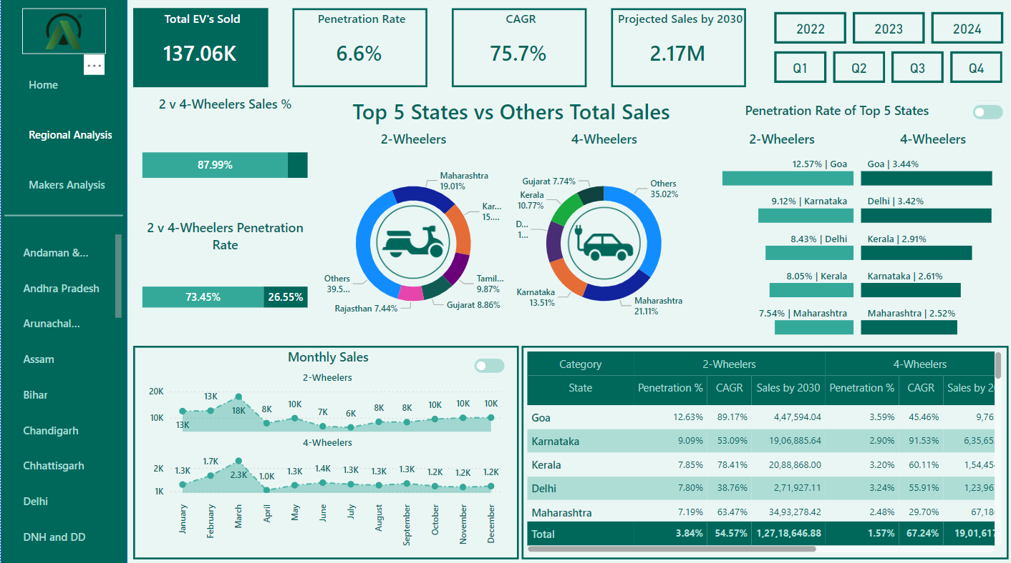
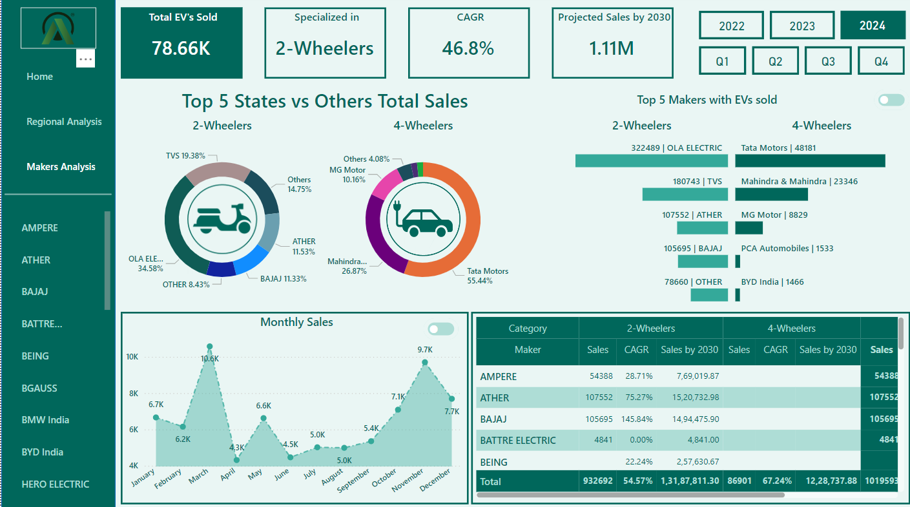
Dashboard Snippet
Visit live Dahsboard
Regional Analysis report
Makers Analysis report

Slide 24
Research resources
The Secondary Questions were answered using the blogs and post from the resources below.
You can find more Information About the Indian Ev Market by referring these links.
https://futuretransport-news.com/10-convincing-reasons-why-electric-vehicles-lead-the-way/
https://www.statista.com/statistics/1482137/india-leading-reasons-to-purchase-electric-vehicle/
https://www.telematicswire.net/fame-ii-scheme-extended-to-july-31-2024/
https://e-vehicleinfo.com/ev-policies-and-subsidies-of-13-states-of-india/
https://theicct.org/publication/electric-vehicle-demand-incentives-in-india-the-fame-ii-scheme-and-considerations-for-a-potential-next-phase-june24/
https://zecat.in/statewise-ev-subsidy-in-india-fully-explained-2023/
chrome-extension://efaidnbmnnnibpcajpcglclefindmkaj/https://assets.ey.com/content/dam/ey-sites/ey-com/en_in/topics/automotive-and-transportation/2022/ey-electrifying-indian-mobility-report.pdf
https://www.mckinsey.com/industries/automotive-and-assembly/our-insights/consumers-are-driving-the-transition-to-electric-cars-in-india
https://www.tataaig.com/knowledge-center/car-insurance/subsidy-for-electric-vehicles
https://diyguru.org/term/what-are-ev-business-opportunities-in-india/
https://www.linkedin.com/pulse/overcoming-obstacles-top-10-challenges-facing-india-rahul-vashisht/
https://allindiaev.com/what-are-ev-business-opportunities-in-india/

Slide 25
Thankyou!!!

