Slide 1

GIT ASSIGNMENT ON RESET
N SUBMITTED BY GROUP 2 -- DIVYANSH DEVRANI
PRASHANT TRIVEDI
SHREYASH KUMAR
MOHD ALIMUDDIN
GAURAV SRIVASTAV

Slide 2

CONTENTS
- VCS
- GIT
- RESET
- BLOCK DIAGRAM OF RESET
- EXAMPLE
WHEN AND HOW TO USE RESET COMMAND
- REPOSITORY LINK FOR COMMIT
MADE BY GROUP 2

Slide 3



Version Control Systems
Version control systems are a category of software tools that helps in recording changes made to files by keeping a track of modifications done to the code.
EXAMPLE OF VCS -)

Slide 4

* IT WAS DEVLOPED BY LINUS TORVALDS. * IT WAS RELEASED ON 7 APRIL 2005. * GIT IS OPEN SOURCE AND FREE. * IT IS A DISTRIBUTED VCS ( VERSION CONTROL SYSTEM ) FOR TRACKING CHANGES IN ANY SET OF FILES , ORIGINALLY DESIGNED FOR COORDINATING WORK AMONG PROGRAMMERS.

Slide 5
GIT RESET
The term reset stands for undoing changes. The git reset command is used to reset the changes. The git reset command has three core forms of invocation. These forms are as follows.
Soft
Mixed
Hard

Slide 6


RESET
SOFT RESET
ONLY CHANGE HEAD, BUT DOES NOT CHANGE STAGED FILE IN INDEX OR WORKING FILE.
MIXED RESET
MOVE HEAD AND UPDATES THE INDEX WITH THE CONTENTS OF THE REVISION TO WHICH HEAD NOW POINTS.
HARD RESET
MOVES HEAD AND UPDATES THE INDEX AND WORKING DIRECTORY. IT IS THE ONLY VERSION OF RESET WHICH CAN CAUSE DATA LOSS.

Slide 7
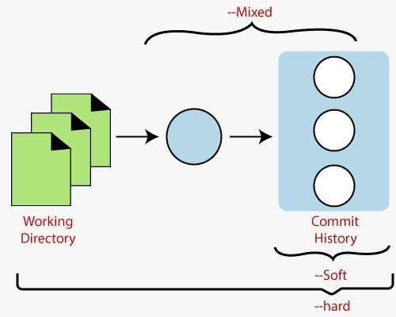

Slide 8
EXAMPLE OF RESET
Suppose you are working on a project and you had done
some changes in it, but now you don’t want to go with those
changes. In this condition you can use RESET command to
undo those changes
LET US ASSUME YOU ARE WORKING ON A PROJECT NAMED
AS “GIT_ASSIGNMENT_2” AND YOU HAD ADDED A FILE
NAMED AS “RESET_ME_PLEASE” IN IT

Slide 9
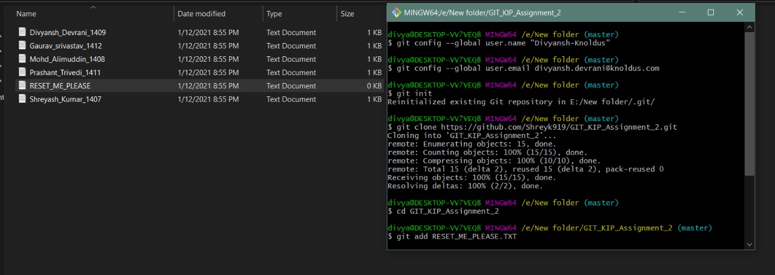
FILE “RESET_ME_PLEASE” HAS BEEN ADDED
BUT NOW YOU DON’T WANT TO ADD THIS FILE AND YOU WANT REMOVE CHANGES SO HERE YOU CAN USE RESET COMMAND TO UNDO CHANGES

Slide 10
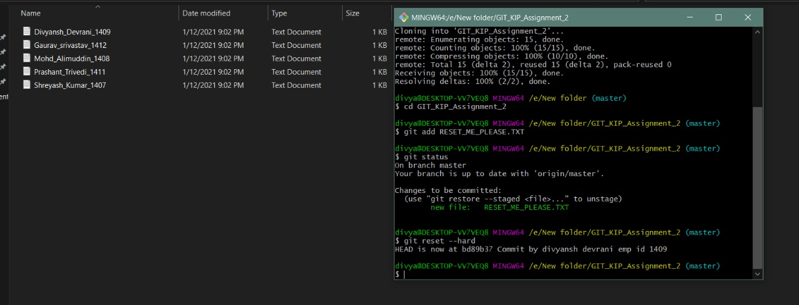
HERE FILE “RESET_ME_PLEASE” has been removed

Slide 11
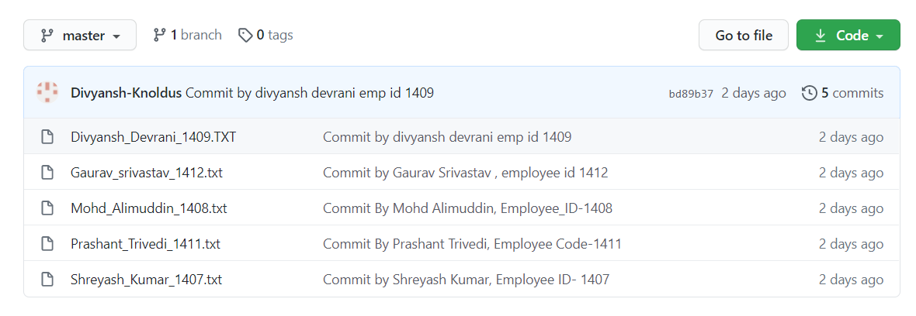
REPOSITORY LINK FOR COMMIT MADE BY GROUP 2
https://github.com/Shreyk919/GIT_KIP_Assignment_2

Slide 12
thanks!

