Slide 1

Deep Learning-Based Cyclone Intensity Prediction Using INSAT-3D Satellite Imagery
SRM INSTITUTE OF SCIENCE AND TECHNOLOGY
SCHOOL OF COMPUTING
DEPARTMENT OF COMPUTING TECHNOLOGIES
18CSP107L / 18CSP108L - MAJOR PROJECT / INTERNSHIP
Batch ID:
Student 1 Reg. No: RA2111003010437
Student 1 Name: Gorrela Sai Saketh
Student 2 Reg. No: RA2111003010444
Student 2 Name: Shrey Kanwar Rathore
Guide name: Dr. Priya S.
Designation: Associate Professor Department: Computing Technologies

Slide 2
Introduction
Tropical cyclone intensity estimation is vital for reducing disaster impact. This project uses a deep CNN with half-hourly INSAT-3D IR images (from 2014 onward) to capture rapid cyclone changes during evolution, intensification, and landfall. Employing both a custom CNN and a modified AlexNet with max pooling, the approach selects the most accurate model for intensity prediction. This indigenous solution minimizes reliance on foreign data and underscores deep learning's transformative role in disaster preparedness.

Slide 3
Abstract
Accurate tropical cyclone intensity prediction is essential for safeguarding coastal communities. This project employs deep Convolutional Neural Networks—including a custom CNN and AlexNet—to analyze half-hourly INSAT-3D IR images, capturing rapid cyclone changes from data spanning 2014 over the Indian Ocean.

Slide 4
Purpose
Enhanced Disaster Preparedness: Deep learning models improve cyclone intensity estimation, reducing forecast uncertainty and enabling timely preventive actions.
Indigenous Forecasting: Utilizing half-hourly INSAT-3D IR images with a custom CNN and modified AlexNet, this solution minimizes reliance on foreign data.
Advanced Techniques: State-of-the-art methods capture rapid cyclone changes, overcoming the limitations of traditional intensity estimation.
Scalable and Future-Ready: The system is designed for continuous enhancement and broader disaster management applications.

Slide 5
Existing System
The existing CNN system predicts tropical cyclone intensity using satellite imagery, automating feature extraction and intensity estimation with higher accuracy than traditional geometric feature-based MLP methods to improve disaster response capabilities.
Key Features:
Deep Learning-Based Analysis: Employs CNNs to automatically detect spatial and structural patterns from raw satellite images, eliminating reliance on manual feature engineering.
Superior Accuracy: Leverages deep learning to capture complex cyclone characteristics, outperforming methods using predefined geometric features and simpler MLP networks.
Timely Disaster Response: Generates rapid, data-driven intensity predictions to support early warnings and mitigate infrastructure and life loss.

Slide 6
Disadvantages
Manual Feature Extraction: Requires predefined geometric features, whereas our CNN models automatically learn patterns from raw images.
Limited Model Complexity: Uses MLP, which is less effective for image processing compared to our CNN and AlexNet architectures.
Lower Prediction Accuracy: Simpler models may not fully capture complex cyclone patterns, making predictions less precise.
No Real-Time Processing: Lacks the ability to analyze live satellite data, while our system can provide real-time intensity estimations.

Slide 7
Proposed System
The proposed CNN system predicts tropical cyclone intensity using INSAT-3D IR imagery, automating real-time forecasts with higher accuracy than traditional methods to enhance disaster preparedness and response.
Key Features:
Deep Learning-Based Prediction: Uses CNN to analyze cyclone patterns from satellite images.
Higher Accuracy: Learns from historical data (2014 onwards) for precise predictions.
Enhanced Disaster Preparedness: Enables quicker, data-driven decision-making to minimize damage.

Slide 8
Advantages
Enhanced Accuracy: Achieves superior precision over traditional techniques by learning spatial-temporal cyclone patterns from raw IR data.
Scalable Design: Modular architecture enables seamless integration with urban management systems for real-time monitoring.
Resource Efficiency: Optimizes computational costs using lightweight CNNs and high-performing pre-trained models like AlexNet.
Customizability: Allows for hyperparameter tuning to further improve results when computational resources permit.

Slide 9
Deep CNN
Deep CNN is a custom-built model designed to extract key spatial features from satellite images to estimate cyclone intensity.
The model consists of three convolutional layers that process the input images, enhancing important features such as cyclone eye structure and cloud patterns.
Each convolutional layer is followed by an activation function (ReLU) to introduce non-linearity and improve feature learning.
This architecture helps in effective pattern recognition, making it well-suited for analyzing cyclone intensity variations from satellite data.

Slide 10
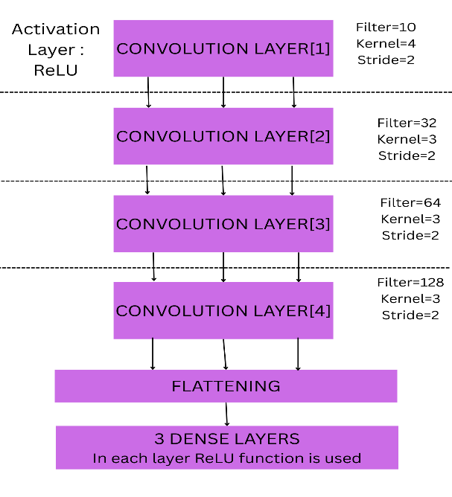
Deep CNN Architecture

Slide 11
AlexNet
Deep CNN is a custom-built model designed to extract key spatial features from satellite images to estimate cyclone intensity.
It consists of multiple convolutional layers, but with the addition of max pooling layers, which help in reducing the dimensionality while retaining essential features.
The max pooling operation ensures that only the most significant cyclone patterns are preserved, improving model efficiency.
The fully connected layers at the end help in mapping the extracted features to cyclone intensity levels.

Slide 12
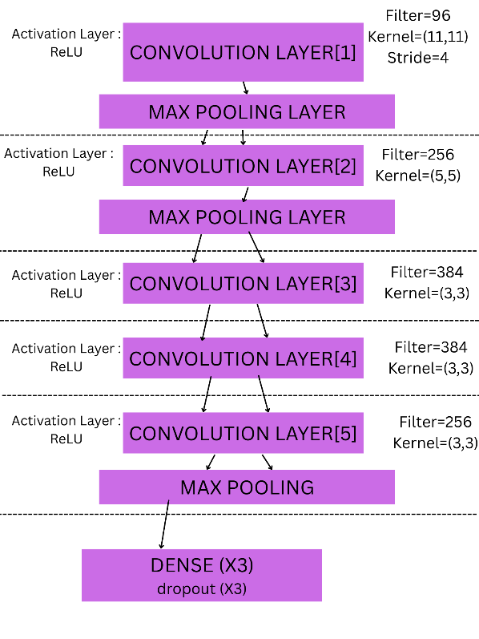
AlexNet Architecture

Slide 13
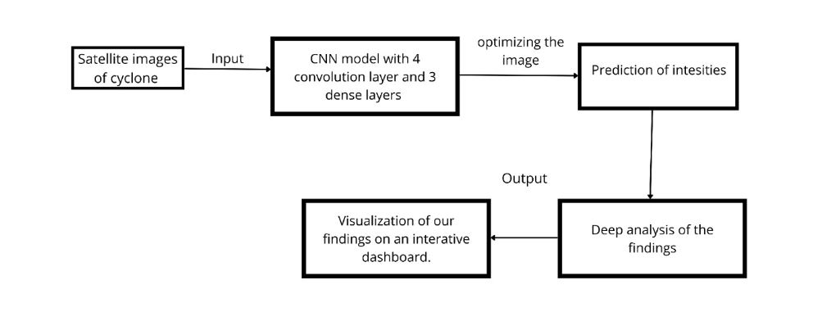
Architecture Diagram

Slide 14
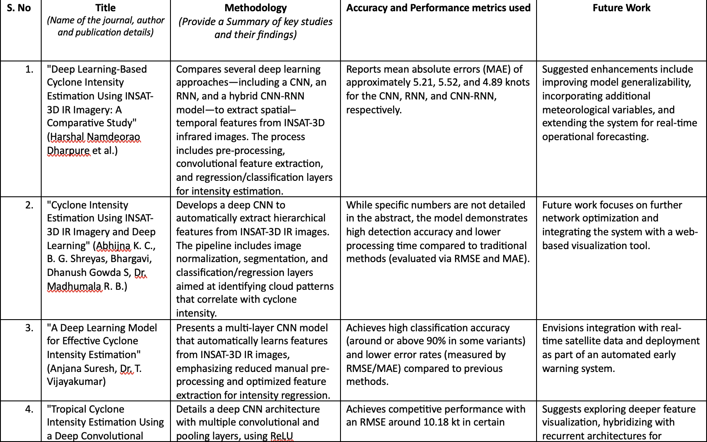
Literature Survey

Slide 15
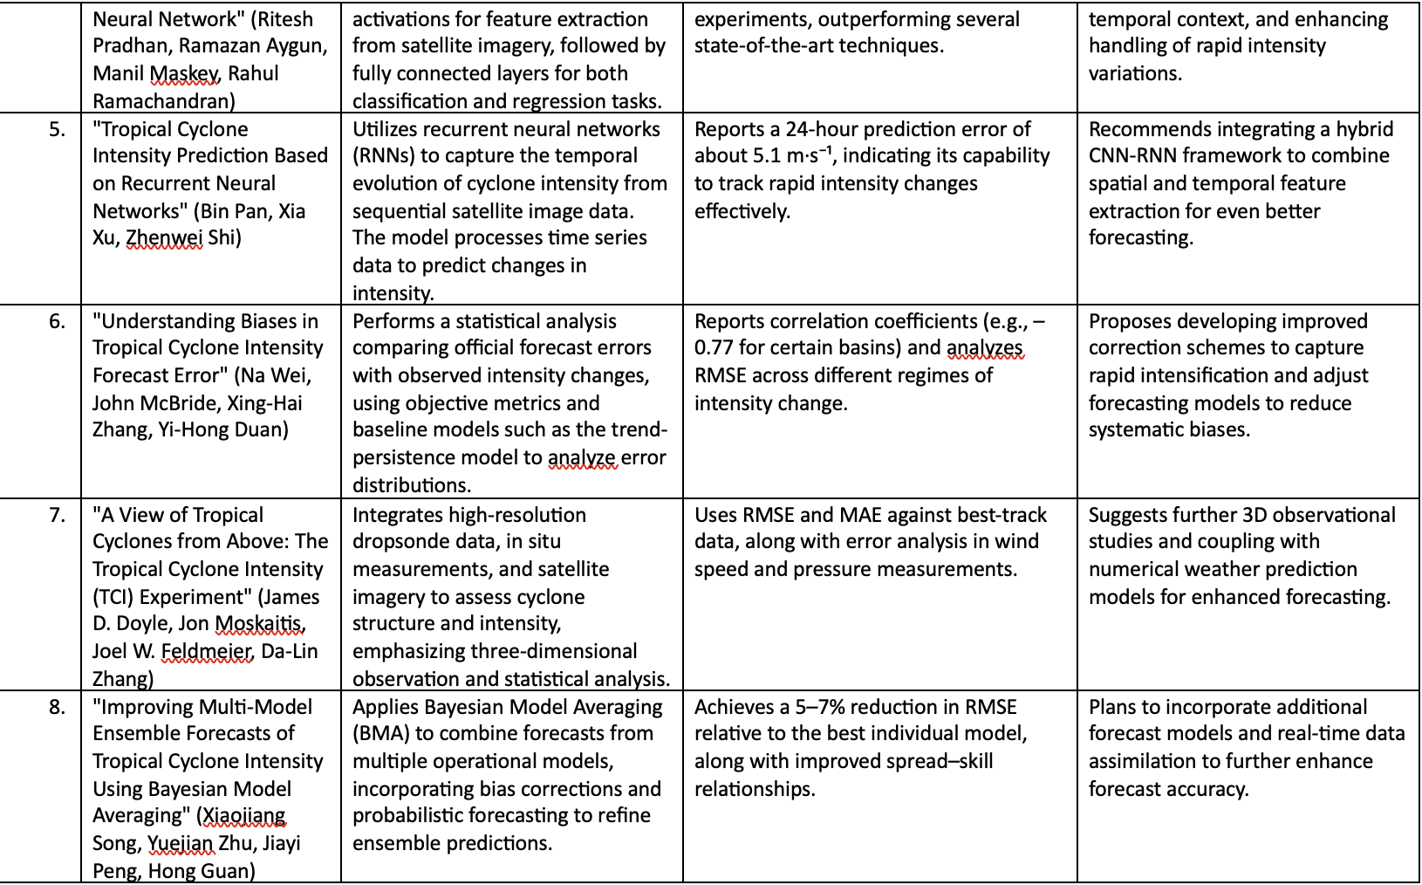
Literature Survey

Slide 16
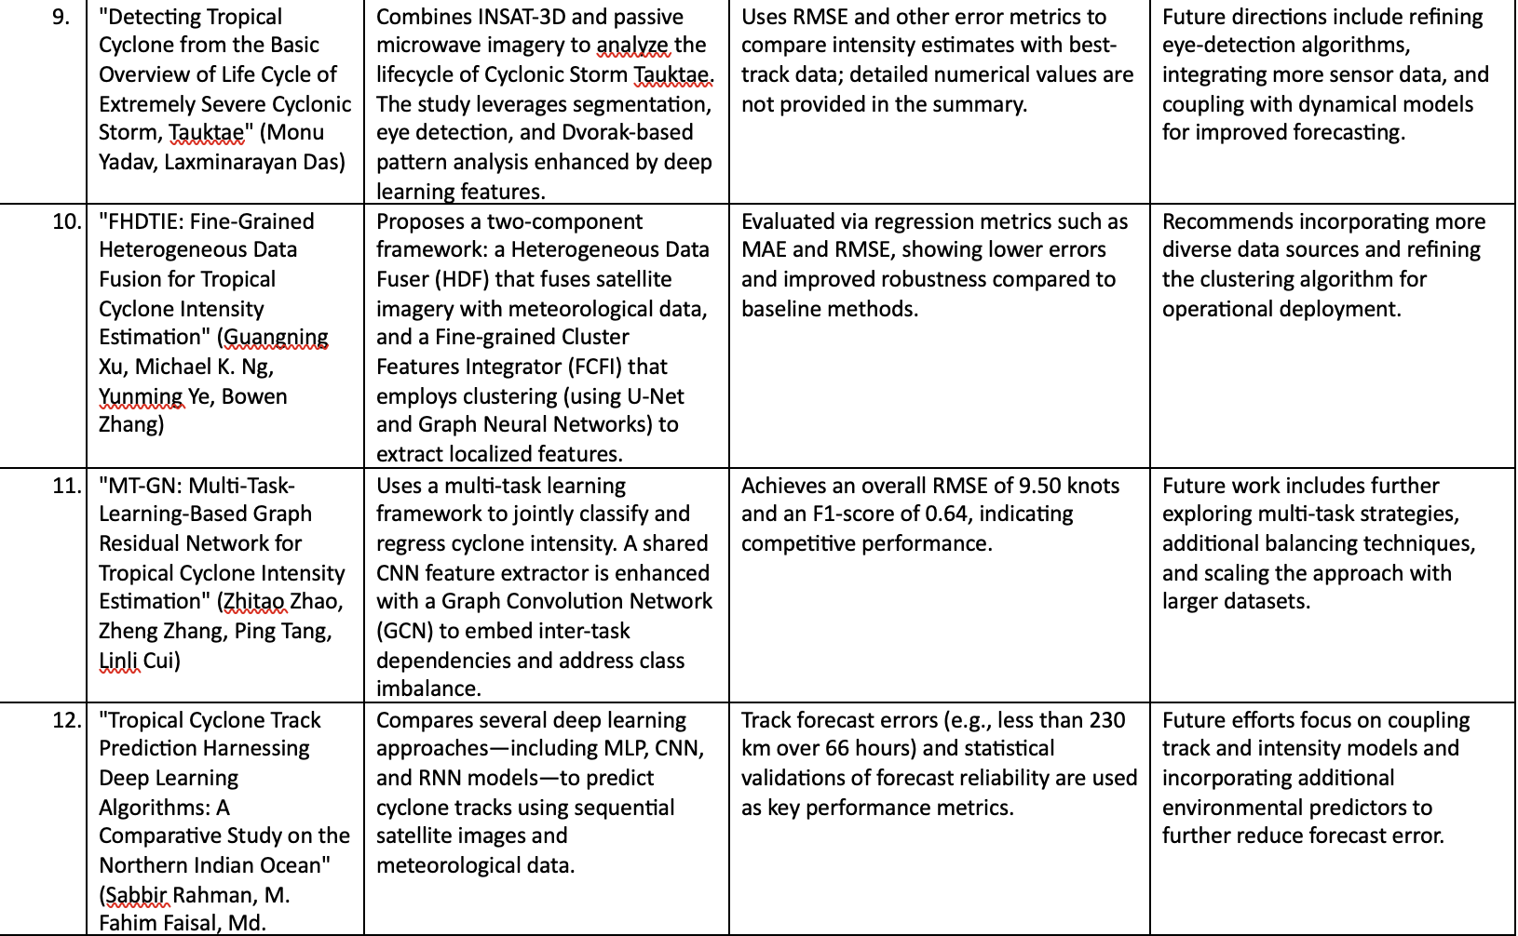
Literature Survey

Slide 17
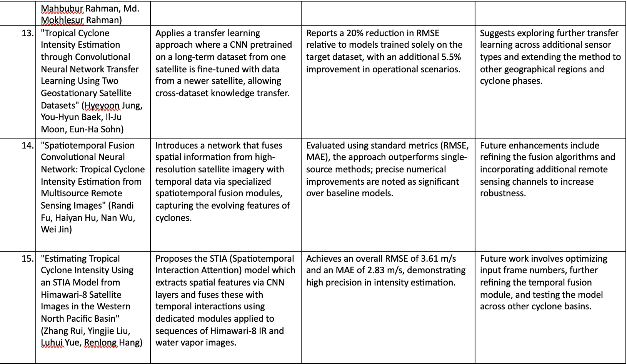
Literature Survey

