Slide 1
DEVELOPMENT AND ANALYSIS OF ARTIFICIAL NEURAL NETWORK FOR RAINFALL PREDICTION
Shri Shankaracharya Institute of Professional Management & Technology, Raipur
Major Project(Phase-I) Report on
CSE 7th Semester
Department of Computer Science and Engineering,
Batch 2019-2023
Session July – Dec 2022
Presentation Date: 24 January 2023
Project Group Members:
Ayush Kumar Sahu
Lokesh Nirmalkar
Shikhar Bargah
Project Guide
Prof. Manoj Singh
(Astt. Prof , CSE)

Slide 2
Introduction about Project
This project is made for prediction of rainfall using Artificial Neural Network(ANN) which is based on prediction and smartly analyzing the previous datasets to predict the future outcome. By using this project model a user can able to predict the future prediction of rainfall. ANN models have been found to be very accurate in calculation, which will help the user to predict the outcome.

Slide 3
Application Area
This project is opted for predicting the rainfall using Artificial Neural network.
By taking the previous data this model will predict the rainfall by analyzing the previous datasets used for prediction.
End users of this model are normal peoples, farmers who wants to know about the prediction of rainfall.

Slide 4
Literature Review
Weather forecasting is one of the most imperative and demanding operational responsibilities carried out by meteorological services all over the world. It is a complicated procedure that includes numerous specialized fields of know-how. The task is complicated because in the field of meteorology all decisions are to be taken in the visage of uncertainty. Different scientists over the globe have developed stochastic weather models which are based on random number of generators whose output resembles the weather data to which they have been fit. The reason is that ANN (Artificial Neural Network) model is based on 'prediction' by smartly 'analyzing' the trend from an already existing voluminous historical set of data.

Slide 5
System requirements
The Software Requirements of our system are:-
1.flask
2.wtforms
3.fbprophet
3.sklearn
4.Keras
5.Tensorflow
6.Imblearn
Hardware requirements
laptop/pc
4GB RAM
I3 processor or above
internetconnection

Slide 6
Problem Identification
To develop an ANN model is to forecast average monthly rainfall in the various parts of India. Indian economy is standing on the summer monsoon. So prediction of rainfall is a challenging topic to Indian atmospheric scientists. Back propagation ANN to forecast the average summer monsoon rainfall over different parts of India.
6

Slide 7
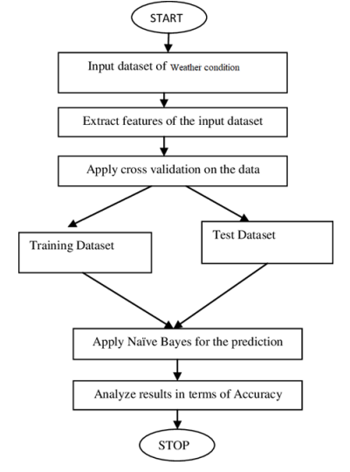
SDLC Model

Slide 8
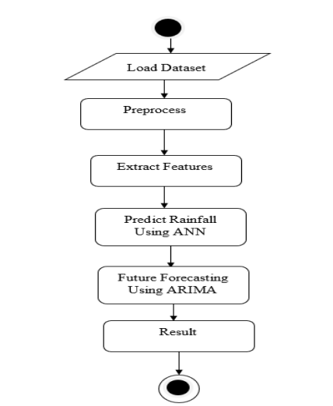
Project Work Flow Diagram

Slide 9
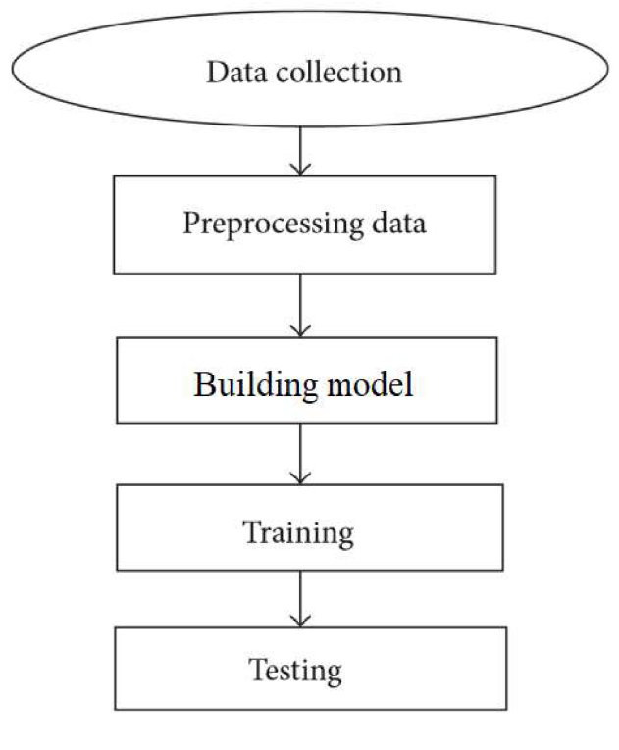
Data flow diagram
9

Slide 10
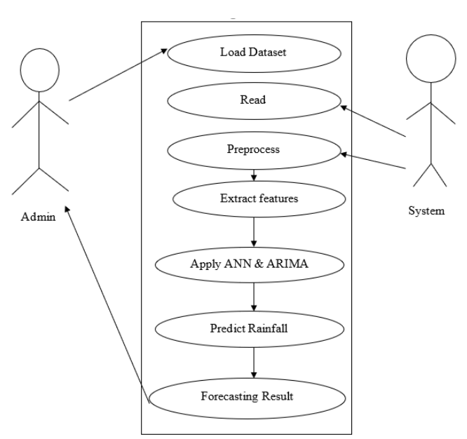
Use case diagram
10

Slide 11
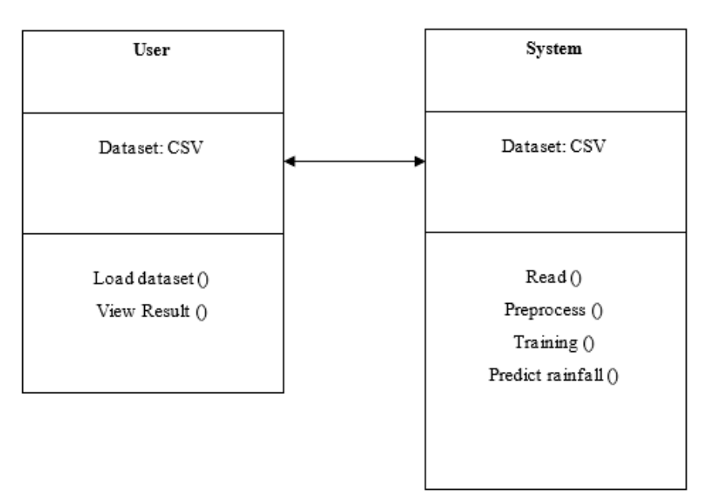
ER Diagram

Slide 12
Result & Conclusion
This project represented the Deep Learning Approach for predicting the rainfall by using the ANN (ARTIFICAL NEURAL NEIWORK). Comparing the present architecture with other state approaches. This project provided a study of ANN used to forecast and predict rainfall and issues that could be found when applying different approaches to forecasting rainfall. Because of nonlinear relationships in rainfall datasets and the ability to learn from the past, Artificial Neural Network makes a superior solution to all approaches available. The future work of the project would be the improvement of architecture for light and other weather scenarios. Also, can develop a model for small changes in climate in future. An algorithm for testing daily basis dataset instead of accumulated dataset could be of paramount Importance for further research.

Slide 13
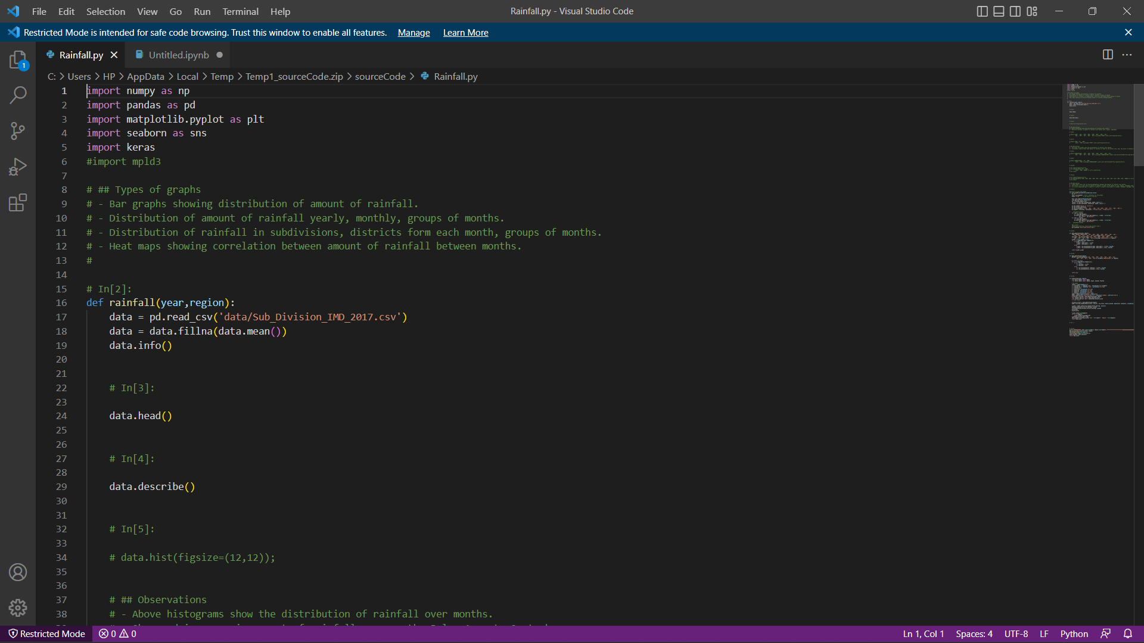
Snapshots

Slide 14
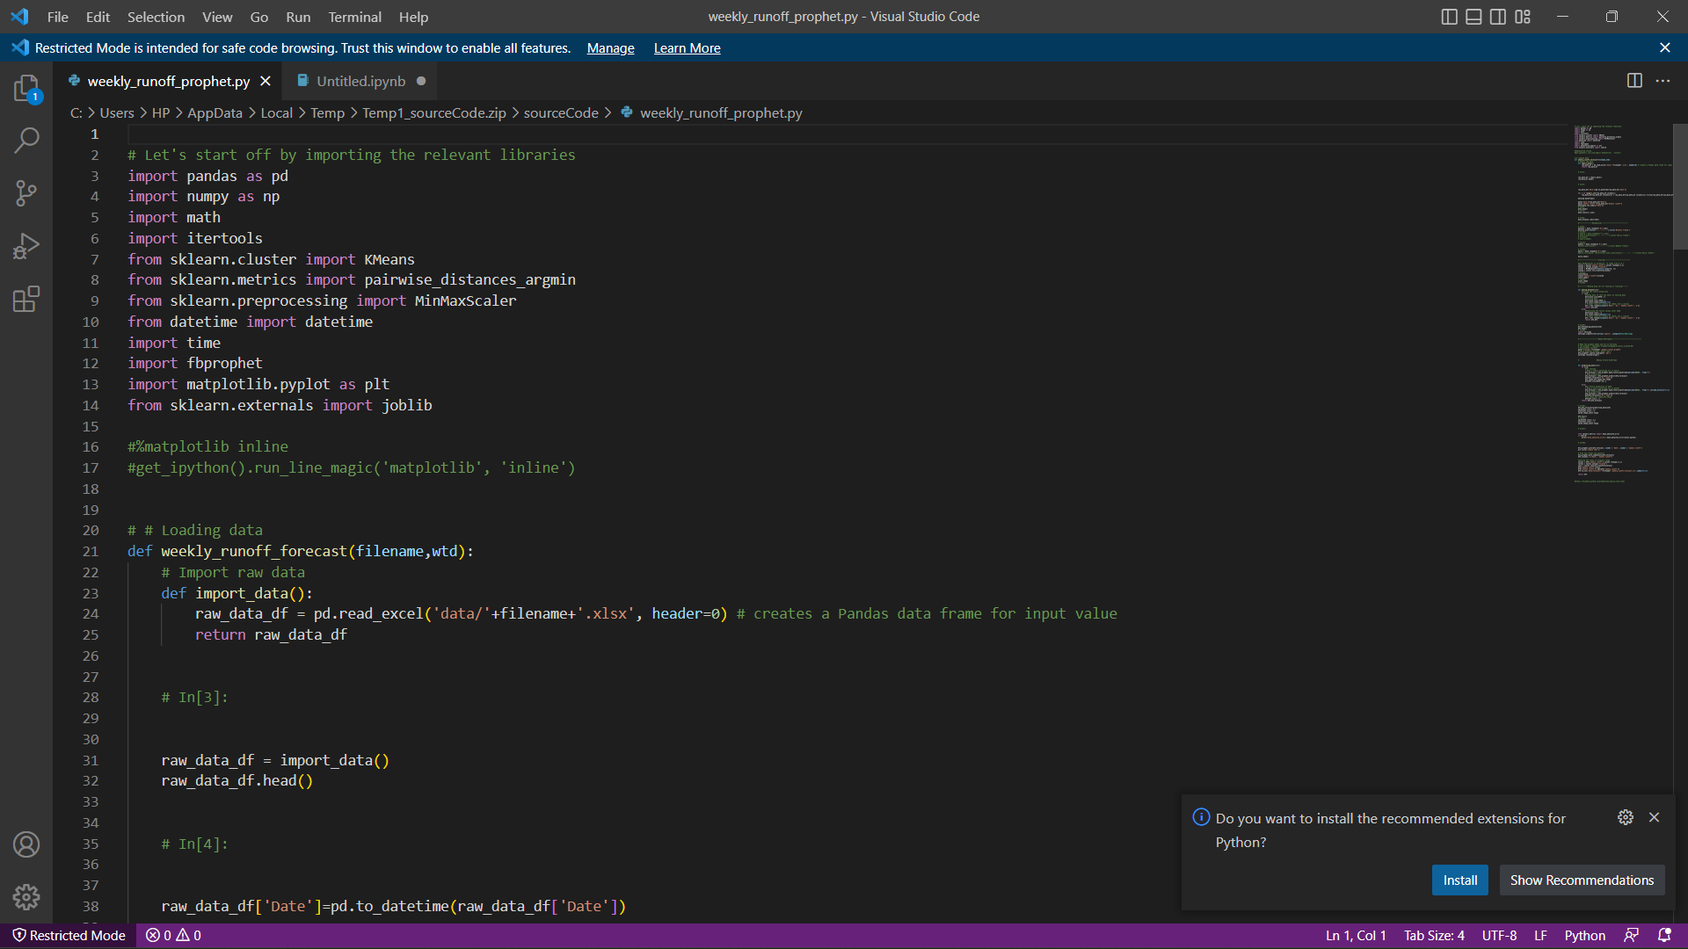

Slide 15
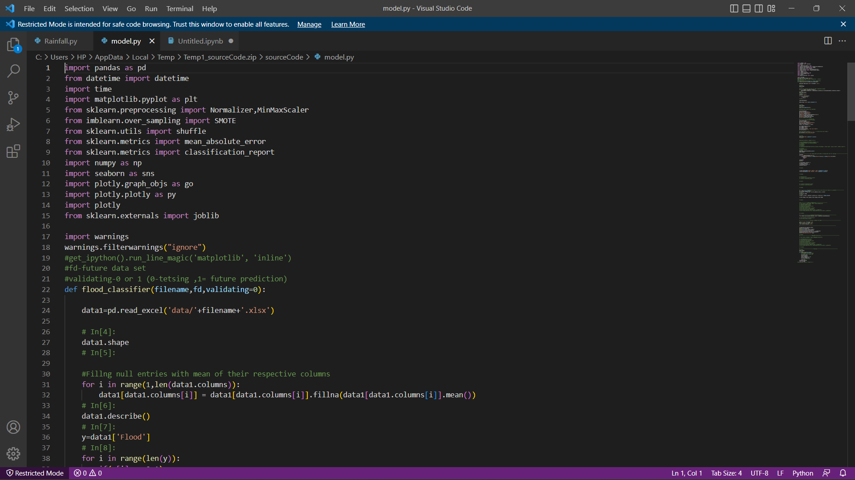

Slide 16
References
Text Book
Mosavi, A., Ozturk, P., & Chau, K. W. (2018). Flood prediction using machine learning models: Literature review. Water (Switzerland), 10(11). https://doi.org/10.3390/w10111536
Web Resources
http://www.stackoverflow.com
http://www.slideshare.com/androidintro.ppt
http://www.sharepdf.com/java1.6help.pdf

Slide 17
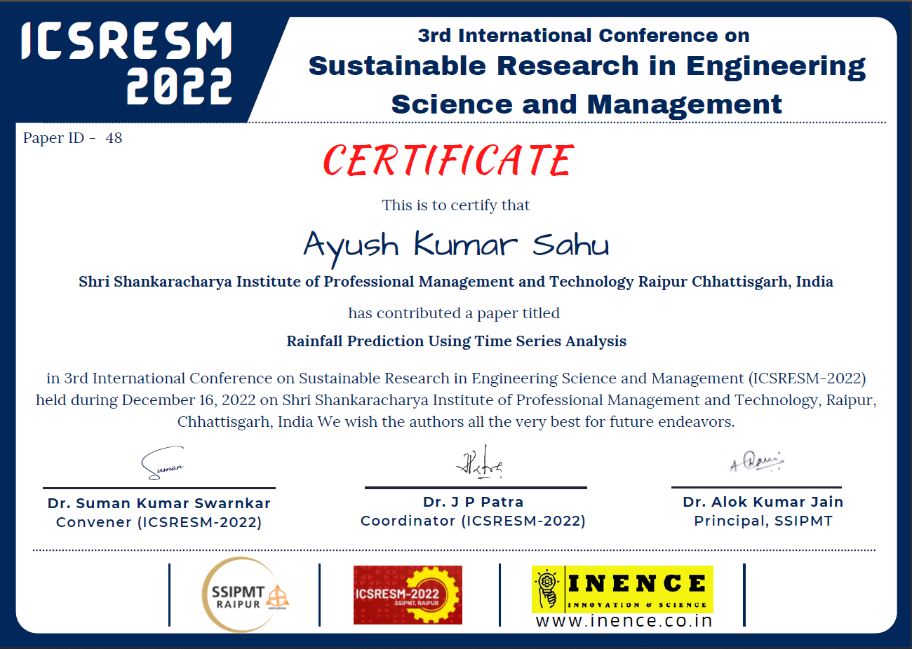
Paper Publication Details

Slide 18


Slide 19


