Slide 1
Song Recommendation Using Mood Detection
Shri Shankaracharya Institute of Professional Management & Technology, Raipur
Major Project(Phase-I) Report on
CSE 7th Semester
Department of Computer Science and Engineering,
Batch 2019-2023
Session July – Dec 2022
Presentation Date: 24.01.2023
Project Guide
Mr. Anand Tamrakar
(Asst. Professor, Dept of C.S.E)
Project Group Members:
Aditya Londhe
Shramistha Sinha

Slide 2
Introduction about Project
This paper proposed an emotion-based music player, which can suggest songs based on the user's emotions; sad, happy, neutral and angry. The application receives either the user's heart rate or facial image from a smart band or mobile camera. It then uses the classification method to identify the user's emotion. This paper presents 2 kinds of the classification method; the heart ratebased and the facial image-based methods. Then, the application returns songs which have the same mood as the user's emotion. The user and song emotions
in this paper are divided into four types namely: neutral, happy, sad and angry. The experimental results present that detecting the happy emotion is the most precise with around 98%, while the accuracy of the sad mood detection is the lowest with 40%.

Slide 3
Application Area
Why did you opt to work on this project?
now days every one can listen to music from cloud-based app because of too many playlist their user confuse which to listen , so we created this emotion detection listen to music depend on the user mood.
What are the Applications and Benefits of this project?
It is often confusing for a person to decide which music he/she must listen from a massive collection of existing options. There have been several suggestion frameworks available for issues like music, dining, and shopping depending upon the mood of user.
Who are the End Users of this project?
The user who is addicted to music and can’t find which music to listen because of too many playlist.

Slide 4
Literature Review
Literature Survey
This an emotion-based music player, which can suggest songs based on the user's emotions; sad, happy, neutral and angry. The application receives facial image from camera
Problem Identification
The significance of music on an individual's emotions has been generally acknowledged. After the day’s toils and hard works, both the primitive and modern man able to relax and ease him in the melody of the music. Studies had proof that the rhythm itself is a great tranquilizer.
However, most people facing the difficulty of songs selection, especially songs that match individuals’ current emotions. Looking at the long lists of unsorted music, individuals will feel more demotivated to look for the songs they want to listen to. Most user will just randomly pick the songs available in the song folder and play it with music player. Most of the time, the songs played does not match the user’s current emotion.

Slide 5
Project Requirements (Developer)
Software’s Required (With Versions duly mentioned) :-
Python 3.8.10
Streamlit
Stream_webrtc
Open cv2
Numpy
Mediapipe
Hardware Required :-
Hard Disk : 512GB
RAM : 16GB
AMD RYZEN 7 4800H 8core 16 thread
GPU RTX 2060 6gb

Slide 6
Project Requirements (End User)
Software’s Required (With Versions duly mentioned):-
Any OS (OPERATING SYSTEM)
Any web browser
Hardware Required:-
Storage :- 1GB

Slide 7
Back End Details
What Back End your project is using?
PYTHON
PYTHON LIBRARIES
Machine Learning
How Many Databases?

Slide 8
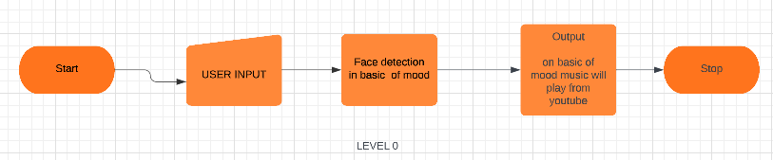
Data Flow Diagram

Slide 9
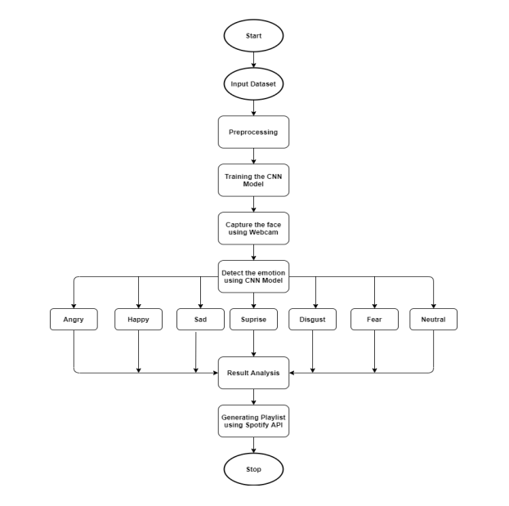
Project Workflow Diagram

Slide 10
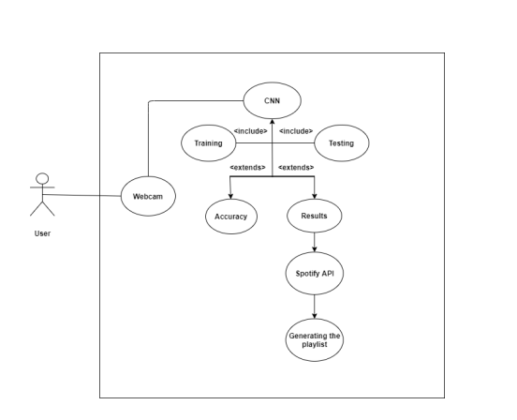
Project Use Case Diagram

Slide 11
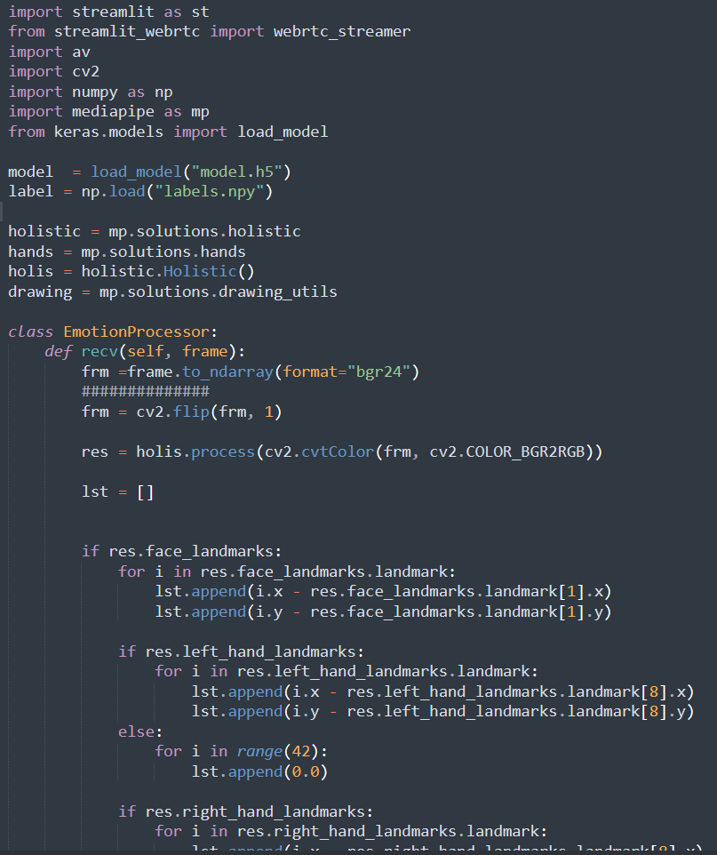
Project Backend Code

Slide 12
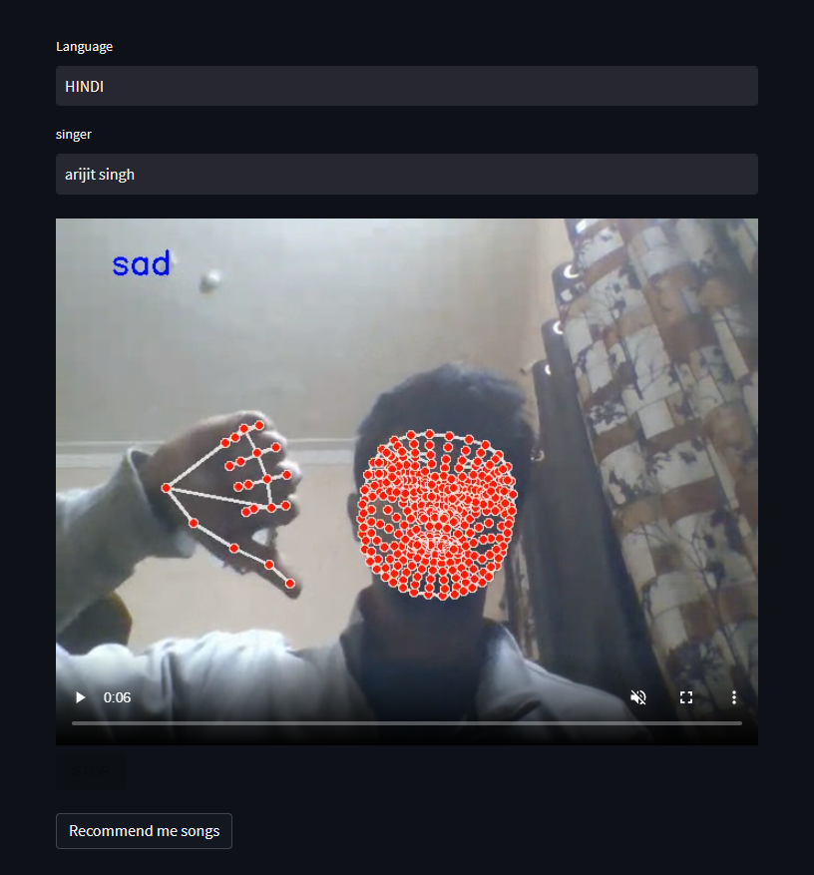
Project Output
Front End Details

Slide 13
Result & Conclusion
The significant of this project is the emotion detection of the images loaded into the proposed model. The main purpose is on its emotion detection functionality. Through the integration between emotion detection technology and music player, the proposed model is aimed to provide betterment in the individual’s entertainment. The proposed is able to detect the four emotions i.e. normal, happy, and sad of the images loaded into it. Once the proposed model compared and detected the emotion of the user, the music player will play the song(s) accordingly.

Slide 14
References
Web Resources
https://utpedia.utp.edu.my/id/eprint/6334/1/TanSiewChing12873_finaldissertation.pdf
(PDF) Music Emotion Recognition using Python (researchgate.net)
Emotion_Based_Music_Recommendation_System-libre.pdf (d1wqtxts1xzle7.cloudfront.net)
https://www.lucidchart.com/pages/data-flow-diagram

Slide 15
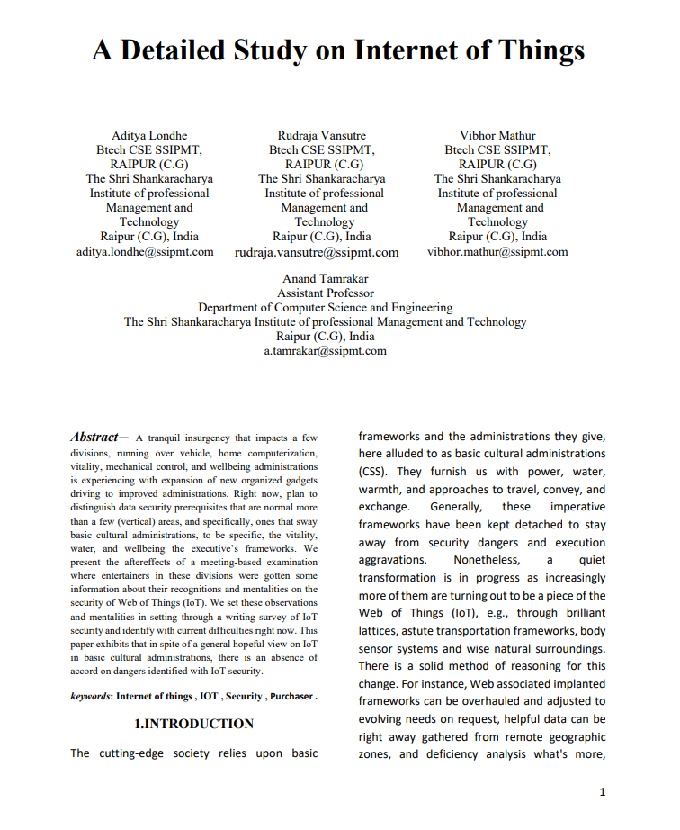
Paper Publication Details
14

Slide 16
