Slide 1

MAJOR PROJECT
Under The Supervision of
Mr. P.K. Hazra
GROUP 1
Ayush Malik ( 1723907)
Rana Ibrahimi ( 1723926)
Shivani Tiwary ( 1723934)

Slide 2
Our Discussion Today
Project Overview
Functions and Features
Design and Implementation
Shortcomings
And
Future Scope

Slide 3

Project Overview

Slide 4
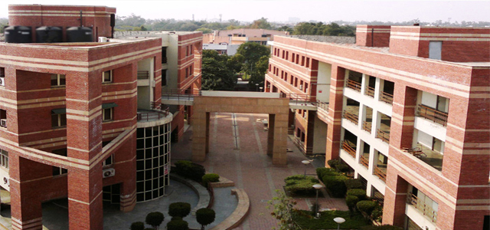
Department Of Computer Science Placement Application

Slide 5
We have designed an Android Application which simplifies the placement process of Department Of Computer Science, University of Delhi.
The application is going to target 3 set of Users.
FACULTY
PLACEMENT
COORDINATORS
STUDENTS

Slide 6
Problems Faced in Current System
Mail Handling
Unread Mails
Data Management
Fund Management
Undue Advantage of Placement Drives
No Registration Mechanism

Slide 7

Functionalities

Slide 8
Placement Coordinator
Mail Handling
Making Announcements to send Information
Announcement Log
Managing Expenditure
Direct Access to Student and Company Information
Enabling G.P.S. Attendance
Managing Student and Company Data
Tracking Student’s Location
Sending Notifications
Managing Student Registrations

Slide 9
Faculty
Track Student Location
Announcements and Notifications
Direct Access to Student and Company Information
Announcement Log
Tracking Expenditure

Slide 10
Student
Register For Placement Drives
Announcements and Notifications
Direct Access to Company Information
Announcement Log
Tracking Expenditure
Hiring Predictor

Slide 11

Design and Implementation

Slide 12


Slide 13
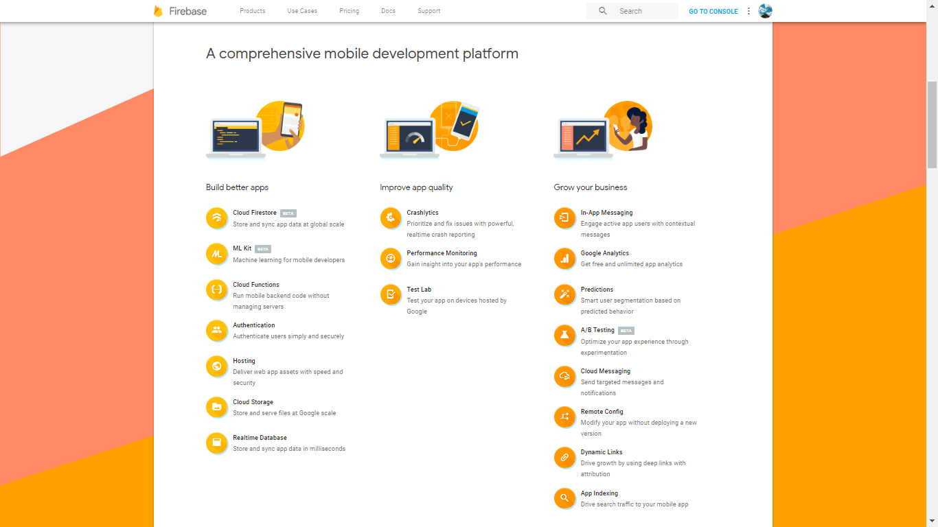

Slide 14



Application Setup
Firebase Server
Super User
(Firebase Console)
Placement
Coordinators
Faculty
Students

Slide 15
Firebase Services we will be using :
Authentication
Cloud Firestore Database
ML Kit
Cloud Functions
Cloud Messaging
Test Lab

Slide 16

Student and Company Queries
Live Location Tracking
Real-Time Database
Login and Registration of Students, Teachers and Faculty
Simplified Mail Handling for Placement Co-ordinators

Slide 17
Expenditure Management
Student Registrations for Placement Drives
Artificially Intelligent Hiring Prediction
GPS based Attendance
Announcements, Notifications and Announcement Log

Slide 18
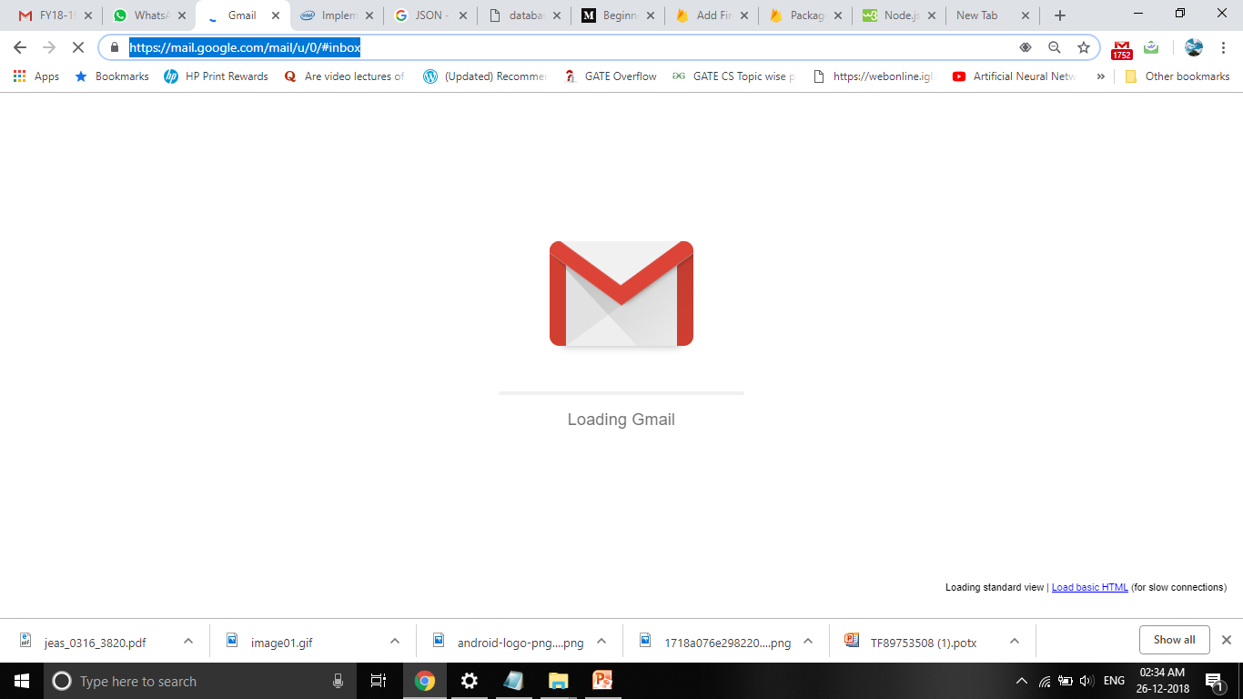
Mail Handling Module
One of the main tasks for the Placement Coordinators ( PCs) is mail handling.
Many times , the mails sent are repetitive in nature. This functionality simplifies the task of sending mails which are repetitive in nature and have similar content.
The application simplifies 3 types of mails :
Placement Invites : These are the mails sent to the companies giving them details about the department and its students.
Faculty Company Information : These request permissions for various rooms for the upcoming placement drives. It also gives the details of the upcoming companies to the Faculty.
Student Company Information : It gives the students information about the upcoming placement drives. This includes information such as company name, package offered, job location, etc.
This module will accept some simple information from the PC. It will automatically compile the mail message and then send it to a pre-defined user base.
We implement this module using Gmail and Intents.

Slide 19

Login and Authentication

Slide 20
Verify E-mail
Verification E-mail
E-mail Verified
E-mail
User Credentials
E-mail
Found / Not Found
Allow / Deny
Access
Allow / Deny
Registration
Firebase Cloud
Firestore
User
Sign In
New User
Sign Up

Slide 21

Announcements Student Registrations G.P.S. Attendance

Slide 22




Push Notifications
Calls
Event Triggered
Firebase Cloud
Functions
Firebase Cloud
Messaging Service
Push
Notifications
Event Triggered
Firebase Cloud
Firestore
Writes
To
Database
Local
Action
Local
Action
Selected Users

Slide 23
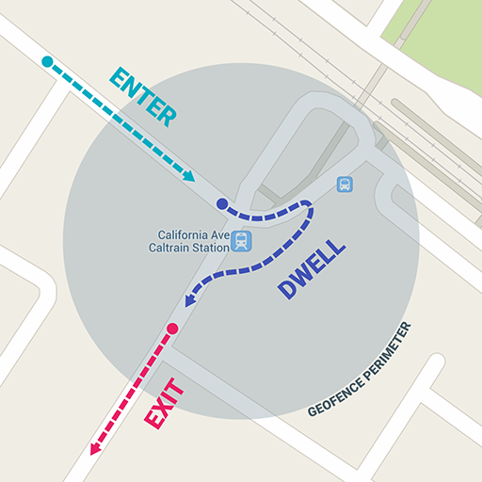
G.P.S. Attendance Location Tracking

Slide 24
GPS
Marking Attendance
Location Tracking
Marking Attendance : The Placement Coordinator will activate the attendance in a GPS based location boundary around his/her cell phone (Placement Drive Premises ). When a Student enters this boundary with his/ her registered cell phone, only then he/she will be able to submit his/her attendance.
Location Tracking : During the specified time of any particular placement drive, the Faculty/ Placement Coordinator will be able to monitor the location of all the students. This utility can be used to ensure transparency.

Slide 25


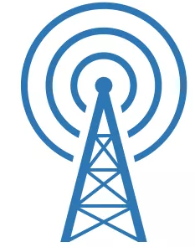
Runs
Periodically
Writes
Latitude-Longitude
Firebase Cloud
Firestore
Service
Gets
Latitude-Longitude
Get
Location
Request
Location
Start
Boot Completed
Placement Coordinator
Faculty
Student
Broad Cast Receiver

Slide 26

Real-time Database

Slide 27
Cloud Firestore
Cloud Firestore is a NoSQL, document-oriented database which stores data in documents arranged in collections.
Simple data is stored in documents, Complex hierarchical data is conveniently organized using sub collections within documents.
Each document contains a set of key-value pairs.

Slide 28
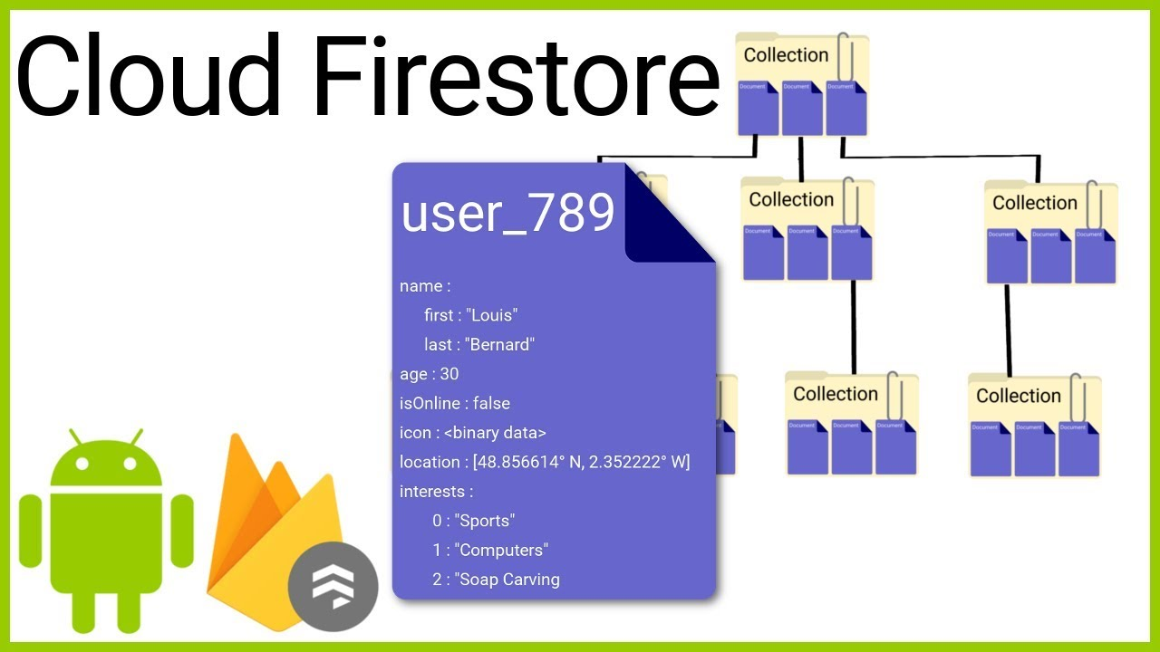

Slide 29
Collections
announce
expenditure
mails
placement_coordinators
placement_events
students
company

Slide 30
Any Changes made to the Cloud Firestore database are immediately reflected across all the devices as soon as they are connected to the Internet.
Application senses change in database using event listeners.
Firebase Cloud Functions are called by the event triggered due to change in the database.
Application uses above mechanism to serve many functions.

Slide 31


Hiring Predictor

Slide 32
We have built an Artificial Neural Network (ANN) to predict if a student will be hired in his/her placement drive or not.
The ANN is built in Python using TensorFlow Library. It is trained using a training dataset. The model which was obtained after training is saved as a Tensor Flow Lite (.tflite) model in Firebase using Firebase ML Kit (Beta).

Slide 33
Attribute | Domain | Interpretation
Score | Whole Numbers from 0 to 100 (including 0 and 100) | Percentage of the student in post-graduation
Gender | {0,1} | 0- Male, 1-Female
Language | {1,2,3,4} | Preferred programming language 1-C++, 2- Java, 3-Python, 4-Other
Communication Skills | {1,2,3} | 1-Average, 2-Good, 3-Excellent
LessMarks | {0,1} | 0-Student didn’t get less than 70% marks in 10th or 12th 1-Student got less than 70% marks in 10th or 12th
Technical Knowledge | {1,2,3,4,5} | 1-Poor ; 5-Excellent
Coding Skills | {1,2,3,4,5} | 1-Poor ; 5-Excellent
Course | {0,1} | 0-M.C.A. , 1-M.Sc.
Projects | Whole Numbers | It indicates the number of projects a student has worked on
Hired | {0,1} | 0-Not Hired,1-Hired

Slide 34
Link to Python Code
Tensor Flow Example\My_Neural_Network.py
Link to Training Dataset
..\Downloads\my_train_data.csv
Link to Testing Dataset
..\Downloads\my_test_new.csv

Slide 35

Student and Company Queries Announcement Log Expenditure Management

Slide 36
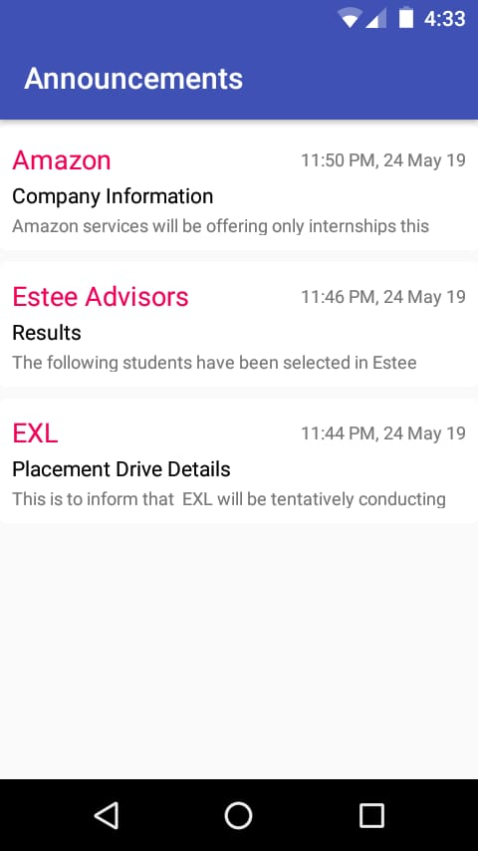
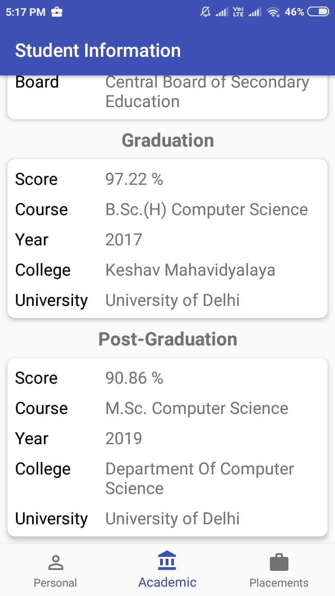
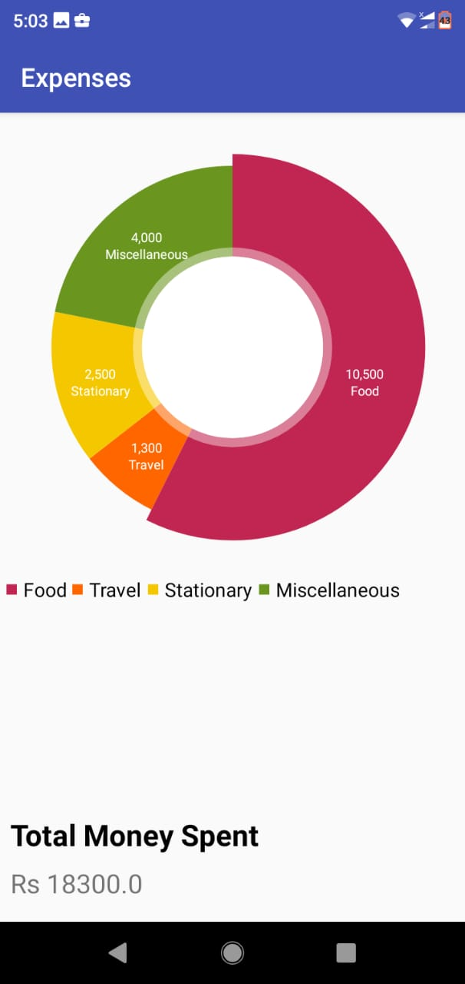

Slide 37

Shortcomings and future Scope

Slide 38
Issues to be solved before deployment
Database Security
Cost Estimation
Beta-testing
Future Work
Additional functionalities
iOS and non-smartphone users
Improved data input validations
Others
Improvement of Hiring Predictor

Slide 39
THANK YOU

