Slide 1
Inventory Control
(A React Js Spring Boot Project)

Slide 2
INTRODUCTION
A Inventory control is the process that controls the stocks or products that a business plans to sell.
A record of the product is maintained by this Inventory Management System.

Slide 3
DETAIL OF INVENTORY
BACK END
The backend, which runs as a Spring Boot programme and provides administrative and product logic.
FRONT END
React is used in the development of front end, which redirects to the home page where you can view the operations to carry out.

Slide 4
INVENTORY DETAIL
SPRING BOOT
Model: Product and Admin
Repository: Product and Admin
Service: Product, ProductImpl
Controller: Product and Admin
REACT JS
Component: Add and Edit Product
Home and Navigation
Service: Product

Slide 5
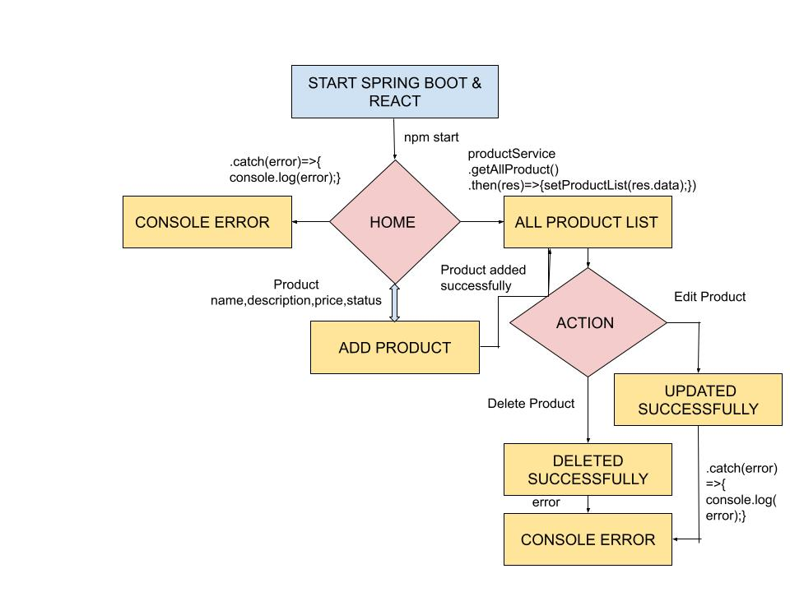

Slide 6
OBJECTIVE
The main objective of the Inventory Control is to check the product if available or not.
It enables you to ensure that the stock or product required for production is available so that production does not suffer.

Slide 7
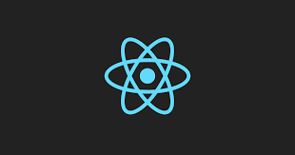

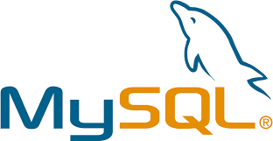
TOOLS USED
React Js
Spring Boot
MySql

Slide 8
THANK YOU

