Slide 1
Graphical Representation & Chat Analysis
Presented By :
112103017 – Hariom Badarkhe
112103048 – Shrikant Hamand
Project Guide:
Prof. Khushal Khairnar

Slide 2
Contents
1. Project Conception and Initiation
2. Project Design
3. Implementation
4. Result
5. Conclusion and future scope
6. References

Slide 3
1. Project Conception and Initiation

Slide 4
1.2. Objectives
To provide user friendly interface for performing operations.
To pre-process the data in such a way that can be suitable to the model.
To automate the process of analysing the WhatsApp chat.
To have ability to analyse chats of group, individual participant within the group and personal chats.
To develop a statistical and analytical report on WhatsApp chats.
To predict the sentiment of uploaded chats as postive, negative and neutral.

Slide 5
1.3. Literature Review
The inspiration of this project is from the web application name “CHATILYZER”.
This application is common visualization tool containing statistical features like top stats, most messaged user graph, analysis of emojis and word cloud.
The drawbacks of this application is that it has only fun stats having funny words (Eg:Yappers) which user may not recognize.
Also it doesn't contain the major part of sentiment analysis known as positive, negative & neutral chats predictions

Slide 6
Chat Analyzer is a statistical analysis tool for WhatsApp chats.
Working on the chat files that can be exported from WhatsApp it generates various plots showing, for example: who is the busiest user in the group.
We propose to employ dataset manipulation techniques to have a better understanding of WhatsApp Chat present in our phones
1.4. Problem Definition

Slide 7
The application can be used by certain investigative officers to analyze skeptical chats for investigation purpose.
It can also be used in digital marketing field which can help for making new marketing strategy.
It can also make the job of exploratory analysis of chats much convenient as it answers most of the common questions which arises during analysis which would be feasible for data analyst and data scientist.
1.4. Scope

Slide 8

1.5. Technology Stack
We are using Core Python and it’s libraries for whole project
Following are the Python libraries/pakeages that we will be using:
Streamlit – For Developing Web UI
Pandas – For Pre-processing the text file
Matplotlib, Word Cloud and Seaborn – For Visualizing the Data
Natural language tool kit – For processing the chats and sentimental prediction.

Slide 9
2. Project Design

Slide 10

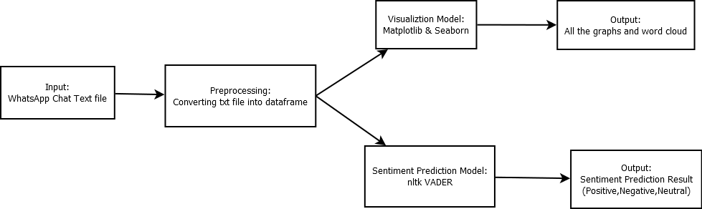

Slide 11
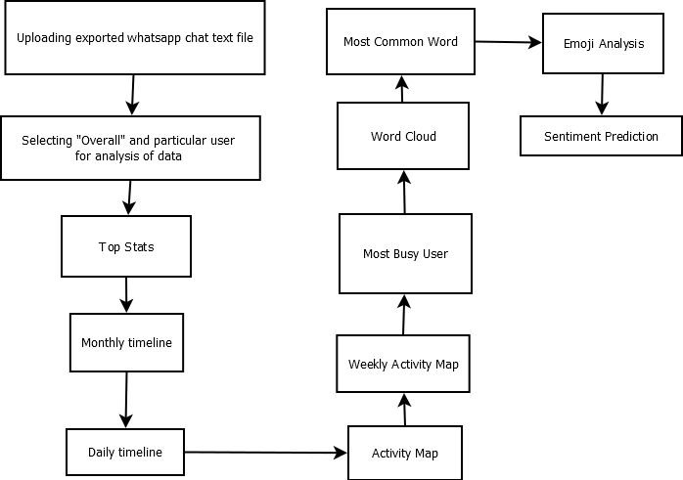
2.2 Design (Flow of Modules)

Slide 12
3.Implementation

Slide 13
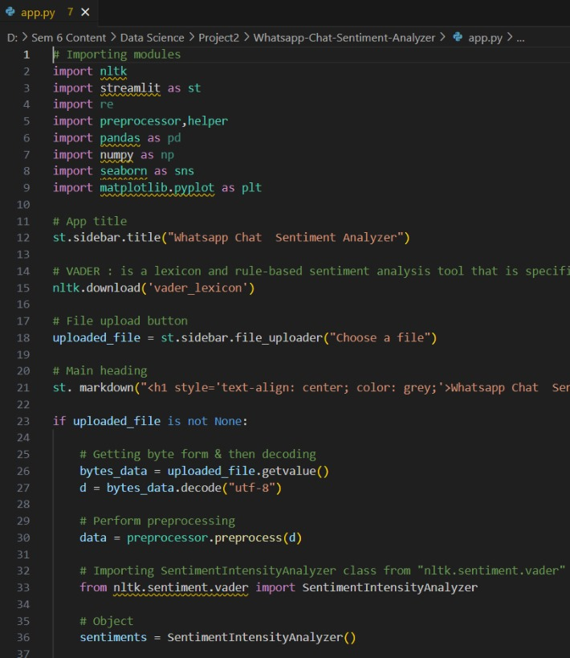
app.py

Slide 14
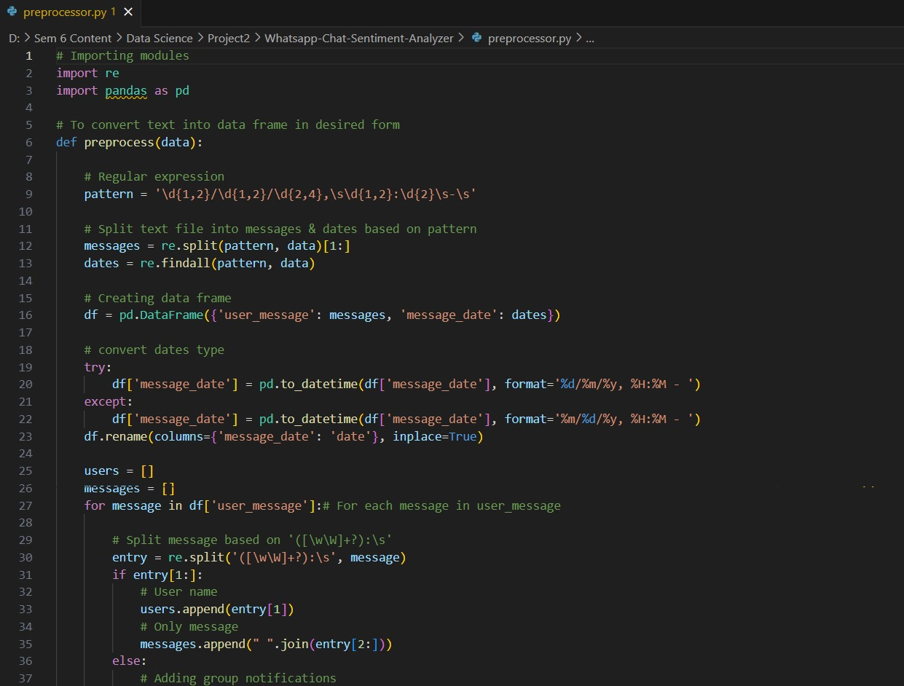
preprocessor.py

Slide 15
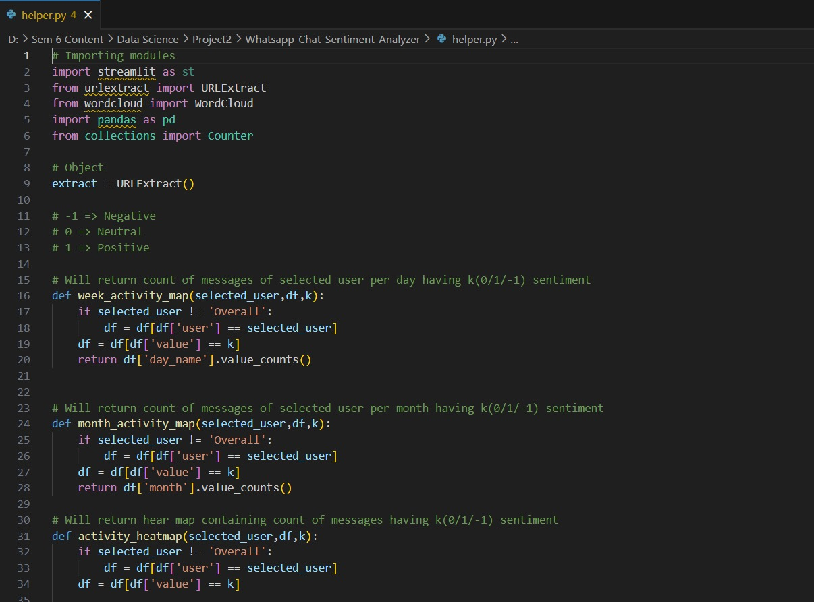
helper.py

Slide 16
4.Results

Slide 17
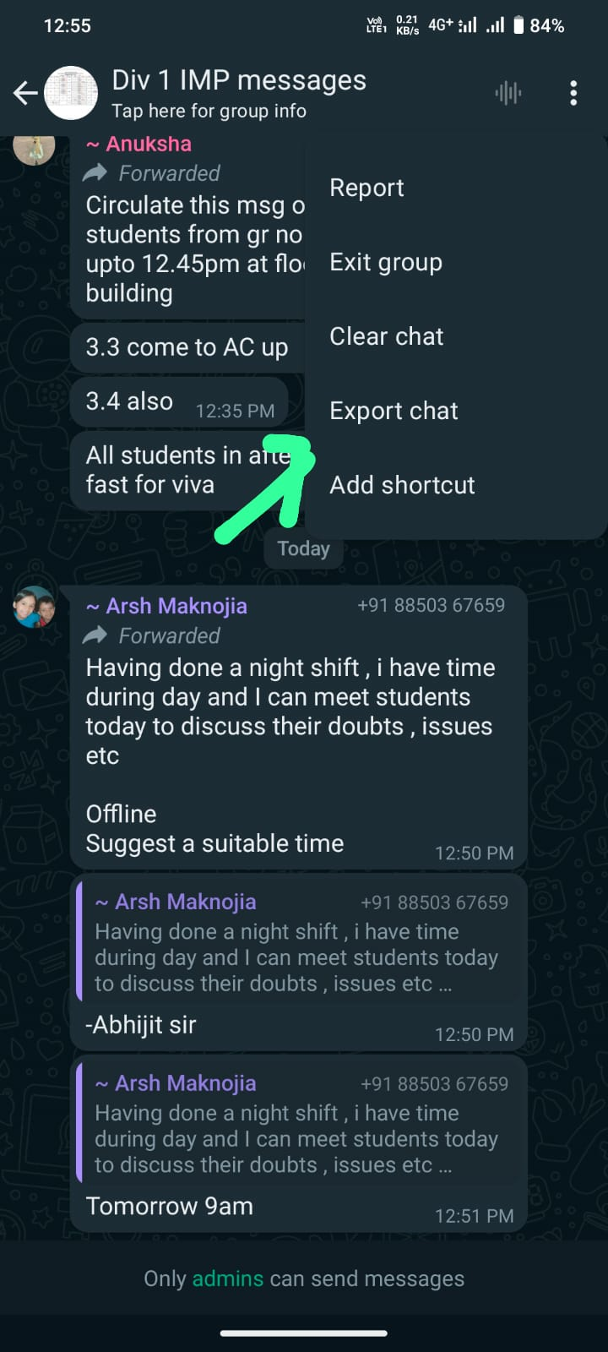
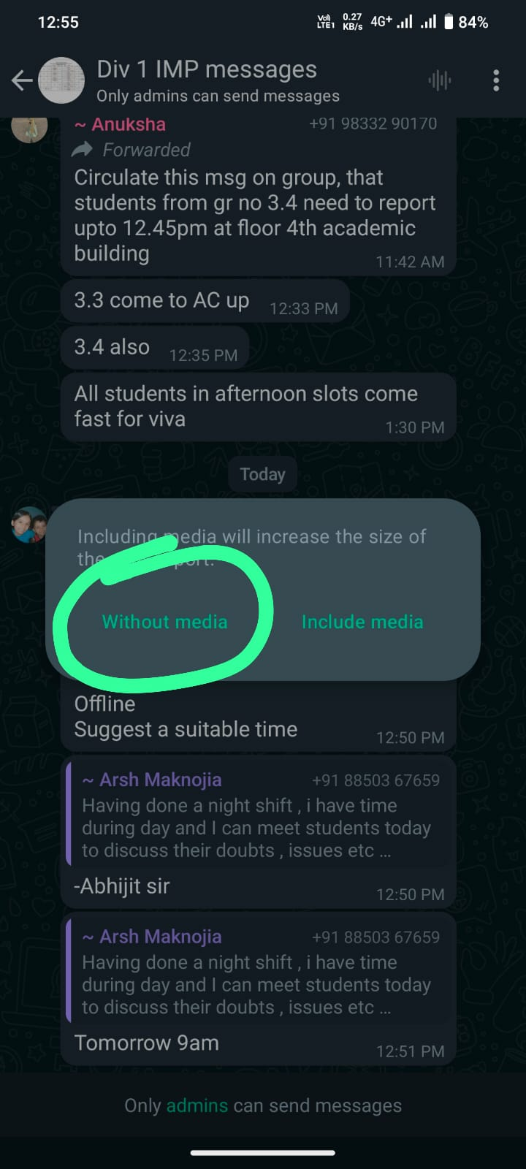
Export Chat in txt Format:

Slide 18
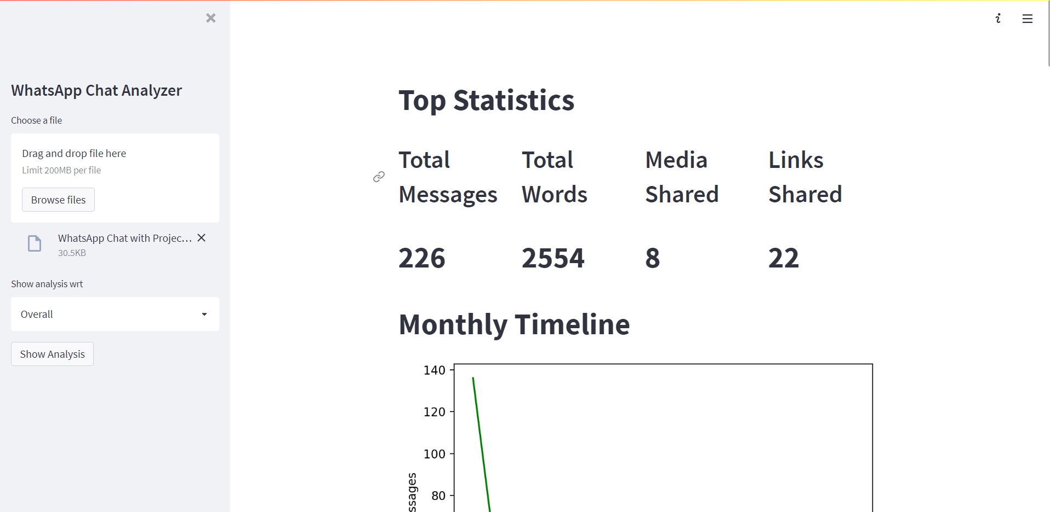

Slide 19
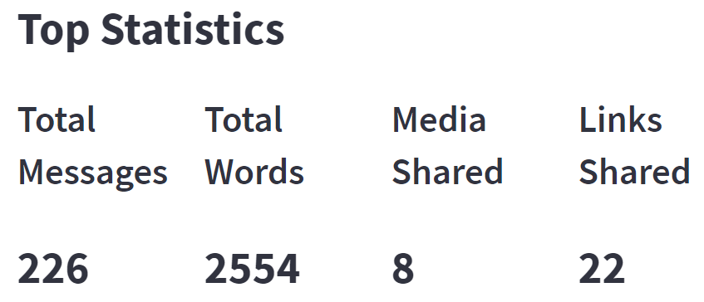
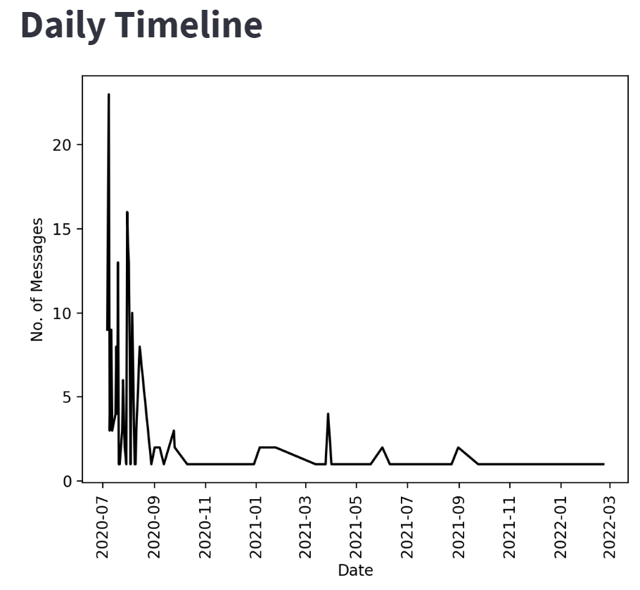
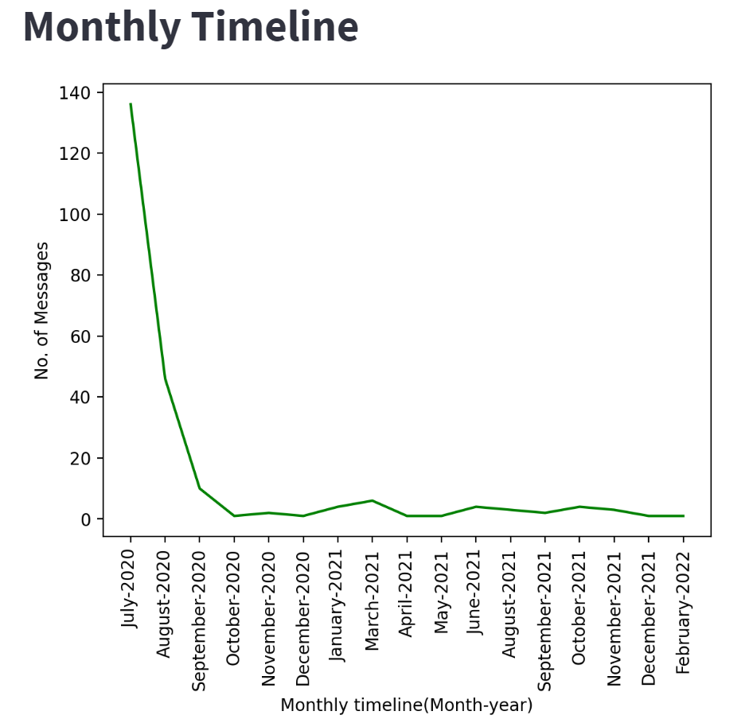
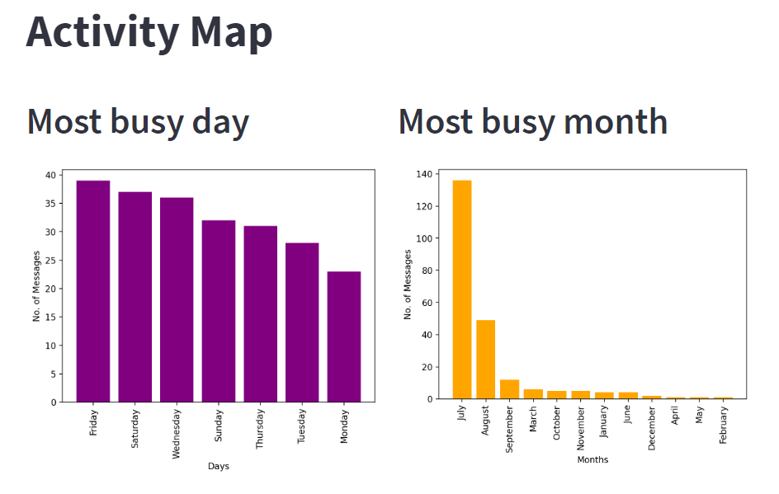

Slide 20
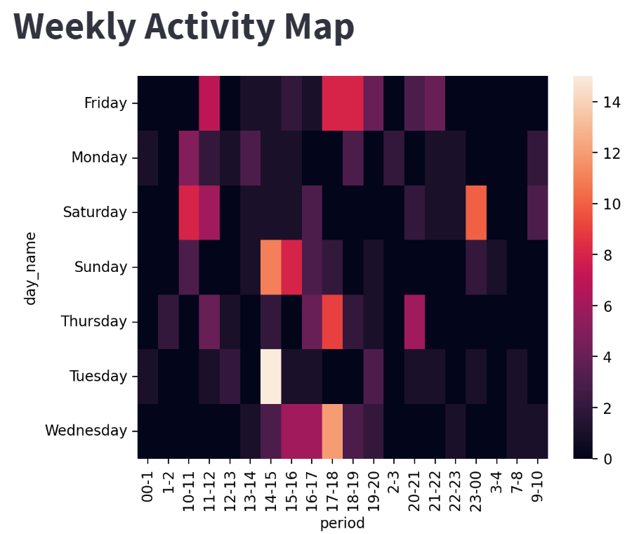
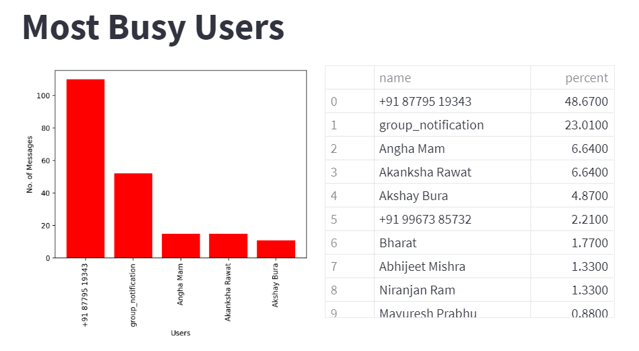
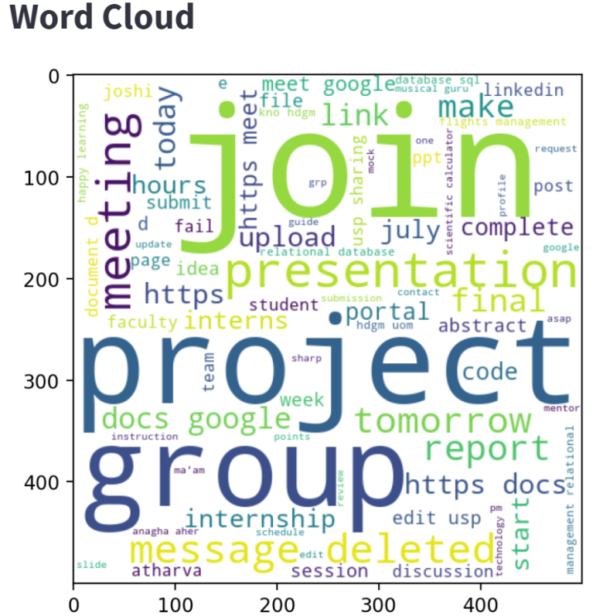
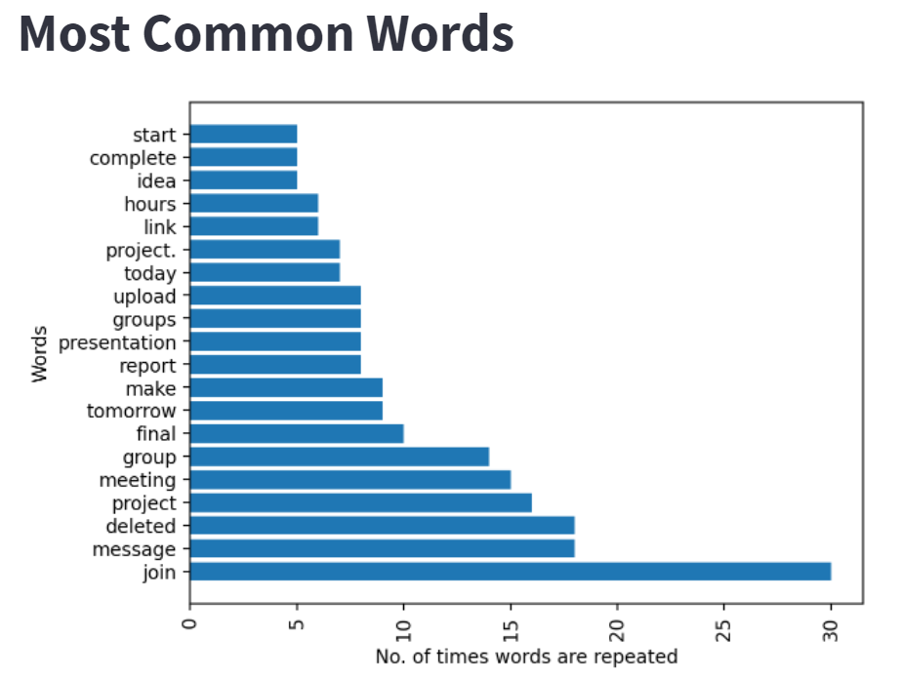

Slide 21
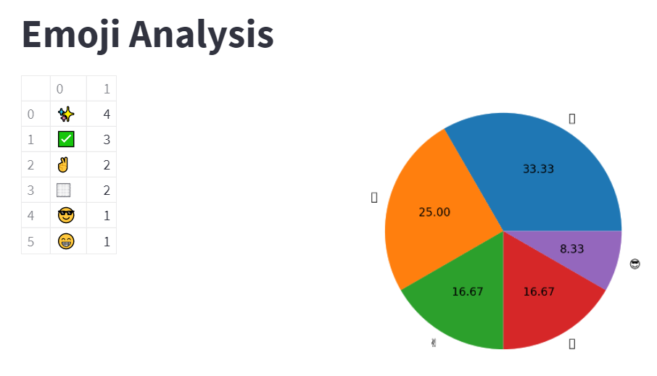
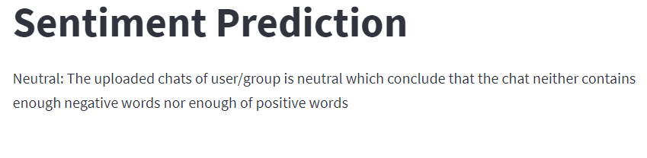

Slide 22
5.Conclusion and Future Scope

Slide 23
5.1 Conclusion:
In Conclusion, it can be said that the capabilities of the application and the power of the python programming language in implementing whatever network data analysis intended, cannot be overemphasized.
This project was able to create an analysis of a group chat and visual representation of chats(i.e which are most active participant, total count of messages, wordcloud of chats).
On Series note, this System has the ability to analyze any group data input into it.
5.2 Future Scope:
The Application can be upgraded to perform Topic Modeling(i.e topic of the chat can be decided using contents).
It can also be upgraded to perform sentiment analysis on images using image processing.
Since our application is only analyzing english text for sentiment prediction we can further upgrade it for regional languages.

Slide 24

6. References:
https://chatilyzer.com/
https://streamlit.io/
https://www.analyticsvidhya.com/blog/2021/04/whatsapp-group-chat-analyzer-using-python/
https://www.kaggle.com/code/sarachang/whatsapp-chat-data-analysis/notebook

Slide 25
Thank You...!!

