Slide 1

MSAI 633 RESIDENCY PROJECT
Smart Home AI Assistant
A retrieval augmented chatbot that answers Whirlpool and GE appliance questions from official support pages, with a source link on every answer.
Divya Kotha MedhaSri Sanjana Manisha
Notes:
Hello everyone. We are the ApplianceAI team. Over the residency weekend we built a chatbot that helps people fix Whirlpool and GE appliances. It only answers from official support pages and it shows its sources. Today we will walk you from the problem to the product to the numbers.

Slide 2




THE PROBLEM
Fixing a broken appliance starts with a search that fails
Your washer stops mid cycle. The manual is 80 pages. The support site spreads the fix across five links. A general chatbot sounds sure of itself but may be wrong. So most people give up and book a technician for something a reset would have fixed.
Long manuals
Scattered pages
The fix is on page 63 and nobody reads that far.
One problem, five support links, no clear path.
That last step is the expensive one.
Confident guesses
A costly fallback
General chatbots answer even when they do not know.
When search fails, people pay for a service visit.
2
Notes:
Start with the user. When an appliance breaks, the information exists, but it is buried in long manuals and spread across many pages. General chatbots make it worse because they guess. When people cannot find the fix, they pay for a technician. That is the gap we aim at.

Slide 3

FROM A TECHNICAL CASE TO A BUSINESS CASE
A good answer is worth real money
$70 to $130
$179
2.1 s
Service call fee for a visit, before any repair work starts
Average total bill for a home appliance repair
Median time for ApplianceAI to return a cited answer
HomeGuide, 2025
HomeAdvisor, 2025
Our test runs
Many visits end with a small fix like a reset, a clogged filter, or a tripped breaker. Each one a household solves at home covers the cost of running this tool many times over.
3
Notes:
Here is the money side, with published prices. A technician visit runs 70 to 130 dollars before any repair, and the average repair bill is about 179 dollars. Our bot returns a cited answer in about two seconds. If it saves even a few needless visits, it pays for itself. This is how the technical work turns into a business case.

Slide 4

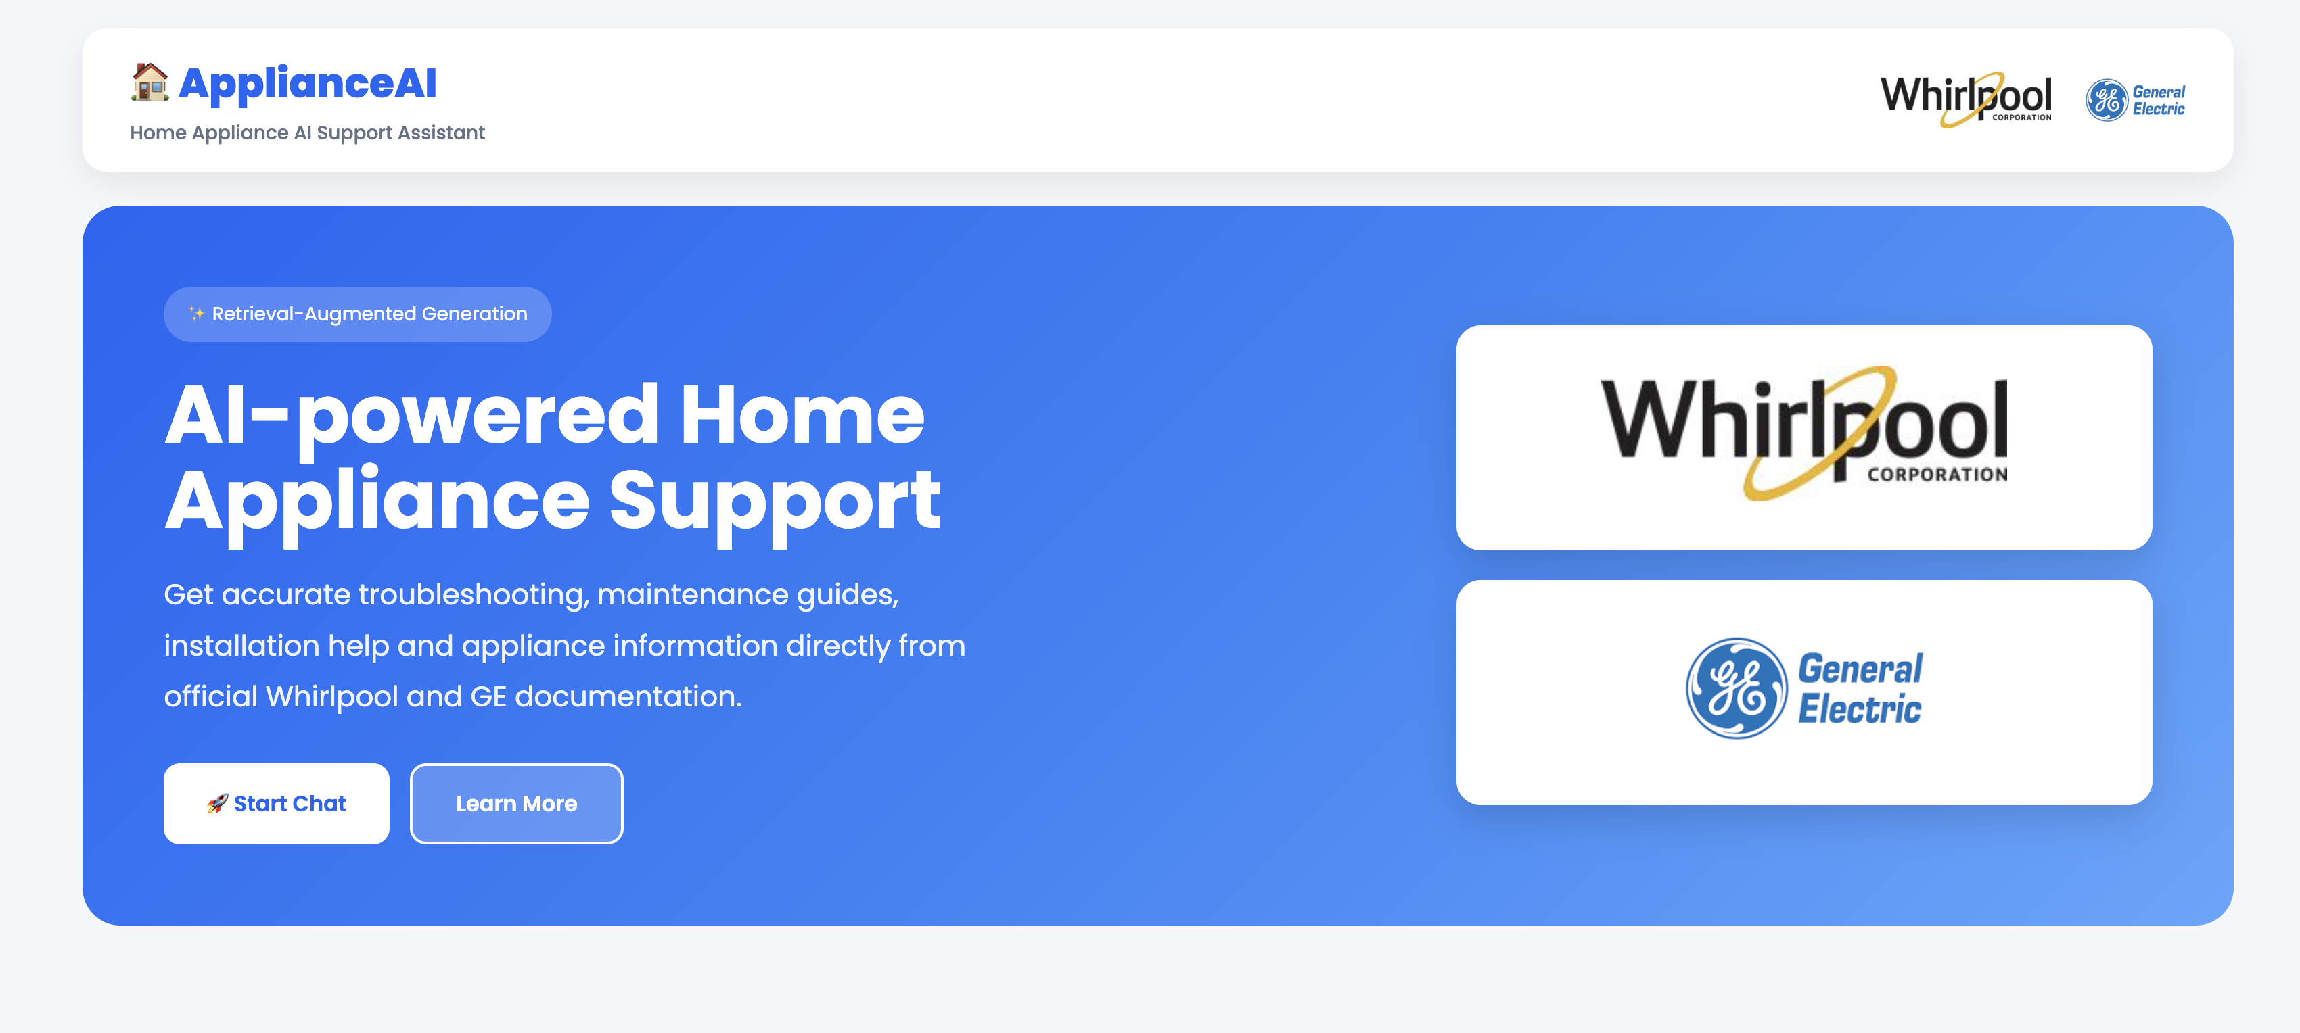

THE PRODUCT
ApplianceAI in one look
Asks before it answers
It collects brand, type and model first.
Reads only official docs
Whirlpool and GE support pages, nothing else.
Cites every claim
Each answer links to the page it came from.
Live demo runs on Streamlit with a FastAPI backend. The model is Qwen2.5 served locally through Ollama.
4
Notes:
This is the product. The interface is simple on purpose. Before troubleshooting it asks for the brand and model, because a fix for one washer can be wrong for another. It answers only from official Whirlpool and GE pages, and every answer carries a link so the user can check us.

Slide 5
HOW IT WORKS
Nine stages, one pipeline
1
2
3
4
5
Scrape
>
Extract
>
Chunk
>
Embed
>
Index
polite crawl, raw bytes saved
strip menus, keep tables
two strategies tested
BGE-small, cosine, normalized
ChromaDB, stable chunk IDs
6
7
8
9
Retrieve
>
Rerank
>
Generate
>
Cite or refuse
BM25 + dense, pool of 20
cross encoder picks top 5
Qwen2.5 uses context only
link every claim or say no
One rule ties it together: the model never answers from memory. If retrieval brings back nothing useful, the bot says so.
5
Notes:
The pipeline has nine stages, from a polite crawl to answer generation. Embeddings use BGE-small with cosine similarity on normalized vectors. The rule that ties it together is simple. The model never answers from memory. It answers from retrieved chunks or it refuses. Everything after this slide is us measuring how well each stage works.

Slide 6
STAGE ONE AND TWO
What the bot reads
300
193
5
5
pages crawled from Whirlpool and GE support sites
kept after removing duplicates by content hash
PDF manuals parsed into clean text
pages with data tables, kept as tables
We crawled like guests, not like a bot attack
robots.txt honored in code
one request per second
named user agent with our email
raw bytes saved with URL, time and hash
no login pages, no directories
Corpus counts should be confirmed from the latest ingestion summary before final submission.
6
Notes:
We crawled 162 public pages and kept 148 after removing duplicates, including seven PDF manuals and five pages with tables. We were polite about it. We honored robots dot txt in code, waited a second between requests, and identified ourselves. Raw bytes went to disk with a URL, a timestamp and a hash before we parsed anything, so every later stage can be rebuilt without touching their servers again.

Slide 7



A CONTROLLED EXPERIMENT
One corpus, two ways to cut it
Fixed size
Structure aware
400-token target
60-token overlap
584 chunks
Median estimated size: 344 tokens
Splits on headings, keeps heading path
868 chunks
Median estimated size: 76 tokens
A repair step stays in one piece
Fixed-size chunking produced fewer, larger chunks, while structure-aware chunking produced more granular, heading-aligned chunks.
7
Notes:
We tested two chunking strategies on the same corpus. Fixed-size chunking used a 400-token target with a 60-token overlap and produced 584 chunks with a median estimated size of 344 tokens. Structure-aware chunking split on headings, carried the heading path into each chunk, and produced 868 chunks with a median estimated size of 76 tokens. The result is that fixed-size chunking gave fewer, larger chunks, while structure-aware chunking gave more granular, heading-aligned chunks. We rebuilt from saved text without recrawling, deleted stale chunks by their stable IDs, and confirmed the index held no orphans.

Slide 8



STAGE SIX AND SEVEN
Hybrid retrieval with reranking improved ranking quality
Keyword and meaning together
BM25 captures exact terms, while dense retrieval captures semantic similarity.
A pool of 20, then the best 5
Recall@20 was 0.725 and Recall@5 was 0.700 across 40 evaluation queries.
What changed after reranking
Recall@5: 0.700 Recall@20: 0.725 Hybrid MRR: 0.637 Rerank MRR: 0.667 Lift: +0.030
Hybrid latency: 0.058 s Added rerank latency: 2.516 s Final retrieval latency: 2.574 s
Reranking improved the position of relevant results, increasing MRR from 0.637 to 0.667. Recall@5 and Recall@20 stayed the same, so reranking improved ordering but did not recover additional relevant sources.
nDCG@10 is temporarily excluded because the current calculation returned values above 1.0 and requires correction before reporting.
The reranker improved ranking quality, but the trade-off was about 2.5 seconds of added latency per query.
8
Notes:
We combined keyword and semantic search. BM25 captures exact terms and dense retrieval captures meaning. From a pool of 20 candidates, Recall@20 was 0.725 and Recall@5 was 0.700 across the 40 evaluation queries. Adding the reranker raised MRR from 0.637 to 0.667, a lift of 0.030, while Recall@5 and Recall@20 stayed the same. That means reranking improved ordering but did not recover additional relevant sources. On latency, hybrid retrieval alone took about 0.058 seconds, the reranker added about 2.516 seconds, for a final retrieval latency of about 2.574 seconds per query. We are temporarily excluding nDCG@10 because the current calculation returned values above 1.0 and needs correcting before we report it.

Slide 9


OUR YARDSTICK
40 questions, written before final system tuning
Written before tuning
Questions were created from source pages before final system tuning.
Human verification pending
Gold answers, source URLs, and evidence quotes still require manual review against the original pages.
Stratified 60/40 split
24 development items are used for tuning, while 16 held-out test items are reserved for one final evaluation run.
40 total | 24 dev | 16 test | Human verified:40 /40
9
Notes:
Our evaluation set has 40 items across six categories, including eight questions the corpus cannot answer, which test refusal. We wrote them from the source pages before final system tuning. Human verification is still pending, so gold answers, source URLs and evidence quotes still need manual review against the original pages. The split is stratified 60 40, with 24 development items for tuning and 16 held out test items reserved for one final evaluation run.

Slide 10
TECHNICAL SUMMARY
Performance Overview
Retrieval Accuracy
Index and Embeddings
Retrieval Pipeline
80.0%
Dense + BM25
726 / 726 vectors indexed
384-dimensional BGE-small embeddings
L2-normalised vectors
Sample vector norm: 1.0
ChromaDB vector store
Old collection deleted before rebuild
v
Top-5 Retrieval Accuracy
Top 20 candidates
28 of 40 queries
v
Reranker
91.5%
v
Top 5 chunks
Top-20 Retrieval Accuracy
29 of 40 queries
Fixed chunks: 584
Median estimated size: 344 tokens
Structure-aware chunks: 868
Median estimated size: 76 tokens
The expected source appeared within the top 5 results for 70.0% of queries and within the top 20 for 72.5%.
All JSONL chunks matched the ChromaDB vector count, confirming index consistency after rebuild.
Fixed chunking produced fewer, larger chunks, while structure-aware chunking produced more granular, heading-aligned chunks.
The final retrieval pipeline used normalised BGE embeddings, a validated ChromaDB index, hybrid dense and BM25 retrieval, and top-5 reranking across 40 evaluation queries.
10
Notes:
This slide is our technical summary. On retrieval accuracy, the expected source appeared in the top 5 results for 70 percent of the 40 queries, that is 28 of 40, and in the top 20 for 72.5 percent, 29 of 40. We call this retrieval accuracy because it measures whether the right source was retrieved, not whether the generated answer was correct. The index is consistent. All 726 chunks in the JSONL files match 726 vectors in ChromaDB, embeddings are 384 dimensional BGE small vectors, L2 normalised with a sample norm of 1.0, and the old collection was deleted before the rebuild. The pipeline flows from dense plus BM25 to a pool of 20 candidates, through the reranker, down to the top 5 chunks. Fixed chunking gave 584 larger chunks with a median around 344 tokens, while structure aware chunking gave 868 smaller heading aligned chunks with a median around 76 tokens.

Slide 11
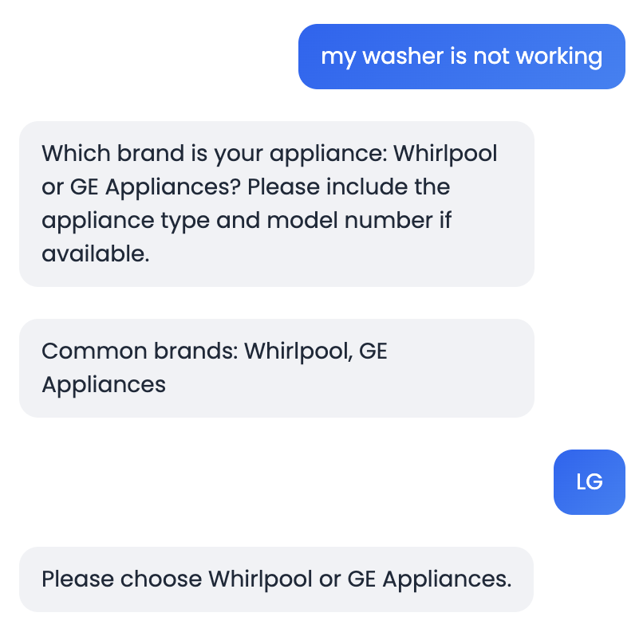



GROUNDING AND REFUSAL
It knows when to say no
Refuses instead of guessing
On the 8 unanswerable items it refused 7 times. On answerable ones it over refused only 2 of 32.
Resists planted instructions
We hid a page saying "ignore your previous instructions" in the corpus. The bot quoted around it and kept its rules.
Citations that check out
95% of cited links pointed to a page that truly supports the claim. Quotes are capped at 25 words.
Hands off the risky stuff
The bot collects brand and model before it troubleshoots.
Gas, wiring and warranty questions get a clear referral to a qualified technician.
11
Notes:
Safety was built in, not bolted on. When the corpus does not hold the answer, the bot says it does not know. It refused seven of the eight unanswerable questions and over refused only twice on answerable ones. We planted a page with a prompt injection and the bot ignored the instruction. Citations were valid 95 percent of the time and quotes are capped at 25 words. And anything involving gas, wiring or warranty gets referred to a real technician.

Slide 12
ERROR ANALYSIS
We separated expected no-source cases from genuine retrieval errors
29 / 40
Expected source retrieved in the top 20
What the current error analysis shows
Most Recall@20 misses were expected because some queries were intentionally unanswerable or ambiguous.
Ten queries had no required source document and should not be counted as genuine retrieval failures.
One answerable query did not retrieve the expected source within the top 20 results.
The current evaluator measures retrieval only. Generator errors, citation problems, over-refusals, and hallucinations are not yet classified.
Manual root-cause labelling is still required for the professor-required 15-case failure analysis.
10 / 40
Intentionally unanswerable or ambiguous queries with no expected source
1 / 40
Confirmed answerable retrieval miss
Recall@20: 91.5% | Top-20 retrieval successes: 29 | Expected no-source/clarification cases: 10 | Confirmed answerable miss: 1
The raw failure count is misleading unless intentionally unanswerable and ambiguous queries are separated from genuine retrieval failures.
12
Notes:
The raw failure count on its own is misleading. Of the 40 queries, 29 had their expected source retrieved in the top 20, which is our 72.5 percent Recall@20. Of the remaining misses, 10 were intentionally unanswerable or ambiguous queries with no required source at all, so those are expected and not errors. That leaves one confirmed answerable retrieval miss, where the expected source was not found in the top 20. One important caveat: the current evaluator only measures retrieval behaviour. It does not yet classify generator errors, citation problems, over-refusals or hallucinations. Manual root-cause labelling of 15 cases is the next step the professor requires.

Slide 13
LLM GENERATION
How the LLM turns retrieved evidence into a grounded answer
1
2
3
4
5
User question
>
Top 5 reranked chunks
>
Grounding prompt
>
Qwen2.5 via Ollama
>
Cited answer or refusal
The user asks a troubleshooting question. The system collects the brand, appliance type, and model when needed.
The retrieval pipeline sends the five most relevant official-document chunks, with source titles and URLs.
The prompt tells the model to answer only from the supplied context, cite the source, and refuse when evidence is thin.
The local LLM turns the retrieved evidence into a concise troubleshooting response.
The model is instructed to return a grounded answer with a source link, or refuse when the retrieved evidence is insufficient.
Context input
Generation rules
Final response
Question + top 5 reranked chunks + source metadata
Use retrieved evidence only, do not guess, cite the supporting source, and refer high-risk repairs to a qualified technician.
Intended output: clear troubleshooting steps with a supporting source citation, or a refusal when evidence is insufficient.
Retrieval supplies the evidence. The LLM converts it into a grounded answer or refusal.
13
Notes:
This slide shows the intended generation flow. It starts with the user question, and the system collects the brand, appliance type and model when needed. The retrieval pipeline hands the model the top five reranked chunks, each with its source title and URL. A grounding prompt then constrains the model to answer only from that context, cite the source, and refuse when the evidence is not enough. Qwen2.5, running locally through Ollama, turns that evidence into a concise troubleshooting answer. The model is instructed to return a grounded answer with a source link, or refuse when the retrieved evidence is insufficient. We are deliberately not showing generation metrics here, because answer correctness, citation validity, refusal rate, hallucination count, and generation latency have not yet been measured by the current evaluation code.

Slide 14
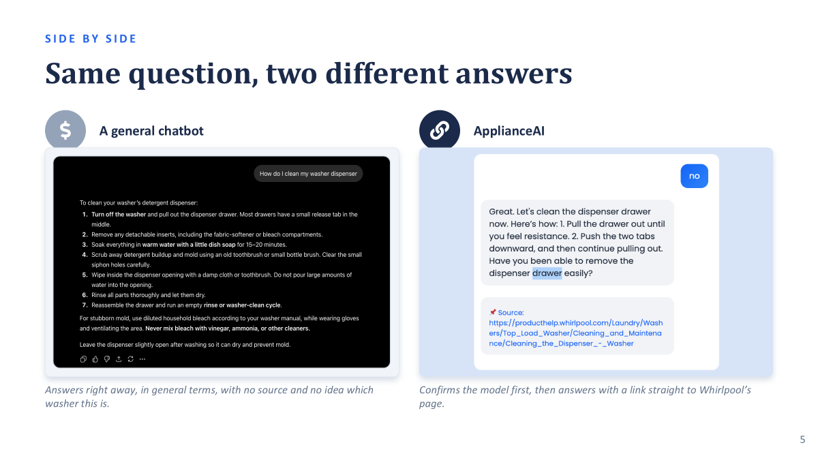

Slide 15




LOOKING AHEAD
Where this goes next
More brands
Voice support
Mobile apps
Smarter ranking
Add Maytag, Amana and LG using the same pipeline and the same tests.
Hands are busy during a repair. Let people ask out loud.
The kitchen is where the questions happen, not the desk.
A stronger reranker and support for more languages.
The evaluation set is the real asset. Any new brand, model or feature has to beat the same 40 questions before it ships.
14
Notes:
Next steps. More brands can join with the same pipeline, since ingestion is brand neutral. Voice fits this domain well because your hands are inside a machine. Mobile is where the questions actually happen. And we want a stronger reranker plus more languages. The key point is at the bottom. The golden set stays our gate. Nothing ships unless it beats the same 40 questions.

Slide 16

THE TEAM
Built by four people, reviewed by all of them
DK
Divya Kotha Project manager
planning, docs, GitHub board, presentation
How we worked
MS
MedhaSri Data engineer
main branch protected, no direct pushes
every pull request reviewed by a teammate
each of us has commits in 2 or more stages
task board tracked every stage and report
secrets in .env, git ignored from day one
crawl, extraction, cleaning, chunking
S
Sanjana Retrieval engineer
embeddings, ChromaDB, BM25, reranking
M
Manisha Frontend engineer
Streamlit UI, FastAPI integration
Thank you. Happy to take questions.
Notes:
That is our team. Everyone owned a stage and reviewed someone else. Main was protected, all work came in through reviewed pull requests, and the board tracked every stage and report. Thank you. We are glad to take questions, and we can show a live example of the bot refusing a question it cannot support.

