Slide 1
Understanding The FBProphet Model
Sit Dolor Amet

Slide 2
Challenges and Innovations in Time Series Analysis
Challenges of Time Series Data:
Complexity: Time series data can be difficult to manage due to issues like multiple seasonalities.
Model Sensitivity: Traditional models like SARIMAX require strict data properties such as stationarity and equally spaced intervals, making them hard to tune.
Traditional vs. Modern Approaches:
SARIMAX: A traditional model with high data quality requirements.
RNN-LSTM: Advanced but complex, requiring deep knowledge of neural networks, posing a high barrier for average analysts.

Slide 3
Innovation in Time Series Modeling
Facebook Prophet:
Introduced in 2017 by Facebook researchers.
Aims to provide an accessible, powerful solution for time series forecasting.
Simplifies the process, lowering the barrier to entry for data analysts and scientists.
Impact:
Facebook Prophet has democratized time series analysis, enabling more analysts to perform sophisticated forecasting without deep expertise in the complexities of traditional models.

Slide 4

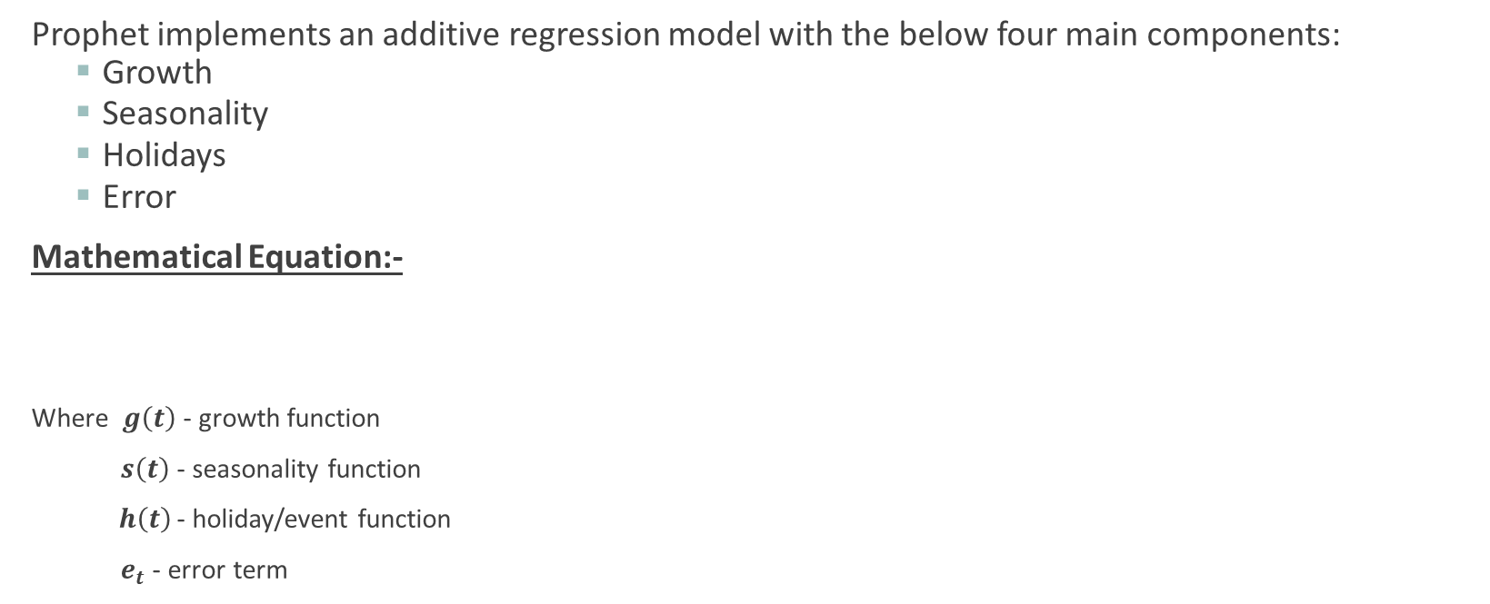
Core Components of the Model
Prophet implements an additive regression model with the below four main components:
Growth
Seasonality
Holidays
Error
Mathematical Equation:-
Where $g\left(t\right)$- growth function
$s\left(t\right)$ - seasonality function
$h\left(t\right)$- holiday/event function
$e_{t}$ - error term

Slide 5

Growth Function
Models the overall trend in the data using familiar linear and logistic functions.
Critical for adjusting the trend line at moments where significant shifts occur, such as market changes or major events.
The growth function has three main components:
Linear Growth: Uses piecewise linear equations. Similar to y = mx + b, but with variable slopes (m) and offsets (b) at changepoints.
Logistic Growth: Useful for data with natural saturation points. The equation takes the form of a logistic curve but with time-variable carrying capacity (C), growth rate (k), and offset (m).
Flat: Used when no growth is expected over time; the function remains constant, focusing on capturing seasonality.

