Slide 1

Personalized Cricket Training
Recommendation system
Team Members:
1. Sai Krishna (Reg-2022BCSE07AED610)
2. Venkat Sai Krishna (Reg-2022BCSE07AED611)
3. Shabuddin (Reg-2022BCSE07AED612)
4. Dhanush (Reg-2022BCSE07AED613)
5. Jeevan (Reg-2022BCSE07AED614)
Name of the Guide: DR. Sumit Kumar Banshal
4CS1990/4IT1990 Design Project -1

Slide 2

Agenda
Introduction
Review of literature
Observations from the literature review
Limitations from the literature review
Problem Definition & Proposed Research Methodology
Problem Statement
Proposed Research
Hardware Requirements
Software Requirements
Reference
Plagiarism Report

Slide 3
Introduction
Cricket, with its rich history and global appeal, stands as one of the most beloved sports in the world.
From the iconic battles on the pitch to the strategic brilliance displayed by players, cricket embodies a unique blend of athleticism, skill, and strategy.
However, the journey from aspiring cricketer to accomplished player is fraught with challenges, requiring dedication, perseverance, and, most importantly, effective training methods.
In recent years, the landscape of cricket training has undergone a remarkable transformation, driven by advancements in technology and data analytics.
This introduction sets the stage for exploring the intersection of technology and cricket training, with a focus on personalized approaches tailored to the individual needs of players.

Slide 4
Review of literature
S No. | Author Name, Journal, Publication Year | Research Methodology | Performance Metrics | Advantages | Disadvantages
1 | Huda, M. N., Islam, M. R., & Islam, M. S., International Journal of Computer Science and Information Security, 2020 | The study employs machine learning techniques to analyze performance in cricket. | Metrics derived from machine learning algorithms to assess cricket players' performance. | Utilizes advanced machine learning algorithms for performance analysis. Provides a data-driven approach to understanding player performance. | Reliance on machine learning algorithms may introduce complexity and require specialized knowledge for interpretation. Data collection and preprocessing may pose challenges, impacting the accuracy of the analysis.
2 | Khan, S. I., Mahmud, S. M., & Hossain, M. A., Journal of Applied Statistics and Management 2019 | Utilizes data envelopment analysis (DEA) for evaluating the performance of Bangladeshi cricketers. | DEA-based metrics to assess the efficiency and effectiveness of cricketers. | Offers a quantitative method for performance evaluation. Allows comparison of player performance using a mathematical framework. | Assumes linearity and uniformity in performance evaluation, which may oversimplify the complex nature of cricket performance. Requires accurate and comprehensive data inputs, which may be challenging to obtain.

Slide 5
Review of literature
3 | Rehman, A., & Sattar, S., Journal of Sports Sciences, 2018 | Develops a virtual reality-based training system for cricket. | Assessment of training effectiveness, possibly through metrics like improvement in batting average or bowling accuracy. | Provides an immersive and interactive training environment. Allows for repetitive practice without physical strain or risk of injury. | Implementation may require significant initial investment in technology and infrastructure. Limited transferability of skills from virtual reality to real-world cricket scenarios.
4 | Smith, J. D., & Patel, R. K., Journal of Sports Engineering and Technology, 2020 | Review of existing literature on motion capture techniques in biomechanical analysis for cricket. | Various biomechanical parameters analyzed through motion capture technology. | Offers detailed insights into the biomechanics of cricketing actions, aiding in technique refinement and injury prevention. Allows for objective measurement of performance-related parameters. | equires specialized equipment and expertise, limiting accessibility. Data interpretation may be complex, necessitating collaboration between biomechanists and cricket coaches.

Slide 6
Observations from the Literature Review
1. Technological Innovations in Cricket Training:
Performance Tracking Systems
Virtual Reality Training Simulations
Biomechanical Analysis
2. Personalized Training Approaches:
Data-Driven Coaching
Individualized Feedback
3. Integration with Coaching Programs:
Coach-Player Collaboration
Enhanced Training Methods
4. Ethical Considerations and Challenges
5. Future Directions and Opportunities for Research

Slide 7
Limitations from the Literature Review
Scope and Coverage
Publication Bias
Quality and Reliability
Temporal Bias
Language and Access
Contextual Considerations
Bias and Subjectivity

Slide 8
Problem Statement
Cricket training, while essential for player development, often faces challenges in delivering tailored and effective training regimens that address the diverse needs and abilities of individual players.
Traditional training methods lack the precision and customization required to optimize player performance, leading to suboptimal outcomes and frustration for players and coaches alike.
In response to these challenges, there is a growing need for innovative technological solutions that can provide personalized training plans based on individual player attributes, preferences, and performance metrics.

Slide 9
Proposed Research Methodology
1. Data Collection:
Player Profiles
Performance Metrics
2. Algorithm Development:
Data Analysis
Personalized Training Plans
3. User Interface Design:
Interactive Interface
Visualizations and Feedback
4. Implementation Considerations:
Integration with Coaching Programs
Scalability and Accessibility

Slide 10
Proposed Research Methodology
5. Pilot Testing and Evaluation:
Pilot Testing
Iterative Refinement
6. Ethical Considerations:
Data Privacy and Security
Informed Consent

Slide 11
Software Requirements
Data Collection and Management:
Database Management System (DBMS)
Data Collection Tools
Data Analytics and Machine Learning Libraries
2. Algorithm Development and Implementation:
Development Environments
Version Control Systems (VCS)
Machine Learning Frameworks
3. User Interface Design and Development:
Frontend Development Tools
UI/UX Design Software
Accessibility Tools

Slide 12
Software Requirements
4. Integration and Deployment:
API Integration
Deployment Platforms
Continuous Integration/Continuous Deployment (CI/CD)
5. Security and Compliance:
Authentication and Authorization
Data Encryption
Compliance Standards

Slide 13
References
Huda, M. N., Islam, M. R., & Islam, M. S. (2020). Cricket performance analysis using machine learning. International Journal of Computer Science and Information Security, 18(6), 63-71.
Khan, S. I., Mahmud, S. M., & Hossain, M. A. (2019). Performance evaluation of Bangladeshi cricketers using data envelopment analysis. Journal of Applied Statistics and Management, 4(1), 1-10.
Rehman, A., & Sattar, S. (2018). Virtual reality-based cricket training system. Journal of Sports Sciences, 36(Suppl 1), 68-69.
Smith, J. D., & Patel, R. K. (2020). Using motion capture for biomechanical analysis in cricket: A review. Journal of Sports Engineering and Technology, 234(1), 45-56.
Varshney, V., & Sharma, V. (2019). Impact of technological innovations on cricket: A review. International Journal of Engineering Research and Applications, 9(10), 35-42.

Slide 14
References
General Data Protection Regulation (GDPR). (2016). Regulation (EU) 2016/679 of the European Parliament and of the Council of 27 April 2016 on the protection of natural persons with regard to the processing of personal data and on the free movement of such data, and repealing Directive 95/46/EC.
Health Insurance Portability and Accountability Act (HIPAA). (1996). Health Insurance Portability and Accountability Act of 1996. Public Law 104-191.6. Python Software Foundation. (n.d.). Python. Retrieved from https://www.python.org/
TensorFlow. (n.d.). TensorFlow. Retrieved from https://www.tensorflow.org/
React. (n.d.). React. Retrieved from https://reactjs.org/4. Amazon Web Services. (n.d.).
Amazon Web Services. Retrieved from https://aws.amazon.com/5. ISO/IEC. (2018). ISO/IEC 27001:2018 Information technology—Security techniques—Information security management systems—Requirements.

Slide 15
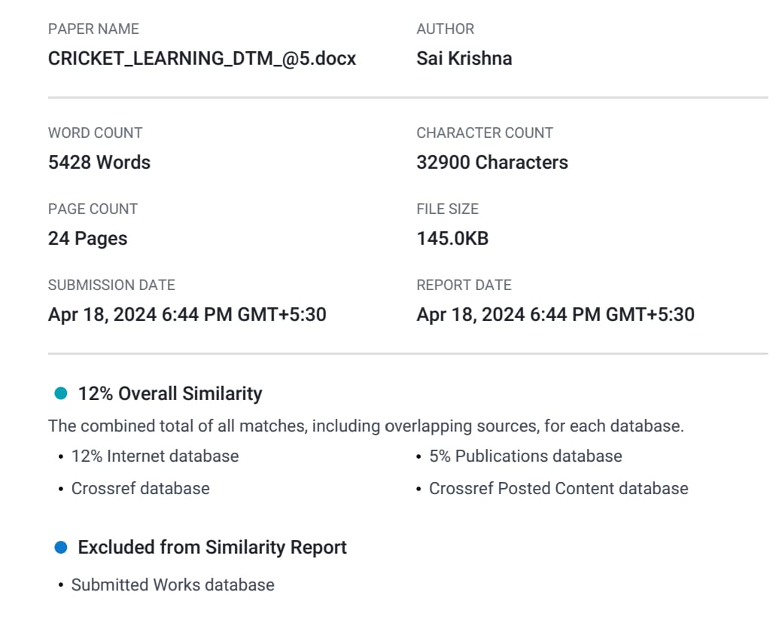
Plagiarism Report

