Slide 1
aI DRIVEN CONTENT SUMMARIZATION FOR ACADEMIC PAPER
SRIRAMAN K
SRI KIRUPA P
TEAM AUTOMATRIX

Slide 2
Problem STATEMENT
ABSTRACT
By integrating UiPath products such as Studio, Document Understanding, and Mail Activities, the bot will efficiently process academic documents, extract key insights, and deliver these summaries via email or store them in a repository.
This solution addresses the time-consuming nature of reviewing extensive academic content, enhancing productivity and information retention for students and faculty members.
Students and faculty members encounter the challenge of reviewing lengthy academic papers, which can be a time-consuming and tedious process.
Efficiently digesting the main ideas and arguments presented in these papers is essential for staying updated in academic fields and making informed decisions in research.

Slide 3
Other softwares
Uipath
Requires coding from scratch, which can be time-consuming
Requires knowledge of programming, NLP techniques, and model training.
Requires building a UI from scratch if needed.
Manual setup and deployment required; may involve complex environments.
UiPath provides a drag-and-drop interface with pre-built components, allowing faster development.
Less programming knowledge needed; built for non-programmers as well as developers.
Built-in user interface elements and the ability to create custom forms and dashboards.
Simplified deployment using UiPath Orchestrator
supports unattended and attended automation.

Slide 4
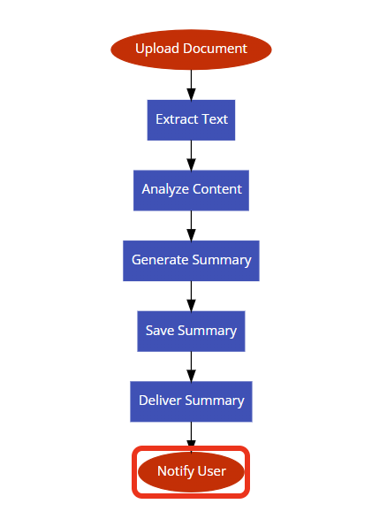
SOLUTION
BASED ON MVP
File Input - The user uploads an academic paper in a supported format (e.g., PDF, Word) through the interface.
Document Understanding - The uploaded file is processed using the AI Center service, which extracts and understands the key content and structure of the document.
Content Evaluation - The AI model evaluates the extracted content to identify key points, arguments, and conclusions.
Summary Generation - A concise summary of the paper is generated based on the evaluation, highlighting the main ideas and insights.
Save and Deliver - The summary is saved to a file using UiPath Studio and can be delivered to the user via email or stored in a document repository for easy access.

Slide 5
INTEGRATE WITH lms
Personalized Research Assistance
FUTURE DIRECTION
Streamlined Candidate Research
Automated Creation of Teaching Materials
Connecting the AI-driven summarization bot with LMS platforms will streamline academic workflows, making it easier for students and faculty to access summarized content directly within their course environments.
Implementing personalized summarization and recommendation features based on faculty members' research interests can help them stay up-to-date with the latest developments in their field.
Integrating the summarization bot with recruitment platforms and academic databases can help recruiters quickly review and summarize candidates' research publications, CVs, and academic achievements.
The bot can be enhanced to automatically generate teaching materials, lecture notes, or presentation summaries from academic papers. Faculty members can quickly transform comprehensive research into teaching content.

Slide 6
Our evolution
6 HOURS
Now
FULL WORKING MODEL
UiPath workflows, integrating the AI model for summarization

Slide 7
CONCLUSION
Using UiPath for AI-driven content summarization offers significant advantages for staff, faculty, and reviewers. By integrating the summarization bot with academic platforms and research databases, staff and faculty can enhance productivity, streamline research activities, and automate the creation of teaching materials.
For reviewers, the bot facilitates streamlined candidate research, automated reporting, and improved candidate matching, ultimately leading to more informed hiring decisions. These enhancements not only optimize workflows but also provide valuable insights, making the summarization bot an indispensable tool in the academic and recruitment sectors.

