Slide 1
Learning to Bid in
Repeated Auctions with
Hidden Reserve Prices
EE4901
Shri Prathaa M - EE22B144

Slide 2
Contents of this Presentation
01
02
03
04
Introduction
Online Learning in Auctions
Fixed Hidden
Reserve Price
Reserve Price drawn from Distribution

Slide 3
01
Introduction
Understanding the Setup of First and Second Price Auction with Single Bidder and Single Seller

Slide 4
First Price Auction
Online Sellers often use hidden reserve prices
Buyer cannot observe reserves → must learn to bid optimally
Incorrect bidding
Overbidding → overspending
Underbidding → lost opportunities
Objective: Minimize regret over entire time horizon

Slide 5
Second Price Auction
Seller has a Hidden Reserve Price
Fixed - bidding once above reserve price reveals it
Stochastic - each winning bid reveals the current reserve price drawn from unknown distribution, F
Bid should be below Valuation (v) to get non-negative utility
Bid shouldn’t go below Reserve price (hidden) to get positive utility
Assumption: Buyer doesn’t want to reveal his valuation
Objective: Learn Empirical Distribution Function and use it to bid optimally

Slide 6
Setup
Single Buyer Fixed Hidden Reserve Price FPA
Truthful Seller
Strategic Seller
Seller strategically chooses to increase reserve price from original value
Seller could be assumed adversarial
(He knows the algorithm the buyer would use to bid and optimise his reserve price)
Fixes the true Reserve Price (p) before auction
Buyer wins if he bids above p and pays his bid amount

Slide 7
Setup
Stochastic Reserve Price Auction
SPA
FPA
Every winning round reveals the underlying reserve price that can be used to build the empirical distribution of reserve price
The winning bids can be used to build the empirical distribution of winning bids

Slide 8
02
Online Learning
in Auctions

Slide 9





Multi-armed bandits
Stochastic bandits
Regret Upper bound
Lower bound
Distribution-independent (Stochastic)
Upper bound
Lower bound
Adversarial bandits
Upper bound
Lower bound
Bandit learning involves selecting one of M actions and observing only the chosen reward.
Let p_{j} be the mean reward of arm j and p* = max_{j} p_{j} .

Slide 10
Online Repeated Auctions
Online advertising relies on repeated first-price (FPA) and second-price (SPA) auctions.
Buyers shade bids in FPA, while truthful bidding is optimal in SPA.
Real ad markets show complex bidder behavior due to budgets and strategic (myopic or non-myopic) bidding.
Myerson–Satterthwaite bilateral trade model: sellers post above their valuation; buyers bid below their valuation.

Slide 11


Online Learning in Auctions
Prior work mostly targets seller-side learning:
Posted-price auctions, dynamic pricing, and discounted valuation models.
Known regret rates for sellers : for truthful buyers
for strategic buyers.
Buyer-side learning is less studied, especially with hidden reserve prices.
Feedback is heavily censored in FPA, resembling binary bandit feedback.

Slide 12
03
Fixed Hidden
Reserve Price FPA
Monotone Bid Price algorithm and Fast Search algorithm

Slide 13

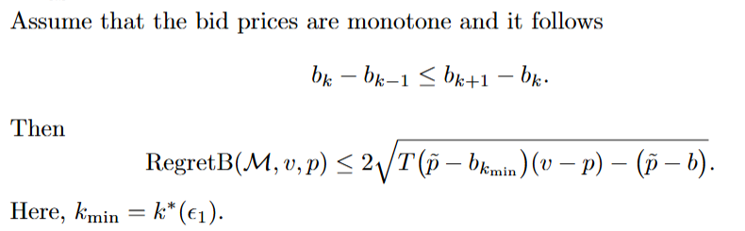

Truthful Seller
Monotone Bid Price Algorithm
Begins at low bid and increases monotonically until it wins once at bid, b*
Bids b* for the rest of the rounds
Attains a regret bounds of
Upper bound :
Lower Bound : Let k* be the first time bid price is accepted and accepted bid price be b*

Slide 14

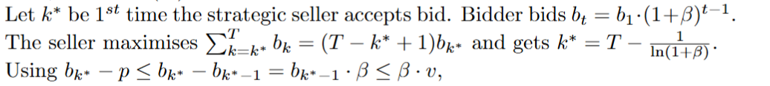
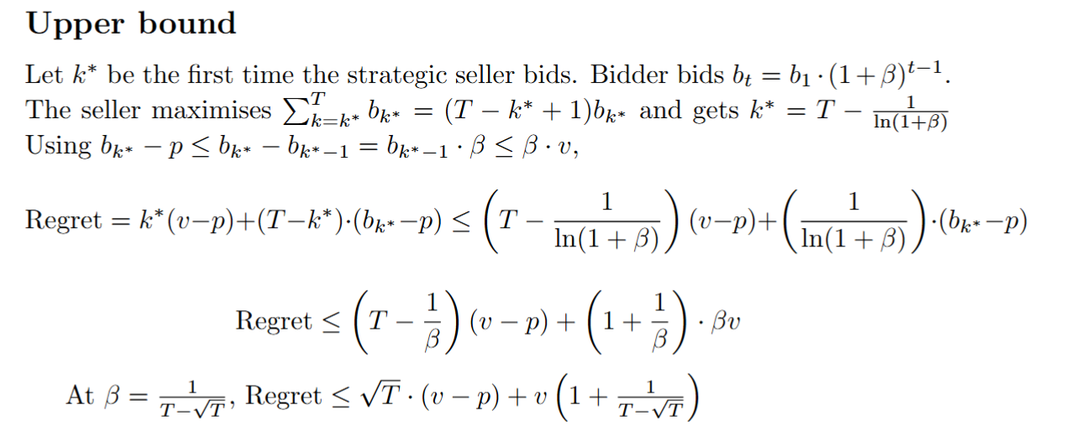
Strategic Seller
Monotone Bid Price Algorithm
Begins at low bid and increases geometrically until it wins once at bid, b*
Bids b* for the rest of the rounds
Attains a regret bounds of
Lower Bound:
Similar to proof of upper bound in truthful seller; bound b*- p using
And optimise k* using AM-GM inequalities
Upper Bound:

Slide 15
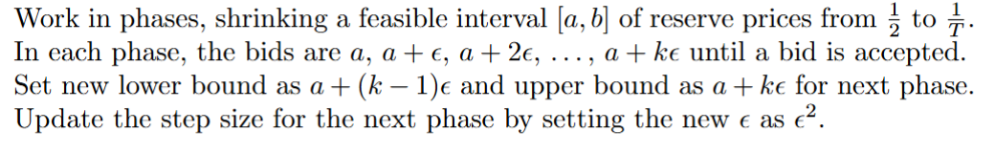
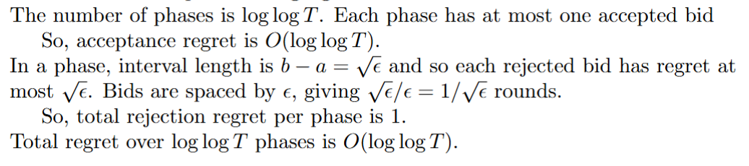
Truthful Seller
Fast Search Algorithm
Work in phases, shrinking a feasible interval [a,b] of possible reserve prices from ½ to 1
The phase has bids a, a+ε, a+2ε,..a+kε until the bid gets accepted
Set upper and lower bounds as a+(k-1)ε and a+kε respectively for next phase with ε² as
Proof
,
.

Slide 16
Strategic Seller
Randomized Fast Search Algorithm
First Phase:
Begin with initial interval [a₁,b₁]=[0,v] and split it into n sub intervals. Randomly select one sub-interval and offer
log⁡ log⁡T bid prices within it. Select k such sub-intervals
Acceptance case in first phase:
Identify the smallest sub-interval [a_{i},b_{i} ] containing an accepted price. This ensures true reserve price p lies in [0,b_{i} ]
Rejection case in first phase:
If no bid is accepted in a chosen sub-interval, repeat the first-phase selection at most k₁​ times
Refinement phase:
Use the accepted interval from the first phase, divide it again into n sub intervals, and randomly choose k sub intervals. Offer log logT bids and find the minimum interval from which a price is accepted. Repeat this bidding for k₂​ phases.
Final FS stage:
Apply Fast Search normally for another log⁡ log T phases to produce a final estimate of the reserve price.
FS Algorithm produces O(log log T) regret. The Randomised FS includes k.k₁.k₂ (log log T)² rounds before FS,
giving O(log³T (log log T)²) regret

Slide 17
04
Reserve Prices drawn from Distribution
Explore-Then-Commit and Explore-Exploit Multi Stage algorithms for SPA

Slide 18






Explore then Commit Algorithm
Stochastic SPA
Stochastic FPA
Exploration Phase:
Set the bid price b to 1 for auctions upto time (T₁), and record the accepted reserve prices {p₁, p₂,.., p_{T1}}.
Exploitation Phase:
Compute an estimate μ from the observed prices and use μ as the bid price for the remaining (T - T₁) auctions.
Exploration Phase:
Set the bid price to each for T_{i} times and .
Exploitation Phase:
Compute an estimate μ of the winning bids and use μ as the bid price for the remaining (T - ) auctions.
Using DKW Inequality, for and
(If Exploration phase length is T₁)
For SPA, T₁=T^{⅔} gives regret of O(T^{2/3} lnT) by taking δ=1/T²
For FPA, exploration phase is MT^{⅔} and so regret is O(M lnT T^{⅔})=O((ln T)².T^{⅔}) for M= ln T

Slide 19
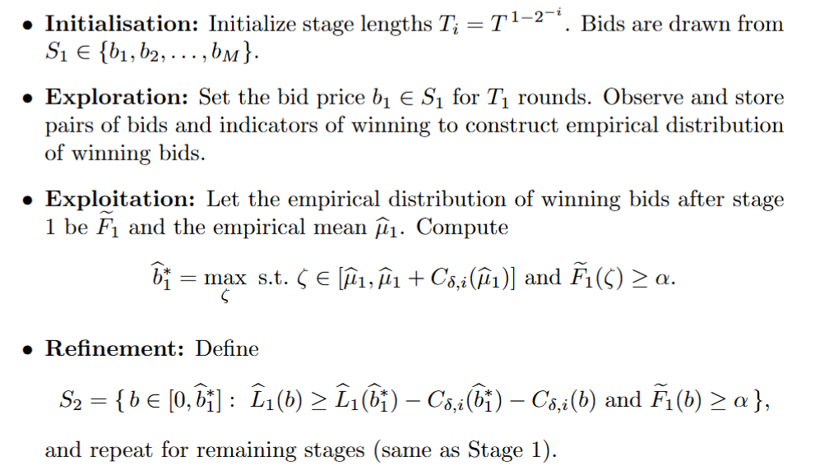
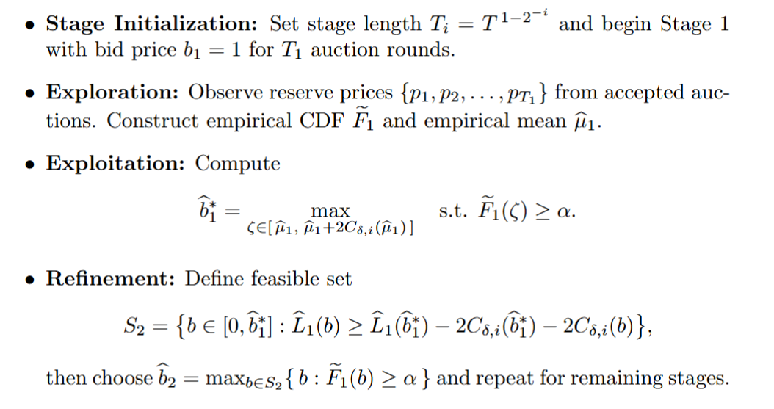
Explore Exploit Multi Stage Algorithm
Stochastic SPA
Stochastic FPA
Buyer wins if he bids above p and pays his bid amount

Slide 20
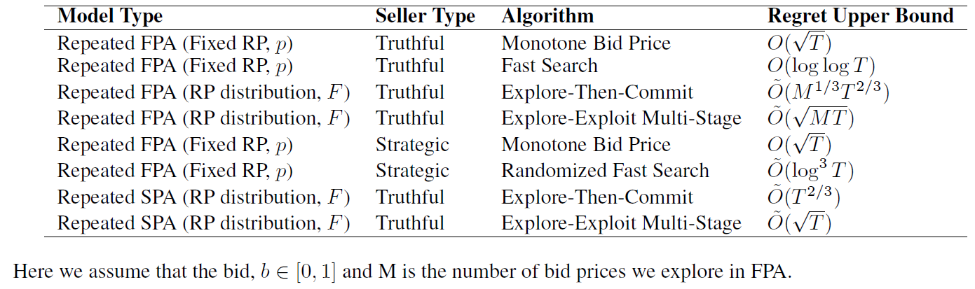
Comparative Study

Slide 21


Exploratory Questions
Strategic seller in Stochastic Reserve Price
In repeated auction, seller draws and inflates it to adversarially
Budget Constrained Buyers
Extend stochastic reserve-price models to budgeted buyers using
Bandits-with-Knapsacks ideas
Shadow-price methods: Index rules like UCB(reward) − λₜ·LCB(cost)

Slide 22
Appendix

Slide 23














Truthful Seller
Proof Sketch :
Upper bound :
We assume that and and so
Regret
We bound using
Now we take such that to get
and so Regret
Regret
Monotone Bid Price Algorithm

Slide 24













Truthful Seller
Monotone Bid Price Algorithm
Lower bound :
For k* , , Regret , and for
For , E[Regret] =
Regret where and using Cauchy Schwarz
By substituting
(We have assumed that )

Slide 25









Strategic Seller
Proof of Lower Bound:
Using to get
Regret
By taking and thus
Regret
By optimising k*, Regret
Monotone Bid Price Algorithm

Slide 26
Strategic Seller
Monotone Bid Price Algorithm

Slide 27
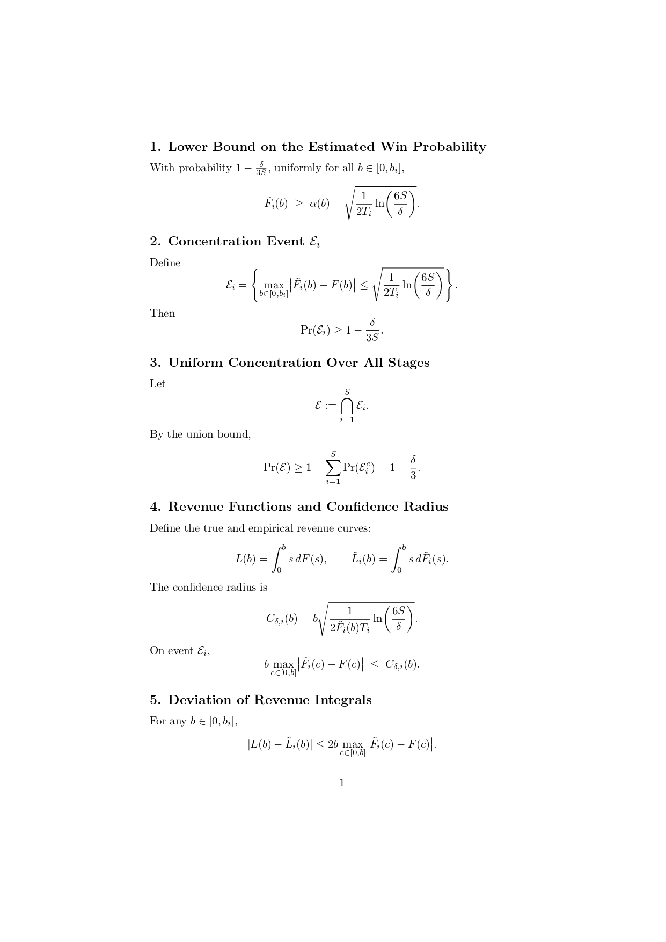
Explore Exploit Multi Stage Algorithm for Stochastic SPA
For FPA the Loss term is bounded by C_{δ,i} while its 2.C_{δ,i} for SPA

Slide 28
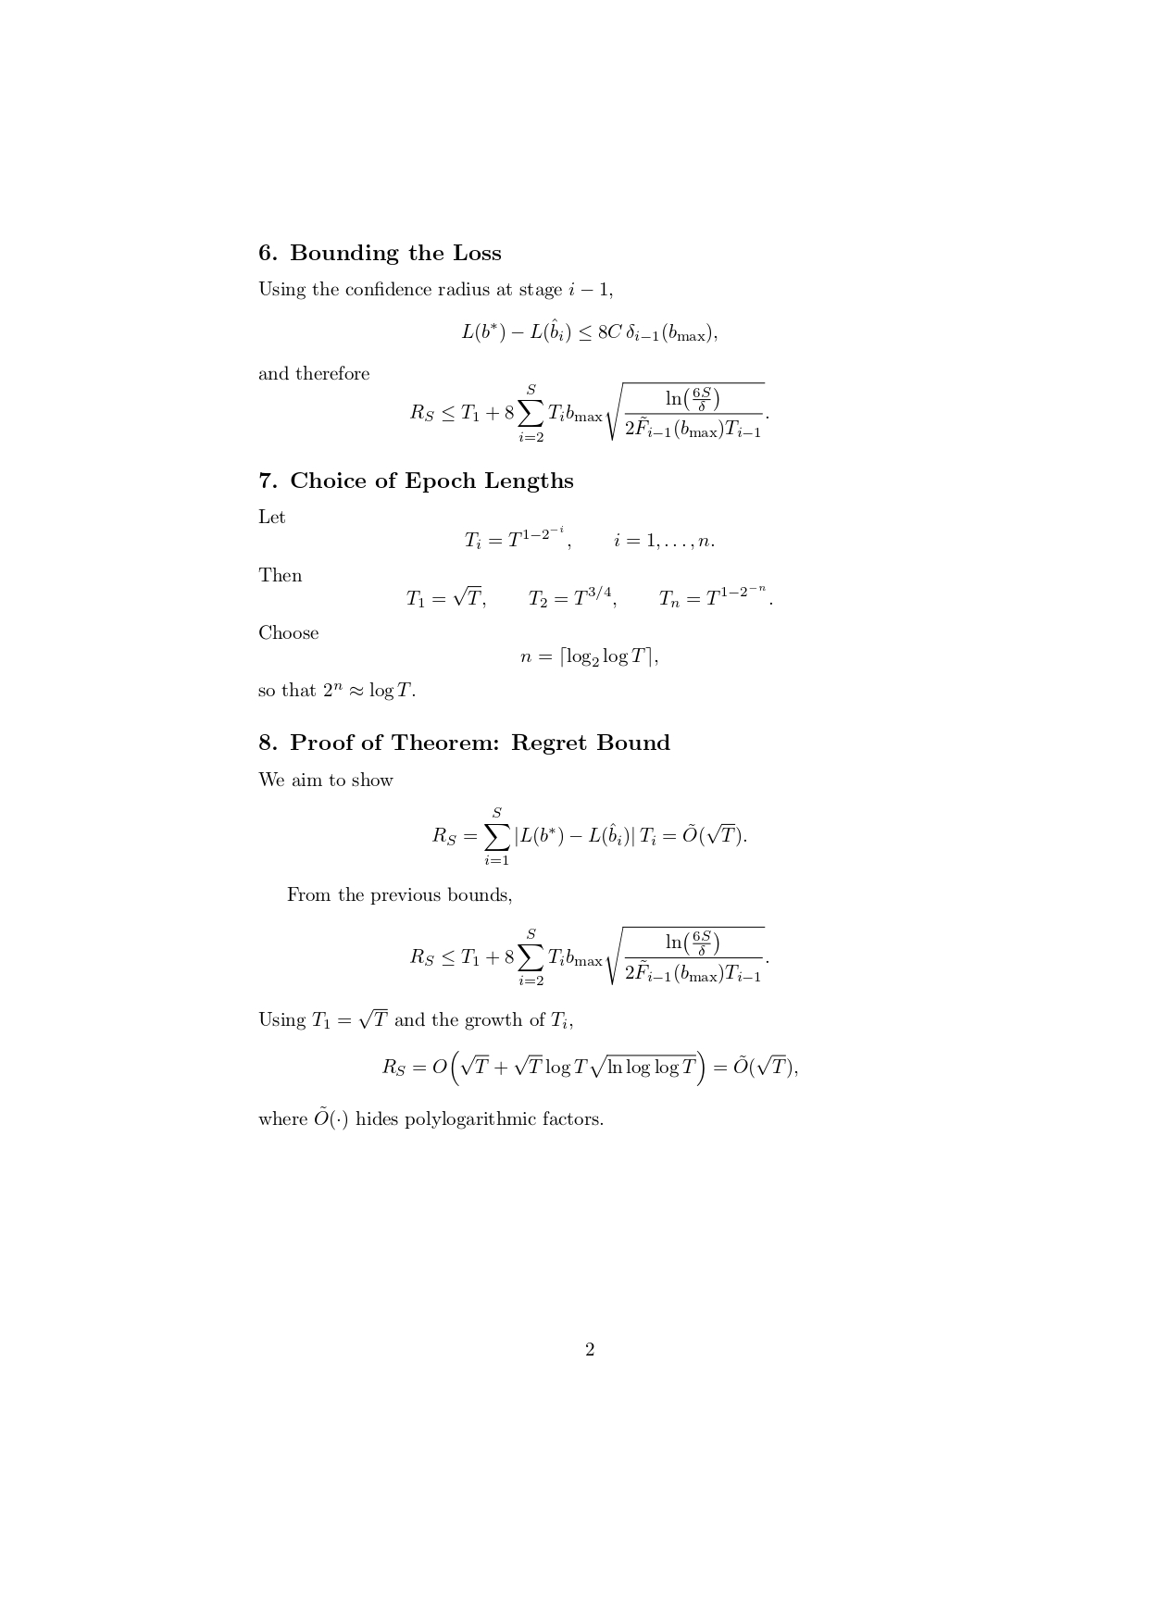
Explore Exploit Multi Stage Algorithm for Stochastic SPA
In regret expression, T_{i}=T ^{1-(½)^i}/|S_{i}| for round,i for each element in S_{i} ,
8 becomes 4 and a factor of √M gets added in 2nd term of regret

Slide 29
Thank You

