Slide 1
CAPSTONE PROJECT
HOTEL MANAGEMENT SYSTEM
Presented By:
1. T. N. SHRIAPPRADHA (2021303547)-Alagappa college of technoloy-Department of chemical technology

Slide 2
OUTLINE
Problem Statement
Proposed System/Solution
System Development Approach
Algorithm & Deployment
Result
Conclusion
Future Scope
References

Slide 3
PROBLEM STATEMENT
The existing hotel management systems often encounter several challenges that impede their efficiency and effectiveness. One prominent issue revolves around the integration and synchronization of various functions within the system. This includes reservation management, room allocation, billing, and inventory control, which often operate as separate entities leading to inconsistencies and errors. Additionally, the lack of a centralized platform for communication and coordination among staff members can result in delays and misunderstandings, impacting customer satisfaction. Furthermore, security vulnerabilities pose a significant concern, as sensitive guest information may be at risk of breaches. Addressing these problems requires the development of a comprehensive hotel management system that seamlessly integrates all functions, enhances communication channels, and prioritizes data security to ensure a smooth and secure operation while maximizing guest satisfaction and operational efficiency.

Slide 4
PROPOSED SOLUTION
1. Integrated Cloud-Based Platform:
- Develop a centralized platform accessible via the cloud.
- Integrate all hotel operations, including reservations, room allocation, billing, and inventory control.
3. Mobile Application:
- Develop a mobile application for staff members to access the system remotely.
- Enable staff to manage tasks, respond to guest requests, and check real-time updates on-the-go.
4. Automation:
- Implement automated processes for routine tasks like check-in/check-out and housekeeping schedules.
- Reduce manual errors and streamline operations for increased efficiency.
6. Security Measures:
- Implement robust cybersecurity measures to safeguard guest information.
- Utilize encryption protocols, access controls, and regular security audits to ensure data security.
By implementing these points, hotels can enhance operational efficiency, improve guest satisfaction, and ensure the security of sensitive data, ultimately leading to a more streamlined and successful hotel management system.

Slide 5
SYSTEM APPROACH
Building the proposed solution would involve a combination of data processing, feature engineering, and machine learning.
Here are the key system and library requirements:
System Requirements:
Hardware:-A computer with sufficient processing power, preferably with multiple cores or a GPU for faster training of machine learning models.-Adequate RAM to handle the size of the dataset and computational requirements
Software:-Anoperating systern compatible with the required machine leaming libraries (e.g., Windows, Linux, macOS

Slide 6
SYSTEM APPROACH- CONT
Library Requirements:
Data Processing and Analysis:-Pandas: For data manipulation and analysis.NumPy: For numerical operations on data.
Data Visualization:-Matplotlib and Seabom: For creating visualizations to understand data patterns.-Pictly or Bokeh Interactive visualization libraries for more complex visualizations

Slide 7
ALGORITHM & DEPLOYMENT
Here's an algorithm outline based on the specified components:
1. Algorithm Selection:
- Choose a suitable algorithm for the hotel management system, considering factors such as the nature of the data, computational requirements, and desired outcomes.
- Common algorithms for predictive analytics tasks in hotel management systems include decision trees, random forests, support vector machines, or neural networks.
2. Data Input:
- Gather relevant data from various sources within the hotel management system, including reservation databases, guest feedback forms, occupancy rates, and historical performance metrics.
- Preprocess the data to handle missing values, normalize features, and encode categorical variables if necessary.

Slide 8
ALGORITHM & DEPLOYMENT
3. Training Process:
Use the training data to train the selected algorithm.
Define the target variable or variables that the model aims to predict, such as room occupancy, customer satisfaction scores. Fit the algorithm to the training data, adjusting model parameters to minimize prediction errors.
Validate the model using cross-validation techniques to assess its generalization performance and prevent overfitting.
4.Prediction Process:
Once the model is trained and validated, use it to make predictions on new data.
Input relevant features or variables into the trained model to generate predictions for specific outcomes, such as future room bookings, expected revenue for a given period, or personalized recommendations for guests.
Monitor model performance over time and update the algorithm as needed to adapt to changing trends or business requirements.

Slide 9
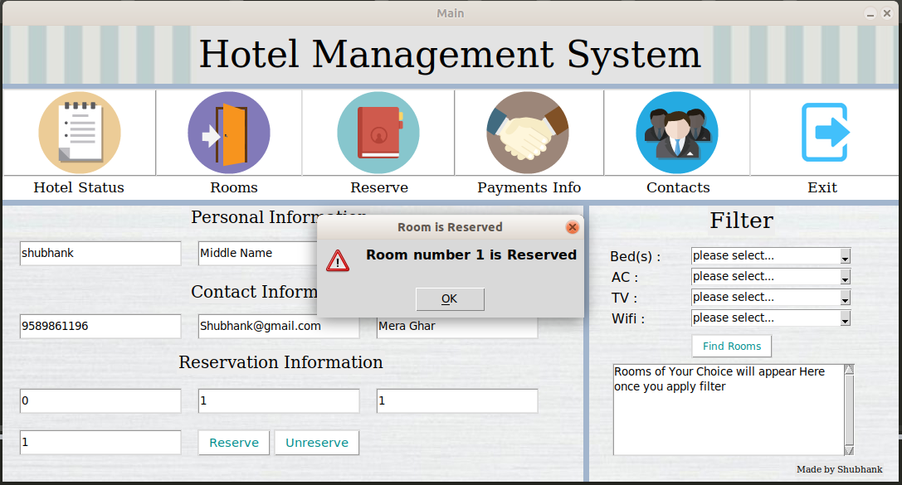
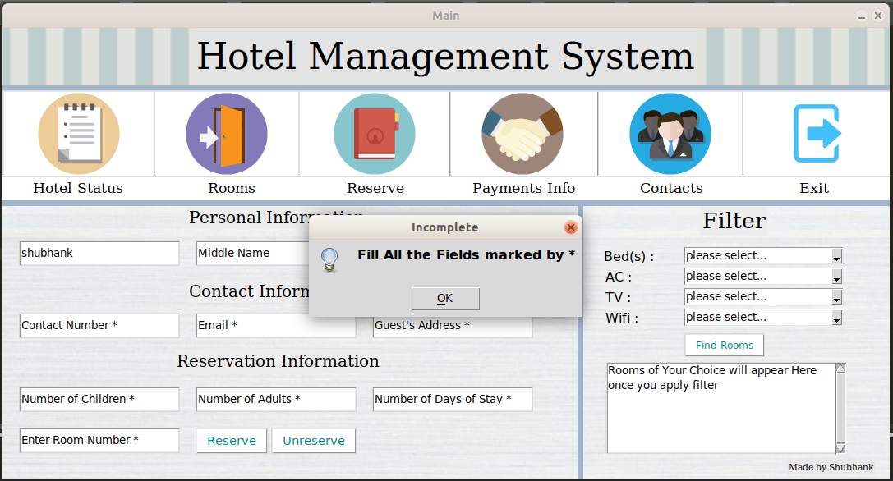
RESULT
Python programming enhances hotel management systems by facilitating tasks such as room availability checks and reservations through intuitive code. Through classes like "Room" and "Hotel," it organizes data and operations efficiently. Python's simplicity allows for easy integration of additional features, promising streamlined management processes. Overall, Python empowers hotels to optimize operations, elevate guest experiences, and adapt swiftly to industry demands.

Slide 10
CONCLUSION
In conclusion, Python offers invaluable tools for enhancing hotel management systems, streamlining operations, and improving guest satisfaction. Its versatility allows for the development of tailored solutions to meet the evolving needs of the hospitality industry. With Python's robust capabilities in data handling, automation, and integration, hotels can achieve greater efficiency, profitability, and competitiveness in today's dynamic market landscape. Embracing Python empowers hotels to stay ahead of the curve, delivering exceptional experiences and driving long-term success in the hospitality sector.

Slide 11
FUTURE SCOPE
The future scope of the project includes:
Integration of Additional Features: Incorporating advanced features such as customer relationship management (CRM), dynamic pricing algorithms, and predictive analytics to optimize revenue management and enhance guest experiences.
Enhanced User Interfaces: Developing intuitive and visually appealing interfaces for both hotel staff and guests, including mobile apps for seamless interaction and booking processes.
Expansion to Multi-Property Management: Scaling the system to support multi-property management, enabling hotel chains to centrally manage operations across different locations while maintaining consistency and efficiency.

Slide 12
REFERENCES
https://www.kaggle.com/datasets
https//pandas.pydata.org/pandas-docs/stable/user guide/index.html
https://matplotlib.org/stable/contents.html

Slide 13
THANK YOU

