Slide 1
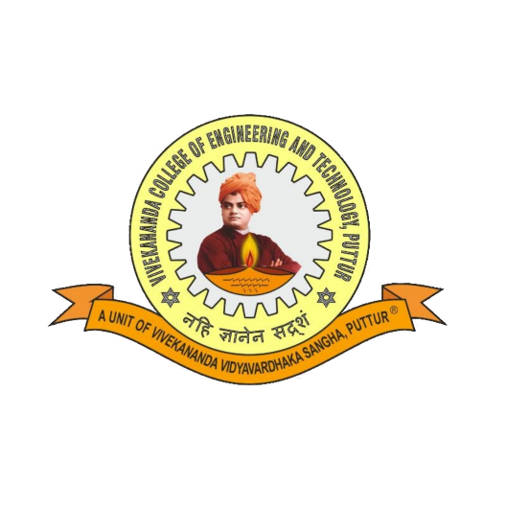
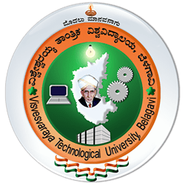
VIVEKANANDA COLLEGE OF ENGINEERNG AND TECHNOLOGY Nehru Nagara, Puttur – 574 203, DK, Karnataka, India
SUBJECT: Research Internship/ Industry Internship
SUBJECT CODE : 21CD82
AI Integration for Improving Sensor Data Quality in Predictive Maintenance
Presented by,
Yuktha K S
(4VP21CD060)
Guide:
Dr. S V Prasad

Slide 2
Contents
Introduction
Company Profile
Internship Project Overview
Methodology
Implementation
Outcomes
Future Scope
Assessment
Conclusion

Slide 3
Introduction
Internship under VTU curriculum (21INT82)
Role: AI-Data Quality Analyst
Organization: Rooman Technologies, Bengaluru
Duration: 15 weeks of hands-on experience

Slide 4
Company Profile
Rooman Technology:
A premier training and skill development company, focusing on delivering industry-specific training by adopting cutting edge teaching methodologies.
Wadhwani Foundations:
Helping people and business providing programs related to communication, skill development, soft skills, entrepreneurship and business growth.
IBM:
Known for its hardware and software products, including computers, servers, storage systems and networking equipment.

Slide 5
Internship Project Overview
The primary objective of the project “AI Integration for Improving Sensor Data Quality in Predictive Maintenance” enhancing the quality, consistency, and reliability in predictive maintenance system.
Objectives
To enhance the quality and reliability of sensor data.
Addressing issues such as noise, inaccuracies and missing values.
To provide accurate data, which in turn results in more accurate predictions.
To reduce the maintenance cost and preventing unexpected downtimes in predictive maintenance models.

Slide 6
Methodology
Data preprocessing, Analysis and Visualization: Handling missing values, detecting outliers, and managing duplicates along with identifying patterns, trends, and anomalies in engine performance metrics.
Feature Engineering and Selection: Principal Component Analysisto reduce the dataset’s dimensionality and Recursive Feature Elimination with a Random Forest estimator was performed to rank features.
Model Development and Selection: Decision Tree classifier for assessing initial feature effectiveness, Isolation Forest Algorithm for anomaly detection. IBM’s AutoAI platform integration to automate feature transformation, model selection and hyperparameter tuning.

Slide 7
Methodology
Evaluation : Multiple evaluation metrics were employed to assess model effectiveness and ensure reliable anomaly detection.
Dashboard Creation: Using Dash and Plotly.
Deployment: Deploying as AutoAI Model on IBM Cloud using Watson Studio.

Slide 8
Implementation
Data Quality Analysis (displaying visualizations)
Engine data(csv or live)
Data Preprocessing
Live Data Display
IBM Cloud API
ML Model
Model prediction
(healthy/faulty)
Flask (handling API Requests)
Prediction output
User controls
Figure 1: Dashboard Implementation

Slide 9
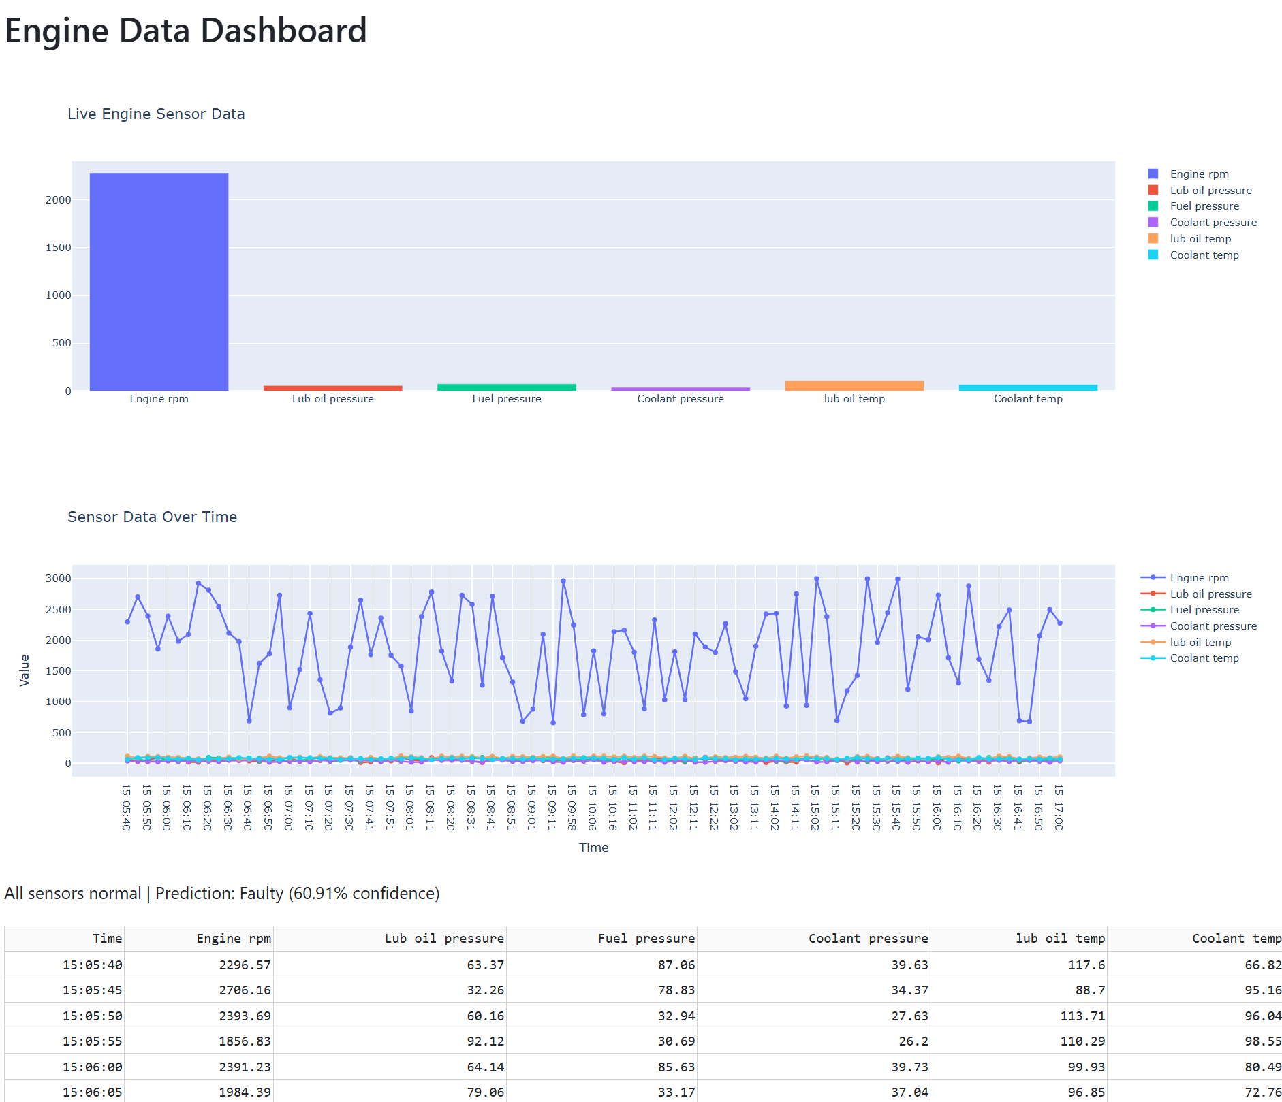
Figure 2: Engine Monitoring Dashboard

Slide 10
Outcomes
Based on response time of the model, it efficiently handles predictions under normal conditions.
Remains responsive even during peak traffic making it suitable for real-time engine health monitoring.

Slide 11
Future Scope
Advanced Analytics & AI: Use machine learning to analyze engine data, enabling predictive maintenance by identifying failure patterns and reducing downtime.
Expanded Monitoring Parameters: Upgrade the system to track a wider range of engine metrics for a more comprehensive health assessment.
User-Friendly Interface Development: Develop a user interface that presents complex data analytics in an accessible manner.

Slide 12
Assessment
Everyday quizzes on regular topics.
Doubt solving sessions.
Assessment on each topic in LMS software.
Project evaluation after submission.
Final assessment on topics like data cleaning, feature engineering, model selection, and cloud deployment, along with general aptitude questions assessing logical reasoning and problem-solving skills.

Slide 13
Conclusion
The internship provided a hands-on experience in data quality analysis, machine learning, cloud technology.
By working on a project, improved the skills like problem solving, adapting and teamwork.
Along this, Wadhwani Foundation Soft skill training provided a good understanding on soft skills that will help in corporate world.
Overall, this internship provided a valuable insights which will be helpful in my career development.

Slide 14
THANK YOU

