Slide 1

Intelligent Voice Control Wearable
Shridatha Mohan Hegde
June 2022

Slide 2
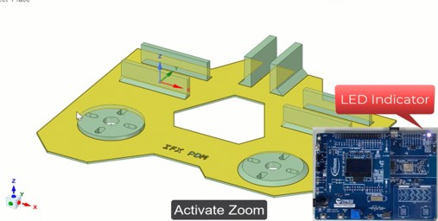

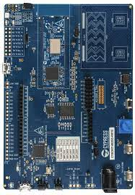
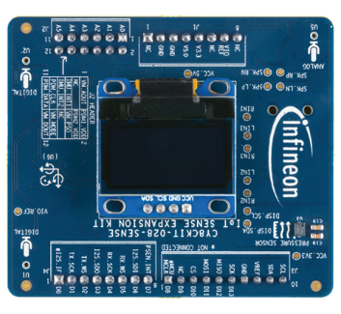

Intelligent Voice Control Wearable
Solution Diagram
Block Diagram
PDM CLK
USB HID
PDM DATA
SPI

Slide 3




Intelligent Voice Control Wearable
Features
Natural Voice command detection using ML
Gesture control using motion sensor
Combined Voice and Gesture inputs used for UI control

Slide 4


Intelligent Voice Control Wearable
Potential Solutions

