Slide 1

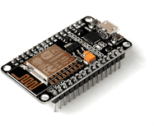
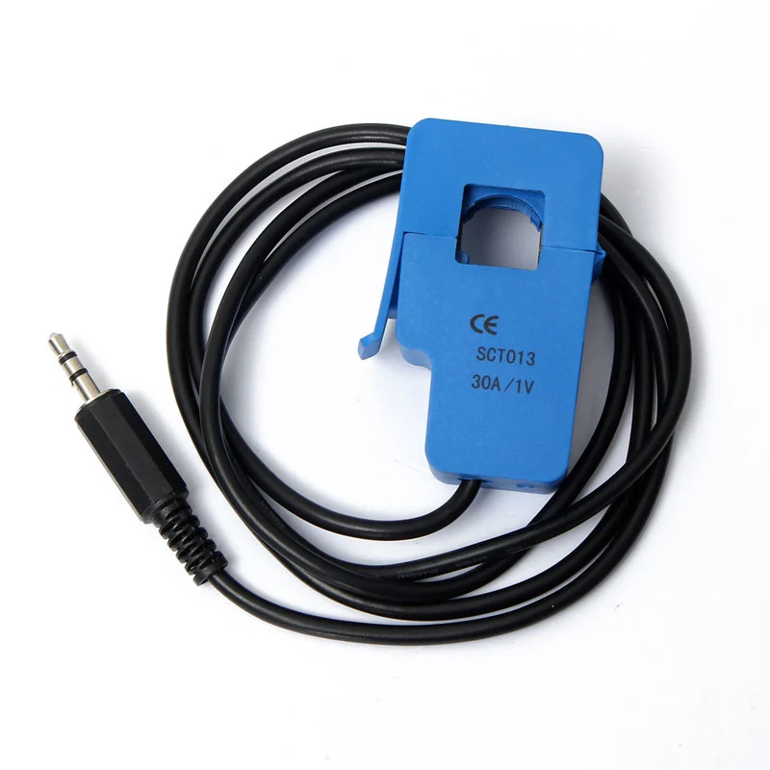






Non-invasive Smart Energy Monitoring System
Shridatha Hegde, Sagar Patil, Sai Preetham M, Saiprasanna K, Akhilesh Kumbhar
Guide- Dr.Sunita V.B.
School of Electronics and Communications
shridathahegde8@gmail.com
Problem statement
Methodology
Results
Design and develop non-invasive smart energy monitoring system.
Data acquisition for different sensor nodes are demonstrated and stored in database using cloud services. Deep Learning models were implemented to provide forecasts with accuracy of 95%
Data Acquisition
Objectives
To develop a data acquisition system and forecast consumption usage with cloud computing
Data Visualization
Optimization details
Contributions
Hardware- Introduction of sleep mode in ESP32 helps in increasing battery life with less current consumption (0.8mA), at the sensor node.
Software- Hyper parameter tuning yielded better optimization of the model increasing accuracy by 15%
This project helps in bridging the gap between electricity demand and supply analysing the consumption patterns and forecasting for future days.
ML model
Literature survey
Conclusions
Gathering pertinent information to the problem statement.
Existing architecture for managing and monitoring
Usage of machine learning to detect anomalies and forecasting
Web API
Due to the global warming and the increase of energy use,
efficient energy consumption is the main research issues these
days. The proposed energy monitoring framework can help efficiently manage usage of energy.
HTTP/HTTPS
End User
Minor Project 2020-21
Notes:
‹#›

