Slide 1

RESTAURANT RATINGS ANALYSIS
A SQL Analytics Study of Consumer Preferences & Restaurant Ratings
Database Design • SQL Queries • Window Functions • Business Insights
Data Science Project | Innomatics Research Labs

Slide 2
About me
Background : B-tech
Why you want to learn Data Science : I want to learn Data Science with Generative AI because I am interested in working with data, analyzing it, and extracting meaningful insights from it. I also want to understand how Generative AI can be applied to data and real-world problems. This course will help me build a strong foundation in data analysis, machine learning, and Generative AI while developing practical skills to create intelligent, data-driven solutions.
Work experience : Fresher
LinkedIn : https://www.linkedin.com/in/shridhar-balla-33b506237/

Slide 3

OVERVIEW
Introduction
Restaurants and consumers generate large volumes of rating and preference data.
Understanding who the consumers are, what cuisines they prefer and how they rate restaurants is hard from raw tables.
This project uses SQL on a restaurant–consumer database to answer business questions.
The data sits in five related MySQL tables analysed with joins, CTEs, window functions, views and stored procedures.
The analysis covers consumer profiles, cuisine preferences, restaurant features and ratings.
01
INTRODUCTION

Slide 4
THE CHALLENGE
Business Problem Statement
Consumer, restaurant and rating data sit in separate tables, so there is no single view.
It is hard to see who the consumers are by city, budget, age and occupation.
Businesses cannot easily compare which cuisines consumers prefer with which get rated most.
Finding top-rated and under-performing restaurants needs ratings joined across tables.
There is no reusable reporting layer, so every question is rewritten from scratch.
02
BUSINESS PROBLEM

Slide 5
GOALS
Project Objective
Design and load a relational database of consumers, restaurants, cuisines, preferences and ratings.
Profile consumers by city, budget, age group, occupation and transport.
Analyse cuisine preferences and compare them with rating activity.
Evaluate restaurants using Overall, Food and Service ratings.
Apply advanced SQL: CTEs, window functions, views and stored procedures.
Deliver business insights for restaurants and recommendation platforms.
03
OBJECTIVE

Slide 6
DATA SOURCE
Dataset Overview & Data Source
What does the database contain?
Restaurant & consumer ratings data stored in a MySQL database
Five related tables: consumers, restaurants, ratings, consumer_preferences, restaurant_cuisines
Consumer attributes: city, age, occupation, budget, smoker, drink level, transport
Restaurant attributes: location, price, alcohol service, parking, franchise, area
Ratings coded 0–2 (2 = Highly Satisfactory) for overall, food and service
Database: Project (MySQL)
All tables, views and procedures were built and queried in MySQL
04
DATA SOURCE

Slide 7
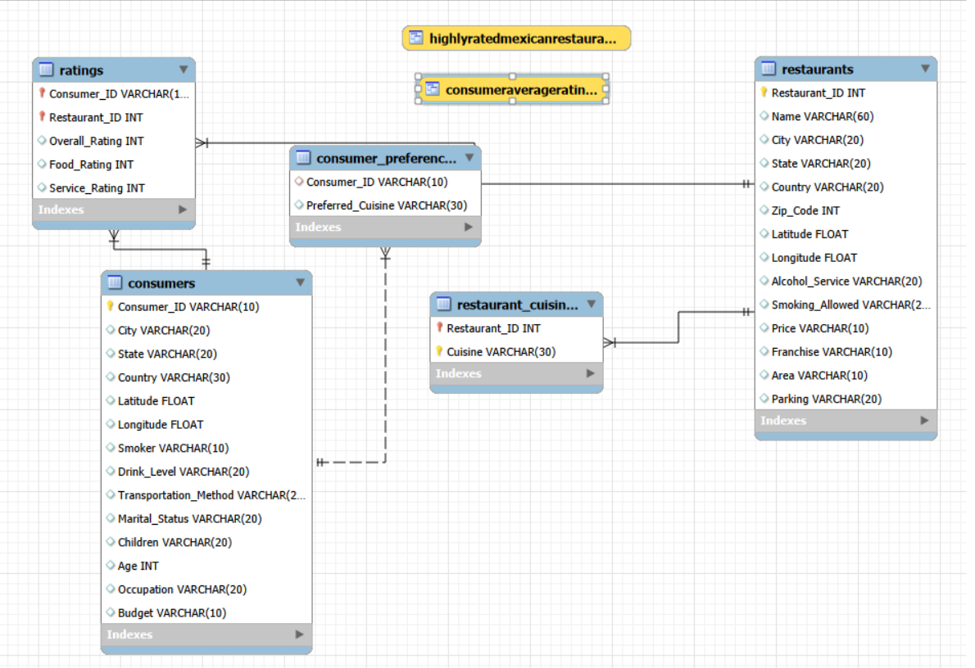
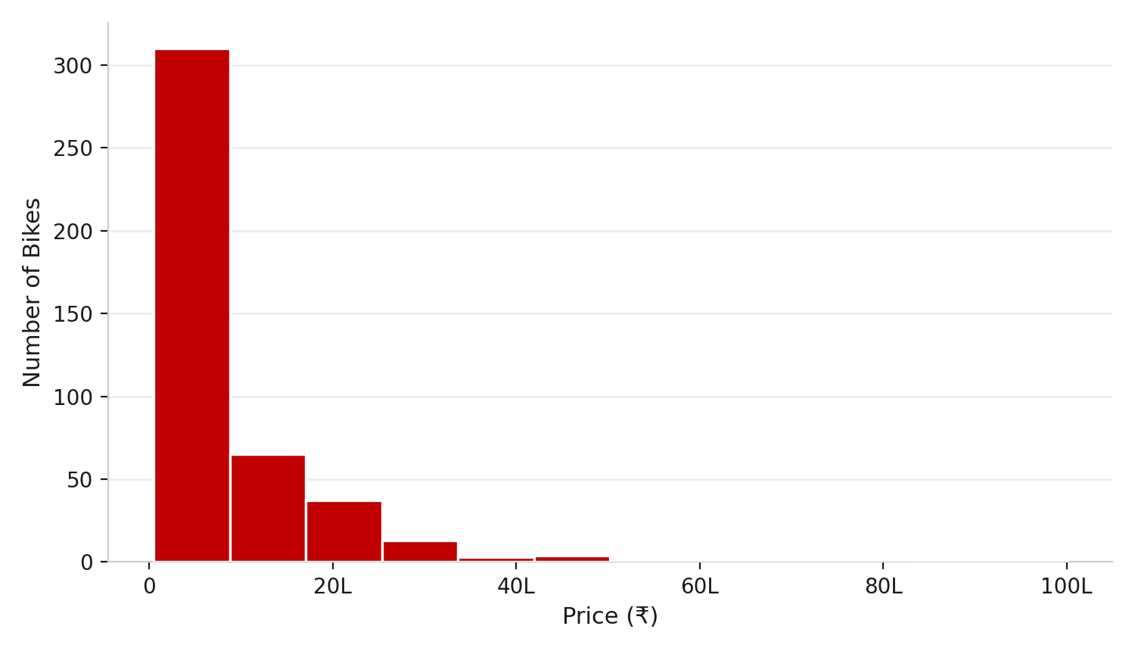
DATABASE DESIGN
Database Structure & Schema Overview
1
Consumers & Preferences
consumers (Consumer_ID, primary key) links one-to-many to consumer_preferences, one row per preferred cuisine.
2
Restaurants & Cuisines
restaurants (Restaurant_ID, primary key) links to restaurant_cuisines, so a restaurant can serve many cuisines.
3
Ratings (Bridge Table)
ratings connects consumers to restaurants through a composite key (Consumer_ID, Restaurant_ID).
Foreign keys enforce integrity across all five tables; two views sit on top for reuse.
ER diagram of the Project database
05
SCHEMA

Slide 8
TABLES & VIEWS
Tables, Views & Key Columns
1
2
3
4
consumers
restaurants
ratings
consumer_preferences
Consumer_ID (PK), City, Age, Occupation, Budget, Smoker, Drink_Level, Transportation_Method
Restaurant_ID (PK), Name, City, Price, Alcohol_Service, Parking, Franchise, Area
Overall, Food and Service ratings; composite key (Consumer_ID, Restaurant_ID)
Consumer_ID (FK) and Preferred_Cuisine; one row per preferred cuisine
5
6
7
8
restaurant_cuisines
Mexican Restaurants View
Consumer Ratings View
Stored Procedures
Restaurant_ID (FK) and Cuisine; a restaurant can serve many cuisines
HighlyRatedMexicanRestaurants: Mexican venues with average Overall_Rating above 1.5
ConsumerAverageRatings: each Consumer_ID with their average Overall_Rating
Two procedures: ratings above a threshold, and consumer segment with restaurant performance
06
DATABASE OBJECTS

Slide 9
APPROACH
SQL Queries & Analysis Approach
01
02
03
Understand the Schema
Build the Database
Explore & Profile
Studied the ER diagram, primary and foreign keys and the 0–2 rating scale before writing any query.
Created the Project database and five tables with primary keys, then added foreign-key constraints.
Previewed every table with LIMIT 10, then profiled consumers by city, budget, age group, occupation and transport.
04
05
06
Filter, Join & Aggregate
Advanced Analytics
Package for Reuse
Combined tables with INNER JOINs and answered questions with WHERE, GROUP BY, HAVING and derived tables.
Used CTEs, window functions (DENSE_RANK, ROW_NUMBER, LEAD, AVG OVER) and EXISTS / NOT EXISTS for ranking and gap analysis.
Saved logic as views and stored procedures so segment and rating reports can be re-run with one call.
07
APPROACH

Slide 10
SQL CONCEPTS
Key SQL Concepts Used
1
2
3
4
Joins
Aggregation
Subqueries
CTEs
INNER JOINs across two to four tables connect consumers, ratings, restaurants and cuisines
COUNT and AVG with GROUP BY and HAVING summarise consumers, cuisines and restaurants
IN, scalar and derived-table subqueries, e.g. food rating below the overall average
WITH clauses build readable multi-step logic such as top-5 consumers and city rankings
5
6
7
8
Window Functions
EXISTS / NOT EXISTS
Views
Procedures & CASE
DENSE_RANK, ROW_NUMBER, LEAD and AVG() OVER (PARTITION BY) for ranks and comparisons
Correlated subqueries for gap analysis, e.g. consumers who never rated an Italian restaurant
Reusable virtual tables: HighlyRatedMexicanRestaurants and ConsumerAverageRatings
Parameterised procedures plus CASE logic for spending segments and rating flags
08
SQL CONCEPTS

Slide 11
15 USE CASES
Key Analysis Questions (Use Cases)
1
How are consumers distributed across city, budget and age group?
9
Which cuisines are offered by the largest number of restaurants?
2
Which occupations and transport methods dominate the consumer base?
10
How are restaurants distributed across price levels?
3
Which cuisines are preferred by the largest number of consumers?
11
Which restaurants received a 'Highly Satisfactory' (2) rating?
4
Which cuisines receive the highest number of ratings?
12
Which Cuernavaca restaurants average an Overall_Rating above 1.0?
5
Which Medium-budget consumers prefer American cuisine?
13
Which restaurants get Food_Ratings below the overall average?
6
Which Mexican-cuisine fans gave an Overall_Rating of 0?
14
Who are the top 2 restaurants per cuisine by Overall_Rating?
7
Which consumers have rated restaurants but never an Italian one?
15
How does each consumer's rating compare with the restaurant average?
8
Which Medium-priced restaurants serve Wine & Beer?
09
USE CASES

Slide 12
QUERY RESULTS
Consumer Profiling & Segmentation
Consumer distribution: counts by city, budget, occupation and transport method (blank values excluded) show where consumers are concentrated and who they are.
Age groups: a CASE expression buckets ages into Under 20, 20–29 … 60+, revealing which age bands dominate the consumer base.
Lifestyle segments: filters on Occupation, Smoker and Drink_Level isolate niches such as student smokers and social drinkers who rated no-parking restaurants.
Engaged reviewers: students who rated more than two restaurants, and average age by occupation among actual raters, show who drives review activity.
Insight: clear consumer segments help restaurants and platforms decide which groups and cities to target first.
TECHNIQUES USED
SQL Concepts Applied
GROUP BY
Counts consumers by city, budget, occupation, transport
CASE
Buckets ages into Under 20 … 60+ bands
HAVING
Keeps students who rated more than 2 restaurants
DERIVED
Average age of consumers who have rated
10
QUERY RESULTS & INSIGHTS

Slide 13
QUERY RESULTS
Cuisine Preferences & Targeting
Cuisine demand: counting distinct consumers per Preferred_Cuisine ranks cuisines by popularity, while joining to ratings shows which preferences generate the most reviews.
Target list: consumers who prefer American cuisine and have a Medium budget form a ready audience for mid-priced American offers.
Dissatisfaction signal: Mexican-cuisine fans who gave an Overall_Rating of 0 flag core customers at risk of churn.
Gap analysis: NOT EXISTS finds consumers who rated restaurants but never an Italian one, and Mexican fans who never rated a top-rated Mexican restaurant.
Insight: these lists turn preference data into cross-promotion and recommendation opportunities.
TECHNIQUES USED
SQL Concepts Applied
COUNT
Distinct consumers per preferred cuisine
JOIN
Links preferences, consumers and ratings
NOT EXISTS
Finds consumers with no Italian ratings
CTE + VIEW
Mexican fans who haven't rated top Mexican spots
11
QUERY RESULTS & INSIGHTS

Slide 14
QUERY RESULTS
Restaurant Profile & Market Mix
Mid-range alcohol venues: restaurants with Wine & Beer service at Medium price are shortlisted by name and city.
Franchise presence: listing franchise outlets shows which cities host chain restaurants.
Cuisine supply: counting distinct restaurants per cuisine can be set against consumer preferences to spot supply–demand gaps.
Price mix: grouping restaurants by Price level shows how the market splits across price tiers.
Local fit: Pizzeria restaurants in cities with student consumers, and restaurants rated by consumers over 30 or in San Luis Potosi, link venues to audiences.
TECHNIQUES USED
SQL Concepts Applied
WHERE
Filters Wine & Beer, Medium-price restaurants
JOIN
Links restaurants, cuisines and consumer cities
COUNT
Distinct restaurants per cuisine
GROUP BY
Restaurant mix by price level
12
QUERY RESULTS & INSIGHTS

Slide 15
QUERY RESULTS
Ratings & Satisfaction Analysis
Top-rated restaurants: listing restaurants with an Overall_Rating of 2 (Highly Satisfactory) shows who delights consumers.
Local performance: average Overall_Rating per restaurant, filtered to Cuernavaca and above 1.0, highlights strong city-level performers.
Food quality alerts: a subquery compares Food_Rating with the overall average to flag restaurants that need food-quality attention.
Best-of Mexican list: the HighlyRatedMexicanRestaurants view keeps Mexican restaurants averaging above 1.5 for repeated use.
Insight: benchmarking ratings against averages pinpoints where each restaurant is strong or weak.
TECHNIQUES USED
SQL Concepts Applied
WHERE
Selects restaurants with Overall_Rating = 2
AVG
Cuernavaca averages above 1.0 via HAVING
SUBQUERY
Food rating below the overall average
VIEW
Mexican restaurants averaging above 1.5
13
QUERY RESULTS & INSIGHTS

Slide 16
QUERY RESULTS
Rankings with CTEs & Window Functions
Rater baseline: AVG() OVER (PARTITION BY consumer) puts each rating beside the consumer’s own average, separating strict from generous raters.
Cuisine leaderboards: DENSE_RANK in a CTE returns the top 2 restaurants per cuisine, with ties included.
Local rankings: ratings for Cuernavaca restaurants are ranked within each restaurant, highest first.
Rating sequence: LEAD compares each of consumer U1008’s ratings with the next one (Restaurant_ID as a time proxy).
Top consumers: a view and CTE find the top 5 consumers by average rating and count the Mexican restaurants they rated; ROW_NUMBER lists the top 3 cuisines for low-budget students.
TECHNIQUES USED
SQL Concepts Applied
AVG OVER
Consumer's average beside each rating
DENSE_RANK
Top 2 restaurants per cuisine, ties kept
ROW_NUMBER
Top 3 cuisines per low-budget student
LEAD
Compares a consumer's next rating
14
QUERY RESULTS & INSIGHTS

Slide 17
QUERY RESULTS
Views & Stored Procedures
ConsumerAverageRatings view: gives each consumer’s average Overall_Rating in one line and feeds the top-5 consumer CTE.
HighlyRatedMexicanRestaurants view: packages a join and aggregation once, then reuses it for gap analysis.
GetRestaurantRatingsAboveThreshold: takes a Restaurant_ID and a minimum rating and returns consumer, overall, food and service ratings.
GetConsumerSegmentAndRestaurantPerformance: maps Budget to a spending segment, compares each rating with the restaurant average (Above, At or Below) and ranks restaurants for that consumer.
Insight: one CALL produces a consumer profile report that analysts and CRM teams can reuse.
TECHNIQUES USED
SQL Concepts Applied
VIEW
Reusable consumer and Mexican-restaurant views
PROCEDURE
Ratings above a threshold for a restaurant
CASE
Maps Budget to a spending segment
FLAG
Above / At / Below restaurant average
15
QUERY RESULTS & INSIGHTS

Slide 18
SUMMARY
Conclusion & Key Findings
The project turned a five-table restaurant–consumer database into clear answers about who consumers are, what they prefer and how restaurants perform.
Consumer segmentation by city, budget, age, occupation and transport gives a solid base for targeting.
Cuisine preference and rating-activity queries show where consumer demand meets restaurant supply.
Overall, Food and Service rating analysis highlights top performers and restaurants that need improvement.
CTEs, window functions and NOT EXISTS enabled leaderboards, rankings and gap analysis.
Views and stored procedures make key reports reusable with a single call.
Overall, SQL alone was enough to move from raw tables to actionable insights for restaurants and recommendation platforms.
16
CONCLUSION

Slide 19
ROADBLOCKS
Challenges Faced During the Project
Data Quality: Blank city, occupation and budget values had to be filtered out.
Rating Scale: Interpreting the 0–2 Overall_Rating scale (2 = Highly Satisfactory).
Duplicate Rows: Multi-table joins repeated records, so DISTINCT was needed.
Ties in Rankings: DENSE_RANK was used so tied restaurants were all included.
No Time Column: Restaurant_ID served as a proxy order for LEAD.
No Preference Order: ROW_NUMBER used Consumer_ID and Preferred_Cuisine to order.
Complex Logic: Views, CTEs and procedures were built and tested step by step.
17
CHALLENGES

Slide 20
WHAT'S NEXT
Future Improvements
Add timestamps and review text to ratings to enable trend and sentiment analysis
1
Add indexes on Consumer_ID and Restaurant_ID to speed up joins as data grows
2
Create more views and stored procedures for recurring city-wise and cuisine-wise reports
3
Connect the database to Power BI or Tableau for interactive dashboards
4
Build a recommendation query using a consumer's preferred cuisine, budget and location
5
18
FUTURE WORK

Slide 21

Q&A
Questions & Discussion
Thank you for your time — happy to discuss the queries, insights, or next steps.

