Slide 1
Recommendation Systems Mid-term Project
Prem Shah (IMT2020044)
Mayank Chadha (IMT2020045)
Shridhar Sharma (IMT2020065)
Darshak Jivrajani (IMT2020119)

Slide 2
Methodology -
Replace nan values with 0.5 rating.
Subtract row wise average to normalize ratings.
Apply SVD as a noise reduction paradigm.
Apply K-Means as a clustering technique.
Create a ratings matrix.
Apply SVD again on the reduced matrix.
Inference.

Slide 3
K-Means
Run the algorithm 10 times with different random cluster centers.
Inertia / Distortion – Distance between each point and its cluster center.
We can determine optimal K using Elbow Curve

Slide 4
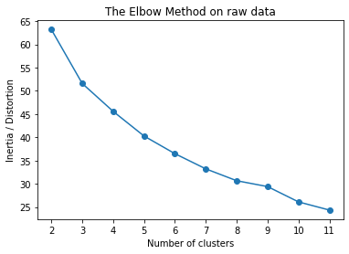
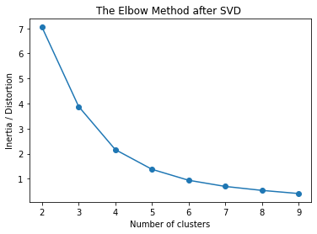
Singular Values of Core Course matrix (162 x 5) –
[20.75, 4.77, 4.05, 3.73, 2.85]
There is no clear elbow when we cluster the raw data without any preprocessing.
To remove the inherent noise in the data, we can apply SVD before clustering.
There is an elbow at k = 5 if we remove 4 singular values (retaining around 60% of total variance)

Slide 5
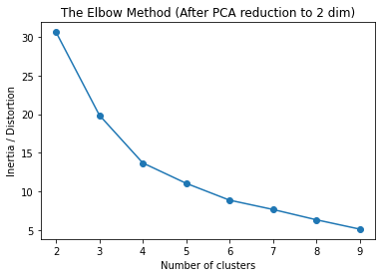
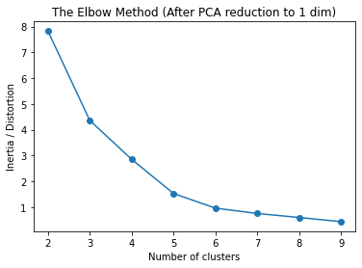
We can also apply PCA for dimensionality reduction to get an elbow.
First, we apply SVD, removing 1 singular value.
Then, we reduce the dimensions from 5 to 2 (retaining 66% importance)
There is elbow at k = 5 / 6
Reducing to a single dimension gives a clearer elbow but more than 60% of information is lost.

Slide 6
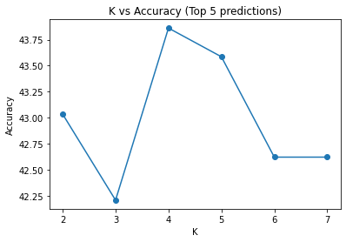
Evaluation Metrics -
Accuracy –
Top 3 electives predicted – 35%
Top 5 electives predicted – 42%
Top 10 electives predicted – 61%
Best Accuracy was for k = 4 – 6

Slide 7
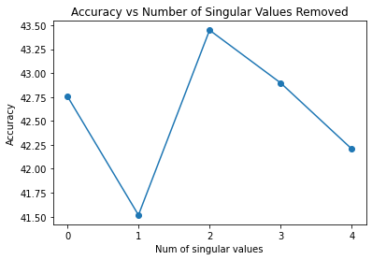
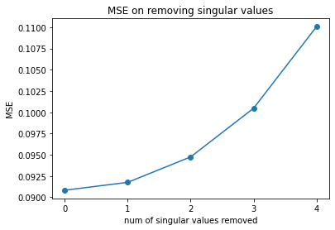
SVD
We decided to remove 2 singular values for Noise Reduction.
However, there was no significant difference in accuracy after applying reduced SVD (+/- 1%).
On multiple runs with random initialization of clusters, we got almost same results on removing different number of singular values, indicating that reduced SVD is not effective for our data.
In fact, application of Reduced SVD resulted in an increase of MSE between the ratings of courses actually rated and predicted ratings.

Slide 8
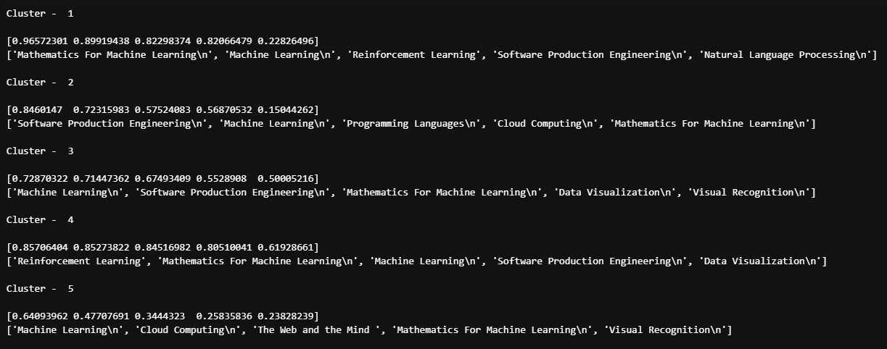
Everyone has rated ML and MML very highly.

Slide 9
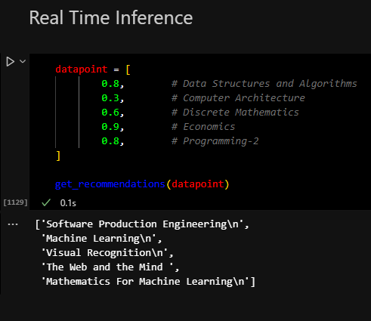
Observations
If a student is inclined towards Economics, then an HSS course is being recommended as expected.
None of the clusters have an ECE elective. Due to less number of ECE students, there is inherent bias in the data towards CSE courses.
DM was a core CSE course, but ECE students had to compulsorily rate it.

