Slide 1


ML – Recap
Perceptron
10th Oct 2022

Slide 2
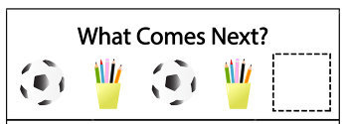
We infer a rule through instances…….
This is a typical “Prediction” Problem

Slide 3


Training samples : Tuple (Pattern, class label)
Class 1
Class 2
We infer a rule through instances…….
What about this ????
This is a typical “Classification” Problem
Test sample : Only pattern is given
We need to complete the Tuple (Pattern, ??class label??)

Slide 4
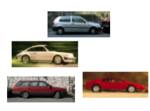


Extending the problem
Training samples : Tuple (Pattern, class label)
Label = CAR
Label = ??
Test sample : Only pattern is given
We need to complete the Tuple (Pattern, ??class label??)
Label = PLANE
Label = ??
Training samples : Tuple (Pattern, class label)

Slide 5
Essence of Learning
(From Prof. Moustafa’s slides)
There has to be a pattern
Pattern may/may not be captured in a mathematical expression
We should have data on it

Slide 6
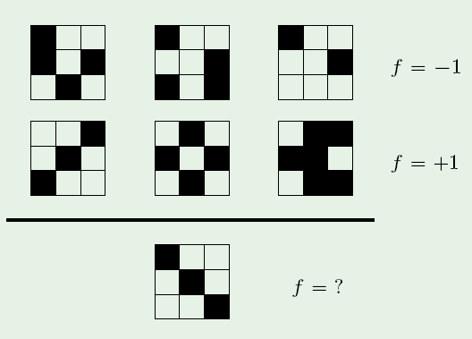
Question
(From Prof. Mostafa’s slides)

Slide 7
From Data ----->To Features
Class 1
Sample 1
Sample 2
Sample 3
Class 2
Sample 4
Sample 5
Sample 6
Let’s Define Feature as, = Number of Black boxes
Number of black boxes
2
1
1
2
3
4
5
6
Training Sample Number

Slide 8
Feature space
Feature extractor : Mapping from Data to Feature Space
Feature Extractor : Data -> (Feature1,Feature2,..)
What is the advantage ?
In this case, if the image is of size 10 X 100, we need 1000 pixels to represent every Data point
But using Feature Extraction, each Data point is now represented by a smaller set of numbers (Reals/Integers)
Features should get us closer towards discovering inherent patterns

Slide 9
Feature space
Extract “good” Features from the Given Data
Each Sample instance is mapped to a point in the Feature-space
Sample Instance = {Feature1, Feature2, Feature3,….}
For an unseen test sample, what do we do ?
Compute number of black boxes
If 1, then Class 2
If 2, then Class 1
Number of black boxes
2
1
1
2
3
4
5
6
Training Sample Number

Slide 10
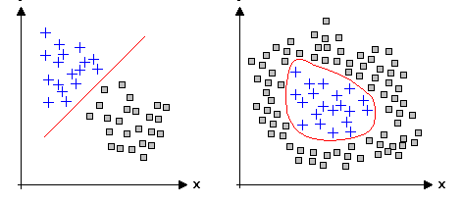
Data separability in Feature-space
Feature2
Feature2
Feature1
Feature1
Linearly separable
Non-Linearly separable
Which kind of data is easier to work with ??

Slide 11
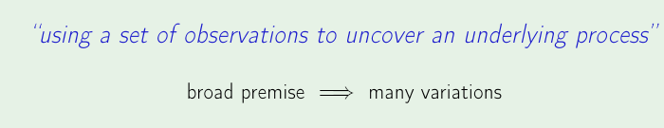
Basic Learning Premise
Training samples are drawn Independently of each other
All Training samples come from the same underlying process
Training Samples are all Independent Identically Distributed (IID) Samples

Slide 12
Learning scenarios
Supervised Learning
Unsupervised Learning
Any more ???

Slide 13
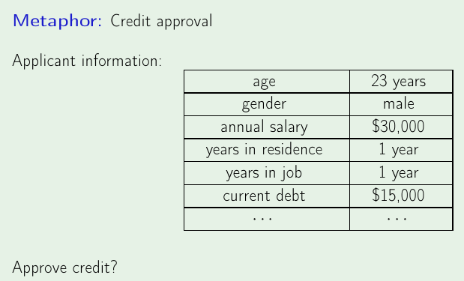
Supervised Learning - Scenario

Slide 14
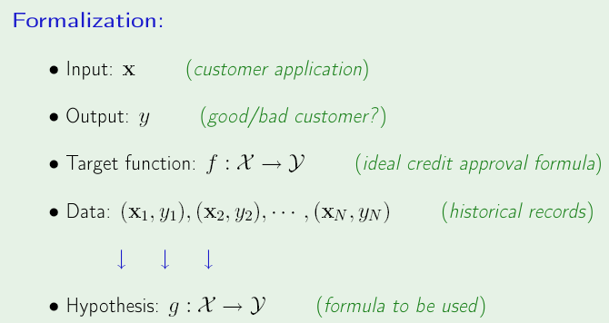

Slide 15
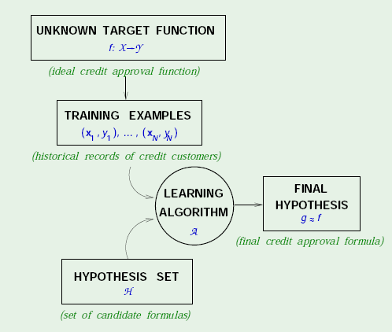

Slide 16
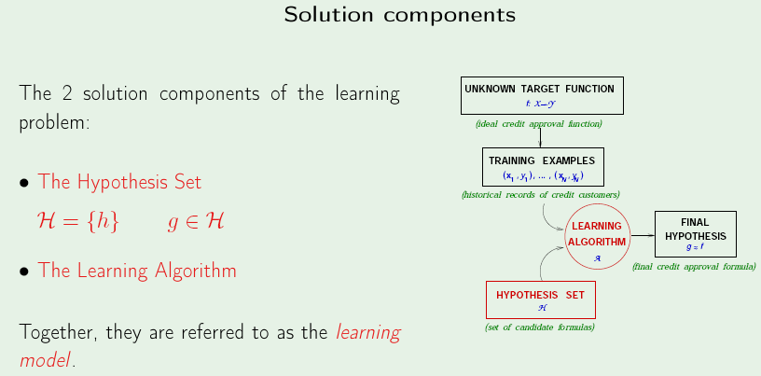

Slide 17
Linear Models
From the Hypothesis set, we are choosing only those that are Linear !!

Slide 18
Linear Models
Examples of Linear Models :
Linear Regression, Logistic Regression, Perceptron, SVM, LDA….
When do you choose which model ?
What are the differences between them ?

Slide 19
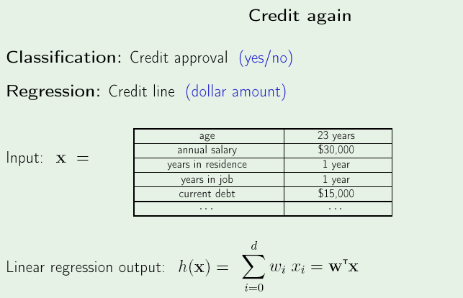
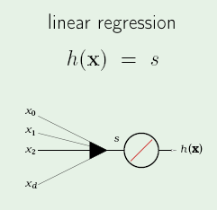
Linear Regression
(Real-valued output)

Slide 20
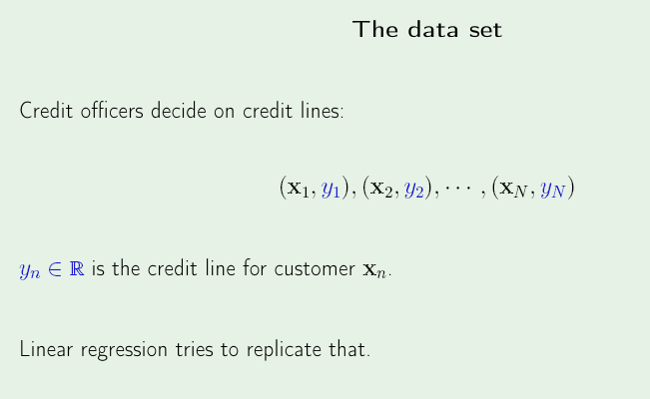
Linear Regression - Objective

Slide 21
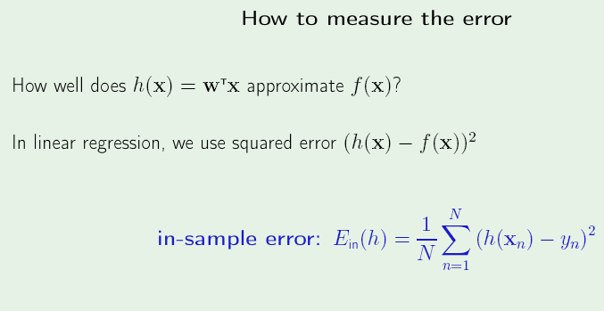
Cost function
Please Remember :
Training Error = In-sample error
Testing Error = Out-of-sample error

Slide 22
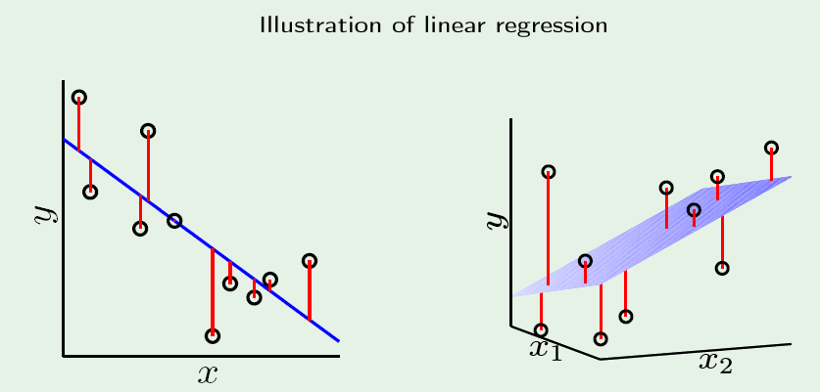
Cost function contribution
Notice : All data points that are not on the line contribute to the cost function

Slide 23
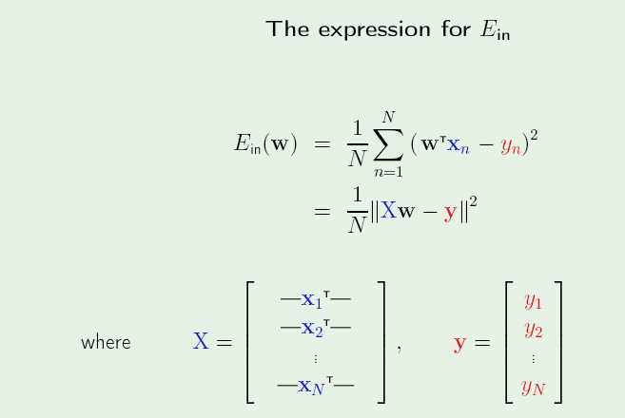
Cost function - Rewriting
Notice : All data points x₁, x₂…..x_{N} contribute to the cost function

Slide 24
Vector calculus - Hints
Given that w is a vector and U is a matrix/vector
(1) d/dw (U^{T}w) = U
(2) d/dw (w^{T}Uw) = 2Uw

Slide 25
Error measure, J = ||y-Xw||²
J = (y – Xw)^{T}(y-Xw), Expanding Norm ||y-Xw||²
^{Expand the brackets :}
J = [y^{T} – (Xw) ^{T}][y – Xw]
= yTy- (Xw)Ty- yTXw + (Xw)T (Xw)
^{= yTy - 2 yTXw + wTXTXw}
dJ/dw = 0 – d/dw(2 yTXw ) + d/dw(wTXTXw)
^{= -2 (yTX) T + 2 XTXw}

Slide 26
Setting dJ/dw = 0
^{-2 (yTX) T + 2 XTXw = 0}
^{(yTX) T =} ^{XTXw}
^{XTXw = (yTX) T = XTy}
^{w} ^{= (XTX) -1 XT}
Hence w is the Pseudo Inverse of X

Slide 27
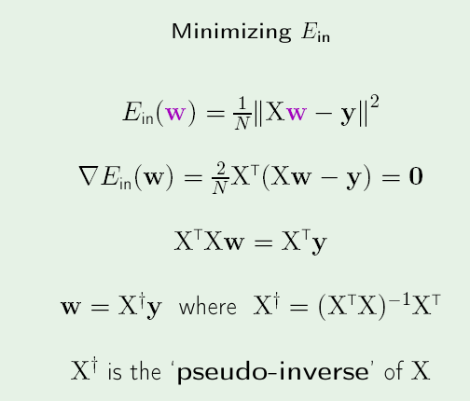

Slide 28
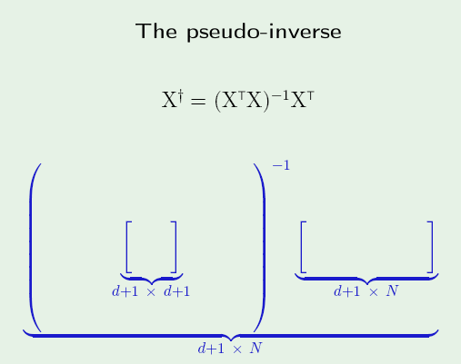
Pseudo-inverse Dimensions
Think : What if “d” was a large number ?!?

Slide 29
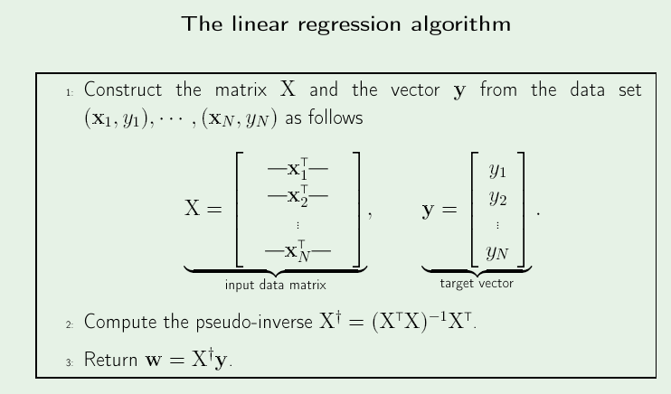

Slide 30
Cost function
Can we think of any other way of quantifying error ?
How about 1-norm of the Deviation ?
How will we know when to choose 1-norm, when to choose 2-norm ?

Slide 31
Logistic Regression

Slide 32

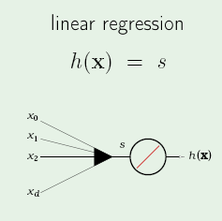
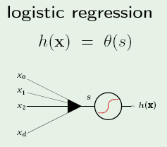
Linear Models – Contd…
Note : The logistic function behaves “linearly” in a certain interval ; It behaves like the Signum function at the tails

Slide 33
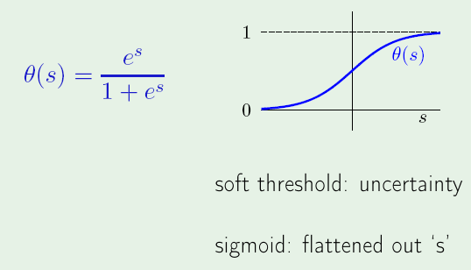
Logistic (Sigmoid) function
Where,

Slide 34
Logistic (Sigmoid) function
Maps real line to [0,1]
Can be used to model posterior probability i.e P(C | x)
Final goal: Feature as input and output as posterior probability,
using the sigmoid model
Step 1: Take linear combination of features (similar to Linear Regression)
Step 2: Apply sigmoid function

Slide 35
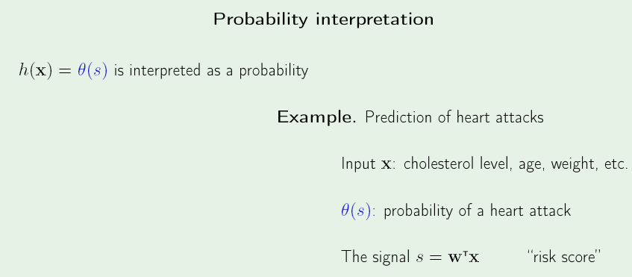
Logistic Regression
Where,
What happens when -----
Risk score is high ?? s is large; Ɵ(s) -> 1
Risk score is low ?? s is small; Ɵ(s) -> 0

Slide 36
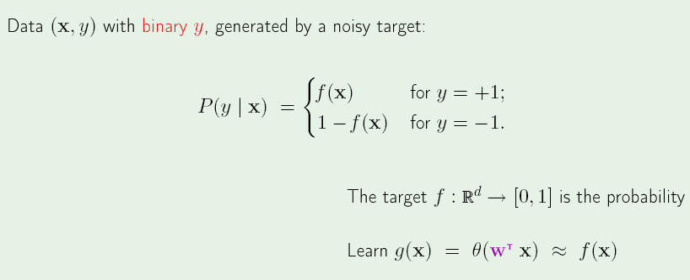
From Discrete to Real-valued
Data tuples given (x,y) represent :
x = [Age, cholesterol level, weight]
y = +1 (Had a heart attack) or -1 (Didn’t have a heart attack)
But we would have wanted the “Probability of Heart Attack” given the Pattern x
If “f” is the IDEAL function that takes in input Pattern “x” and outputs the probability that the pattern “x” will lead to a Heart Attack

Slide 37
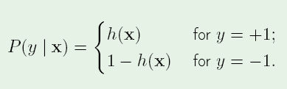
How to quantify the error ?
For each (x,y), y is generated by probability f(x)
We are trying to learn “f”
If we use “h” as approximation to “f”, it means
If h = f, how likely are we to get y from x

Slide 38


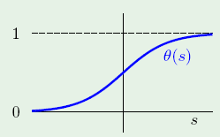




MLE - Estimation
Given pattern “x”, what is the likelihood that “y” is generated by “h” :
Re-writing P(y|x), using odd symmetry about 0.5

Slide 39


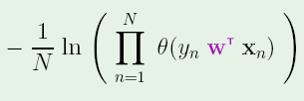

Maximizing the Likelihood
Maximize
Maximize the log
Maximize scaled version
Minimize
Same as minimizing

Slide 40


MLE
Error Measure =
Re-write the Error Measure, expanding Ɵ
If (y_{n}) and (w^{T}x_{n}) have same sign, then it contributes e^{-ve} number ;
Hence contribution is small (i.e Hypothesis is correct for that point)
If (y_{n}) and (w^{T}x_{n}) have opposite signs, then it contributes e^{+ve} number ;
Hence contribution is large (i.e Hypothesis is wrong for that point)
Hence we need to minimize the Error Measure
Objective : Find that parameter “w” that minimizes the Error measure

Slide 41
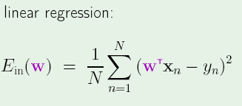
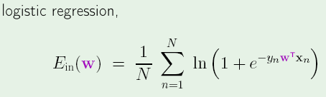
MLE
We got a closed form solution !!
Closed form solution not possible ☹
Way ahead : Iterative solution

Slide 42
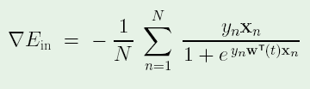

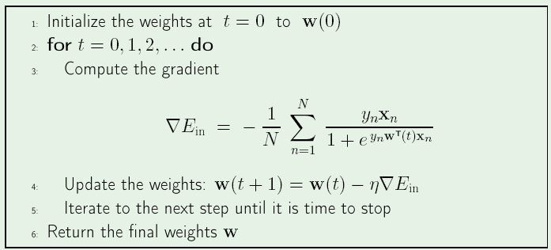
Gradient Descent
Initialize w as w(t)
Differentiate Error wrt w :

Slide 43
Logistic Regression
  Classifier
  Discriminative model (vs Generative model)
  Parameters – feature weights
  Estimation – ML estimation
  Gradient Descent (Iterative Method)
Summary : Maximum likelihood estimation of ”w” assuming that the observed training set was generated by a binomial model

Slide 44
Other Linear Models..

Slide 45
Same old Example

Slide 46
Perceptron – Why?
Guaranteed to solve if Data is Linearly Separable
Link to Support Vector Machines (SVM) – Neural Networks (NN)

Slide 47
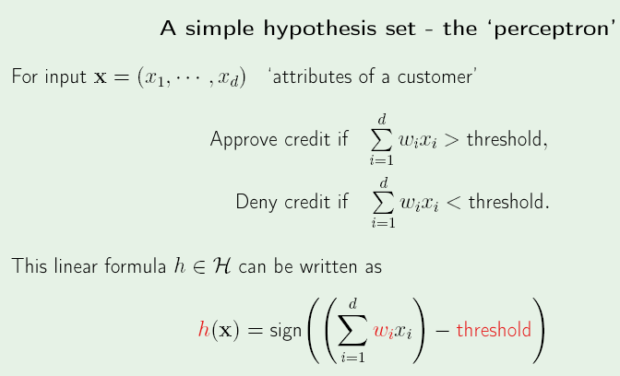
Perceptron

Slide 48
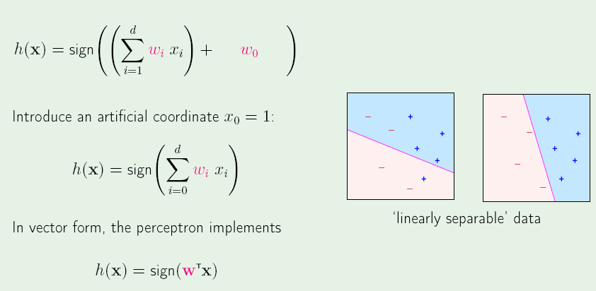
Linearly separable data

Slide 49
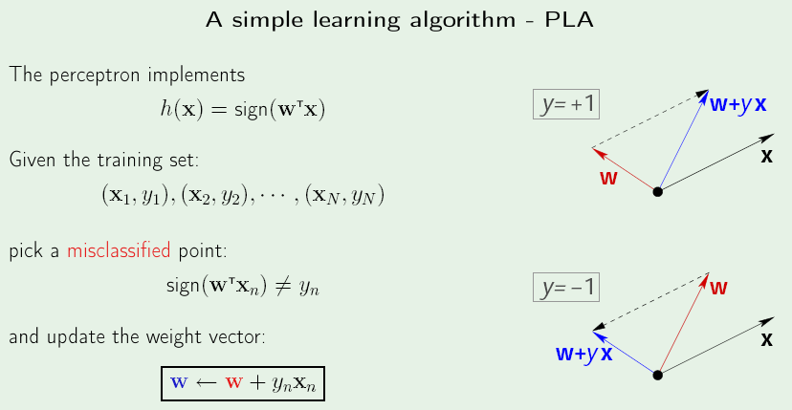
Perceptron learning Algorithm

Slide 50
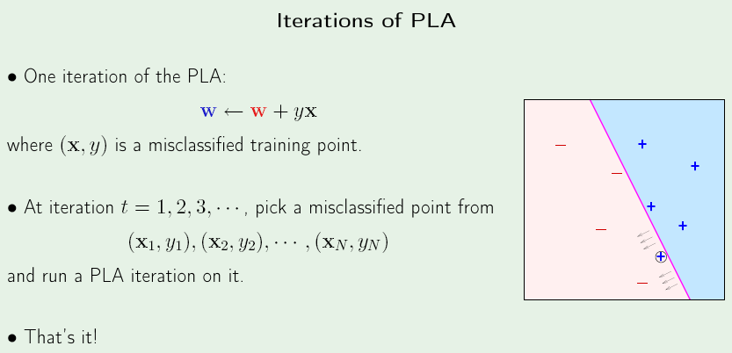

Slide 51
Perceptron -Wiki
Invented in 1957 by Frank Rosenblatt
In 1969 a famous book entitled “Perceptions” by Minsky & Papert , they showed that it was impossible for Perceptron to learn an XOR function.

Slide 52
To Do
Perceptron on MNIST Data
Take 2 classes at a time and check if 2 confusing classes such as “1” and “7” can be classified using Perceptron
Is the Number of iterations taken dependent on the Initialization ?

Slide 53
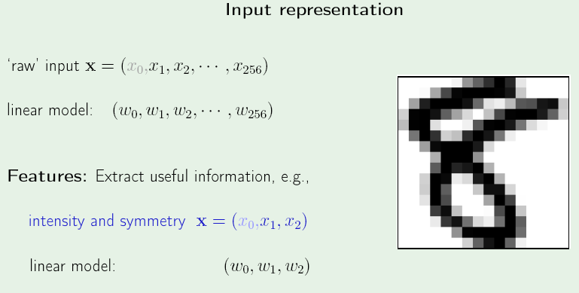
Perceptron - MNIST

Slide 54
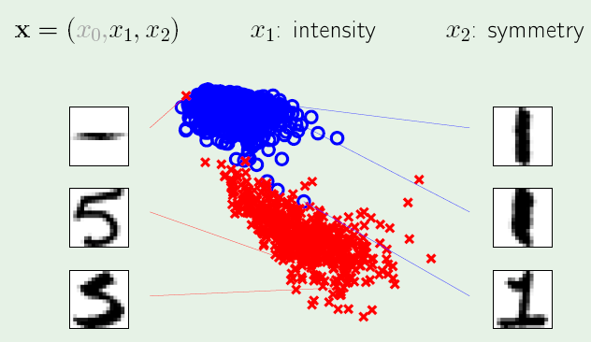
Feature Space

Slide 55
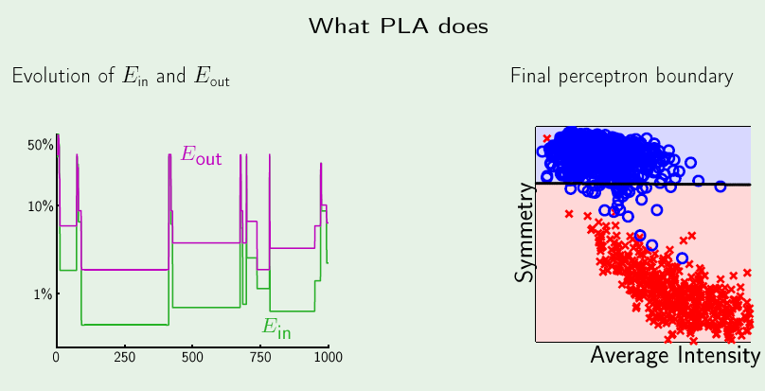
PLA - Output

Slide 56
Pocket - Version

Slide 57
PLA Vs Pocket

Slide 58
To Do
Perceptron on MNIST Data
Think of a suitable feature set. Take 2 classes at a time and check if 2 confusing classes such as “1” and “7” can be classified using Perceptron
What is the cost function we are minimizing in Perceptron ?
  Apply Gradient Descent to this cost function
Prove : Convergence of Perceptron

Slide 59
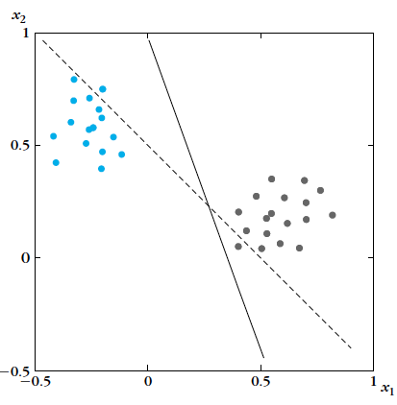
PLA aims to do..
we have blue points and
the gray points (two
classes)
Assume we start with
the dotted line,
x₁+x₂ -0.5 = 0;
that will classify two
points wrongly, one blue
point and one gray point

Slide 60
PLA
The perceptron learns a line
which separates the
points correctly
1.42x₁+0.51x₂ -0.5 = 0
This line has zero
Training error

Slide 61

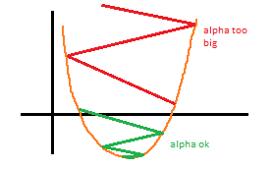


PLA
Cost function
Gradient Descent
Y

Slide 62
Iteration in PLA
Y

Slide 63
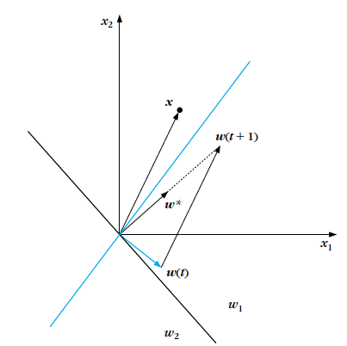
Weight correction (blue to black)

Slide 64
Perceptron inference
Given this straight line, say we have learnt, the inference is as follows :
On the straight line x₁-x₂ = 0;
If x₁-x₂ > 0, then RED class;
If x₁-x₂ < 0 BLUE class
x₁-x₂ < 0
x₂
x₁-x₂ = 0
x₁-x₂ > 0
x₁

Slide 65
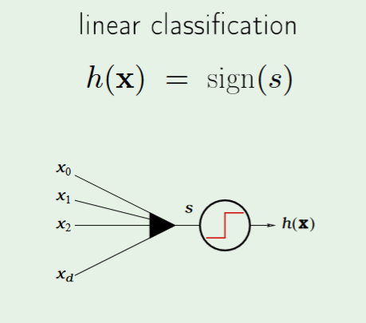
Linear Models
How does this figure look for perceptron ?

