Slide 1


SVM – SoftMargin-Kernel Trick
2nd Nov 2022

Slide 2
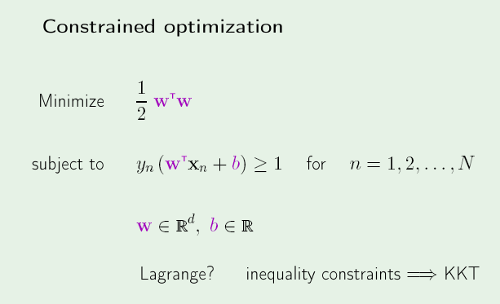

Slide 3
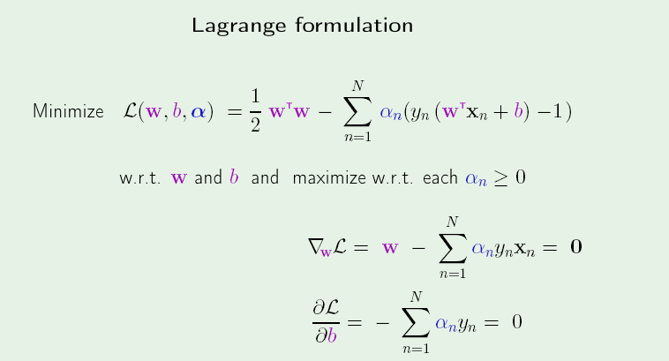

Slide 4
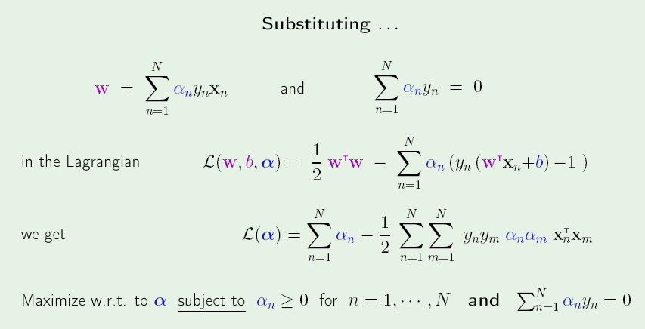

Slide 5
Quadratic Programming
min (α^{T}Qα + Aα) such that Bα ≤ 0
L(α,λ) = α^{T}Qα + Aα + λ ^{T}Bα
δL / δ α = 0
δL / δ λ = 0
Give Q, A and B, the package returns α

Slide 6
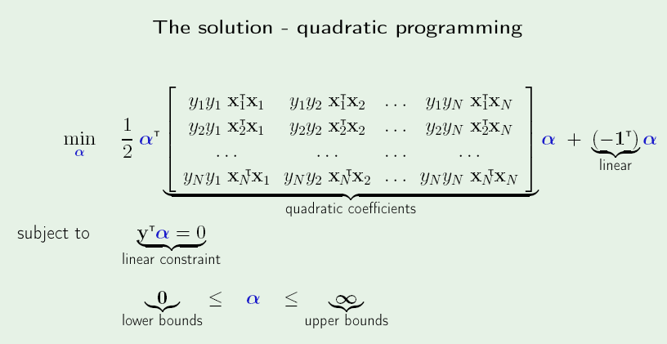

Slide 7
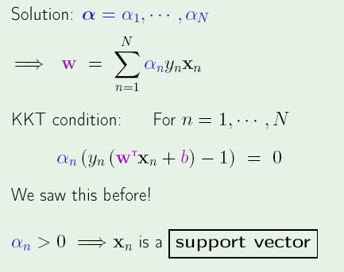

Slide 8
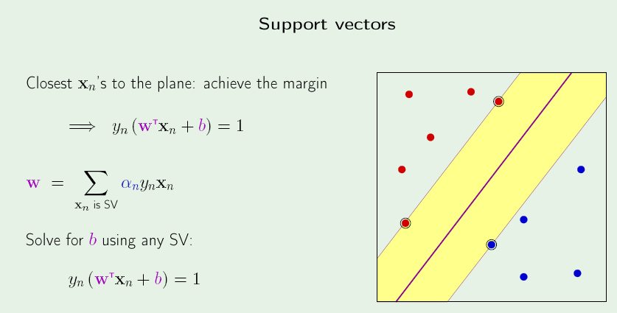

Slide 9
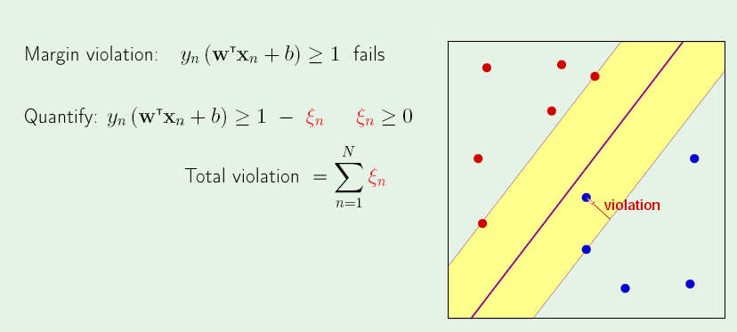
Soft Margin SVM

Slide 10
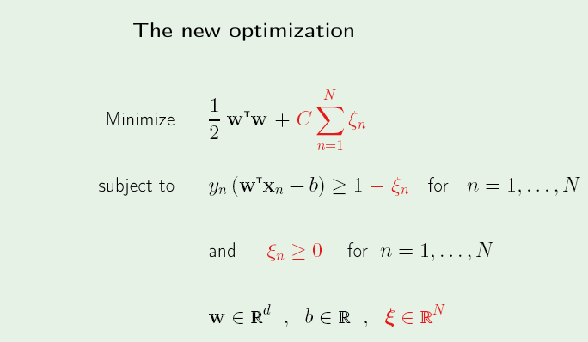

Slide 11
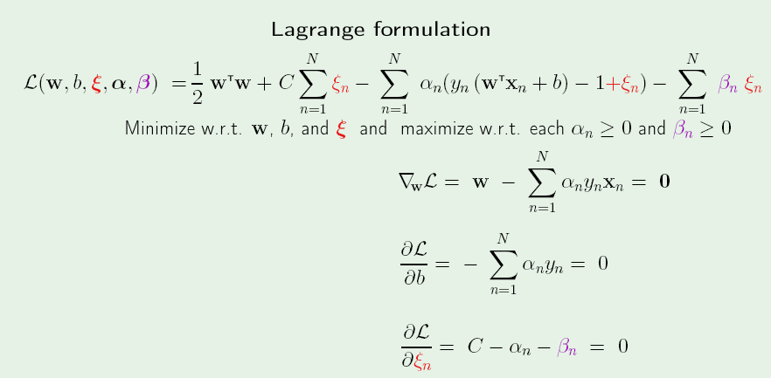

Slide 12
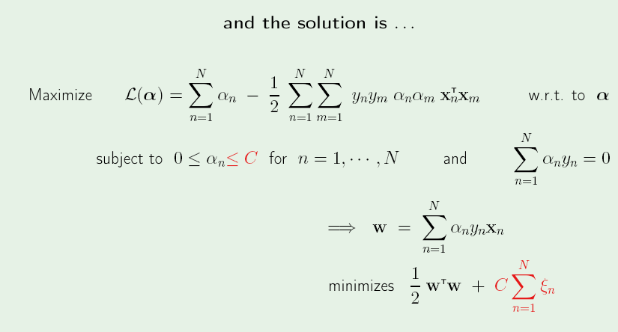

Slide 13
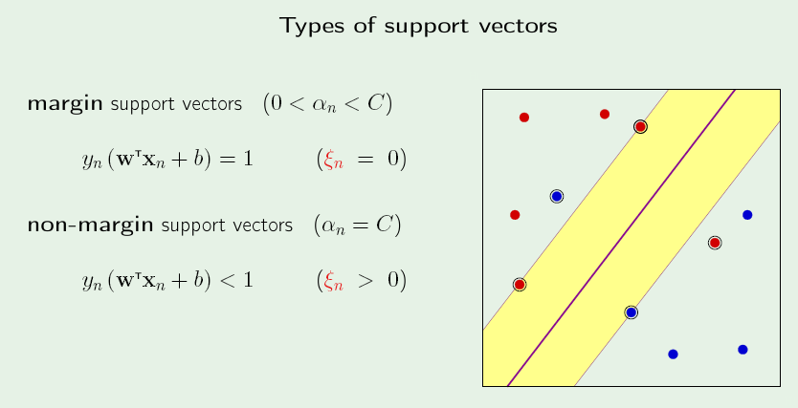

Slide 15
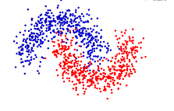
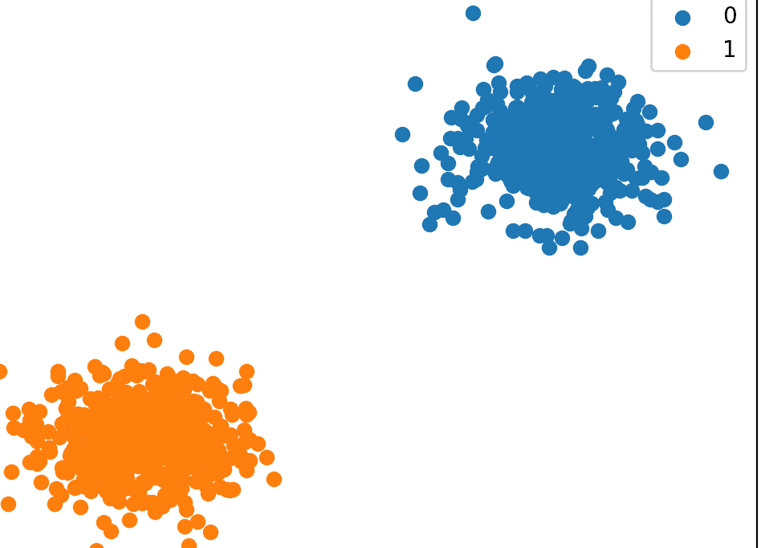
Context
Problem of Binary Classification

Slide 16
Non-linear Transformation of Data

Slide 17
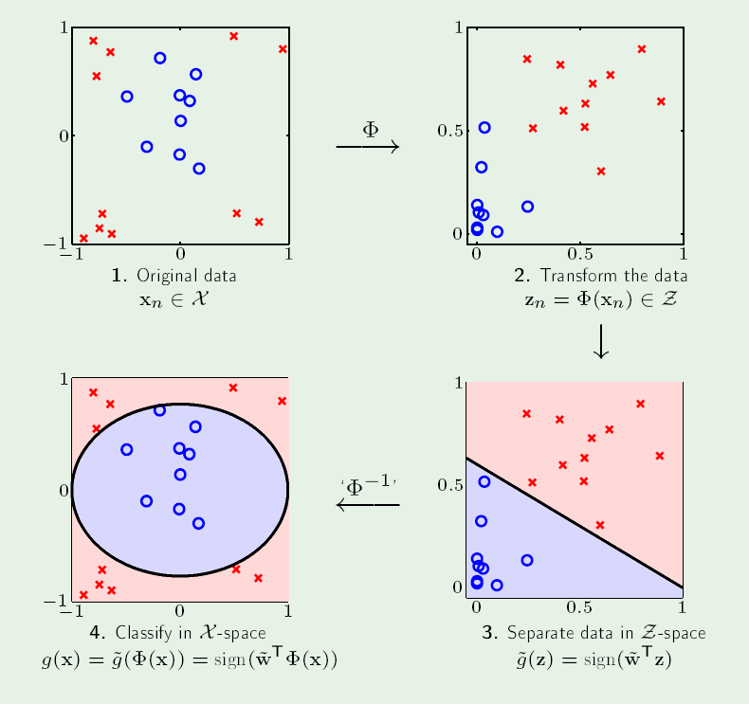

Slide 18
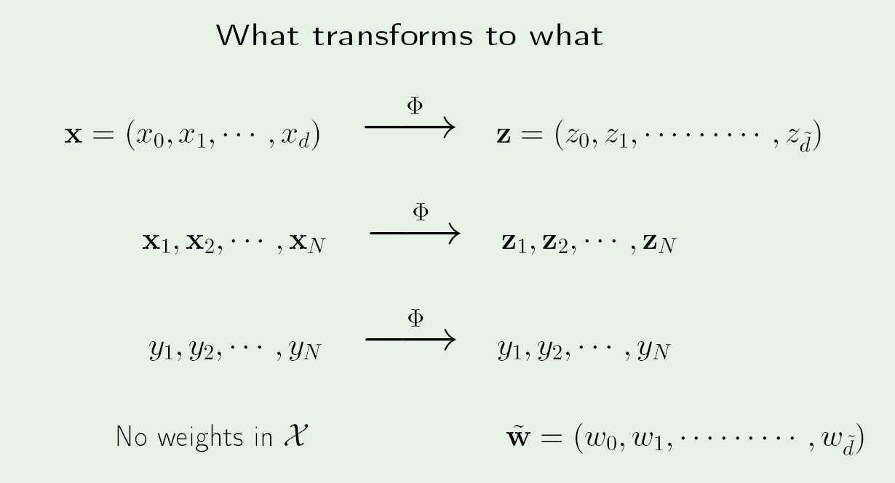

Slide 19
Non-Linear Transforms
Allows use of Linear Models even if Data is NOT Linearly separable!!
But we now need to manage High-Dimensional Feature spaces!!
Example :
Old Feature space (2-D space) : x₁, x₂
Non-linear Transformation of order 2 : x²₁, x²₂ , x₁ x₂ , x₁ , x₂ (5-D space)
Non-linear Transformation of order 3 : x³₁, x³₂ , x²₁ x₂, x₁ x²₂ , x²₁ , x²₂ ,… (?-D space)

Slide 20
Impact
What is the Dimension of the New Feature space if we have a d-Dimensional space and the non-linear transformation is of order p?
Impact on VC-Dimension ? Is it worrisome ?

Slide 21
High-Dimensional Feature space
Advantages
Better chance of Decision boundary being Linear
Disadvantages
Storing features will need more memory (Before that, we need to check if its possible to compute them)
Number of parameters to learn !!
Computationally expensive !!

Slide 22
Appearance of Dot-products
Data Points appear NOT as Stand-alone, BUT as Pair-wise Dot Products

Slide 23
What if …
We can perform a Non-Linear Transformation on Data points….and NOT need to know what each vector transforms to
We only need to know what the Pair-wise Dot products are !

Slide 24
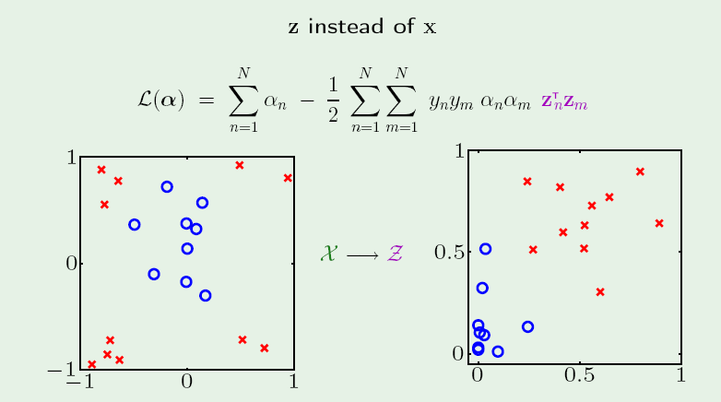

Slide 25
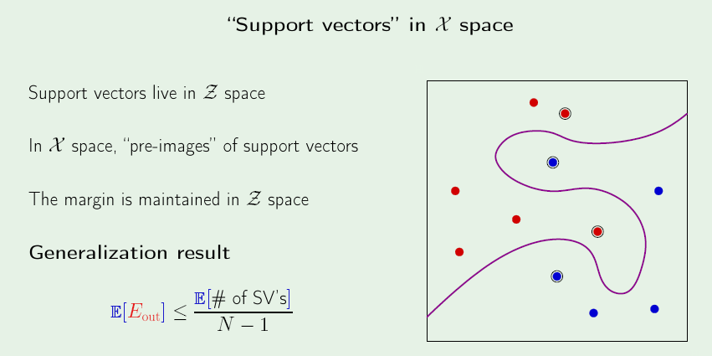

Slide 26
Kernel function
A Kernel “K” is a function i.e
K : X x X -> R such that,
K(x_{i}, x_{j}) = Ф^{T}(x_{i}) Ф(x_{j})
The Kernel Takes as I/P : A Pair of Low-Dimensional Vectors and Gives as O/P the Dot-product of these 2 vectors as if they were Transformed to a Higher Dimensional Space.
Here x_{i} is Low-Dimensional BUT Ф(x_{i}) is High-Dimensional
Eg. One instance of K(x_{i}, x_{j}) = (x_{i} ^{T}x_{j})²
Here what is Ф ?

Slide 27
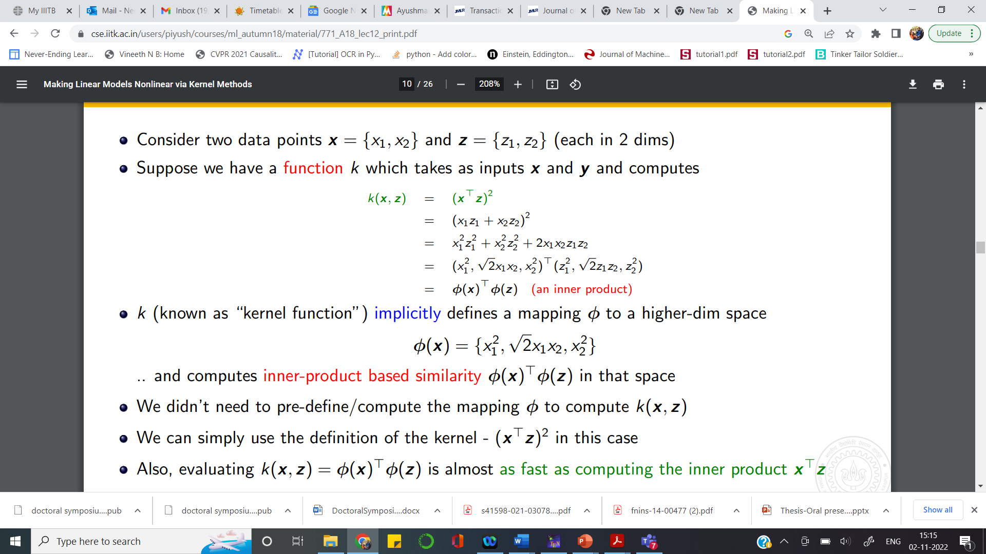

Slide 28
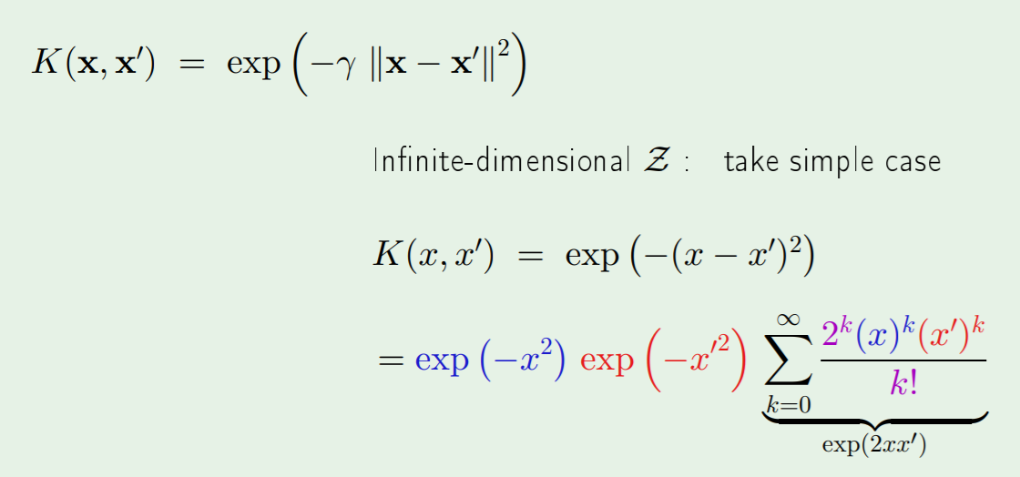
RBF Kernel – Find Ф

Slide 29
RBF Kernel – Find Ф

Slide 30
RBF Kernel – Find Ф
What is the Dimensionality of this Transformation ???

Slide 31
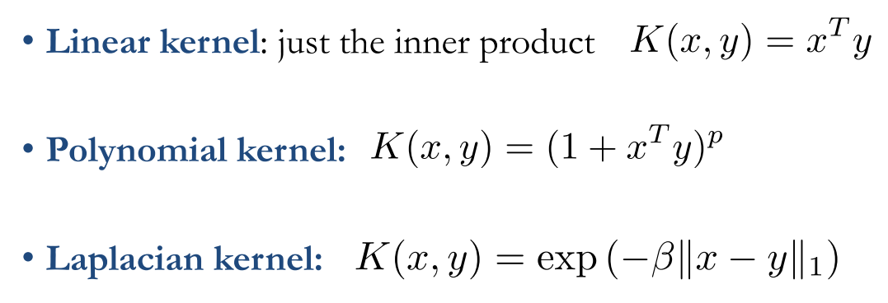
Common Kernels

Slide 32
Kernel Properties
Kernel must be symmetric..ie. K(x_{i}, x_{j}) = K(x_{j}, x_{i})
Kernel must be Positive Semi-Definite

Slide 33
Existence of Ф
Given Finite Data set x₁, x₂,………....x_{N}
Mercer’s Theorem : There exists Ф, such that
K(x_{i}, x_{j}) = Ф^{T}(x_{i}) Ф(x_{j}) iff the Gram Matrix “G” associated with “K” is positive definite
What is Gram Matrix G ?

Slide 34
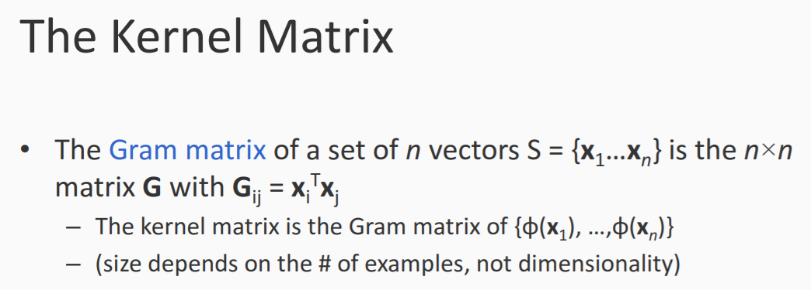
Gram Matrix G

Slide 35
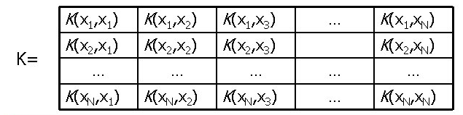
Kernel - Gram Matrix
Replacing the elements with Ф
<Ф(x1), Ф(x1)> | <Ф(x1),Ф(x2)> | … | … | <Ф(x1), Ф(xN)>

Slide 36
Kernel “K” is Diagonalizable
IS there a way of constructing Ф, from K ???
K = V Λ V^{T}
V = v₁
v₂
…
v_{N} Each Row of V is an Eigen vector
Λ = Diagonal matrix with Eigen values along Diagonal

Slide 37
Defining Ф
Define Ф (x_{i}) = sqrt(λ_{s})vis Here s takes values 1 through N
What Happens to < Ф (x_{i}), Ф (x_{j})> ??
Σ sqrt(λ_{s})v_{is} sqrt(λ_{s})v_{sj}
₌ λ_{s} v_{is} v_{sj}
= K(i,j) { Check back from the Diagonalization Equation}
Summing s : 1 to N

Slide 38
Creating New Kernels from Existing Ones
If we know “K₁, K₂….” are valid kernels, how can we generate New Kernels ??
What is most important in determining if the created “Kernel” is valid ??

Slide 39
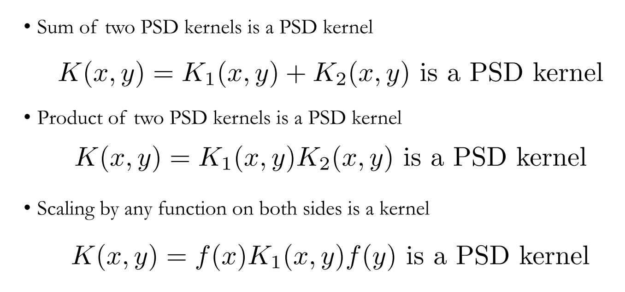
Creating New Kernels from Existing Ones

Slide 40
Points to ponder…
All it needs is a Look-up Table !
What is the impact of Original Dimension “d” ?
What is the impact of Transformed Dimension “d~” ?
Impact of Number of samples N ?
Computational Cost ? Memory Cost ?

Slide 41
Kernel-ized – Version
Where-ever DOT-products appear, we can use Kernels !!
Linear Regression can have a Kernel Linear Regression Version
PCA can have a Kernel PCA Version
…………………………

Slide 42
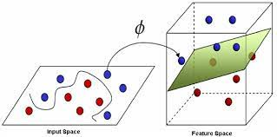
Impact of using Kernel K

Slide 43
Advantages of Kernel Trick
It converts SVM to a family of classifiers..Based on choice of Kernel..we get a distinct member of this family

