Slide 1
Linear Algebra & Convex Optimization – Lecture 10
SVD Applications
References: Online

Slide 2
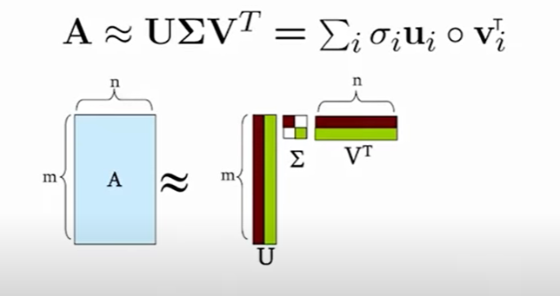
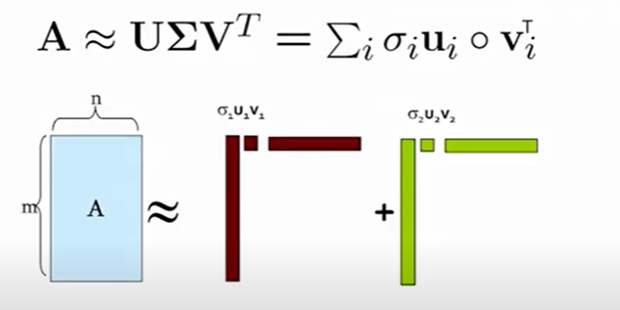
SVD : Matrix Approximation
Linear Transformation of $x$ via $Ax$ can be considered as :
1. Linear transformation using individual matrices $σ_{i}u_{i}v_{i}^{T}$.
2. Summation of linear transformation using rank-1 matrices $σ_{i}u_{i}v_{i}^{T}$.

Slide 3
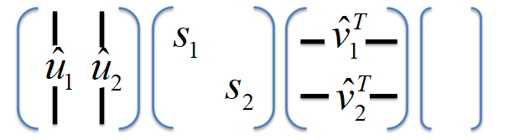











$$v_{2}$$
$$u_{2}$$
SVD – Perspective ( $m=n=2, r=2)$
$$\vec{x}$$
$$v_{1}$$
$$U$$
$$S$$
$$VT$$
$$x$$
$$u_{1}$$
$$Ax=$$
$$=y$$
i) Input with Left & Right Singular Vectors
$$s_{2}\left(v_{2}^{T}⋅x\right)$$
$$\vec{x}$$
$$s_{1}\left(v_{1}^{T}⋅x\right)$$
ii) Input Transformation & Scaling
$$s_{2}\left(v_{2}^{T}⋅x\right)\vec{u_{2}}$$
Linear Transformation of $x$ via $Ax$ is in 3 stages:
$$\vec{y}$$
1. Input transformation or vector $x$ with Matrix $V^{T}$
2. Scaling with Matrix $S$
$$s_{1}\left(v_{1}^{T}⋅x\right)\vec{u_{1}}$$
3. Output vector formation with columns of Matrix $U$
iii) Output Formation

Slide 4
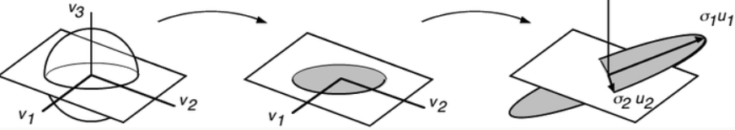
SVD – Perspective ( $m=n=3, r=2)$
$$U$$
$$Σ$$
$$VT$$
$$σ_{1}$$
$$ν_{1}^{T}$$
$$Ax=$$
$$u_{1}$$
$$u_{2}$$
$$u_{3}$$
$$σ_{2}$$
$$x$$
$$=y$$
$$ν_{2}^{T}$$
$$0$$
$$ν_{3}^{T}$$
Graphical Representation of basis transformation:

Slide 5

SVD- Applications : Latent Concept Discovery
Matrix
Alien
Serenity
Casablanca
Amelie
User- Movie Matrix : Toy Example
‘latent’ concepts
M₁
….
M₂
M_{n}
U₁
1 1 1 0 0
3 3 3 0 0
4 4 4 0 0
5 5 5 0 0
0 0 0 4 4
0 0 0 5 5
0 0 0 2 2
U₁
U₂
$$A_{m×n}=$$
U₂
.
.
.
.
.
.
SciFi
.
.
U_{m}
Matrix Entries: Star Rating from the users
Romance
U_{m}
Objective: Discover the latent “concepts”
in Movies from the User Ratings
Assumption: There exists two type of Hidden Concepts in Movies

Slide 6






SVD- Applications : Latent Concept Discovery
$U$: “user to concept” similarity matrix
Matrix
Alien
Serenity
Casablanca
Amelie
$VT$: “concept to movie” similarity matrix
SciFi-concept
$Σ$: Concept Strength
Romance-concept
$$U$$
U₁
1 1 1 0 0
3 3 3 0 0
4 4 4 0 0
5 5 5 0 0
0 0 0 4 4
0 0 0 5 5
0 0 0 2 2
0.14 0.00
0.42 0.00
0.56 0.00
0.70 0.00
0.00 0.60
0.00 0.75
0.00 0.30
U₂
$$Σ$$
.
.
.
.
.
.
$$V^{T}$$
=
x
12.4 0
0 9.5
x
0.58 0.58 0.58 0.00 0.00
0.00 0.00 0.00 0.71 0.71
U_{m}

Slide 7

Matrix Reconstruction with Noisy Data
M₁
….
M₂
M_{n}
User –Movie Matrix with Noisy Data:
U₁
Matrix
Alien
Serenity
Casablanca
Amelie
$$A_{m×n}=$$
U₂
.
.
U_{m}
U₁
1 1 1 0 0
3 3 3 0 0
4 4 4 0 0
5 5 5 0 0
0 2 0 4 4
0 0 0 5 5
0 1 0 2 2
0.13 -0.02 -0.01
0.41 -0.07 -0.03
0.55 -0.09 -0.04
0.68 -0.11 -0.05
0.15 0.59 0.65
0.07 0.73 -0.67
0.07 0.29 0.32
U₂
.
.
.
.
.
.
12.4 0 0
0 9.5 0
0 0 1.3
0.56 0.59 0.56 0.09 0.09
-0.12 0.02 -0.12 0.69 0.69
0.40 -0.80 0.40 0.09 0.09
=
x
x
U_{m}
Low singular value implies the ‘concept’ is not important

Slide 8


Rank – k Approximation
$A$=
$σ_{1}{.u}_{1}v_{1}^{T}+σ_{2}{.u}_{2}v_{2}^{T}$ + $σ_{3}{.u}_{3}v_{3}^{T}$==> Rank – 3 Matrix
1 1 1 0 0
3 3 3 0 0
4 4 4 0 0
5 5 5 0 0
0 2 0 4 4
0 0 0 5 5
0 1 0 2 2
0.13 -0.02 -0.01
0.41 -0.07 -0.03
0.55 -0.09 -0.04
0.68 -0.11 -0.05
0.15 0.59 0.65
0.07 0.73 -0.67
0.07 0.29 0.32
12.4 0 0
0 9.5 0
0 0 1.3
0.56 0.59 0.56 0.09 0.09
-0.12 0.02 -0.12 0.69 0.69
0.40 -0.80 0.40 0.09 0.09
$$\hat{A}$$
=
=
x
x

Slide 9



Rank – k Approximation
$$A_{k}$$
1 1 1 0 0
3 3 3 0 0
4 4 4 0 0
5 5 5 0 0
0 2 0 4 4
0 0 0 5 5
0 1 0 2 2
0.92 0.95 0.92 0.01 0.01
2.91 3.01 2.91 -0.01 -0.01
3.90 4.04 3.90 0.01 0.01
4.82 5.00 4.82 0.03 0.03
0.70 0.53 0.70 4.11 4.11
-0.69 1.34 -0.69 4.78 4.78
0.32 0.23 0.32 2.01 2.01
≈
$A$=
Reconstructed Low –Rank Matrix, $A_{k}$:
$σ_{1}{.u}_{1}v_{1}^{T}+σ_{2}{.u}_{2}v_{2}^{T}$ ==> Rank – 2 Matrix
Reduces Noise components
Fills in zero entries

Slide 10
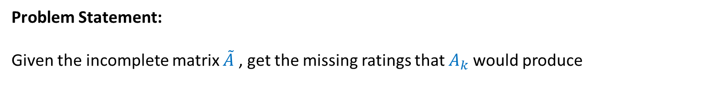

Applications : Movie Recommender Systems
Data: Users rating movies represented as ‘user-movie’ Matrix Sparse and often noisy
Assumptions:
There are k basic user profiles, and each user is a linear combination of these profiles
E.g., action, comedy, drama, romance, actor specific
Each user is a weighted combination of these profiles. The “true” matrix has rank k
If we had the matrix A with all ratings of all users for all movies, the matrix $A_{k}$ would tell us the true preferences of the users for the movies.
Observed Matrix $\tilde{A }$ =$A_{k}$+ Noise
What we observe is a noisy, and incomplete version $,\tilde{A}$
Problem Statement:
Given the incomplete matrix $\tilde{A}$ , get the missing ratings that $A_{k}$would produce

Slide 11

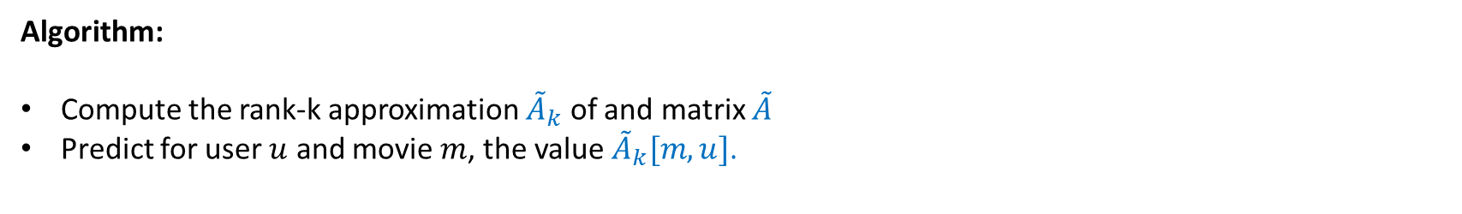
Applications : Movie Recommender Systems
Algorithm:
Compute the rank-k approximation ${\tilde{A}}_{k}$ of and matrix $\tilde{A}$
Predict for user $u$ and movie $m$, the value ${\tilde{A}}_{k}[m,u]$.
1 1 1 0 0
0 3 3 0 0
4 4 0 0 0
5 5 5 0 0
0 2 0 4 4
0 0 0 5 5
0 1 0 2 2
0.14 -0.06 -0.04
0.30 -0.11 -0.61
0.43 -0.16 0.76
0.74 -0.31 -0.18
0.15 0.53 0.02
0.07 0.70 -0.03
0.07 0.27 0.01
12.4 0 0
0 9.5 0
0 0 1.3
$\tilde{A }$ =
=
x
x
0.51 0.66 0.44 0.23 0.23
-0.24 -0.13 -0.21 0.66 0.66
0.59 0.08 -0.80 0.01 0.01

Slide 12

Applications : Movie Recommender Systems
1 1 1 0 0
0 3 3 0 0
4 4 0 0 0
5 5 5 0 0
0 2 0 4 4
0 0 0 5 5
0 1 0 2 2
0.14 -0.06 -0.04
0.30 -0.11 -0.61
0.43 -0.16 0.76
0.74 -0.31 -0.18
0.15 0.53 0.02
0.07 0.70 -0.03
0.07 0.27 0.01
12.4 0 0
0 9.5 0
0 0 1.3
0.51 0.66 0.44 0.23 0.23
-0.24 -0.13 -0.21 0.66 0.66
0.59 0.08 -0.80 0.01 0.01
=
x
x
0.96 1.14 0.82 -0.01 -0.01
1.94 2.32 1.66 0.07 0.07
2.77 3.32 2.37 0.08 0.08
4.84 5.74 4.14 -0.08 0.08
0.40 1.42 0.33 4.06 4.06
-0.42 0.63 -0.38 4.92 4.92
0.20 0.71 0.16 2.03 2.03
Filled in non-entries with approximate values
${\tilde{A}}_{k}$ =
Reduced the value of noisy entries

