Slide 1
Linear Algebra & Convex Optimization – Lecture 11
Functions & Derivatives

Slide 2
Outline
Functions & Derivatives
Matrix Derivatives

Slide 3







Functions
Example:
with
Finding minimum/maximum of a function is critical in many scenarios
Notes:
.

Slide 4
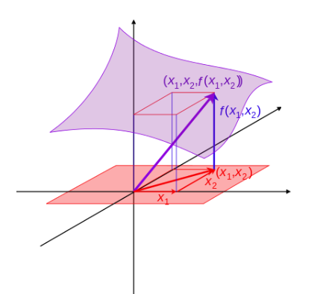
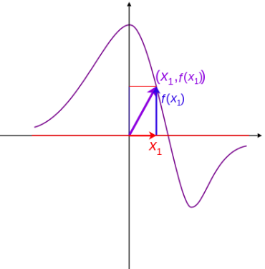











Graph of Functions
A real valued function $f\left(x_{1},x_{2}, ….x_{n}\right)$ is a mapping
such that the dom $f$ is a subset of $ℝ^{n}$
$$f:ℝ^{n}→ℝ$$
$f\left(x_{1},x_{2}, ….x_{n}\right)$ can be plotted as a graph in $ℝ^{n+1}$
$$f:ℝ→ℝ$$
$$f:ℝ^{2}→ℝ$$
dom $f$
$$ℝ$$
$$ℝ$$
$$ℝ$$
$$ℝ$$
$$ℝ$$
$$n=1$$
$$n=2$$
Notes:
Example Loss Function in a Neural Network.
Orange area is the domain of the function. Domain is the set of dependent variables on which the function is defined.

Slide 5




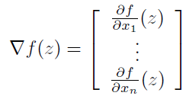





First Derivative
Partial Derivatives:
Gradient Function of f:
$$∇f:ℝ^{n}→ℝ^{n}$$
At $x=z$
Notes:
Gradient is a vector on the domain of f(x)
Direction of gradient tells in which direction the function changes the sharpest.

Slide 6
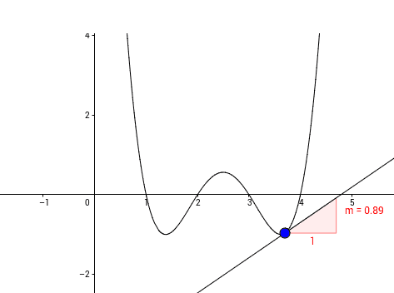








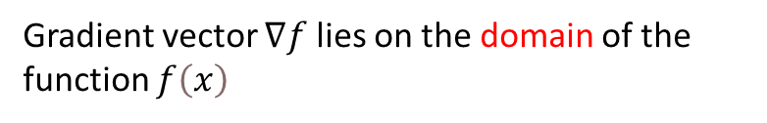
Gradient $(f:ℝ→ℝ)$
$$f\left(x\right)=\left(x−1\right)\left(x−2\right)\left(x−3\right)\left(x−4\right)$$
Gradient vector $∇f$ lies on the domain of the function $f\left(x\right)$
$$f\left(x\right)$$
$$∇f\left(x1\right)$$
$$x1$$
$$x$$
$∇f\left(x1\right)$ is the 1D Gradient Vector at $x=x_{1}$
Value of Gradient $∇f\left(x1\right)$= Slope of the tangent
Direction of Gradient $∇f\left(x1\right)$= sign of the Slope of the tangent
Notes:
Gradient is a vector on the domain of f(x)
Direction of gradient tells in which direction the function changes the sharpest.

Slide 7
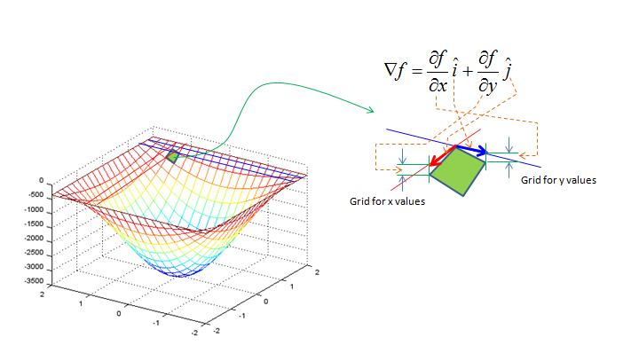
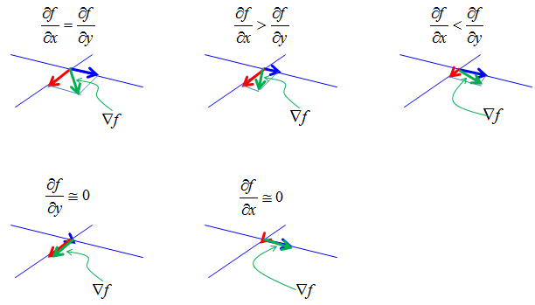


Gradient $(f:ℝ^{2}→ℝ)$
$$f:ℝ^{2}→ℝ$$
Notes:
Gradient is a vector on the domain of f(x)
Direction of gradient tells in which direction the function changes the sharpest.

Slide 8
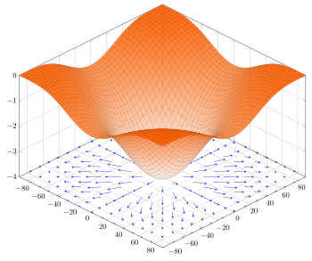
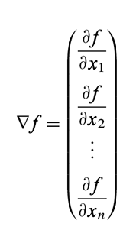


Gradient $(f:ℝ^{2}→ℝ)$
Gradient for $f:ℝ^{n}→ℝ$
$$f\left(x_{1},x_{2}\right)=−{\left(\cos^{2}{x_{1}}+\cos^{2}{x_{2}}\right)}^{2}$$
Notes:
Gradient is a vector on the domain of f(x)
Direction of gradient tells in which direction the function changes the sharpest.

Slide 9





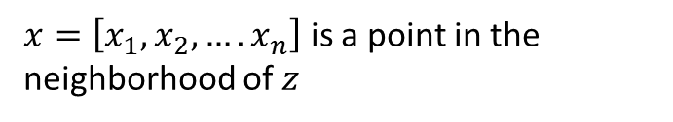

First Order Taylor Approximation
$$f:ℝ^{n}→ℝ$$
$x=\left[x_{1},x_{2}, ….x_{n}\right]$ is a point in the neighborhood of $z$
First Order Taylor Approximation in Compact Form:

Slide 10
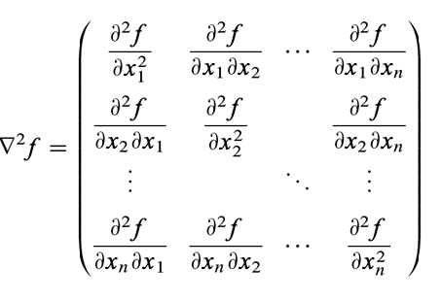
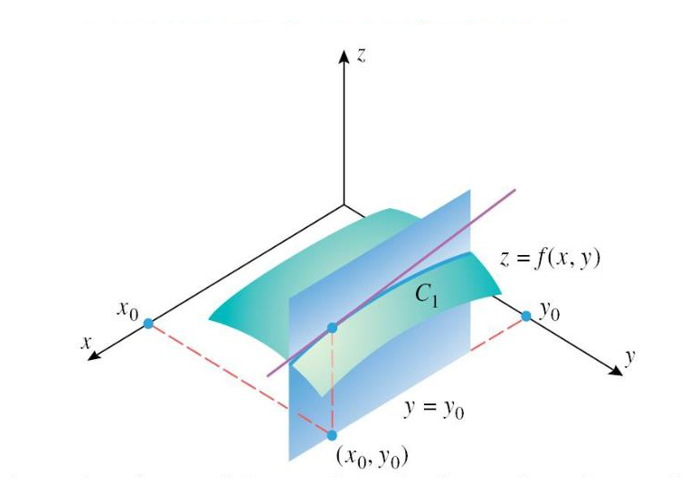





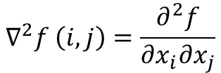


Hessian $(f:ℝ^{n}→ℝ)$
$\frac{∂2f}{∂y∂x}$ = $\frac{∂}{∂y}\left(\frac{∂f}{∂x}\right)$
For$f\left(x_{1},x_{2}, ….x_{n}\right)$ depending on $n$ variables:
$${\left.\frac{∂f}{∂x} \right|}_{\begin{aligned}x=x0, x0+ δ \\ y=y0+ δ\end{aligned}}$$
$${\left.\frac{∂f}{∂x} \right|}_{\begin{aligned}x=x0, x0+ δ \\ y=y0\end{aligned}}$$
$${\left.\frac{∂2f}{∂y∂x} \right|}_{\begin{aligned}x=x0 \\ y=y0\end{aligned}}$$
$$∇^{2}f \left(i,j\right)=\frac{∂^{2}f}{∂x_{i}∂x_{j}}$$
Hessian is symmetric if $f$ is continuous at $x_{1},x_{2}, ….x_{n}$ .
For $f:ℝ^{n}→ℝ$,
$$∇^{2}f:{ ℝ}^{n} →ℝ^{n×n}$$
Notes:
Hessian is rich in information on second order behavior of the function in all possible directions. Hessian linked to concept of “curvature”

Slide 11
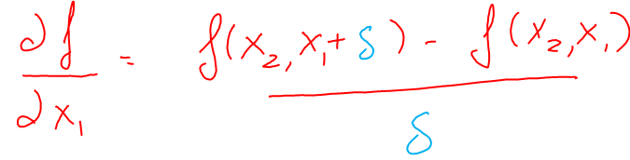
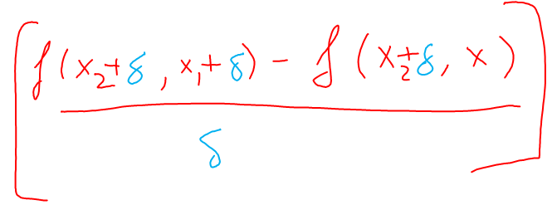

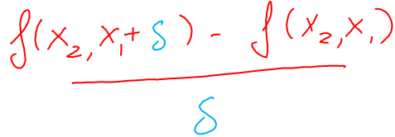
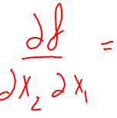
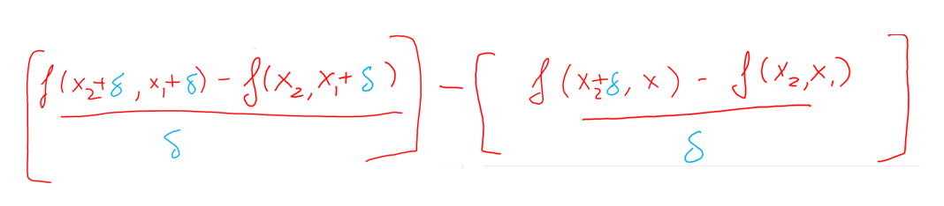
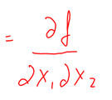


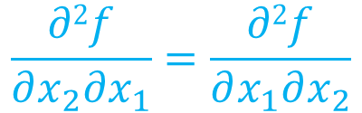
$$\frac{∂2f}{∂x_{2}∂x_{1}}=\frac{∂2f}{∂x_{1}∂x_{2}}$$

Slide 12
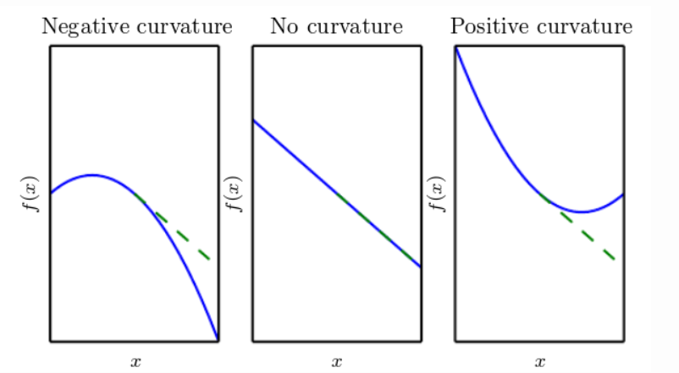
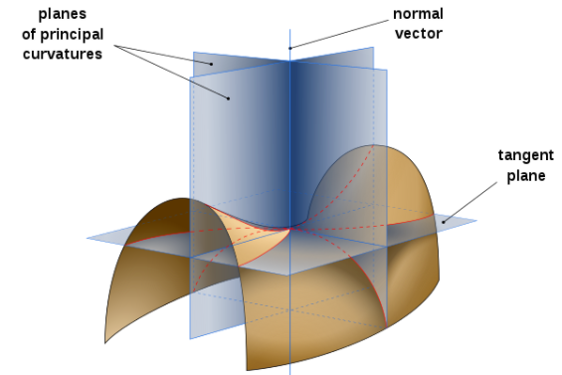
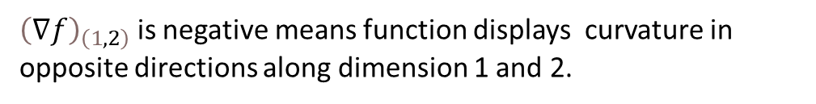
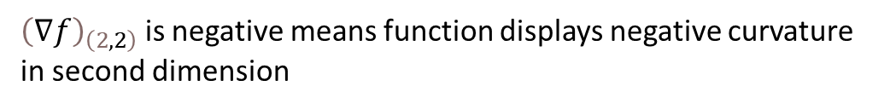
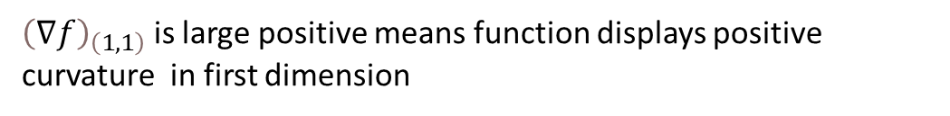
Properties of Hessian Matrix
Hessian Matrix evaluated at location x captures
the nature of curvature of a function
${\left(∇f\right)}_{\left(1,1\right)}$ is large positive means function displays positive curvature in first dimension
${\left(∇f\right)}_{\left(2,2\right)}$ is negative means function displays negative curvature in second dimension
${\left(∇f\right)}_{\left(1,2\right)}$ is negative means function displays curvature in opposite directions along dimension 1 and 2.
Notes:
The Hessian matrix of a function is the rate at which different input dimensions accelerate with respect to each other. If H1,1H1,1 is high, it means there is a high acceleration in dimension 1. If H1,2H1,2 is high, then we accelerate simultaneously in both dimensions. If H1,2H1,2 is negative, then as we accelerate in the first dimension, we decelerate in the second dimension.

Slide 13

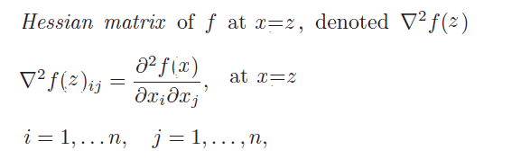
Second Order Taylor Approximation

Slide 14
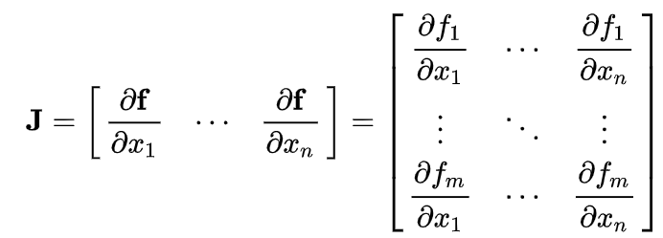

Jacobian $(f:ℝ^{n}→ℝ^{m})$
Defined for functions of the form $f:ℝ^{n}→ℝ^{m}$
Jacobian of $f:ℝ^{n}→ℝ$ is equivalent to transpose of gradient of $f, ∇f^{T}$

Slide 15
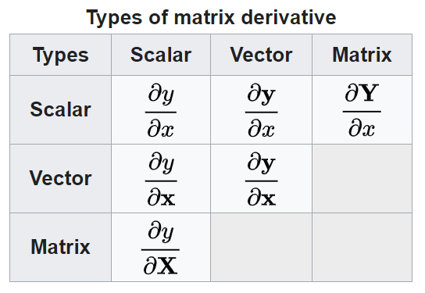
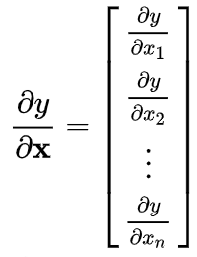
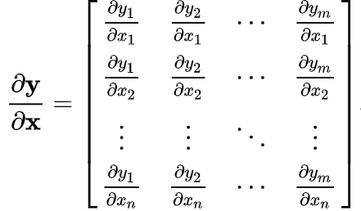

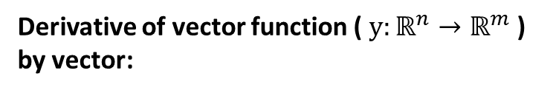
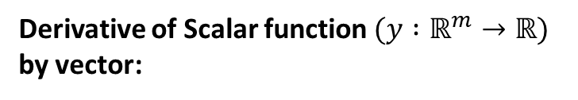
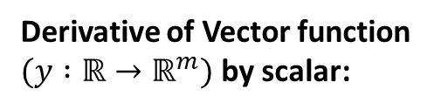
Matrix Calculus – (First Order Derivatives)
Derivative of Scalar function $(y :ℝ^{m}→ℝ)$ by vector:
The derivative is column vector (Gradient) by convention
(denominator layout or Gradient convention)
Derivative of vector function ( $y:ℝ^{n}→ℝ^{m}$ ) by vector:
Derivative of Vector function $(y :ℝ→ℝ^{m})$ by scalar:
The derivative is row vector by convention (denominator layout or Gradient convention)
Transpose of Jacobian Matrix

Slide 16













Matrix Calculus
Some Common Derivatives
(in denominator layout convention)
u & v are functions of vector x
A & b are independent of vector x

