Slide 1
Linear Algebra & Convex Optimization – Lecture 12
Convex Functions
Text : Convex Optimization , S. Boyd
Notes:
Purpose is to explore basic mathematics that underlines ML and develop intuition.
More rigorous treatment as in a mathematics course is avoided.

Slide 2













Matrix Calculus
Some Common Derivatives
(in denominator layout convention)
u & v are functions of vector x
A & b are independent of vector x
Notes:
1.) Why is it generic form ? . Inequality (Less than) can be multiplied by –ve to change to Greater than condition. Similarly objective function can be multiplied by –ve to change condition to maximum. Equality condition can be brought in by introducing simultaneous Less than and Greater than conditions.
2) General Optimization very difficult to solve. Methods involve some compromise, e.g., very long computation time, or
not always finding the solution

Slide 3
Matrix Calculus
Some Common Derivatives
(in denominator layout convention)
u & v are functions of vector x
A & b are independent of vector x
Notes:
1.) Why is it generic form ? . Inequality (Less than) can be multiplied by –ve to change to Greater than condition. Similarly objective function can be multiplied by –ve to change condition to maximum. Equality condition can be brought in by introducing simultaneous Less than and Greater than conditions.
2) General Optimization very difficult to solve. Methods involve some compromise, e.g., very long computation time, or
not always finding the solution

Slide 4
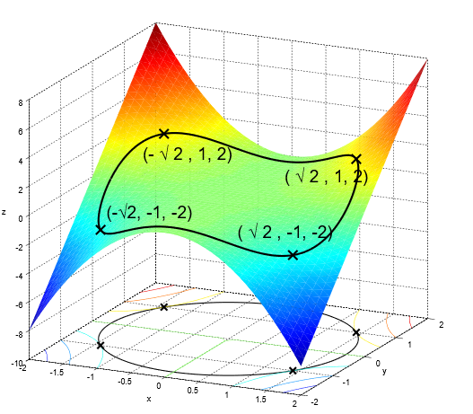
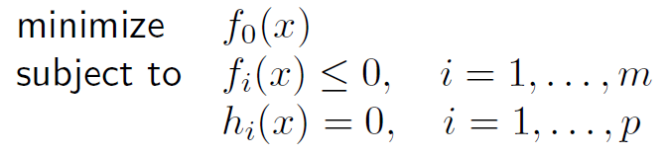
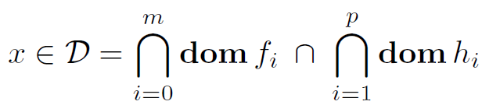





General Optimization Formulation
$$f_{0}\left(x\right)$$
General Formulation:
$h_{1}\left(x\right)$ =0
Implicit Constraints:
Explicit Constraints:
Illustration – 1: $f_{0}:ℝ^{2}→ℝ$
Un-Constraint Problem:
Notes:
Derive the conjugate of quadratic function : https://www.youtube.com/watch?v=b8864Bu5-u8

Slide 5
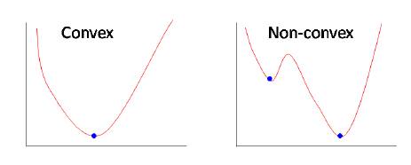
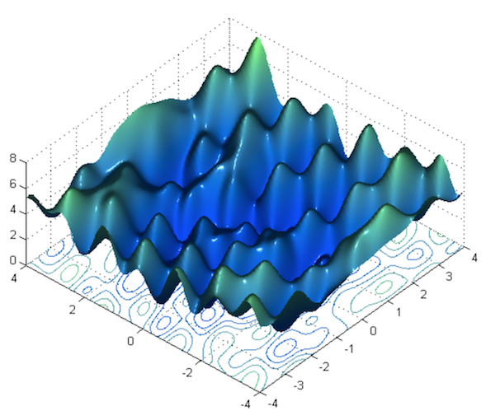
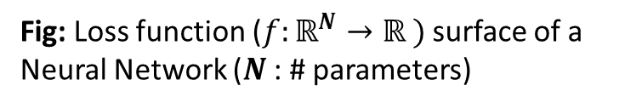
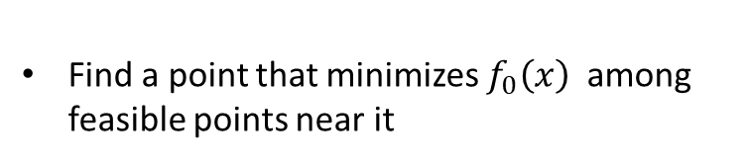
Non - Convex Optimization
Local Optimization Methods:
Find a point that minimizes $f_{0}\left(x\right)$ among feasible points near it
Requires initial guess
Provides no information on distance to global optimum.
Fig: Loss function ($f:ℝ^{N}→ℝ )$ surface of a Neural Network ($N$ : # parameters)
Notes:
traditional techniques for general nonconvex problems involve compromises

Slide 6











Convex Sets
Definition :
Given any $2$ points, $x_{1},$ $x_{2}$ in a set $S$ , and any $2$ non-negative numbers , $θ_{1},θ_{2}$, such that $θ_{1}+θ_{2}=1$ , the affine combination of the points, $θ_{1}x1+θ_{2}x_{2} ,$ should lie inside the set $S$.
$$x_{2}$$
$$x_{1}$$
$$θ=1$$
$$θ=0.6$$
$$x_{1}$$
$$x_{2}$$
$$x_{3}$$
$$θ=0$$
Convex Set
$$x_{1}$$
Convex Set
$$x_{2}$$
Non- Convex Set

Slide 7



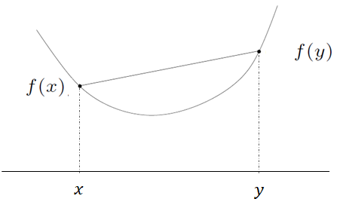



Convex Functions
$$θf\left(x\right)+\left(1−θ\right)f\left(y\right)$$
$f(θx+\left(1−θ\right)y$)
$$θx+\left(1−θ\right)y$$

Slide 8
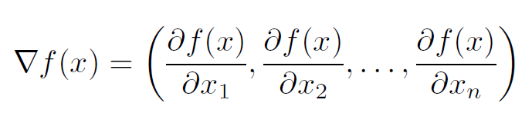
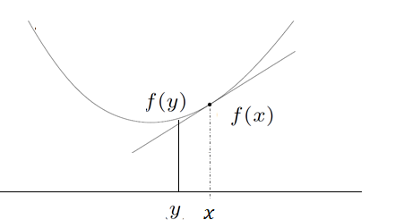

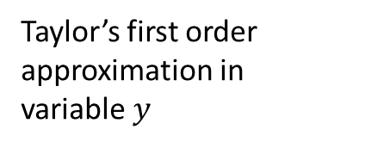
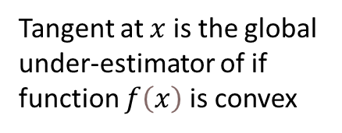

First Order Condition for Convexity
Assume
exists at each $x∈dom f$
Taylor’s first order approximation in variable $y$
Tangent at $x$ is the global under-estimator of if function $f\left(x\right)$ is convex
Notes:
f(x) is a scalar , while delta f(x) is a vector. Shows, How much f(x) changes in every dimension at point x .
Taylor’s expansion : f(x) + f(x)’(y-x)
Intuitively, if we approximate f(x) by a line at any point, all values of f(y) should lie above the line. Then the function is complex.
The tangent is the equation of line with slope as delta f(x) (y = mx + c)

Slide 9
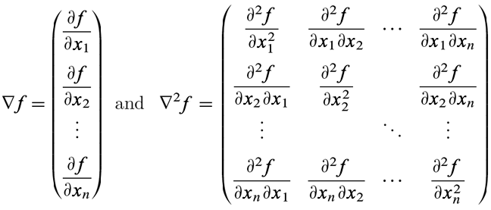
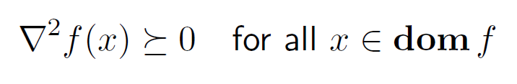
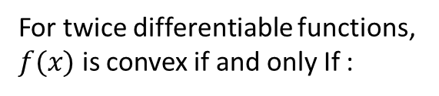
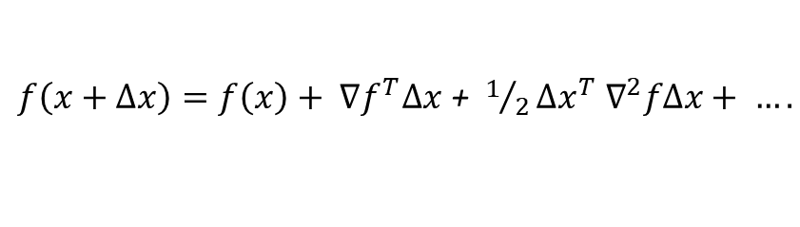
Second Order Condition for Convexity
Taylor series expansion of a multi-variable scalar function $f(x)$ with $x∈ℝ^{n}$ :
$f\left(x+Δx\right)=f\left(x\right)+ ∇f^{T}Δx$ + $1/2{Δx}^{T}{ ∇}^{2}fΔx+ ….$
For $f(x)$ with $x∈ℝ^{n}$ Hessian matrix is defined as :
For twice differentiable functions,
$f(x)$ is convex if and only If :
Notes:
Curvature has to be positive. Describe each entry in hessian.

Slide 10
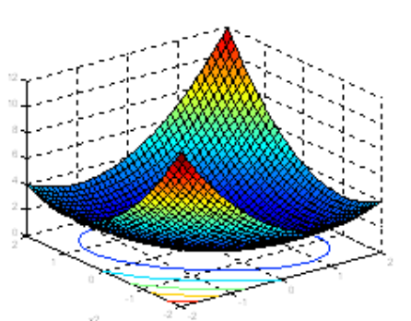
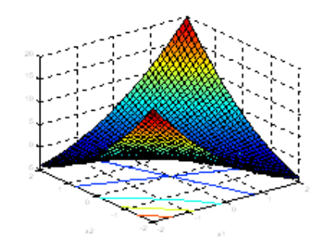
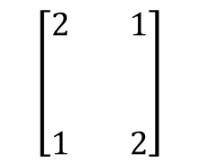
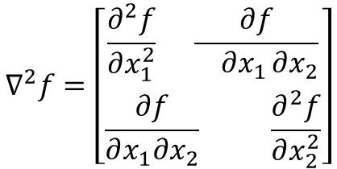


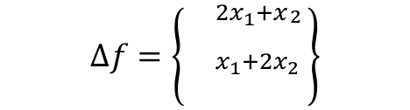



Convexity : Examples
$${f= x}_{1}^{2}+x1x_{2}+x_{2}^{2}$$
$$Δf=\left\{\begin{aligned}{}_{x_{1}+2x_{2}}^{{2x}_{1}+x_{\begin{aligned}2 \\ \end{aligned}}} \\ \end{aligned}\right\}$$
$$∇^{2}f=\left[\begin{aligned}\frac{∂^{2}f}{∂x_{1}^{2}} \frac{∂f}{ ∂x_{1}∂x_{2}} \\ \frac{∂f}{∂x_{1}∂x_{2}} \frac{∂^{2}f}{∂x_{2}^{2}}\end{aligned}\right]$$
$$\left[\begin{aligned}2 1 \\ \\ \\ 1 2\end{aligned}\right]$$
$$=$$
Eigen Values, $λ_{1,2 }=1 ,3$
Change $f$ to ${f= x}_{1}^{2}+3x1x_{2}+x_{2}^{2}$
Eigen Values, $λ_{1,2 }=−1 ,5$
Notes:
Curvature has to be positive

Slide 11





Convexity : Examples
Quadratic Function:
Poll : Is the function $f\left(x\right)={\left\|x\right\|}^{2}$ convex ? ( $x∈ℝ^{n}$)
Notes:
Check The notation S^n – Recollect the matrix calculus in deriving the objective. Convexity of quadratic problem will be visited in the future slides.

Slide 12



Convexity : Examples
Least Squares Objective:
Convex for any A, hence will have global minimum
Notes:
Check The notation S^n – Recollect the matrix calculus in deriving the objective. Convexity of quadratic problem will be visited in the future slides.

Slide 13
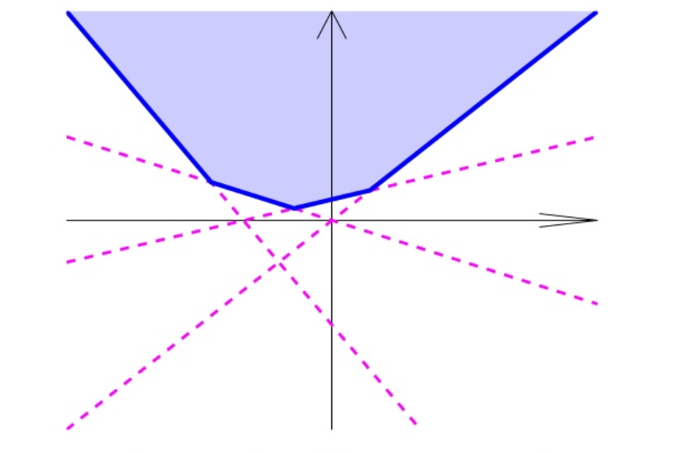


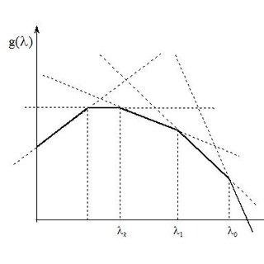



Operations that preserve Convexity
Non-Negative Multiple:
Sum:
Pointwise Maximum - Convex
Pointwise Maximum :
Proof:
Pointwise Minimum - Concave
Notes:
A maximum of a set must be an element of the set. A supremum need not be.

Slide 14
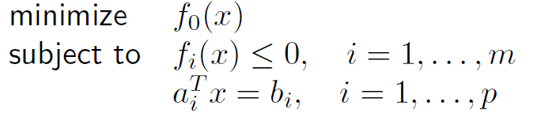
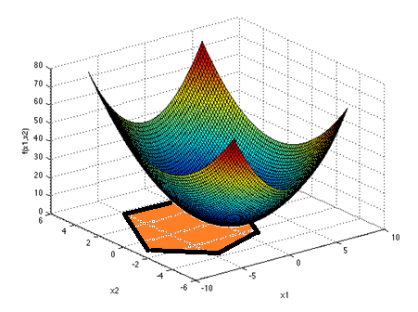
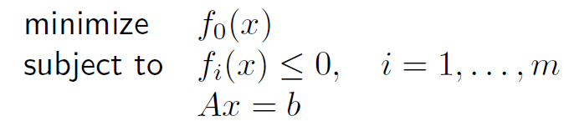

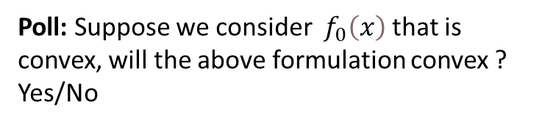

Convex Optimization Formulation
$$f_{0}\left(x\right)$$
General Optimization Formulation:
$$h_{1}\left(x\right)=0$$
Convex Optimization Formulation:
Poll: Suppose we consider $f_{0}\left(x\right)$ that is convex, will the above formulation convex ? Yes/No
Feasible region of a convex optimization problem is convex
Alternative way of writing:
Convex formulation
Notes:
Derive the conjugate of quadratic function : https://www.youtube.com/watch?v=b8864Bu5-u8

