Slide 1
Linear Algebra & Convex Optimization – Lecture 13
Lagrange Method

Slide 2
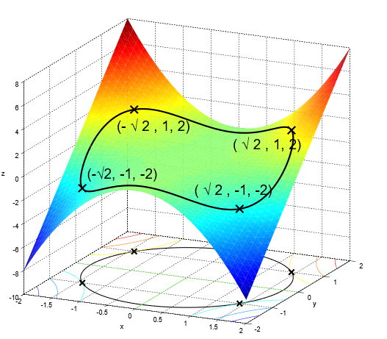
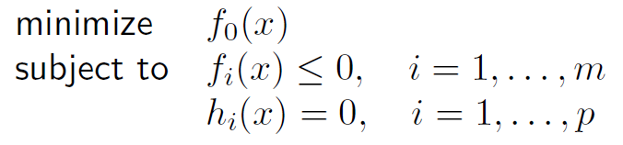
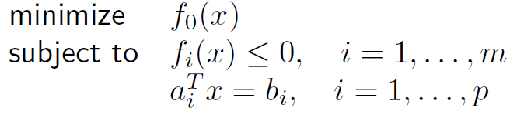
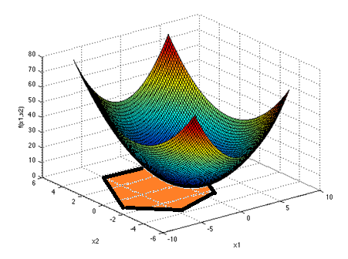
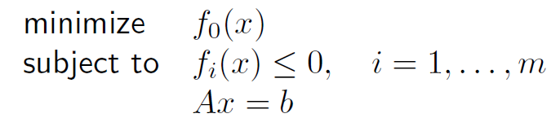



Convex Optimization Formulation
$$f_{0}\left(x\right)$$
General Optimization Formulation:
$$h_{1}\left(x\right)=0$$
Convex Optimization Formulation:
Poll: Suppose we consider $f_{0}\left(x\right)$ that is convex, will the above formulation convex ? Yes/No
Feasible region of a convex optimization problem is convex
Alternative way of writing:
Convex formulation
Notes:
Derive the conjugate of quadratic function : https://www.youtube.com/watch?v=b8864Bu5-u8

Slide 3
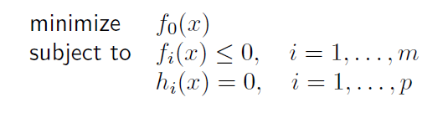


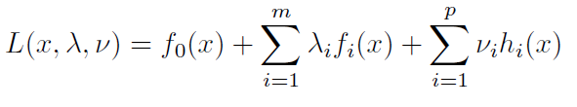
Lagrangian Function
standard form problem (not necessarily convex):
Notes:
Explain Why Langrange dual ?.

Slide 4
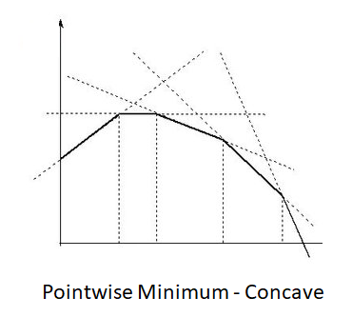

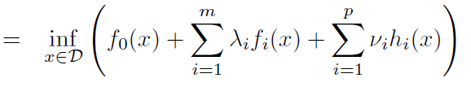



Lagrange Dual Function
$g$ is concave as it is point-wise infimum of family of affine functions in $\left(λ,v\right)$
Proof :
Consider a slight change of notation $L_{x}\left(ξ\right)= L\left(x,λ,ν\right)$
where $ξ=(λ,ν)$
For a fixed $x , L_{x}\left(ξ\right)$ is affine in $ξ$
$$\left\{L_{x}\left(ξ\right):x∈D\right\}$$
is a family of affine functions
Lagrange dual function in Lagrange variables is concave irrespective of the original functions
$g\left(ξ\right)=\underset{x}{in}f \left\{{ L}_{x}\left(ξ\right):x∈D \right\}$ is point-wise infimum on a family of affine functions
Hence $g\left(ξ\right)=g\left(λ,v\right)$ is concave
Notes:
Dual problem is concave hence have a single maximum. This makes the dual problem interesting sometimes.

Slide 5
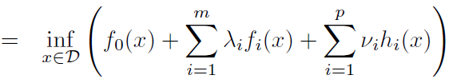










Lagrange Dual Function : Lower Bound Property
Standard Form Problem ( optimal value p*):
Lagrangian:
Lagrange Dual Function:
Proof :

Slide 6
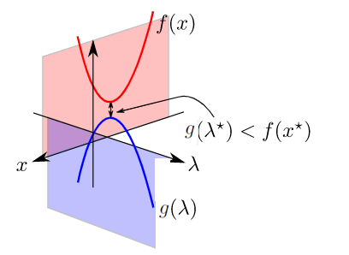

Lagrange Dual Function : Illustration
Combined graph depiction of Dual and Original Problems
$${=p}^{∗}$$

Slide 7






Lagrange Dual Optimization Problem
Dual problem is a convex optimization problem
Dual problem has a global maximum, $d^{∗}$ , even if original problem is non-convex
Dual problem find best lower bound on primal problem’s optimal value, $p^{∗}$
$λ, v$ are dual feasible if , $λ≥0 , \left(λ,v\right)∈\operatorname{dom}{g}$
Weak Duality:
Lagrangian dual problem is infeasible
Primal problem is infeasible
Notes:
Fat Matrix, multiple solutions case.

Slide 8

Strong Duality
Strong duality :${ d}^{∗}=p^{∗}$
Does not hold in general ; holds for convex problems
Primal – Dual Gap
$${=p}^{∗}$$
Primal & Dual Problems
Primal – Dual Gap is zero for strong duality
Notes:
We are not going to the proof here.

Slide 9










Complementary Slackness
Assume strong duality holds for the given problem ::
The 2 inequalities can be replaced with equalities
This Implies :
Gradient of $L\left(x,λ^{∗},ν^{∗}\right)$ evaluated at $x^{∗}$ is zero, $∇L\left(x^{∗},λ^{∗},ν^{∗}\right)=0⋅$
Notes:
the ith optimal Lagrange multiplier is zero unless the ith constraint is active at the optimum.

Slide 10


KKT (Karush-Kuhn-Tucker) Conditions
For Convex Problems: KKT conditions are sufficient for strong duality
Any pair of primal & dual points that satisfy KKT conditions are optimal points and have zero duality gap
In a few special cases, KKT conditions can be solved analytically to obtain the solution.
Notes:
the ith optimal Lagrange multiplier is zero unless the ith constraint is active at the optimum.

Slide 11










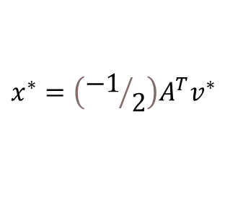

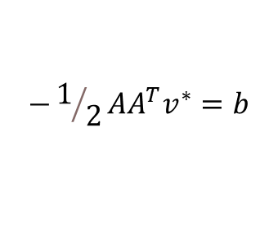
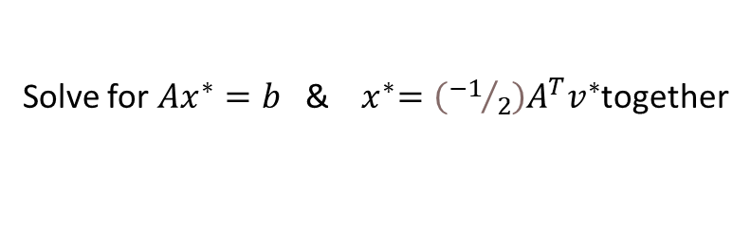

Lagrange Method : Least Norm
Least Norm solution with Constraints:
Lagrangian :
Domain:
KKT conditions:
$∇_{x}L\left(x,v^{∗}\right)$ = $2x+A^{T}v^{∗}$
$∇_{x}L\left(x,v^{∗}\right)=0$ at $x=x^{∗}$
$$2x^{∗}+A^{T}v^{∗}=0$$
$$x^{∗}=\left({−1}/2\right)A^{T}v^{∗}$$
Solution :
Solve for $Ax^{∗}=b$ &${ x}^{∗}=\left({−1}/2\right)A^{T}v^{∗}$together
$$−1/2AA^{T}v^{∗}=b$$
$$v^{∗}=−2{\left(AA^{T}\right)}^{−1}b$$
This gives, $x^{∗}=A^{T}{\left(AA^{T}\right)}^{−1}b$
$x={\left(A^{T}A\right)}^{−1}A^{T}b$ is the least square solution ( For Tall A)
Notes:
Fat Matrix, multiple solutions case.

Slide 12








Lagrange Method : Constrained Least Squares
Least Squares solution of linear equations:
Lagrangian :
$${L\left(x,v\right)=\left(Ax−b\right)}^{T}\left(Ax−b\right)+ν^{T}\left(Cx−d\right)$$
KKT conditions:
$$∇_{x}\left(L\left(x,v^{∗}\right)\right)$$
$$=2A^{T}Ax−2A^{T}b+C^{T}v^{∗}$$
$∇_{x}L\left(x,v^{∗}\right)=0$ at $x=x^{∗}$
$$2A^{T}Ax^{∗}−2A^{T}b+C^{T}v^{∗}=0$$
Solution :
$$\left[\begin{matrix}2A^{T}A & C^{T} \\ C & 0\end{matrix}\right]\left[\begin{matrix}x^{∗} \\ v^{∗}\end{matrix}\right]=\left[\begin{matrix}2A^{T}b \\ d\end{matrix}\right]$$
Solve for $x^{∗}$ & $v^{∗}$ together as
$$\left[\begin{matrix}x^{∗} \\ v^{∗}\end{matrix}\right]={\left[\begin{matrix}2A^{T}A & C^{T} \\ C & 0\end{matrix}\right]}^{−1}\left[\begin{matrix}2A^{T}b \\ d\end{matrix}\right]$$
KKT Matrix is square and is invertible, if solution exists
KKT Matrix
Notes:
Fat Matrix, multiple solutions case.

Slide 13




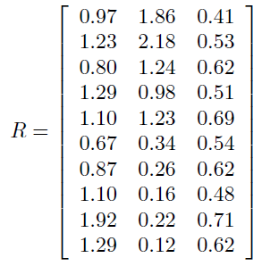




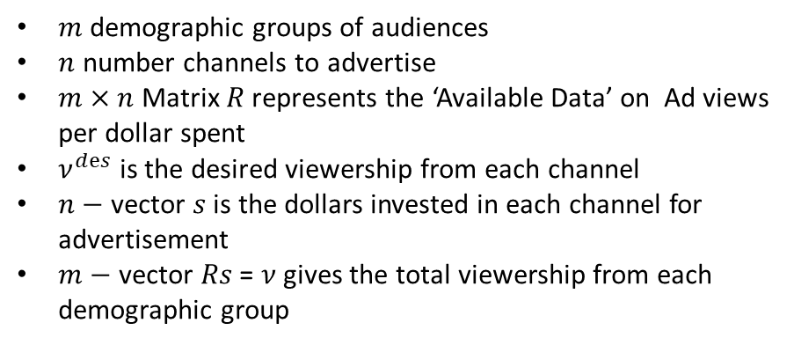
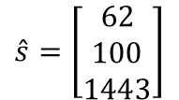
Constrained Least Squares: Advertising Purchase Example
$m$ demographic groups of audiences
$n$ number channels to advertise
$m×n$ Matrix $R$ represents the ‘Available Data’ on Ad views per dollar spent
$ν^{dⅇs}$ is the desired viewership from each channel
$n−$ vector $s$ is the dollars invested in each channel for advertisement
$m−$ vector $Rs$ = $ν$ gives the total viewership from each demographic group
:
Unconstrained Objective:
$$\hat{s}=\left[\begin{matrix}62 \\ 100 \\ 1443\end{matrix}\right]$$
Find $\hat{s}$ that minimizes ${\left\|Rs−v^{dⅇs}\right\|}^{2}$
Total Dollars to be spent is 1605
Constrained Objective:
B is the total budget available
$$\hat{s}=\left[\begin{aligned}315 \\ \begin{matrix} \\ \begin{aligned}110 \\ 859\end{aligned} \\ \end{matrix}\end{aligned}\right]$$
Actual budget available is 20% less i.e. B = 1284
Solving constrained least squares, we get
Notes:
Fat Matrix, multiple solutions case.

