Slide 1
Linear Algebra & Convex Optimization – Lecture 2
Notes:
.

Slide 2
From Last Lecture
Vector Scaling, Addition & Subtraction
Data Representation as Vectors
Vector Inner Product

Slide 3
Outline
Vector Norms
Vector Distances Use-case – Clustering
Textbook: Introduction to Applied Linear Algebra, S. Boyd: Chapters 4,5.

Slide 4
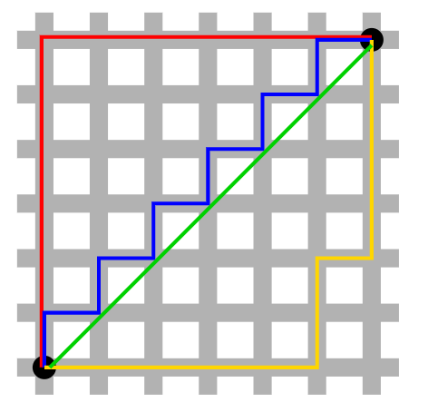









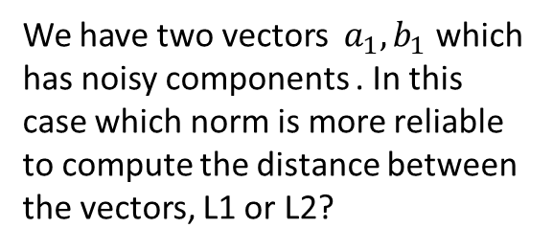
Vector Norms
Euclidean norm (L2) of n-dimensional vector $x$ :
L1 - Norm:
L1-Norm vs L2- Norm
Norm of Sum:
Poll:
We have two vectors $a_{1},b_{1}$ which has noisy components . In this case which norm is more reliable to compute the distance between the vectors, L1 or L2?

Slide 5


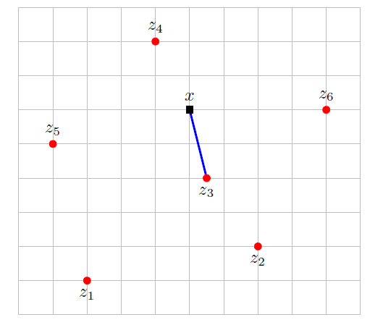
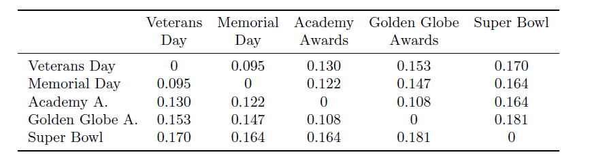
Distances : Examples
Nearest neighbor:
Document Distances:
Document represented as vectors : histogram of words
Difference of vector norms are distances between documents
:
Pairwise Distances between various Wikipedia articles

Slide 6




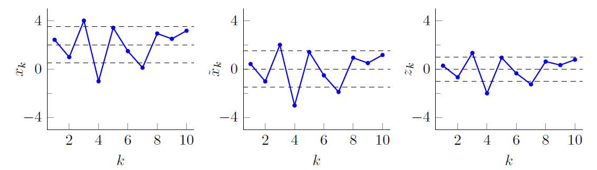
Standardization (Vector Dimension)
Comparison of two time –series data
Vector Standardization:
Vector Standardization: Useful for comparing 1D series data

Slide 7
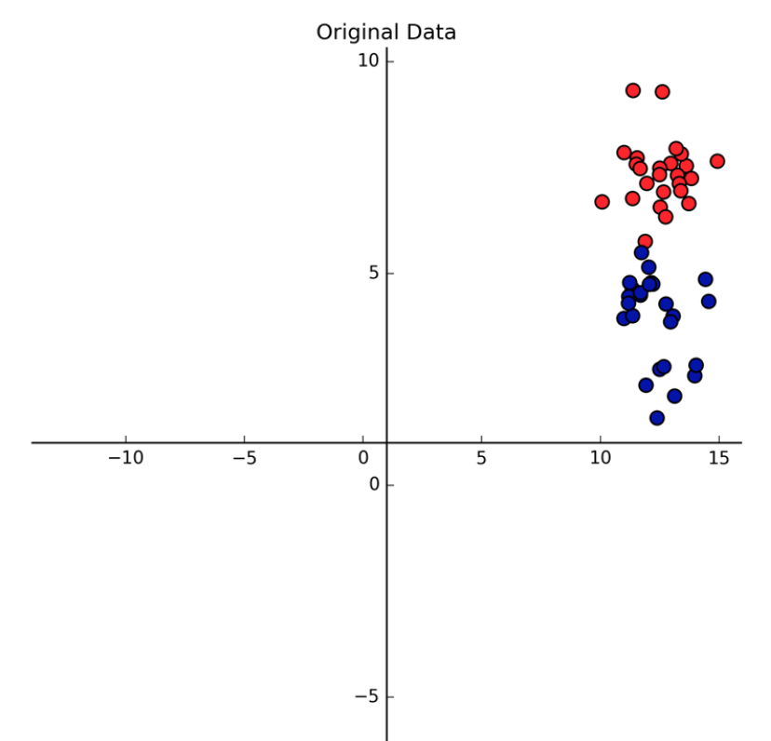
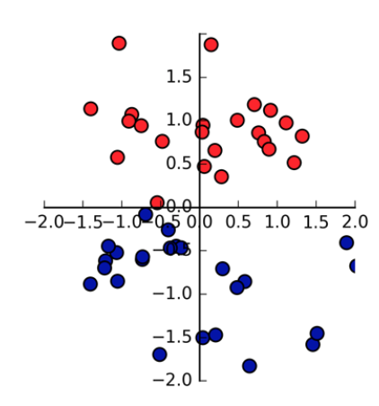

Standardization (Feature Dimension)
Z$\left(:,ⅈ\right)=\frac{1}{std (X(:,i)}\left[X\left(:,ⅈ\right)−avg( X\left(:,ⅈ\right))\right]$
Standardization is done along feature dimension
Useful in ML applications
Data Standardization:
Person Name | Salary | Year of Experience | Expected Position Level
Aman | 100000 | 10 | 2
Abhinav | 78000 | 7 | 4
Ashutosh | 32000 | 5 | 8
Dishi | 55000 | 6 | 7
Abhishek | 1200000 | 8 | 3
Before Data Standardization
After Data Standardization

Slide 8
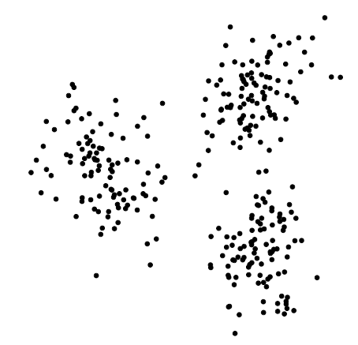
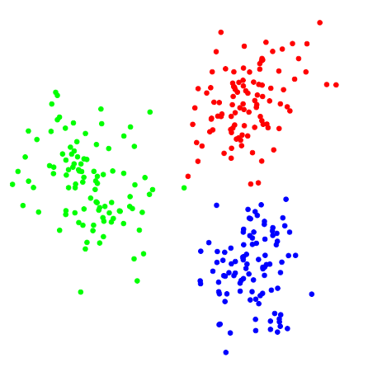
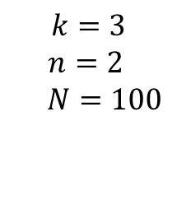
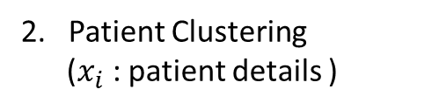
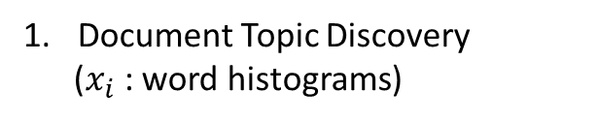
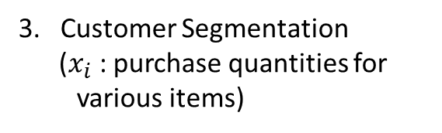
Clustering
Objective: Given a set of $N$ $n$ –vectors, $x_{1},x_{2},…,x_{N}$ find $k$ groups/clusters where $k<<N$
Example Applications:
Document Topic Discovery
($x_{i}$ : word histograms)
2. Patient Clustering
($x_{i}$ : patient details )
3. Customer Segmentation
($x_{i}$ : purchase quantities for various items)
$$k=3$$
$n=2$
$N=100$
Before Clustering
After Clustering

Slide 9



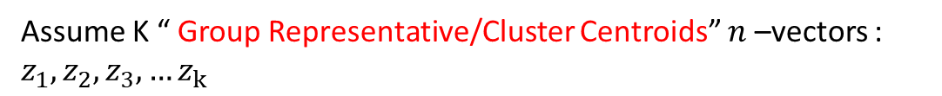
Clustering Formulation
Assume K “ Group Representative/Cluster Centroids” $n$ –vectors : $z_{1},z_{2},z_{3},…z_{k}$
[ $z_{1},z_{2},z_{3},…z_{k}$ need not be from $x_{1},x_{2},…,x_{N}$ ]
$c_{1},c_{2},…c_{N}$ , $c_{i}∈\left\{ 1, 2,⋯k\right\}$ are group assignment variables

Slide 10
Clustering Objective
Objective:
To seek a choice of group assignments , $c_{1},c_{2},…c_{N}$ , $c_{i}∈\left\{ 1, 2,⋯k\right\}$ , that minimizes the objective
Solution:
1. With representatives ($z_{1},z_{2},z_{3},…z_{k}$) fixed, find the best cluster assignments ($c_{1},c_{2},…c_{N}$) that minimizes ${ J}^{clust}$
2. With cluster assignments ($c_{1},c_{2},…c_{N}$) fixed , find the best representatives ($z_{1},z_{2},z_{3},…z_{k}$) that minimizes ${ J}^{clust}$

Slide 11

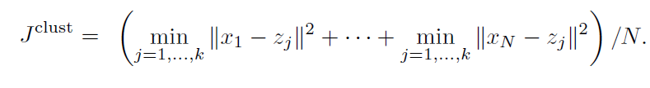





Best Clustering
Representatives ($z_{1},z_{2},z_{3},…z_{k}$) fixed:
Minimize each ${\left\|x_{i}−z_{c_{i}}\right\|}^{2}$ term independently to minimize ${ J}^{clust}$
Nearest representative to $x_{i}$ will be chosen : If $z_{j}$ is the nearest representative, $c_{i}=j$
Cluster Assignments ($c_{1},c_{2},…c_{N}$) fixed: :
Rewrite
where ,
Poll:
Will the cluster representatives(z) change a different distance metric is used

Slide 12
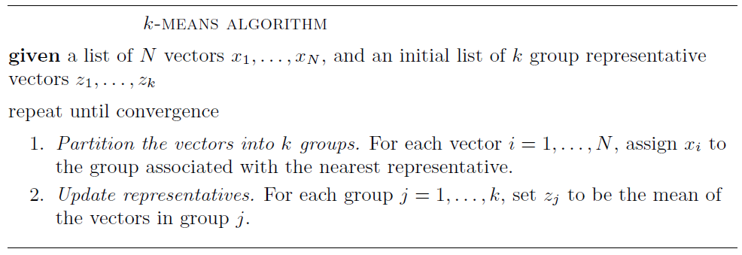
K- Means Algorithm

Slide 13
K- Means illustration
K – Means Illustration
K = 4

Slide 14
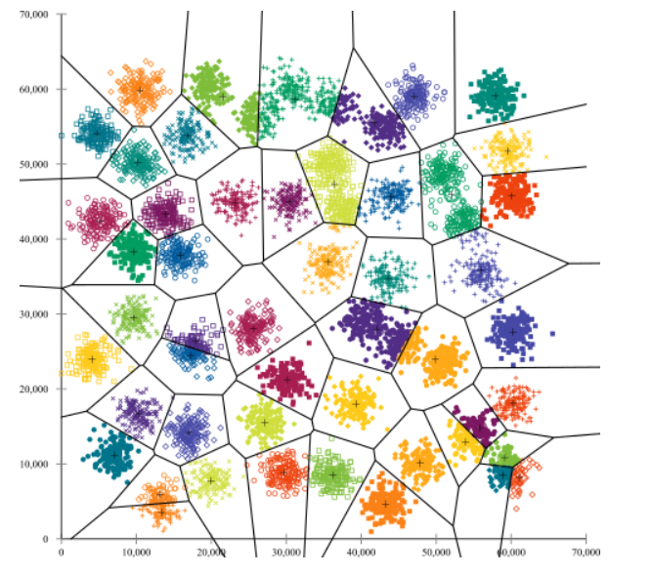
K-Means Challenges :
Challenges:
1. Clustering depends on the value of ‘K’ . Difficult to predict the ideal ‘K’ for many cases
2. Clustering varies with different initial points
3. With varying cluster sizes, optimal clustering is difficult to achieve
Initialization problem in K-Means with large number of clusters. (refer k-means++)

