Slide 1
Linear Algebra & Convex Optimization – Lecture 3
Notes:
.

Slide 2
From Last Lectures
Vector Scaling, Addition & Subtraction
Vector Inner Product
Distance definition between vectors
Clustering

Slide 3
Outline
Vector Distances Use-case – Clustering
Sub-spaces
Linear Independence
Basis, Orthogonal Basis
Orthogonalization
Textbook: Introduction to Applied Linear Algebra, S. Boyd: Chapters 4,5.

Slide 4
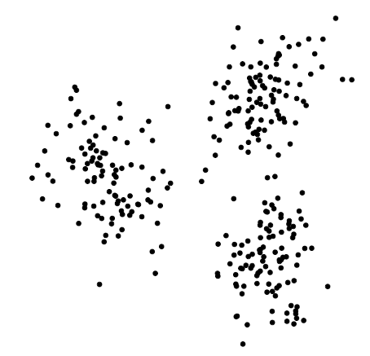
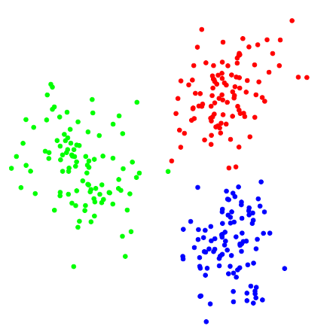
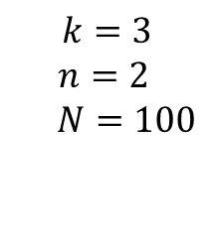
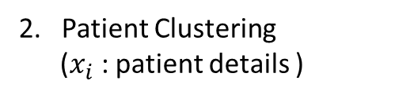
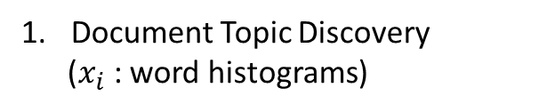
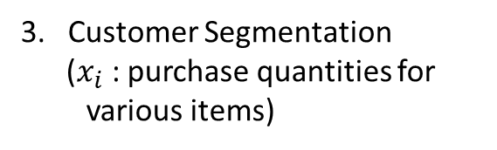
Clustering
Objective: Given a set of $N$ $n$ –vectors, $x_{1},x_{2},…,x_{N}$ find $k$ groups/clusters where $k<<N$
Example Applications:
Document Topic Discovery
($x_{i}$ : word histograms)
2. Patient Clustering
($x_{i}$ : patient details )
3. Customer Segmentation
($x_{i}$ : purchase quantities for various items)
$$k=3$$
$n=2$
$N=100$
Before Clustering
After Clustering
Notes:
Now that we understood the distance related concepts around multi-dimensional vectors, clustering is a direct application of this knowledge.

Slide 5



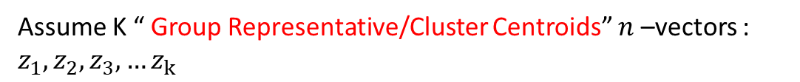
Clustering Formulation
Assume K “ Group Representative/Cluster Centroids” $n$ –vectors : $z_{1},z_{2},z_{3},…z_{k}$
[ $z_{1},z_{2},z_{3},…z_{k}$ need not be from $x_{1},x_{2},…,x_{N}$ ]
$c_{1},c_{2},…c_{N}$ , $c_{i}∈\left\{ 1, 2,⋯k\right\}$ are group assignment variables
Notes:
Our choice of clustering objective Jclust makes sense, since it encourages all points to be near their associated representative, but there are other reasonable choices. For example, it is possible to use an objective that encourages more balanced groupings.

Slide 6
Clustering Objective
Objective:
To seek a choice of group assignments , $c_{1},c_{2},…c_{N}$ , $c_{i}∈\left\{ 1, 2,⋯k\right\}$ , that minimizes the objective
Solution:
1. With representatives ($z_{1},z_{2},z_{3},…z_{k}$) fixed, find the best cluster assignments ($c_{1},c_{2},…c_{N}$) that minimizes ${ J}^{clust}$
2. With cluster assignments ($c_{1},c_{2},…c_{N}$) fixed , find the best representatives ($z_{1},z_{2},z_{3},…z_{k}$) that minimizes ${ J}^{clust}$
Notes:
Our choice of clustering objective Jclust makes sense, since it encourages all points to be near their associated representative, but there are other reasonable choices. For example, it is possible to use an objective that encourages more balanced groupings.

Slide 7

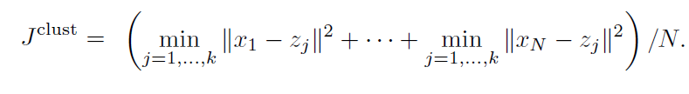





Best Clustering
Representatives ($z_{1},z_{2},z_{3},…z_{k}$) fixed:
Minimize each ${\left\|x_{i}−z_{c_{i}}\right\|}^{2}$ term independently to minimize ${ J}^{clust}$
Nearest representative to $x_{i}$ will be chosen : If $z_{j}$ is the nearest representative, $c_{i}=j$
Cluster Assignments ($c_{1},c_{2},…c_{N}$) fixed: :
Rewrite
where ,
Poll:
Will the cluster representatives(z) change a different distance metric is used
Notes:
The objective Jclust is a sum of N terms. The choice of ci (i.e., the group
to which we assign the vector xi) only aects the ith term in Jclust, which is
(1=N)kxi 􀀀 zcik2. We can choose ci to minimize just this term, since ci does not
aect the other N 􀀀1 terms in Jclust. How do we choose ci to minimize this term?
This is easy: We simply choose ci to be the value of j that minimizes kxi 􀀀 zjk over j. In other words, we should assign each data vector xi to its nearest neighbor
among the representatives. This choice of assignment is very natural, and easily
carried out.

Slide 8
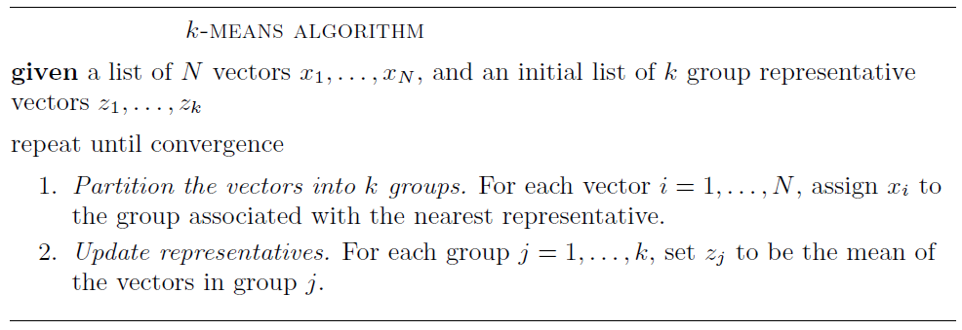
K- Means Algorithm
Notes:
The objective Jclust is a sum of N terms. The choice of ci (i.e., the group
to which we assign the vector xi) only aects the ith term in Jclust, which is
(1=N)kxi 􀀀 zcik2. We can choose ci to minimize just this term, since ci does not
aect the other N 􀀀1 terms in Jclust. How do we choose ci to minimize this term?
This is easy: We simply choose ci to be the value of j that minimizes kxi 􀀀 zjk over j. In other words, we should assign each data vector xi to its nearest neighbor
among the representatives. This choice of assignment is very natural, and easily
carried out.

Slide 9
K- Means illustration
K – Means Illustration
K = 4
Notes:
The objective Jclust is a sum of N terms. The choice of ci (i.e., the group
to which we assign the vector xi) only aects the ith term in Jclust, which is
(1=N)kxi 􀀀 zcik2. We can choose ci to minimize just this term, since ci does not
aect the other N 􀀀1 terms in Jclust. How do we choose ci to minimize this term?
This is easy: We simply choose ci to be the value of j that minimizes kxi 􀀀 zjk over j. In other words, we should assign each data vector xi to its nearest neighbor
among the representatives. This choice of assignment is very natural, and easily
carried out.

Slide 10
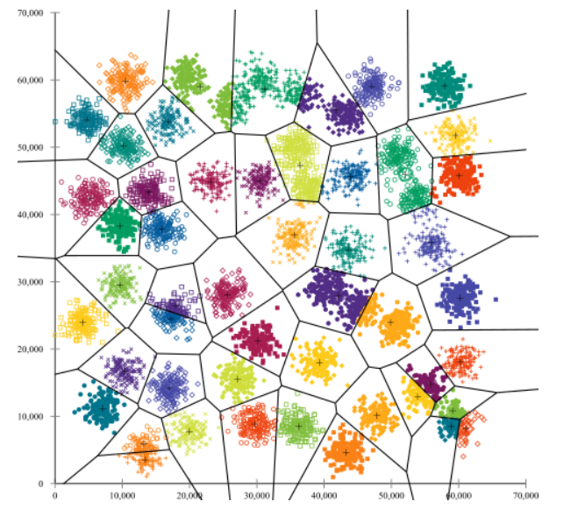
K-Means Challenges :
Challenges:
1. Clustering depends on the value of ‘K’ . Difficult to predict the ideal ‘K’ for many cases
2. Clustering varies with different initial points
3. With varying cluster sizes, optimal clustering is difficult to achieve
Initialization problem in K-Means with large number of clusters. (refer k-means++)
Notes:
The objective Jclust is a sum of N terms. The choice of ci (i.e., the group
to which we assign the vector xi) only aects the ith term in Jclust, which is
(1=N)kxi 􀀀 zcik2. We can choose ci to minimize just this term, since ci does not
aect the other N 􀀀1 terms in Jclust. How do we choose ci to minimize this term?
This is easy: We simply choose ci to be the value of j that minimizes kxi 􀀀 zjk over j. In other words, we should assign each data vector xi to its nearest neighbor
among the representatives. This choice of assignment is very natural, and easily
carried out.

Slide 11
Sub-spaces, Basis, Linear Independence

Slide 12

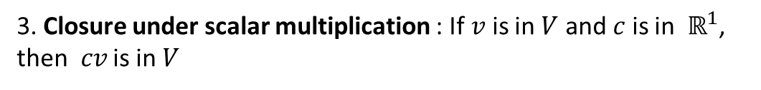
Subspace -Definition
$V$ is a subspace in $ℝ^{n}$ if it satisfies :
1. Non-emptiness : The zero vector is in $V$
2. Closure under addition : If $u$and $v$ are in $V$, then $u+ v$ is in $V$
3. Closure under scalar multiplication : If $v$ is in $V$ and $c$ is in${ ℝ}^{1}$, then$cv$ is in $V$

Slide 13
Subspace -Illustration
Not a Sub-space !
Not a Sub-space !
x + y
y
3x
x
y
x
0.x not in sub-space

Slide 14
Subspace - Illustration
2D Plane is a Sub-space !
This is a Sub-space !
y
x + y
x
x + y
x
y
3y
Notes:
We can potentially have subspaces of dimension n or lesser in case of Rn.

Slide 15
Span and Linear Independence
V² = Span { u , v }
u , v are linearly independent
Sub-space V²
Sub-space V¹
V¹ = Span { x }
2
a = [2.0, 2.0]
= 2.x
v
a
c₂.v
b
1
x = [1.0, 1.0]
c₄.v
-2
-1
1
2
3
u
c₁.u
-1
b = [-1.5, -1.5]
-2
c₃.u
= -1.5.x
a = c1.u + c2.v
y = c.x, where y is any vector in V¹
b = c3.u + c4.v
y is linearly dependent on x
y = c_{i}.u + c_{j}.v , where y is any vector in V²
Notes:
V1 spanned by any one vector, V2 spanned by any 2 independent vectors.
Span of any set of vector is a sub space.

Slide 16
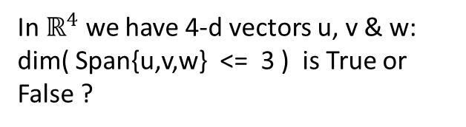

Dimension & Span
a is linearly dependent on u , v
w
b
= c₁u + c₂v
m
u
u
v
v
a
w is linearly in-dependent on u , v
dim ( Span{u,v} ) = 2
OR
Poll:
In $ℝ^{4}$ we have 4-d vectors u, v & w: dim( Span{u,v,w} <= 3 ) is True or False ?
$$ℝ^{3}$$
= Span { u , v, w }
b = m + c₃ w
= c₁u + c₂v + c₃ w
Notes:
write and explain meaning of $a_{1},{ a}_{2},{ a}_{3}…{ a}_{m}∈ℝ^{n}$

Slide 17


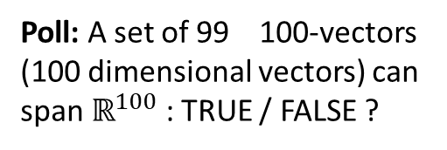



Linear Independence / Dependence & Basis
Definitions :
Let
$$a_{1},{ a}_{2},{ a}_{3}…{ a}_{m}$$
are linearly dependent if,
1.
$a_{1},{ a}_{2},{ a}_{3}…{ a}_{m}∈ℝ^{n}$ ,
$$λ_{1}a_{1}+λ_{2}a_{2}+λ_{3}{a_{3}}_{}⋯λ_{m}a_{m}=0$$
is true for some non-zero $λ_{1},λ_{2 ⋯},λ_{m}$
2. If
$a_{1},{ a}_{2},{ a}_{3}…{ a}_{n}∈ℝ^{n}$ are n independent vectors, then
$$ℝ^{n}$$
= Span {$a_{1},{ a}_{2},{ a}_{3}…{ a}_{n}$} . Any n + 1 ^{st} vector in $ℝ^{n}$ can be
represented as a linear combination of the n independent vectors.
Let
$$a_{1},{ a}_{2},{ a}_{3}…{ a}_{m}$$
are linearly in-dependent if,
3.
$a_{1},{ a}_{2},{ a}_{3}…{ a}_{m}∈ℝ^{n}$ ,
$$λ_{1}a_{1}+λ_{2}a_{2}+λ_{3}u_{3}⋯λ_{m}a_{m}=0$$
is true if and only if $λ_{1},λ_{2 ⋯},λ_{m}=0$
Poll: A set of 99 100-vectors (100 dimensional vectors) can span $ℝ^{100}$ : TRUE / FALSE ?
Any set of linearly independent set of vectors that spans a Vector Space V forms the basis for V
Notes:
write and explain meaning of $a_{1},{ a}_{2},{ a}_{3}…{ a}_{m}∈ℝ^{n}$

Slide 18





Orthonormal Vectors
Poll :
Are orthonormal vectors linearly independent ?
$$ℝ^{3}$$
Z
$$ℝ^{3}$$
$$y=\left[\begin{matrix}1 \\ 2 \\ 3\end{matrix}\right]$$
[0 0 1]
Z
$$x=\left[\begin{matrix}2 \\ −1 \\ 0\end{matrix}\right]$$
X
[1 0 0]
Y
[0 1 0]
Y
X
Notes:
Basis transformation is like speaking different languages to describe the same concept.
By default we assume X, Y basis.
How much should I go in the direction of w and v to reach point a?

Slide 19
Orthogonal Subspaces
Subspace S is orthogonal to subspace T means: every vector in S is orthogonal to every vector in T.
Poll :
X-Y plane and Y-Z plane forms 2 sub-spaces. Are they orthogonal subspaces ?
T = span { x}
x
u
v
S= span { v, u}
Notes:
Basis transformation is like speaking different languages to describe the same concept.
By default we assume X, Y basis.
How much should I go in the direction of w and v to reach point a?

Slide 20



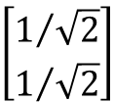
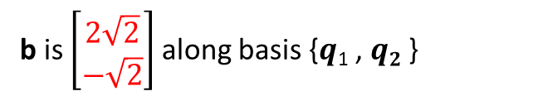
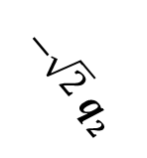


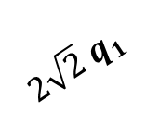

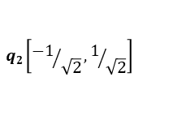
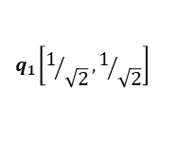
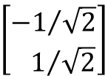
Orthonormal Basis
&
2
1
$2\sqrt{2}$ $q1$
$−\sqrt{2}$ $q2$
$$q2\left[{−1}/{\sqrt{2}},1/{\sqrt{2}}\right]$$
b [3, 1]
Example:
$$q1\left[1/{\sqrt{2}},1/{\sqrt{2}}\right]$$
q₁ =
$$\left[\begin{aligned}1/{\sqrt{2}} \\ 1/{\sqrt{2}}\end{aligned}\right]$$
$$\left[\begin{aligned}{−1}/{\sqrt{2}} \\ { 1}/{\sqrt{2}}\end{aligned}\right]$$
q₂ =
-2 -1
1 2 3
-1
-2
-3
${\hat{x}}_{1}=$ $q_{1}^{T}b$
${\hat{x}}_{2}=$ $q_{2}^{T}b$
b is $\left[\begin{matrix}2\sqrt{2} \\ −\sqrt{2}\end{matrix}\right]$ along basis {$q$₁ , $q2$ }
$b={\hat{x}}_{1}q_{1}+{\hat{x}}_{2}q_{2}=$ $2\sqrt{2}q_{1}−\sqrt{2}q_{2}$
Notes:
Basis transformation is like speaking different languages to describe the same concept.
By default we assume X, Y basis.
How much should I go in the direction of w and v to reach point a?

Slide 21
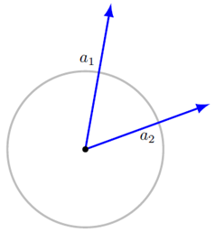
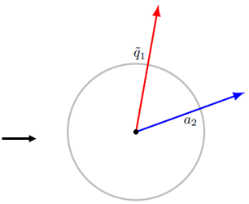
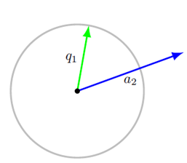

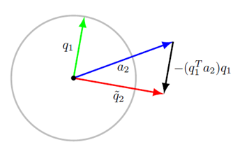
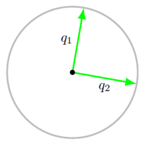


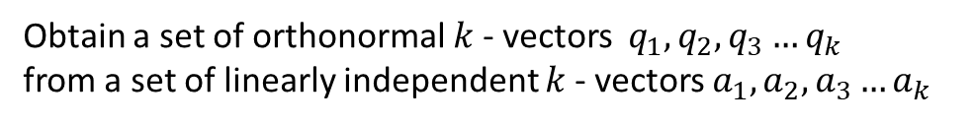
Gram – Schmidt Algorithm
Objective:
Obtain a set of orthonormal $k$- vectors $q_{1},q_{2},q_{3}…q_{k}$
from a set of linearly independent $k$- vectors $a_{1},a_{2},a_{3}…a_{k}$
Notes:
Basis transformation is like speaking different languages to describe the same concept.
By default we assume X, Y basis.
How much should I go in the direction of w and v to reach point a?

Slide 22
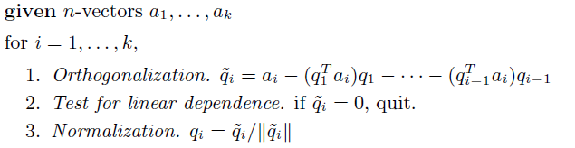
Gram – Schmidt Algorithm
Algorithm:
Process terminates early if $a_{1},a_{2},a_{3}…a_{k}$ are dependent
Notes:
Basis transformation is like speaking different languages to describe the same concept.
By default we assume X, Y basis.
How much should I go in the direction of w and v to reach point a?

