Slide 1
Linear Algebra & Convex Optimization – Lecture 4

Slide 2
From Last Lecture
Sub-spaces
Linear Independence
Basis, Orthogonal Basis
Orthogonalization

Slide 3
Outline
Matrices
Matrix – Vector Product
Matrix Operator Examples
Textbook: Introduction to Applied Linear Algebra, S. Boyd: Chapters 6,7.

Slide 4
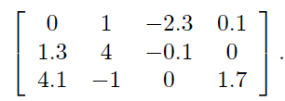

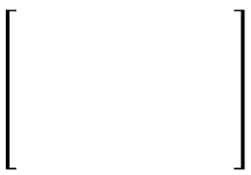





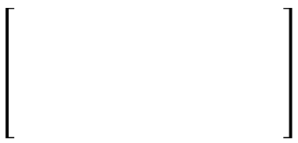


Matrix Definition , Notations
$3×4$ Matrix
Matrix: Rectangular arrangement of numbers
$$B=$$
$m×n$ Matrix : m rows, n columns
- Set of $n$ $m$-dimensional column vectors
- Set of$m$ $n$-dimensional row vectors
Examples : Image Representation , Set of Images , Set of Documents
Square Matrix : $m= n$
Tall Matrix : $m> n$
Wide Matrix : $m< n$

Slide 5





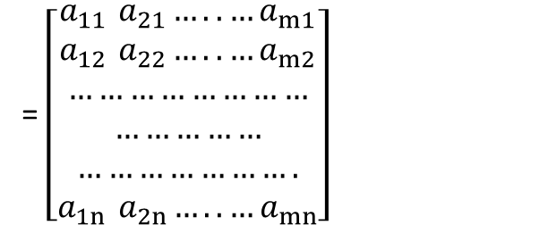
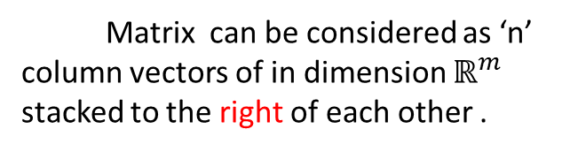




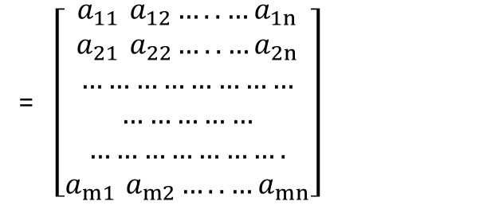


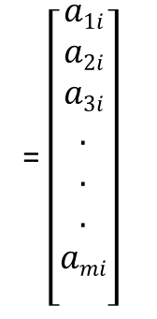



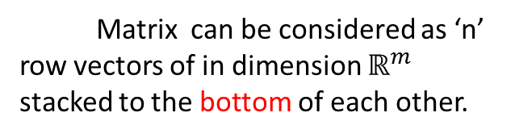
Matrix Representations
= $\left[\begin{aligned}a1i \\ a2i \\ a3i \\ . \\ . \\ . \\ ami \\ \end{aligned}\right]$
= $\left[\begin{matrix}a_{11 }a_{12}…..…a_{1n} \\ a_{21 }a_{22}…..…a_{2n} \\ …………………… \\ …………… \\ …………………. \\ a_{m1 }a_{m2}…..…a_{mn}\end{matrix}\right]$
= $\left[\begin{aligned} \\ \\ a1 a2 a3 an \\ \\ \\ \end{aligned}\right]$
Matrix can be considered as ‘n’ column vectors of in dimension $ℝ^{m}$ stacked to the right of each other .
$$m×n$$
$$A$$
$$ai$$
$$m×n$$
m$×1$
Column –form representation
$$a_{i}∈ℝ^{m}$$
= $\left[\begin{aligned}a_{1}^{T} \\ a_{2}^{T} \\ . \\ . \\ . \\ a_{n}^{T} \\ \end{aligned}\right]$
= $\left[\begin{matrix}a_{11 }a_{21}…..…a_{m1} \\ a_{12 }a_{22}…..…a_{m2} \\ …………………… \\ …………… \\ …………………. \\ a_{1n }a_{2n}…..…a_{mn}\end{matrix}\right]$
$$a_{i}^{T}$$
= $\left[a1i a2i a3i…ami\right]$
$$B=$$
$$AT$$
1$×m$
n$×m$
Matrix can be considered as ‘n’ row vectors of in dimension $ℝ^{m}$ stacked to the bottom of each other.
$$n×m$$
Row –form representation

Slide 6
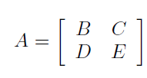
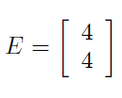
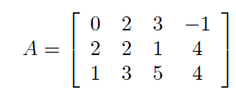



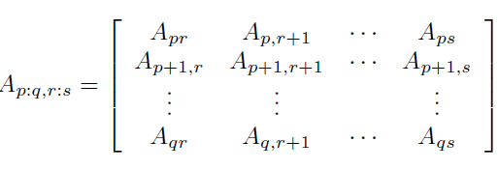




Matrix Representations
Block Matrices
$B , C, D, E$ : block/sub-matrices of Matrix A
Block Matrices must have ‘same dimension’ to fit together
Example:
Sub-Matrices
$A : m×n$ Matrix
Notes:
Slicing in python

Slide 7
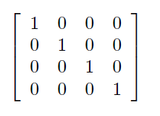


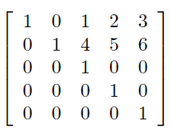
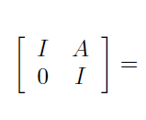


Matrix Representations
$4×4$ Identity Matrix
Identity Matrix
Block Matrix Examples :
If
then
Sparse Matrices :
A matrix is sparse if it has enough zeros that it pays to take advantage of them
Notes:
Slicing in python

Slide 8
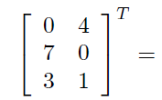
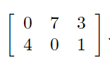



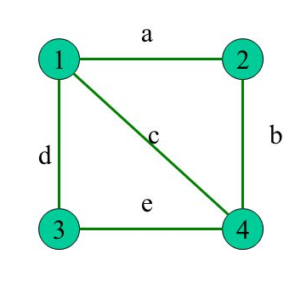
Matrix Transposes
Transpose of Block Matrices :
Symmetric Matrices :
1
2
3
4
Poll:
1
0
1
1
1
Affinity matrix of directed graphs will always be symmetric: True or False ?
Graph Affinity Matrix
(Un-directed Graph)
2
1
0
0
1
3
1
0
0
1
4
1
1
1
0
Notes:
Slicing in python

Slide 9








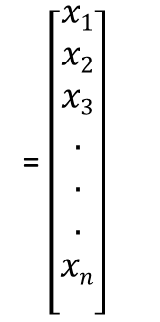









Matrix –Vector Multiplication –Column Interpretation
$$A$$
.
$$x$$
=
$$y$$
$$m×n$$
n$×1$
$$m×1$$
= $\left[\begin{aligned}x1 \\ x2 \\ x3 \\ . \\ . \\ . \\ xn \\ \end{aligned}\right]$
= $\left[\begin{aligned} \\ \\ a1 a2 a3 … …an… \\ \\ \\ \end{aligned}\right]$
$$A$$
$$a_{i}∈ℝ^{m}$$
$$x$$
$$m×n$$
m$×1$
n$×1$
$$x∈ℝ^{n}$$
$$x_{1}⋅a_{1}+x_{2}⋅a_{2}…+x_{n}⋅a_{n}=y$$
1$×1$
m$×1$
1$×1$
m$×1$
1$×1$
m$×1$
m$×1$
Notes:
Matrix is Identical to the notion of a linear function:
If A23 is positive and large, then y2 depends strongly on x3, and increases as
x3 increases.
If A32 is much larger than the other entries in the third row of A, then y3
depends much more on x2 than the other inputs.

Slide 10



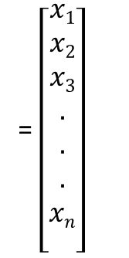





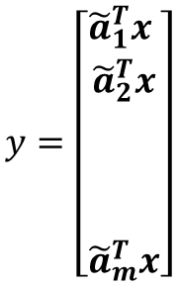



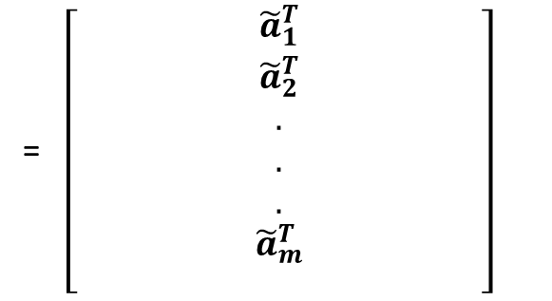
Matrix –Vector Multiplication: Row Interpretation
$$A$$
.
$$x$$
=
$$y$$
$$m×n$$
n$×1$
$$m×1$$
= $\left[\begin{aligned}x1 \\ x2 \\ x3 \\ . \\ . \\ . \\ xn \\ \end{aligned}\right]$
= $\left[\begin{aligned}{\tilde{a}}_{1}^{T} \\ {\tilde{a}}_{2}^{T} \\ . \\ . \\ . \\ {\tilde{a}}_{m}^{T} \\ \end{aligned}\right]$
$$y=\left[\begin{aligned}{\tilde{a}}_{1}^{T}x \\ {\tilde{a}}_{2}^{T}x \\ \\ \\ \\ {\tilde{a}}_{m}^{T}x\end{aligned}\right]$$
Inner-product Interpretation : Output vector components are Inner-product of matrix rows and input vector
$$A$$
$$x$$
n$×1$
$$m×n$$
m$×1$
$$x∈ℝ^{n}$$
$$A:{ ℝ}^{n}→ℝ^{m}$$
$$m×n$$
matrix A is a function that maps a point in n-dimensional space to a
point in m-dimensional space
$$ℝ^{n}$$
$$ℝ^{m}$$
$$A:{ ℝ}^{n}→ℝ^{m}$$
x
y
Notes:
Matrix is Identical to the notion of a linear function:
If A23 is positive and large, then y2 depends strongly on x3, and increases as
x3 increases.
If A32 is much larger than the other entries in the third row of A, then y3
depends much more on x2 than the other inputs.

Slide 11

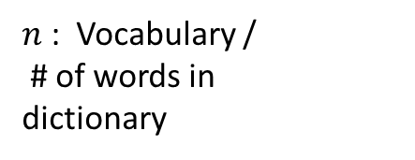

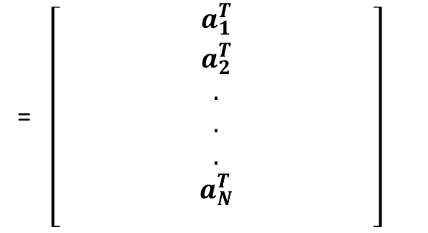


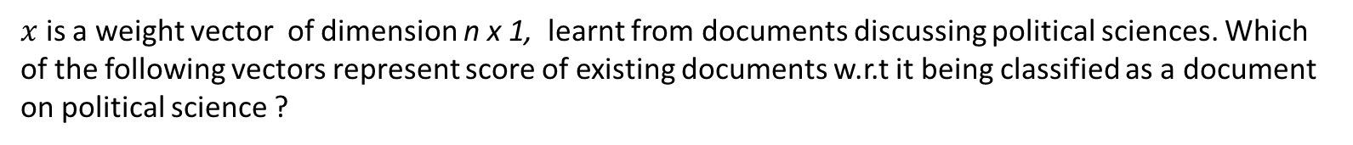
Poll
n x N Matrix A represents a collection of documents, where$A_{ij}=$ Number of times word $i$ appears in document $j , N$ : # of documents ; $n$ : Vocabulary / # of words in dictionary
$x$ is a weight vector of dimension n x 1, learnt from documents discussing political sciences. Which of the following vectors represent score of existing documents w.r.t it being classified as a document on political science ?
A) $Ax$ B) $A^{T}x$ C)$x^{T}Ax$ D) $A1$
Document –Term Matrix
= $\left[\begin{aligned}a_{1}^{T} \\ a_{2}^{T} \\ . \\ . \\ . \\ a_{N}^{T} \\ \end{aligned}\right]$
$N$ : # of documents
$n$ : Vocabulary /
# of words in
dictionary
$$AT$$
$$N×n$$
$A_{ij}=$ Number of times word $j$ appears in document $i$
$:$ Word count vectors for documents $1,2,⋯N$
Notes:
write and explain meaning of $a_{1},{ a}_{2},{ a}_{3}…{ a}_{m}∈ℝ^{n}$

Slide 12

Column Space of a Matrix
= $\left[\begin{aligned} \\ \\ a1 a2 a3 … …an… \\ \\ \\ \end{aligned}\right]$
Column space of matrix A is defined as :
$$ℂ\left(A\right)=\operatorname{Span}\left\{a_{1},a_{2,…}a_{n}\right\}$$
$$A$$
$$m×n$$
$$is a subspace as it formed using Span of vectors$$
$$ℂ\left(A\right)$$
Poll:
For $m×n$ Matrix A, Column space C(A) will
a subspace in A) $ℝ^{m}$ B) $ℝ^{n}$
$${ℂ\left(A\right)=\left\{x1a1+x_{2}a_{2}⋯{+x_{n}\left.a_{n}\right| x∈ℝ^{n}}_{}^{}\right\}}_{}$$
= $\left\{A\left.x \right| x∈ℝ^{n}\right\}$
= $\left[\begin{aligned}x1 \\ x2 \\ x3 \\ . \\ . \\ . \\ xn \\ \end{aligned}\right]$
Consider the equation:
$$Ax=b$$
where
$$x$$
n$×1$
If
$$b∉ℂ\left(A\right)$$
Then there is no solution for
$$x∈ℝ^{n}$$
$$Ax=b$$
Notes:
write and explain meaning of $a_{1},{ a}_{2},{ a}_{3}…{ a}_{m}∈ℝ^{n}$

Slide 13
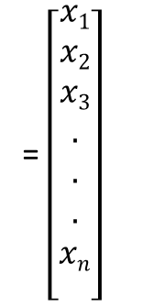



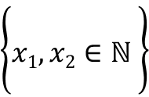
















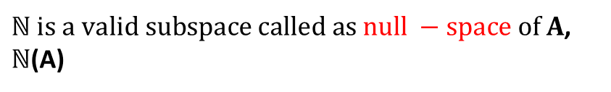

Null Space of a Matrix
= $\left[\begin{aligned}x1 \\ x2 \\ x3 \\ . \\ . \\ . \\ xn \\ \end{aligned}\right]$
= $\left[\begin{aligned} \\ \\ a1 a2 a3 … …an \\ \\ \\ \end{aligned}\right]$
Poll:
$$x$$
$$A$$
n$×1$
For $m×n$ Matrix A, Null space N(A) will
a subspace in A) $ℝ^{m}$ B) $ℝ^{n}$
$$m×n$$
$$a_{i}∈ℝ^{m}$$
$$x∈ℝ^{n}$$
.
$$x$$
=
$$0$$
$$ℕ=\left\{\begin{aligned}x∈ℝ^{n} | \\ \end{aligned}\right\}$$
$$A$$
Is $ℕ a subspace ?$
$$m×n$$
n$×1$
$$m×1$$
$$A$$
.
$$0$$
=
$$0$$
$ℕ is a valid subspace called as null −space of A$, $ℕ$(A)
$$\left\{\begin{aligned} \\ x1, x2∈ℕ \\ \end{aligned}\right\}$$
For any
.
$$A$$
.
$( c1 x1+c2x2$)
=
$$c_{1} Ax_{1}+c_{2} Ax_{2}$$
=
$$0$$
Notes:
write and explain meaning of $a_{1},{ a}_{2},{ a}_{3}…{ a}_{m}∈ℝ^{n}$

Slide 14








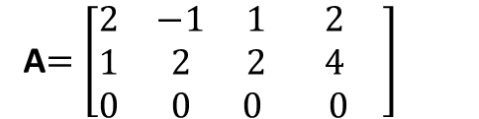

Dimension of Column & Null Spaces
a
b
c
d
A$=\left[\begin{matrix}2 & −1 & 1 2 \\ 1 & 2 & 2 4 \\ 0 & 0 & 0 0 \end{matrix}\right]$
$$ℂ\left(A\right)=$$
$$Span\{a,b,c,d\}$$
3
3$×$4
c can be expressed in terms of a and b
c = (4/5) a + (3/5)b
2
d = 2. c
# of linearly independent column vectors= Rank of the matrix = # of linearly independent row vectors
1
$$Dim\left(ℂ\left(A\right)\right)=2$$
b
[-1, 2, 0]
1
2
$ℕ$(A)
$$=\left\{x∈\left.ℝ^{n}\right|Ax=0\right\}$$
1
a
[2 ,1, 0 ]
2
c
[1, 2, 0]
$$Dim\left(ℕ\left(A\right)\right)= ?$$
$$ℂ\left(A\right)$$
d
[2, 4, 0]
Poll: rank (A + B) = rank(A) + rank (B)
TRUE/FALSE ?
$$Dim\left(ℕ\text{(}\text{A}\text{)} \right)=\#Columns −Rank=2$$
$Ax=x_{1}a+x_{2}b+x_{3}c+x_{4}d$= 0
Notes:
Rank of A is the number of linearly independent column vectors in the matrix.

Slide 15



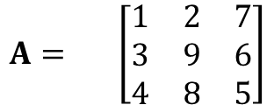






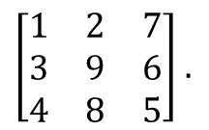





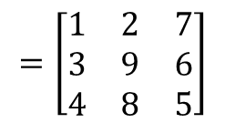

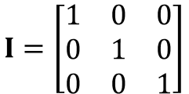


Matrix- Vector Multiplication : Examples
Identity Matrix Multiplication:
$$c1$$
$$c2$$
$$c3$$
$$r1$$
$$A= \left[\begin{matrix}1 & 2 & 7 \\ 3 & 9 & 6 \\ 4 & 8 & 5\end{matrix}\right]$$
$$I=\left[\begin{matrix}1 & 0 & 0 \\ 0 & 1 & 0 \\ 0 & 0 & 1\end{matrix}\right]$$
$$r2$$
$$r3$$
$$c1$$
$$c2$$
$$c3$$
$$c1$$
$$c2$$
$$c3$$
$$c1$$
$$c2$$
$$c3$$
$\left[\begin{matrix}1 & 2 & 7 \\ 3 & 9 & 6 \\ 4 & 8 & 5\end{matrix}\right]$ $.$
$$\left[\begin{matrix}1 & 0 & 0 \\ 0 & 1 & 0 \\ 0 & 0 & 1\end{matrix}\right]$$
$$= \left[1⋅\left[\begin{matrix}1 \\ 3 \\ 4\end{matrix}\right]+0.\left[\begin{matrix}2 \\ 9 \\ 8\end{matrix}\right]+0.\left[\begin{matrix}7 \\ 6 \\ 5\end{matrix}\right] 0⋅\left[\begin{matrix}1 \\ 3 \\ 4\end{matrix}\right]+1.\left[\begin{matrix}2 \\ 9 \\ 8\end{matrix}\right]+0.\left[\begin{matrix}7 \\ 6 \\ 5\end{matrix}\right] 0⋅\left[\begin{matrix}1 \\ 3 \\ 4\end{matrix}\right]+0.\left[\begin{matrix}2 \\ 9 \\ 8\end{matrix}\right]+1.\left[\begin{matrix}7 \\ 6 \\ 5\end{matrix}\right] \right]$$
$A .I$ =
$$=\left[\begin{matrix}1 & 2 & 7 \\ 3 & 9 & 6 \\ 4 & 8 & 5\end{matrix}\right]$$
Notes:
First Column of A is sampled by the first column of I. Consider this as multiple matrix-vector multiplications

Slide 16










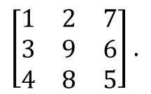







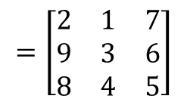

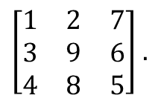

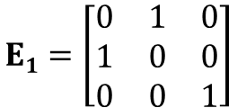


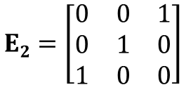



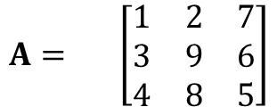


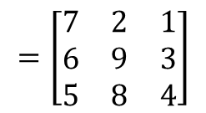

Matrix- Vector Multiplication : Examples
Column Interchange:
$$c1$$
$$c2$$
$$c3$$
$$r1$$
$$E1=\left[\begin{matrix}0 & 1 & 0 \\ 1 & 0 & 0 \\ 0 & 0 & 1\end{matrix}\right]$$
$$E2=\left[\begin{matrix}0 & 0 & 1 \\ 0 & 1 & 0 \\ 1 & 0 & 0\end{matrix}\right]$$
$$A= \left[\begin{matrix}1 & 2 & 7 \\ 3 & 9 & 6 \\ 4 & 8 & 5\end{matrix}\right]$$
$$r2$$
$$r3$$
$$c1$$
$$c2$$
$$c3$$
$$c1$$
$$c2$$
$$c3$$
$$c1$$
$$c2$$
$$c3$$
$\left[\begin{matrix}1 & 2 & 7 \\ 3 & 9 & 6 \\ 4 & 8 & 5\end{matrix}\right]$ $.$
$$\left[\begin{matrix}0 & 1 & 0 \\ 1 & 0 & 0 \\ 0 & 0 & 1\end{matrix}\right]$$
$$= \left[0⋅\left[\begin{matrix}1 \\ 3 \\ 4\end{matrix}\right]+1.\left[\begin{matrix}2 \\ 9 \\ 8\end{matrix}\right]+0.\left[\begin{matrix}7 \\ 6 \\ 5\end{matrix}\right] 1⋅\left[\begin{matrix}1 \\ 3 \\ 4\end{matrix}\right]+0.\left[\begin{matrix}2 \\ 9 \\ 8\end{matrix}\right]+0.\left[\begin{matrix}7 \\ 6 \\ 5\end{matrix}\right] 0⋅\left[\begin{matrix}1 \\ 3 \\ 4\end{matrix}\right]+0.\left[\begin{matrix}2 \\ 9 \\ 8\end{matrix}\right]+1.\left[\begin{matrix}7 \\ 6 \\ 5\end{matrix}\right] \right]$$
$A .E1$ =
$$c2$$
$$c1$$
$$c3$$
$$=\left[\begin{matrix}2 & 1 & 7 \\ 9 & 3 & 6 \\ 8 & 4 & 5\end{matrix}\right]$$
$$c1$$
$$c2$$
$$c3$$
$$c1$$
$$c2$$
$$c3$$
$$c1$$
$$c2$$
$$c3$$
$\left[\begin{matrix}1 & 2 & 7 \\ 3 & 9 & 6 \\ 4 & 8 & 5\end{matrix}\right]$ $.$
$$\left[\begin{matrix}0 & 0 & 1 \\ 0 & 1 & 0 \\ 1 & 0 & 0\end{matrix}\right]$$
$$= \left[0⋅\left[\begin{matrix}1 \\ 3 \\ 4\end{matrix}\right]+0.\left[\begin{matrix}2 \\ 9 \\ 8\end{matrix}\right]+1.\left[\begin{matrix}7 \\ 6 \\ 5\end{matrix}\right] 0⋅\left[\begin{matrix}1 \\ 3 \\ 4\end{matrix}\right]+1.\left[\begin{matrix}2 \\ 9 \\ 8\end{matrix}\right]+0.\left[\begin{matrix}7 \\ 6 \\ 5\end{matrix}\right] 1⋅\left[\begin{matrix}1 \\ 3 \\ 4\end{matrix}\right]+0.\left[\begin{matrix}2 \\ 9 \\ 8\end{matrix}\right]+0.\left[\begin{matrix}7 \\ 6 \\ 5\end{matrix}\right] \right]$$
$A .E2$ =
$$c3$$
$$c2$$
$$c1$$
$$=\left[\begin{matrix}7 & 2 & 1 \\ 6 & 9 & 3 \\ 5 & 8 & 4\end{matrix}\right]$$

Slide 17






Matrix- Vector Multiplication : Examples
$$x=\left[\begin{matrix} \\ \begin{aligned}x_{1} \\ . \\ . \\ x_{n}\end{aligned}\end{matrix}\right]$$
$$\left[\begin{aligned}\begin{aligned}x_{2}−x_{1} \\ . \\ . \\ \end{aligned} \\ x_{n}−x_{n−1}\end{aligned}\right]$$

Slide 18





Matrix- Vector Multiplication : Applications
Feature matrix and weight vector:
Polynomial evaluation at multiple points:
$t_{1},t_{2,…}t_{m}$ be the $m$ points at which the polynomial need to be evaluated
evaluates the polynomial

Slide 19



Matrix- Operator: Applications
Scaling:
Dilation:
Rotation:

Slide 20







Matrix- Operator: Applications
1D Convolution:
Toeplitz Matrices:

Slide 21










Matrix- Operator: Applications
2D Convolution:
Image Blurring:
Matrix Operation for :
Poll:
Dimensions of Matrix
:
A ) $m×n$
B ) $\left(m+p−1\right)×\left(n+q−1\right)$
C ) $\left(m+p−1\right)\left(n+q−1\right)×$ $mn$

Slide 22







Matrix Norms
Frobenius Norm ( ) Properties :
Triangle Inequality is valid for Matrix Norms
: Can define distances between two Matrices
Notes:
This agrees with our denition for vectors when A is a vector, i.e., n = 1. The
norm of an m n matrix is the norm of an mn-vector formed from the entries of
the matrix (in any order). Like the vector norm, the matrix norm is a quantitative
measure of the magnitude of a matrix. In some applications it is more natural
to use the RMS values of the matrix entries, kAk=pmn, as a measure of matrix
size. The RMS value of the matrix entries tells us the typical size of the entries,
independent of the matrix dimensions.

