Slide 1
Linear Algebra & Convex Optimization – Lecture 5
Notes:
Purpose is to explore basic mathematics that underlines ML and develop intuition.
More rigorous treatment as in a mathematics course is avoided.

Slide 2
From Last Lecture
Matrix – Vector Multiplication Interpretations
Column Spaces & Null Spaces
Matrix – Vector Multiplication Applications

Slide 3
Outline
Matrix – Matrix Multiplication
QR-Factorization
Matrix Inverses
Linear System of Equations

Slide 4


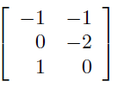
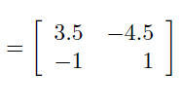

Matrix-Matrix Multiplication
$${\left(AB\right)}^{T}=B^{T}A^{T}$$
Example:
Notes:
C_ij is the inner product of ith row of A and jth column of B. – A measure of similarity between ith row of A and jth column of B

Slide 5

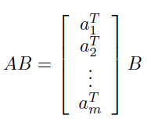
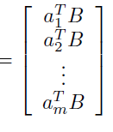


Features of Matrix - Matrix Multiplication
Product of Block Matrices:
Column Interpretation of Matrix-Matrix Product:
$A:m×p$Matrix
$B:p×n$ Matrix
Row Interpretation of Matrix-Matrix Product:
Notes:
C_ij is the inner product of ith row of A and jth column of B. – A measure of similarity between ith row of A and jth column of B

Slide 6
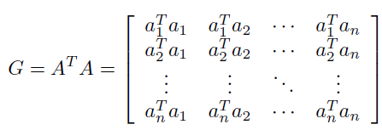





Properties of Matrix Multiplication
Gram Matrix:
Poll:
Poll:
Gram Matrix is Symmetric: TRUE or FALSE
Notes:
C_ij is the inner product of ith row of A and jth column of B. – A measure of similarity between ith row of A and jth column of B

Slide 7
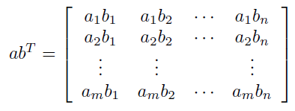

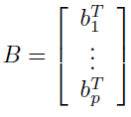




Properties of Matrix Multiplication
Vector Outer Product:
$a$is $m×1$ vector ; $b$is $n×1$ vector
Outer Product Representation of Matrix-Matrix Product:
$A:m×p$Matrix
$B:p×n$ Matrix
Notes:
C_ij is the inner product of ith row of A and jth column of B. – A measure of similarity between ith row of A and jth column of B

Slide 8
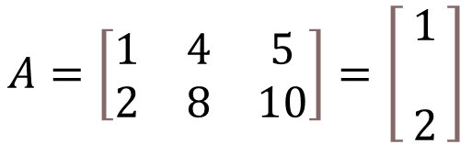


Rank – 1 Matrices
Poll:
What is the rank of the product of matrices A (m x p) & B (n x p) if rank of A = rank of B = p?
$$A=\left[\begin{matrix}1 & 4 & 5 \\ 2 & 8 & 10\end{matrix}\right]=\left[\begin{matrix}\begin{aligned}1 \\ \end{aligned} \\ 2\end{matrix}\right]$$
$$\left[1 4 5\right]$$
Rank(AB) = p + p
Rank(AB) <= p
Rank(AB) = p
Rank(AB) = 2p
$$A=uv^{T}$$
Given $u:m×1$ vector & $v:n×1$ vector
Clue:
Any $m×n$ matrix of the form $uv^{T}$ will have Rank -1
Proof: Look at the column space for dimension . Check all possible linear combinations of columns
Notes:
Answer = B

Slide 9




Orthonormal Matrices
Matrices with orthonormal columns:
$A:m×n$ Matrix with orthonormal columns, $a_{1},a_{2},a_{3}…a_{n}$
Poll:
Poll:
$A^{T}A$ is
If A and B are 2 orthogonal matrices, then AB is orthogonal :
A) TRUE B) FALSE
A) $A$ B) $A^{T}$ C) $I$ D) $0$
When $A$ is orthonormal.
Notes:
Gilbert Strang- Lecture 1

Slide 10











Orthonormal Matrices : Properties
$x, y :$ Any $n$–dimensional vectors
Let $f:ℝ^{n}→ℝ^{m}$ be the mapping induced by $m×n$ Orthonormal Matrix $A$ on any $n$–dimensional vector
Notes:
Gilbert Strang- Lecture 1

Slide 11

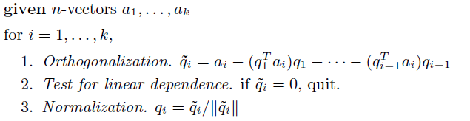






QR Factorization
$A:n×k$ Matrix with independent columns, $a_{1},a_{2},a_{3}…a_{k}$
$Q:n×k$ Matrix with orthonormal columns, $q_{1},q_{2},q_{3}…q_{k}$
$q_{1},q_{2},q_{3}…q_{k}$ are obtained after Gram-Schmidt orthogonalization procedure of $a_{1},a_{2},a_{3}…a_{k}$
Gram-Schmidt Orthogonalization
$A=QR$ , where $Q$ is having orthonormal columns and $R$is upper triangular
= $\left[\begin{aligned} \\ \\ a1 a2 a3 … ak \\ \\ \\ \end{aligned}\right]$
= $\left[\begin{aligned} \\ \\ q1 q2 q3 … qk \\ \\ \\ \end{aligned}\right]$
$$A$$
$$Q$$
$$n×k$$
$$n×k$$
Notes:
Gilbert Strang- Lecture 1

Slide 12
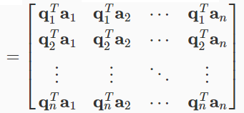




Finding R in QR Factorization
But, how do we confirm R is upper triangular ?
When we calculated $q_{2}$ via Gram-Schmidt we made sure it is orthogonal to $a_{1}$ i.e. $q_{2}^{T}a_{1}=0$
When we calculated $q_{3}$ via Gram-Schmidt we made sure it is orthogonal to $a_{1}$ and $a_{2}$ i.e. $q_{3}^{T}a_{1}=q_{3}^{T}a_{2}=0$
When we calculated $q_{n}$ via Gram-Schmidt we made sure it is orthogonal to $a_{1}$ $,a_{2}$ ,… $a_{n−1}$
i.e. $q_{n}^{T}a_{1}=q_{n}^{T}a_{2}= ……. =q_{n}^{T}a_{n−1} = 0$
Notes:
Gilbert Strang- Lecture 1

Slide 13
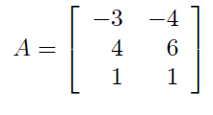






Left Inverses
Left Inverse of $m×n$ Matrix $A$ :
$n×m$ Matrix $X$that satisfies $XA=I$
Examples:
1.
Poll:
Poll: Matrix A has the left inverse its transpose. Then is A is
Identity Matrix B) Zero Matrix
C) Symmetric Matrix D) Orthonormal Matrix
2.
Notes:
Gilbert Strang- Lecture 1

Slide 14







Left Invertibility
$A$ has left inverse $C$
Column of $A$ are linearly independent
Proof:
Suppose columns are not linearly independent.
Then for some vector $x$, we have $Ax=0$
$$CAx=\left(CA\right)x=Ix=x$$
for any vector $x$
Poll:
Poll:
This contradicts
$$CAx=C\left(Ax\right)=C⋅0=0$$
Columns of a wide matrix will be independent
A) TRUE B) FALSE
Only Square or Tall Matrices will have left inverses
Proof:
$m×n$ matrix $A$ is wide when $n>m$
matrix $A$ will only have a maximum rank of $m$
Wide matrix $A$ will have dependent columns and hence no left inverse.
Notes:
Gilbert Strang- Lecture 1

Slide 15




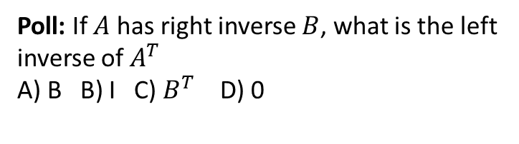
Right Inverse
Right Inverse of $m×n$ Matrix $A$ :
$n×m$ Matrix $X$that satisfies $AD=I$
$A$ has right inverse $D$
Rows of $A$ are linearly independent
Only Square or Wide Matrices will have right inverses
Poll:
Poll: If $A$ has right inverse $B$, what is the left inverse of $A^{T}$
A) B B) I C) $B^{T}$ D) 0
If $A$ has right inverse $B$, $B^{T}$ is the left inverse of $A^{T}$
Notes:
Gilbert Strang- Lecture 1

Slide 16








Inverses
Proof of Left Inverse = Right Inverse :
Proof of uniqueness of Inverse:
Suppose another right inverse, $\tilde{X} ,$exists
Notes:
Gilbert Strang- Lecture 1

Slide 17
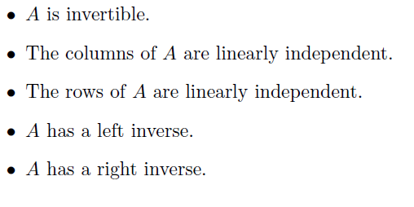
Invertibility Conditions
The following are equivalent for a Square Matrix $A$ :
Non-Invertible Matrices are called Singular Matrices
Notes:
Gilbert Strang- Lecture 1

Slide 18
Appendix

