Slide 1
Linear Algebra & Convex Optimization – Lecture 6
Text : Introduction to Applied Linear Algebra, S. Boyd: Chapters 8, 11.
Reference: Linear Algebra, Gilbert Strang

Slide 2

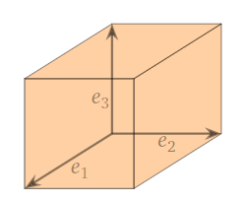
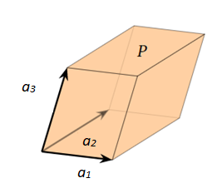
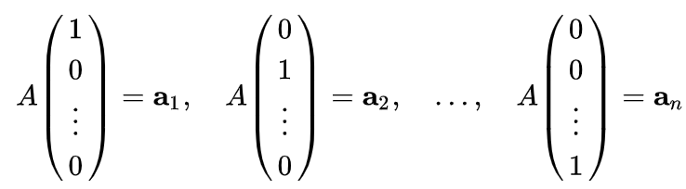

Determinant & Singularity
Determinant is a scalar value associated with every $n×n$ square matrix $A:ℝ^{n}→ℝ^{n}$
Determinant is measure of linear transformation induced by $A$
a₃
If columns of $A$ are linearly dependent, det(A) = 0
a₁
a₂
parallelotope is ‘squashed’ for Singular Matrices
Notes:
Gilbert Strang- Lecture 1

Slide 3
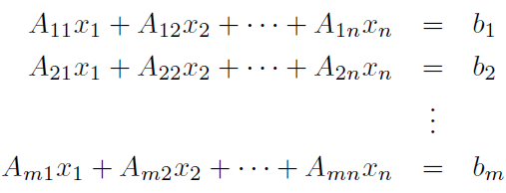

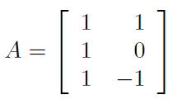






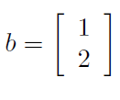
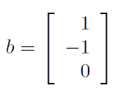



System of Linear Equations
$m×n$ Matrix $A:$ Coefficient Matrix
Example 1:
Example 2:
No Solution in this case
Many Solutions !
Notes:
Gilbert Strang- Lecture 1

Slide 4
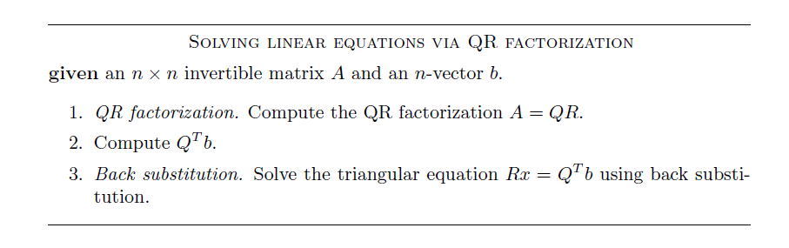
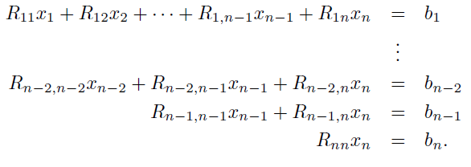

Ax = b , A is square and invertible
Back-substitution

Slide 5
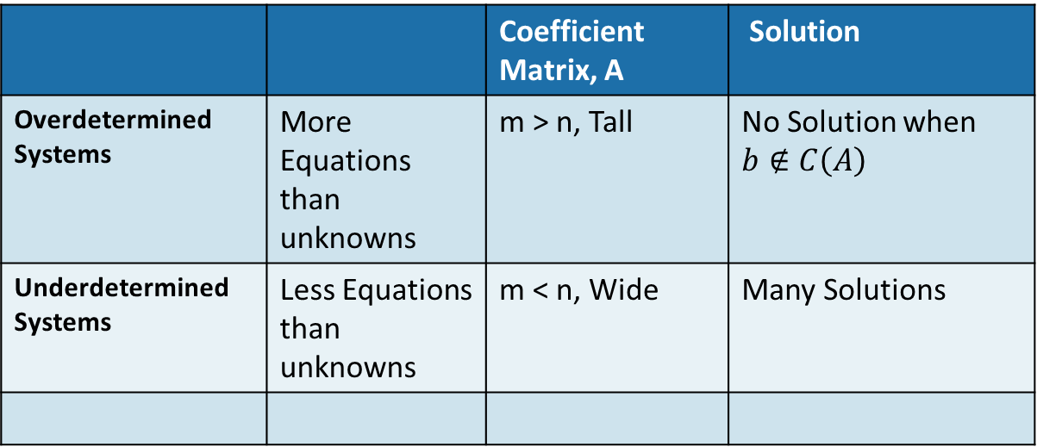
Overdetermined & Underdetermined Systems
 |  | Coefficient Matrix, A | Solution
Overdetermined Systems | More Equations than unknowns | m > n, Tall | No Solution when $b∉C\left(A\right)$
Underdetermined Systems | Less Equations than unknowns | m < n, Wide | Many Solutions

Slide 6
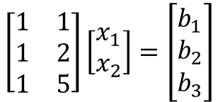




Ax = b with no solutions
$$A$$
$$x$$
$$b$$
$$\left[\begin{matrix}1 & 1 \\ 1 & 2 \\ 1 & 5\end{matrix}\right]\left[\begin{matrix}x_{1} \\ x_{2}\end{matrix}\right]=\left[\begin{matrix}b_{1} \\ b_{2} \\ b_{3}\end{matrix}\right]$$
Usually $b∉C\left(A\right)$
Then no Solutions !
What is the best we can do ?
Find a vector $p$ in Column space of A that is the closest to vector $b$
Solve for $A\hat{x}=p$

Slide 7



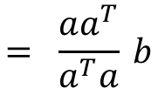
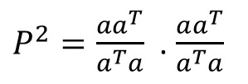

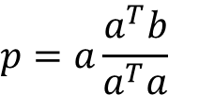







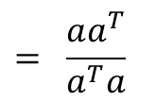
Projections
Projection of a vector $b$ to a Sub-space $S$ = “closest’ point $p$ in the sub-space to the vector $b$
$ℝ^{2}$
$$S$$
$$ⅇ=\left(b−p\right)⊥S$$
$$p=c_{1}a$$
a
$$c_{1}=\frac{a^{T}b}{a^{T}a}$$
$$a^{T}\left(b−c_{1}a\right)=0$$
e = b-p
b
$$p=a\frac{a^{T}b}{a^{T}a}$$
p
$$= \frac{aa^{T}}{a^{T}a} b$$
$$= P b$$
$P$ is the projection matrix.
$P\left(Pb\right)=P^{2}b=$ $p$
$P^{2}=\frac{aa^{T}}{a^{T}a}$ . $\frac{aa^{T}}{a^{T}a}$
$$= \frac{aa^{T}}{a^{T}a}$$
$$= P$$

Slide 8









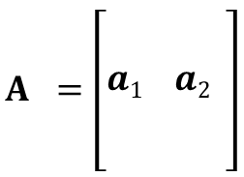


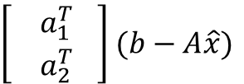



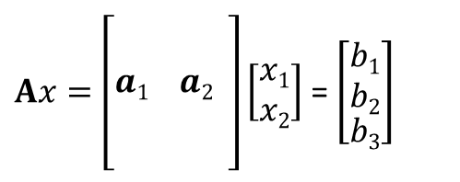

Projection Method for best solution
$Ax=\left[\begin{aligned} \\ \\ a1 a2 \\ \\ \end{aligned}\right]\left[\begin{aligned}x1 \\ x2\end{aligned}\right]$ = $\left[\begin{aligned}\begin{aligned}b1 \\ b2\end{aligned} \\ b3\end{aligned}\right]$
$$A =\left[\begin{aligned} \\ \\ a1 a2 \\ \\ \end{aligned}\right]$$
Problem: Best Solution for Ax=b when $b∉C\left(A\right)$
3$×2$
3
a₁
$p={{\hat{x}}_{1}a}_{1}+{{\hat{x}}_{2}a}_{2}$ = $A\hat{x}$
$ⅇ=b−p=\left(b−A\hat{x}\right)⊥$ plane $C\left(A\right)$
$$ℂ\left(A\right)$$
2
p = ${\hat{x}}_{1}a_{1}$+ ${\hat{x}}_{2}a_{2}$
$$a_{1}^{T}\left(b−A\hat{x}\right)=0$$
$\left[\begin{aligned}{ a}_{1 }^{T} \\ a_{2 }^{T}\end{aligned}\right]$ $(b−A\hat{x})$
a₂
$$A^{T}\left(b−A\hat{x}\right)=0$$
1
e = b-p
$$a_{2}^{T}\left(b−A\hat{x}\right)=0$$
1
b
1
2
$$A^{T}A\hat{x}=A^{T}b$$
The best approximate solution for Ax=b when $b∉C\left(A\right)$ is
$\hat{x}={\left(A^{T}A\right)}^{−1}A^{T}b$
2
$$\hat{x}={\left(A^{T}A\right)}^{−1}A^{T}b$$
$$p=A\hat{x}= A{\left(A^{T}A\right)}^{−1}A^{T}b$$
If $b∈C\left(A\right)$, $Pb=b$
$$=Pb$$

Slide 9



Ax= b : Gram Matrix $A^{T}A$
If $A$ has linearly independent columns, $A$ is tall or square
$A$ has left Inverse
If columns of Matrix $A$ are linearly independent, the Gram Matrix $A^{T}A$ is invertible.
$Ax=0 is$ true only if $x=0$
$$Ax=0$$
$$x=0$$
Hence, if tall Matrix $A$ has linearly independent columns, the Square Matrix , $A^{T}A$ has independent columns OR ${ A}^{T}A$ is invertible

Slide 10


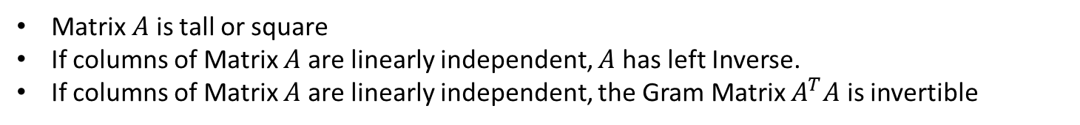
Pseudo Inverse
Matrix $A$ is tall or square
If columns of Matrix $A$ are linearly independent, $A$ has left Inverse.
If columns of Matrix $A$ are linearly independent, the Gram Matrix $A^{T}A$ is invertible
Matrix ${\left(A^{T}A\right)}^{−1}A^{T}$ is the left inverse of Matrix $A$
Moore –Penrose Psuedo Inverse:
Poll:
If A has independent columns, A can have many left inverses. It also means A can have many Moore-Penrose Pseudo Inverses?
TRUE / FALSE ?
${\left(A^{T}\right)}^{−1}$ does not exist when the matrix is not square

Slide 11



Least Squares
Problem Setting:
We have $Ax=b$
Matrix $A$ is tall with linearly independent columns, $b∉C\left(A\right)$
Objective: Seek an $x$ for which the residual, $r=Ax−b$ is minimal.
If ${\left\|A\hat{x}−b\right\|}^{2}<{\left\|Ax−b\right\|}^{2}$ is true for all $x$ , then $\hat{x}$ is a solution
Notes:
Object

Slide 12



Least Squares: Column/Row Interpretations
Column Interpretation:
Row Interpretation:
Poll: Which interpretation fits in a classifier training setting.
A) Row B) Column
Minimize
The least squares objective is to find the $\hat{x}$ that minimizes the sum of residuals
Notes:
Object

Slide 13
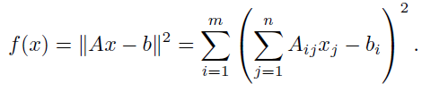



Least Squares : Loss Function Optimization
For $\hat{x}$ to become optimal point
Once we solve the equation for $\hat{x}$ , we get the same solution,
(Details of the differentiation will be re-visited after introducing vector calculus)
Notes:
Object

Slide 14









Pseudo Inverse via QR Factorization
If columns of Matrix $A$ are linearly independent, $A$ has left Inverse.
If columns of Matrix $A$ are linearly independent ,QR Factorization of Matrix $A$, $A=QR$ exists.
Do we have to compute pseudo inverse to get the solution $\hat{x}$ ?
$$A\hat{x}=QR\hat{x}=b$$
$$\hat{x}=R^{−1}Q^{T}b$$
$$R\hat{x}=Q^{T}b$$
If columns of $A$ are linearly independent, the ‘approximate solution’ for $Ax=b$ for can be found by solving${ R\hat{x}=Q^{T}b }_{}$

