Slide 1
Linear Algebra & Convex Optimization – Lecture 7
Text : Introduction to Applied Linear Algebra, S. Boyd: Chapters 14,15.

Slide 2
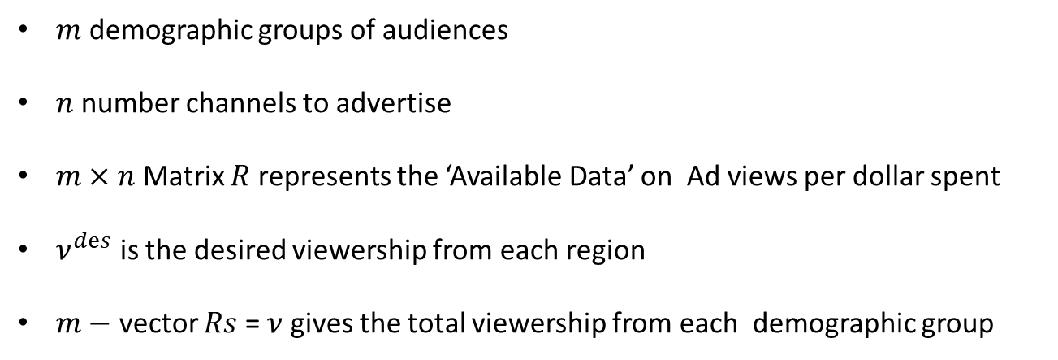

Example: Advertising Purchase
$m$ demographic groups of audiences
$n$ number channels to advertise
$m×n$ Matrix $R$ represents the ‘Available Data’ on Ad views per dollar spent
$ν^{dⅇs}$ is the desired viewership from each region
$m−$ vector $Rs$ = $ν$ gives the total viewership from each demographic group
$n−$ vector $s$ is the dollars invested in each channel for advertisement
Poll: What does $n−$ vector $s$ represents ?
A) Total Views per channel B) Dollars to be invested in each channel C) Total Views per region D) Dollars to be invested in each region

Slide 3
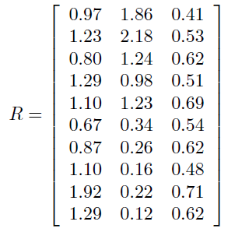





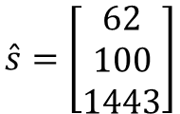


Example: Advertising Purchase
:
Objective:
find $s$ so that $v=Rs=ν^{dⅇs}$
$$\hat{s}=\left[\begin{matrix}62 \\ 100 \\ 1443\end{matrix}\right]$$
Solution:
Find $\hat{s}$ that minimizes ${\left\|Rs−v^{dⅇs}\right\|}^{2}$
This Least Square formulation does-not take consider any budgetary constraints

Slide 4




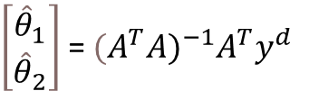




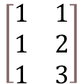





Scalar Input Data : Straight Line Fit
Example:
$$y=mx+c$$
$[y,x]$ = [1,1]
$$1=θ_{1}+θ_{2}$$
$[y,x]$ = [2,2]
$$2=θ_{1}+{2θ}_{2}$$
$$m=θ_{2}, c=θ_{1} , y=\hat{f}\left(x\right)$$
$[y,x]$ = [2,3]
$$2=θ_{1}+{3θ}_{2}$$
Input
Output
2 -
$$\left[\begin{matrix}1 & 1 \\ 1 & 2 \\ 1 & 3\end{matrix}\right]$$
$$\left[\begin{matrix}θ_{1} \\ θ_{2}\end{matrix}\right]=$$
$$\left[\begin{matrix}1 \\ 2 \\ 2\end{matrix}\right]$$
1 -
$$A$$
$$yd$$
1
2
3
$\hat{θ}$are the parameters of the line that makes least square error
$\left[\begin{aligned}{\hat{θ}}_{1} \\ {\hat{θ}}_{2}\end{aligned}\right]$ = ${(A}^{T}{A)}^{−1}A^{T}y^{d}$
Also known as Linear Regression.

Slide 5
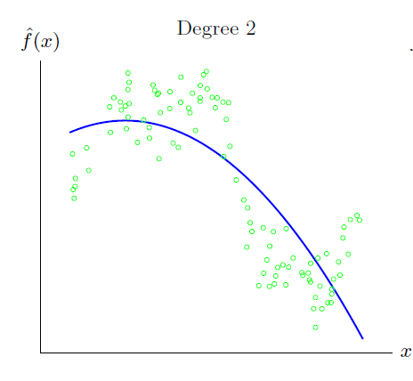

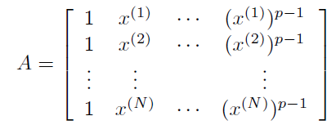
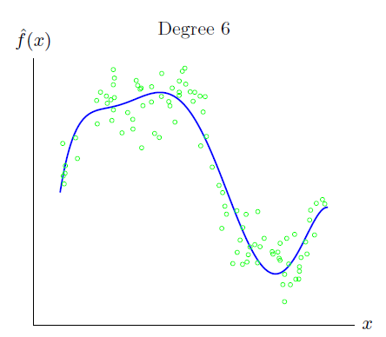

Scalar Input Data : Polynomial Fit
Poll: Do you think a polynomial of degree 100 is better suited for the data distribution shown in bottom figure?
A) Yes B) No

Slide 6


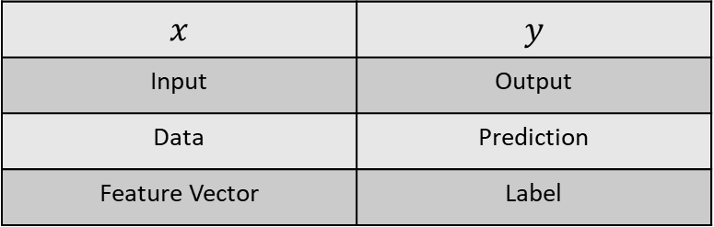
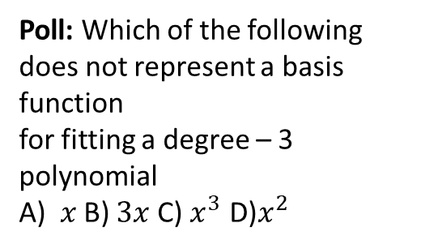

Data Fitting
$$x$$ | $$y$$
Input | Output
Data | Prediction
Feature Vector | Label
Objective
Given are $N$ input- output (data-prediction) pairs
Common Terminologies
Based on observed data, learn a function $f:ℝ^{n}→ℝ$ that maps (predicts) any $n$-vector $x$ to a scalar value
Linear Parameter Model:
Poll: Which of the following does not represent a basis function
for fitting a degree – 3 polynomial
A) $x$ B) $3x$ C) $x^{3}$ D)$x^{2}$
$f_{i}:{ ℝ}^{n}→ℝ$ are pre-defined basis functions or feature mappings
$θ_{i}$ are the model parameters to be learnt

Slide 7




General Regression Model
Regression Model:
Examples:
Advertising spending on various products vs Total revenue
Dosages of various drugs vs Blood pressure
Amount of different fertilizers , water etc. vs crop yield

Slide 8




Least Squares Classifier
Given $N$ Data points and Label for each Data
The outcome $y$ takes only two values : -1 & 1
Steps:

Slide 9
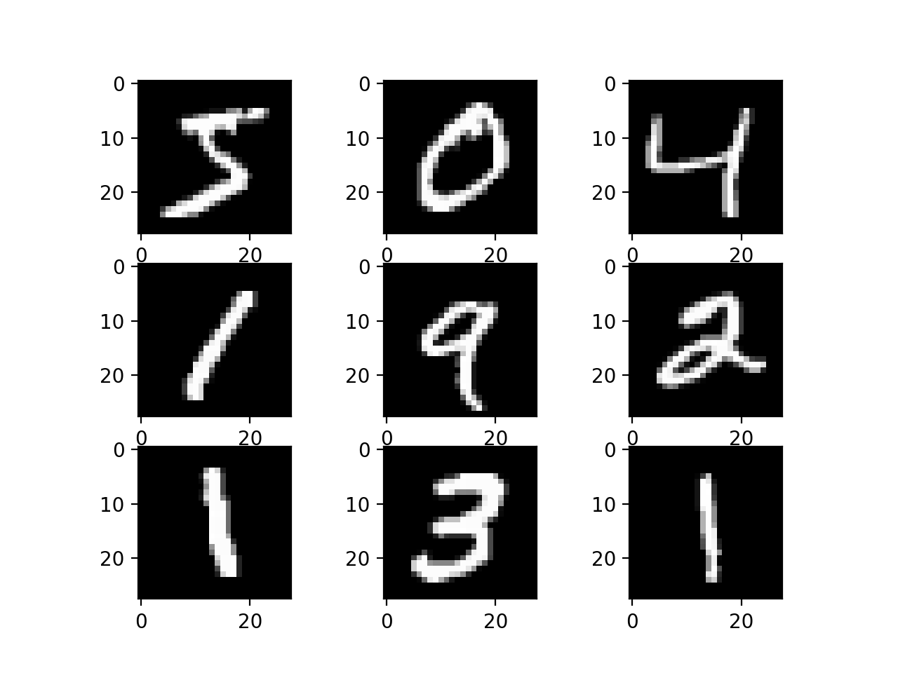
MNIST Classification
MNIST digits Samples
Objective: Train a classifier to classify the digit ‘0’
Data: 60,000 Images (28x28) with labels 0 - 9

Slide 10
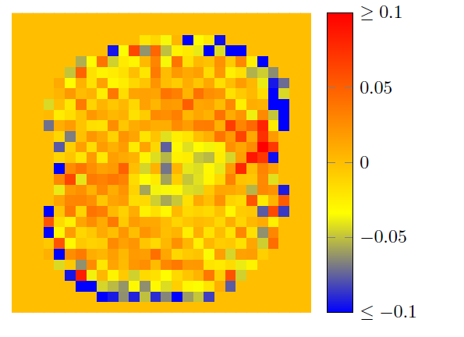
Least Squares Classifier for Handwritten Digits 0-9
Pre-processing-steps:
Poll: What is the modified number of weight parameters to be learnt ?
A) 784 B) 493 C) 492 D) 494
Training Classifier for digit 0:

