Slide 1
Linear Algebra & Convex Optimization – Lecture 8
References : Introduction to Linear Algebra, Gilbert Strang; Online References

Slide 2
Analysis of Square Matrices

Slide 3











Eigen Vectors
$$n×n$$
square matrix A is a function that maps a point in n-dimensional space to another
point in the same space
Consider a transformation induced by the Square Matrix
Y
$${Ax}_{2}$$
$$A=\left[\begin{matrix}2 & 1 \\ 1 & 2\end{matrix}\right]$$
$$x_{2}$$
E.g. If $y=\left[\begin{matrix} 0 \\ −1\end{matrix}\right] ,$ $Ay=$ $\left[\begin{matrix}−1 \\ −2\end{matrix}\right]$
$$y$$
But,
$$x_{1}$$
X
If $x_{1}=\left[\begin{matrix} 1 \\ −1\end{matrix}\right]$
$Ax_{1}=\left[\begin{matrix}2 & 1 \\ 1 & 2\end{matrix}\right]\left[\begin{matrix} 1 \\ −1\end{matrix}\right]=\left[\begin{matrix} 1 \\ −1\end{matrix}\right]=1.x_{1},$
$$Ay$$
$${Ax}_{1}$$
If $x_{2}=\left[\begin{matrix} \\ \begin{aligned}1 \\ 1\end{aligned}\end{matrix}\right], Ax_{2}= \left[\begin{matrix}3 \\ 3\end{matrix}\right]=3 .x_{2},$
For a square Matrix A, certain vectors only get linearly scaled and do not change the direction !!
These directions are eigen vectors.
The scaling value the eigen vectors undergo are eigen values.

Slide 4


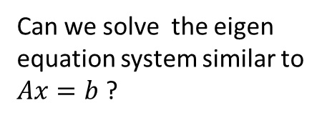


Definition :
A vector $v∈ℝ^{n}$ is an eigen vector of an $n×n$ square matrix $A$ if
$$Av=λν$$
Poll:
Can we solve the eigen equation system similar to $Ax=b$ ?
$Av=λν$ can also be written as $\left(A−λI\right)ν=0$
Columns of $(A−λI)$ are dependent
$$\left|A−λI\right|=0$$
Goal:
Find all sets of $\left(λ_{i},v_{i}\right)$ where $\left(A−λiI\right)νi=0$, where $λi$ is associated with the eigen vector $v$_{i}

Slide 5
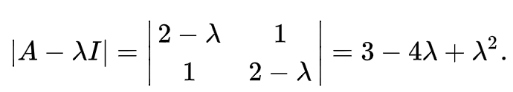
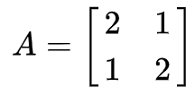

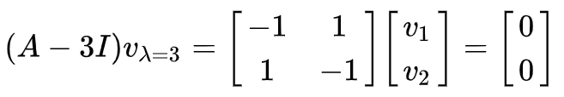

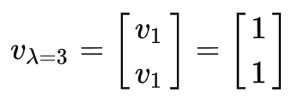



Finding Eigen Values & Vectors :
Goal:
Find all sets of $\left(λ_{i},v_{i}\right)$ where $\left(A−λiI\right)νi=0$, where $λi$ is associated with the eigen vector $v$_{i}
Roots of Characteristic Equation
How many such $λ_{i}$s we can find?
Characteristic Polynomial
Example:
$$\left(λ−1\right)\left(λ−3\right)=0$$
$$λ1=1,λ2=3$$
Determinant of $n×n$ square matrix $A−λI$ will have characteristic polynomial of degree $n$
A characteristic polynomial on $λ$ of degree $n$ will have $n$ roots (real/complex , repeated/distinct)

Slide 6
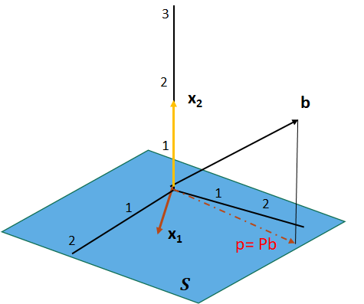
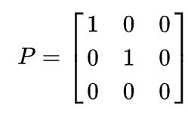
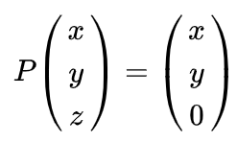


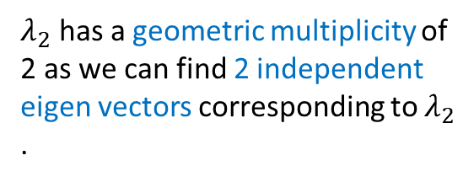


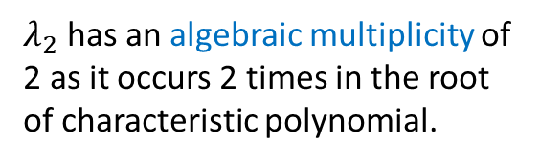



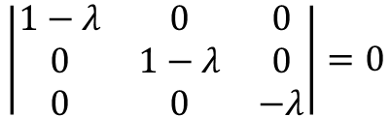

Eigen Values & Vectors of Projection Matrix
Projection Matrix $P$ is defined with respect a sub-space $S$
$Pb$ will modify all $b∉S$
For all $b∈S$, $Pb=1.b$ .
This implies all $b∈S$ are eigenvectors with $λ=1$
For all $b⊥S$, $Pb=0.b$ .
This implies all $b⊥S$are eigenvectors with $λ=0$
$λ_{2}$ has an algebraic multiplicity of 2 as it occurs 2 times in the root of characteristic polynomial.
Example:
Projection Matrix for X-Y Plane:
$$\left|P−λI\right|=0$$
$$\left|\begin{matrix}1−λ & 0 & 0 \\ 0 & 1−λ & 0 \\ 0 & 0 & −λ\end{matrix}\right|=0$$
$λ_{2}$ has a geometric multiplicity of 2 as we can find 2 independent eigen vectors corresponding to $λ_{2}$ .
$$λ{\left(1−λ\right)}^{2}=0$$
Geometric Multiplicity < = Algebraic Multiplicity
$$λ_{1}=0, λ_{2}=1$$

Slide 7
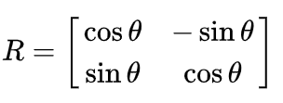














Eigen Values & Vectors of Rotation Matrix
Rotation Matrix:
Y
$${Rx}_{1}$$
$$x_{2}$$
$$x_{1}$$
Example:
$${Rx}_{2}$$
$$θ$$
$$θ$$
$$θ={90}^{0}$$
X
$$R=\left[\begin{matrix}0 & −1 \\ 1 & 0\end{matrix}\right]$$
$$\left|R−λI\right|=$$
$$\left|\begin{matrix}−λ & −1 \\ 1 & −λ\end{matrix}\right|$$
$${=λ}^{2}+1=0$$
How do you interpret complex eigen values ? Check this:
https://haoye.us/post/2019-12-05-interpreting-complex-eigenvalues/
$$λ_{1}=i;λ_{2}=−i$$
$$ν_{1}=\left[\begin{aligned}1 \\ i\end{aligned}\right]$$
$$ν_{2}=\left[\begin{aligned}1 \\ −i\end{aligned}\right]$$

Slide 8

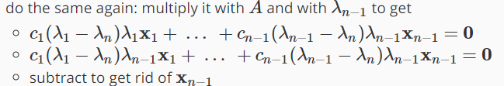




Linear Independence of Eigen Vectors:
Proof:
We should prove $c_{1}=c_{2}=⋯c_{n}=0$
$c_{1}=c_{2}=⋯c_{n}=0$
implies
$x_{1},x_{2,…}x_{n}$ are independent

Slide 9
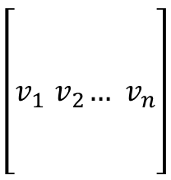






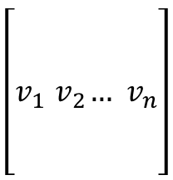

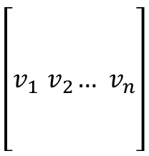
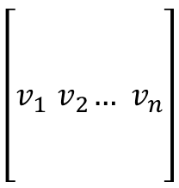
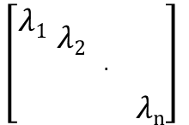


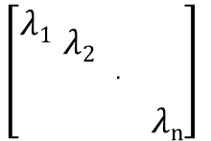


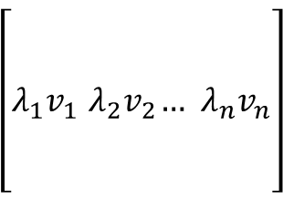
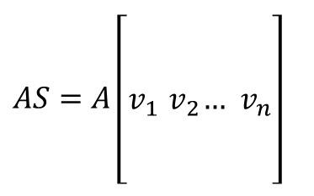



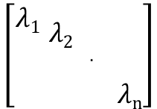


Eigen Decomposition (Spectral Decomposition):
For $n×n$ square matrix $A$ , assume there are $n$ distinct eigen values
$$Aν_{1}=λ_{1}v_{1}$$
$$\left[\begin{aligned} \\ \\ v_{1}{ v}_{2}…{ v}_{n} \\ \\ \end{aligned}\right]$$
$$\left[\begin{aligned} \\ \\ {λ_{1}v}_{1}{ λ_{2}v}_{2}…{ λ_{n}v}_{n} \\ \\ \end{aligned}\right]$$
$$\left[\begin{aligned} \\ \\ v_{1}{ v}_{2}…{ v}_{n} \\ \\ \end{aligned}\right]$$
$$Aν_{2}=λ_{2}v_{2}$$
$$\left[\begin{aligned}\begin{aligned}\begin{aligned}λ1 \\ \end{aligned} λ2 \\ \end{aligned} . \\ λn\end{aligned}\right]$$
$$Av=λv$$
.
.
$$A$$
$$=$$
$$=$$
$$Aν_{n}=λ_{n}v_{n}$$
$$\left[\begin{aligned} \\ \\ v_{1}{ v}_{2}…{ v}_{n} \\ \\ \end{aligned}\right]$$
$AS=A\left[\begin{aligned} \\ \\ v_{1}{ v}_{2}…{ v}_{n} \\ \\ \end{aligned}\right]$
$$\left[\begin{aligned} \\ \\ v_{1}{ v}_{2}…{ v}_{n} \\ \\ \end{aligned}\right]$$
$$\left[\begin{aligned}\begin{aligned}\begin{aligned}λ1 \\ \end{aligned} λ2 \\ \end{aligned} . \\ λn\end{aligned}\right]$$
$$\left[\begin{aligned}\begin{aligned}\begin{aligned}λ1 \\ \end{aligned} λ2 \\ \end{aligned} . \\ λn\end{aligned}\right]$$
$$S=$$
$$=$$
where, $Λ$
$$=SΛ$$
$$=$$
Matrix Factorization
Matrix Diagonalization
$$AS =SΛ$$
$S^{−1}$ exists for $A$
$$A=SΛS^{−1}$$
$$S^{−1}AS=Λ$$

Slide 10







Eigen Decomposition : Application
Efficiently Computing Matrix Powers:

Slide 11



Similar Matrices
E.g. If A has distinct eigenvalues,
$$S^{−1}AS=Λ$$
$A$ and $∧$ is similar, in this case $M=S$
Why are they called ‘’similar’’ ?
Similar Matrices have same eigenvalues

Slide 12
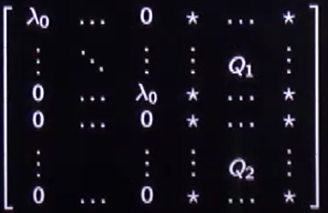





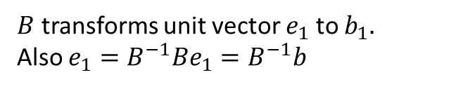



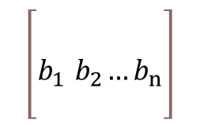


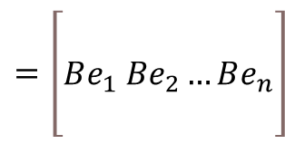





Why Geometric Multiplicity <= Algebraic Multiplicity ?
$B$ transforms unit vector $e_{1}$ to $b_{1}.$
Also $e_{1}=B^{−1}Be_{1}=B^{−1}b$
$$B:ℝ^{n}→ℝ^{n}$$
Y
$$\left[\begin{aligned} \\ \\ b_{1}{ b}_{2}…b_{n} \\ \end{aligned}\right]$$
$$=\left[\begin{aligned} \\ Be_{1} Be_{2}…Be_{n} \\ \end{aligned}\right]$$
$$B$$
$$b_{1}$$
$$B=$$
$$e_{1}$$
$$Aν_{i}=λ_{0}v_{i}$$
and geometric multiplicity of $λ_{0}$ is $k$
$$B^{−1}$$
$\left\{v_{1},v_{2,⋯}ν_{k}\right\}$ forms the set of independent eigen vectors
Create a matrix $P$ such that
$$P=\left[v_{1} v_{2} . . .v_{k}{ u}_{k+1} . . .{ u}_{n}\right]$$
$=P^{−1}$ $\left[λ_{0}v_{1} {λ_{0}v}_{2} . . .{λ_{0}v}_{k}{ Au}_{k+1} . . .{Au}_{n}\right]$
${ u}_{k+1} ,. . ,{ u}_{n}$ are any set of independent vectors that span rest of $ℝ^{n}$
$=\left[λ_{0}{P^{−1}v}_{1} {{ λ}_{0}P^{−1}v}_{2} . . .{λ_{0}P^{−1}v}_{k}{{ P}^{−1}Au}_{k+1} . . .{ P}^{−1}{Au}_{n}\right]$
$=\left[λ_{0}e_{1}{ λ}_{0}e_{2}. . .{ λ}_{0}e_{k}{{ P}^{−1}Au}_{k+1} . . .{ P}^{−1}{Au}_{n}\right]$
$M=P^{−1}AP$ is a similar matrix of $A$ with same eigen values
$$λ_{M}=Soln. of \det\left(M−λI\right)$$
$M=P^{−1}AP$
$=P^{−1}A$ $\left[v_{1} v_{2} . . .v_{k}{ u}_{k+1} . . .{ u}_{n}\right]$
$$M=$$
$$λ_{M}=Soln. of {\left(λ_{0}−λ\right)}^{k} . det\left(Q_{2}−λI\right)$$
$=P^{−1}$ $\left[Av_{1} {Av}_{2} . . .{Av}_{k}{ Au}_{k+1} . . .{Au}_{n}\right]$
*$λ_{0}$ will be a root of ${\left(λ_{0}−λ\right)}^{k} .λ_{0} may or maynot be root of det\left(Q_{2}−λI\right)$ . Hence Algebraic Multiplicity of $λ_{0}$ is at least $k$

Slide 13


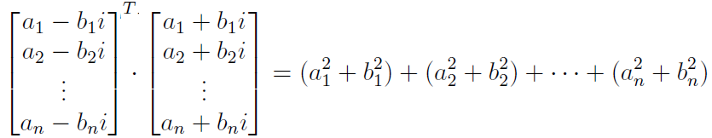













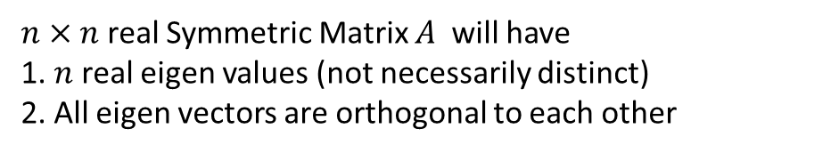
Eigen Analysis: Symmetric Matrices ( A = A^{T} )
$n×n$ real Symmetric Matrix $A$ will have
1. $n$ real eigen values (not necessarily distinct)
2. All eigen vectors are orthogonal to each other
Proof: (Real Eigen Values)

Slide 14
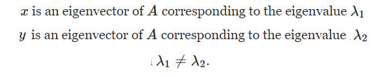





Eigen Analysis: Symmetric Matrices ( A = A^{T} )
$n×n$ real Symmetric Matrix $A$ will have
1. $n$ real eigen values (not necessarily distinct)
2. All eigen vectors are orthogonal to each other
Proof: (Orthogonal Eigen Vectors)

Slide 15
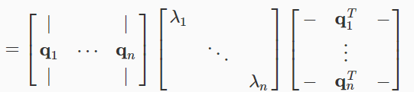




Eigen Analysis: Symmetric Matrices
Sum of Rank-1 Matrices
Spectral Decomposition of Matrix $A$

Slide 16
Positive Semi-Definite (PSD) Matrices
What is the intuition on Matrix transformation for PSD Matrices ?
A matrix is positive semi-definite if it is symmetric and all eigen values are non-negative
A matrix $M$is positive semi definite if $x^{T}Mx≥0$ for all $x≠0$

